Slide 1

Climate Workshop
Notes:
Dear Facilitator, these slides can support your facilitation of the En-ROADS Climate Workshop, which complements the En-Roads simulation model. You may pick and choose from these slides and adjust them to suit your audience and setting.
Script: Welcome everyone! I am [introduce yourself] and I’ll be facilitating the En-ROADS Climate Workshop today.

Slide 2


Developed by:
Notes:
Script: We’ll be using an interactive tool called En-ROADS which is developed by Climate Interactive, a leading nonprofit climate & energy think tank, in partnership with the MIT Sloan Sustainability Initiative.

Slide 3
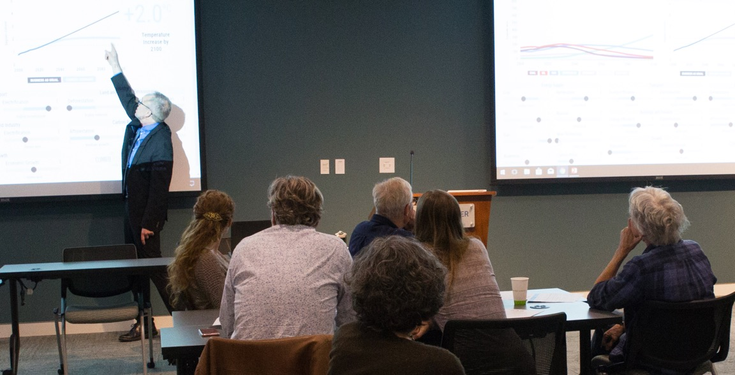
Agenda:
Introduction
Scenarios of Climate Success
Debrief

Slide 4

Introduction

Slide 5
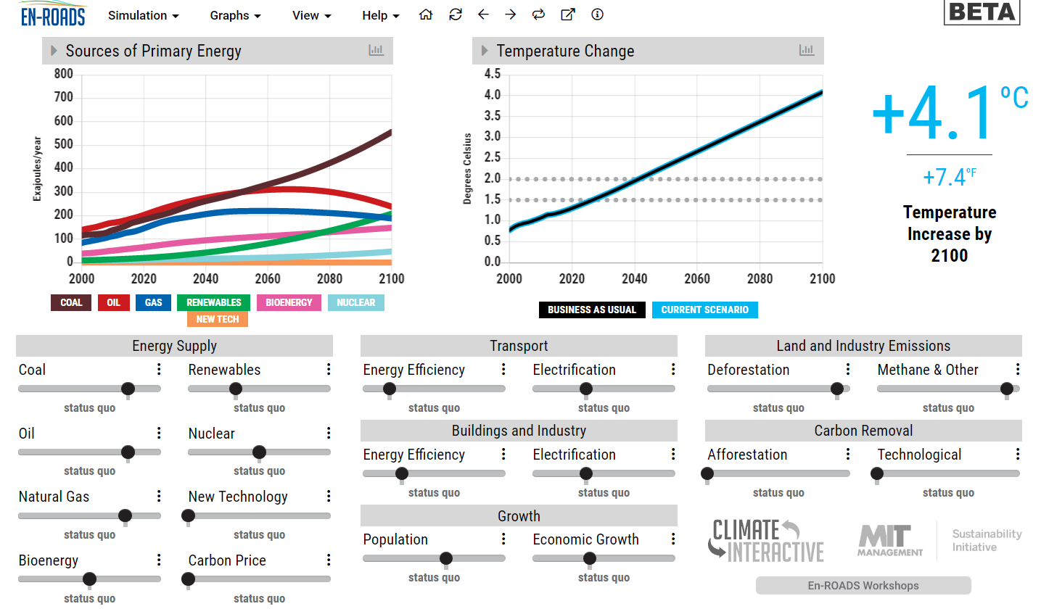
En-ROADS is a cutting-edge simulation model to test climate solutions and generate climate scenarios for the future.
Notes:
Script: We will be using a powerful climate simulator tool called En-ROADS. En-ROADS is:
- Powered by the latest research on climate science and solutions
- Great tool for people to learn about and assess the impacts of different approaches to addressing climate change
- Create climate scenarios for the future
- Transparent – All equations and model assumptions are open source
- Dynamic - Assumptions are adjustable
- Fast - Runs in real time

Slide 6
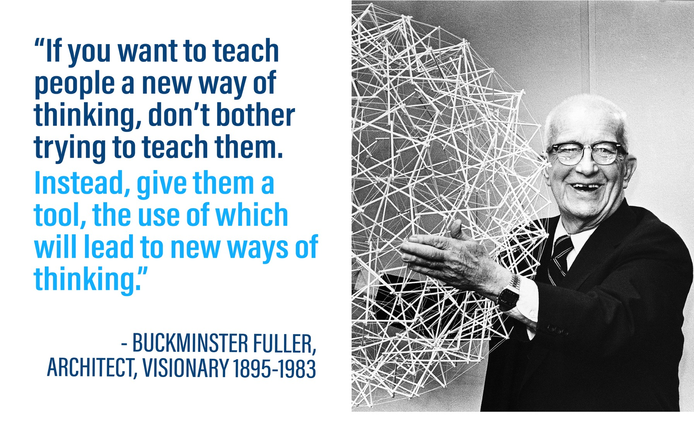

Slide 7
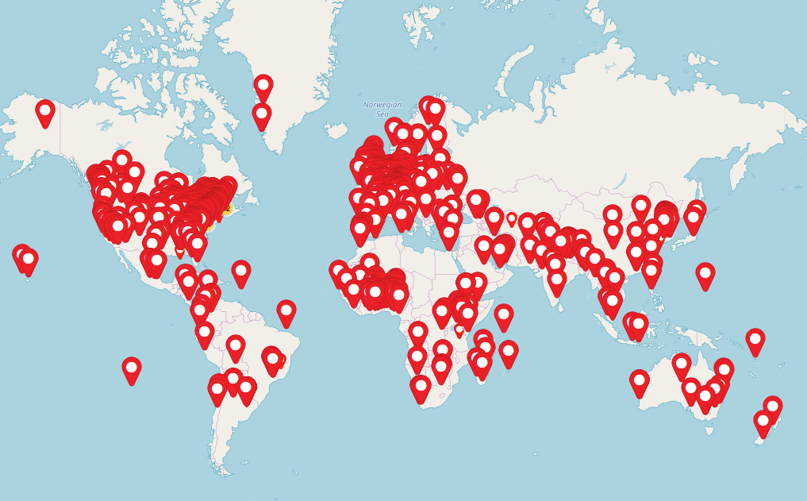
Climate Interactive/MIT simulations:
Over 62,000 participants in 93 countries
Notes:
Script: You are part of a global movement to become more knowledgeable about and equipped to solve climate change by experiencing this interactive workshop.

Slide 8
Let’s briefly review the science and what’s at stake….

Slide 9
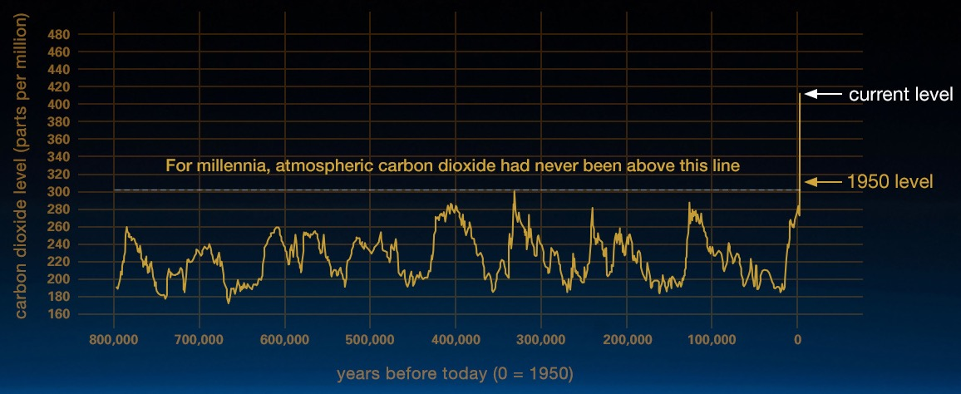
Atmospheric CO₂ is higher than any time in that last 800,000 years, and levels are increasing faster than any time in millions of years.
Source: https://climate.nasa.gov/evidence/

Slide 10
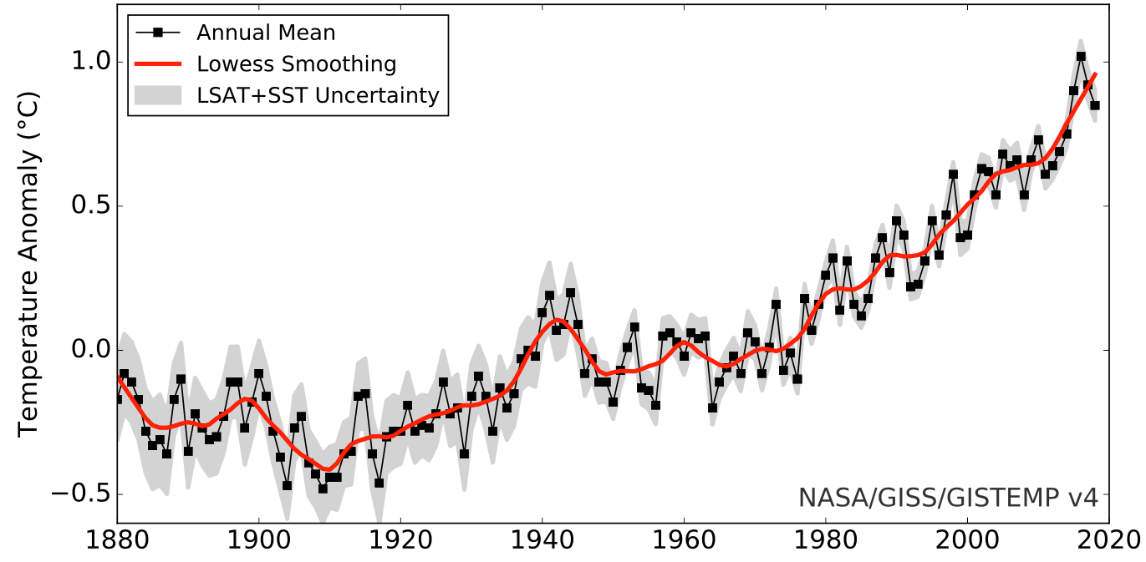
Global Average Surface Temperature Anomaly
NASA (GISS) https://data.giss.nasa.gov/gistemp/graphs_v4/
ºF
1.8
Zero = 1951-1980 average
0.9
0.0
-0.9

Slide 11
CO₂ Emissions by Source 1860-2016
Notes:
Script: But where does all the CO2 come from? Any ideas? This graph shows the sources of CO2 from the year 1860 to 2016. The primary contributor to CO2 emissions are the fossil fuels—coal (which you see in brown), oil (in black), and gas (in blue). You can see that there has been lots of growth in coal, oil and gas over the last 100 years. Comparatively, Land-use change emissions, which is primarily from deforestation, has not grown as substantially and may even be declining. Others emissions primarily consists of lime calcination for Concrete production.

Slide 12
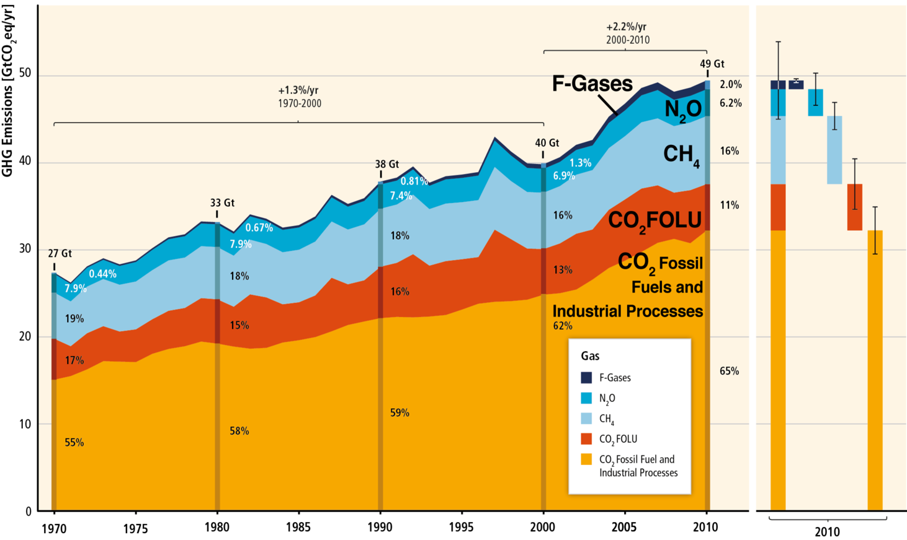
Total annual greenhouse gas emissions by gases 1970- 2010
Source: IPCC AR5
Notes:
Script: Carbon dioxide is not the only thing that is contributing to climate change. There are also several other greenhouse gases. Here you see the relative contribution from different gases. In orange and red you can see the contribution that CO2 makes from fossil fuels and land use, then in light blue is methane (CH4), then nitrous oxide (N2O), and the F-gases. Agriculture contributes 50% of global methane (CH4) emissions and 60% of global nitrous oxide (N²0) emissions. Heavy industry and manufacturing, as well as consumer goods are sources of N2O and F-gases.

Slide 13
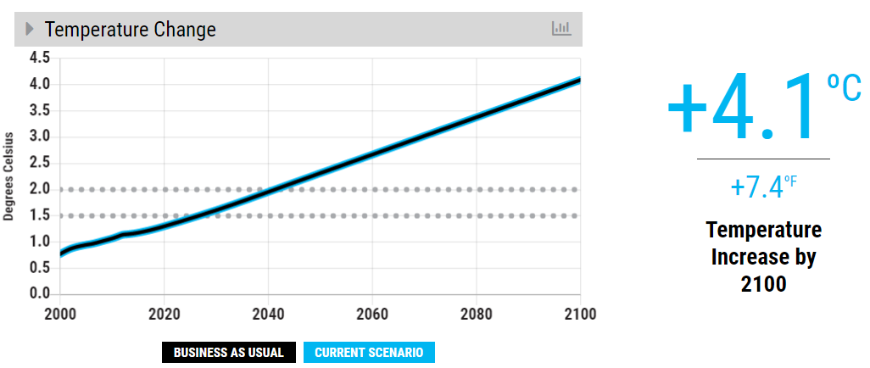

Business as usual
Our climate goals (2ºC)
Notes:
Script: If we continue business as usual, our best estimates show that temperature rise will be over 4 degrees Celsius by 2100. That’s 7.4 degrees Fahrenheit. Compare the bold line to the dotted lines where our climate goals – 2 degrees and 1.5 degrees – are on the graph.

Slide 14
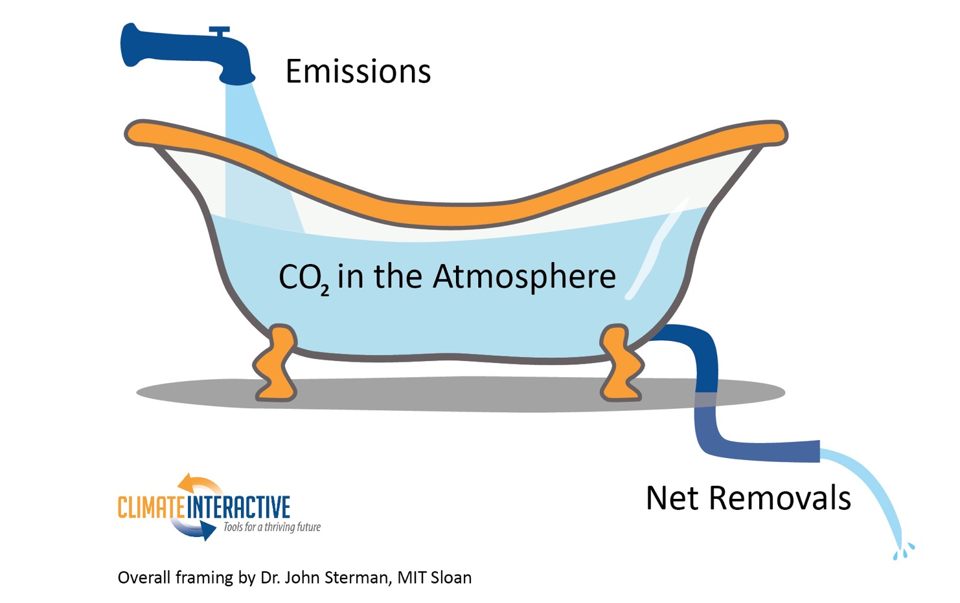
Bathtub Dynamics

Slide 15
What does +4 °C of warming mean?
Multi-meter sea level rise within 50-150 years possible
Widespread increase in the frequency of drought across the globe (~60% increase)
Desertification of Mediterranean Europe
Intense and frequent heat waves and floods in many areas across the world
Committed warming (centuries to millennia): + >6 ˚C
Long-term equilibrium sea level rise (millennia): ~13-15 m
Melting of more than two third of glaciers in the Hindu Kush Himalaya⁷
Irreversible change
Notes:
Script: If we do not take to reduce our fossil fuel use, we could see severe impacts by the end of the century. For example…
Sources
C. Prudhomme, I. Giuntoli, E. L. Robinson, D. B. Clark, N. W. Arnell, R. Dankers, B. M. Fekete, W. Franssen, D. Gerten, S. N. Gosling, S. Hagemann, D. M. Hannah, H. Kim, Y. Masaki, Y. Satoh, T. Stacke, Y. Wada, D. Wisser, Hydrological droughts in the 21st century, hotspots and uncertainties from a global multimodel ensemble experiment. Proceedings of the National Academy of Sciences, 111.9(2013): 3262–3267.
A. Levermann, P. U. Clark, B. Marzeion, G. A. Milne, D. Pollard, V. Radic, A. Robinson, The multimillennial sea-level commitment of global warming. Proceedings of the National Academy of Sciences 110, 13745-13750 (2013); published online EpubAugust 20, 2013 (10.1073/pnas.1219414110).
S. Solomon, D. Battisti, S. C. Doney, K. Hayhoe, I. M. Held, D. P. Lettenmaier, D. Lobell, D. Matthews, R. Pierrehumbert, M. Raphael, R. Richels, T. L. Root, K. Steffen, C. Tebaldi, G. W. Yohe, Climate stabilization targets: Emissions, concentrations, and impacts over decades to millenia. (National Academy of Sciences, Washington DC, 2010), pp. 190.
J. Hansen, P. Kharecha, M. Sato, V. Masson-Delmotte, F. Ackerman, D. J. Beerling, P. J. Hearty, O. Hoegh-Guldberg, S. L. Hsu, C. Parmesan, J. Rockstrom, E. J. Rohling, J. Sachs, P. Smith, K. Steffen, L. Van Susteren, K. von Schuckmann, J. C. Zachos, Assessing "dangerous climate change": required reduction of carbon emissions to protect young people, future generations and nature. PLoS One 8, e81648 (2013)10.1371/journal.pone.0081648).
Lynas, Mark. Six Degrees: Our Future on a Hotter Planet. Washington, D.C.: National Geographic, 2008. Print.
7. P. Wester, A. Mishra, A. Mukherji, A. B. Shrestha (eds) (2019) The Hindu Kush Himalaya Assessment—Mountains, Climate Change, Sustainability and People. Springer Nature Switzerland AG, Cham.

Slide 16
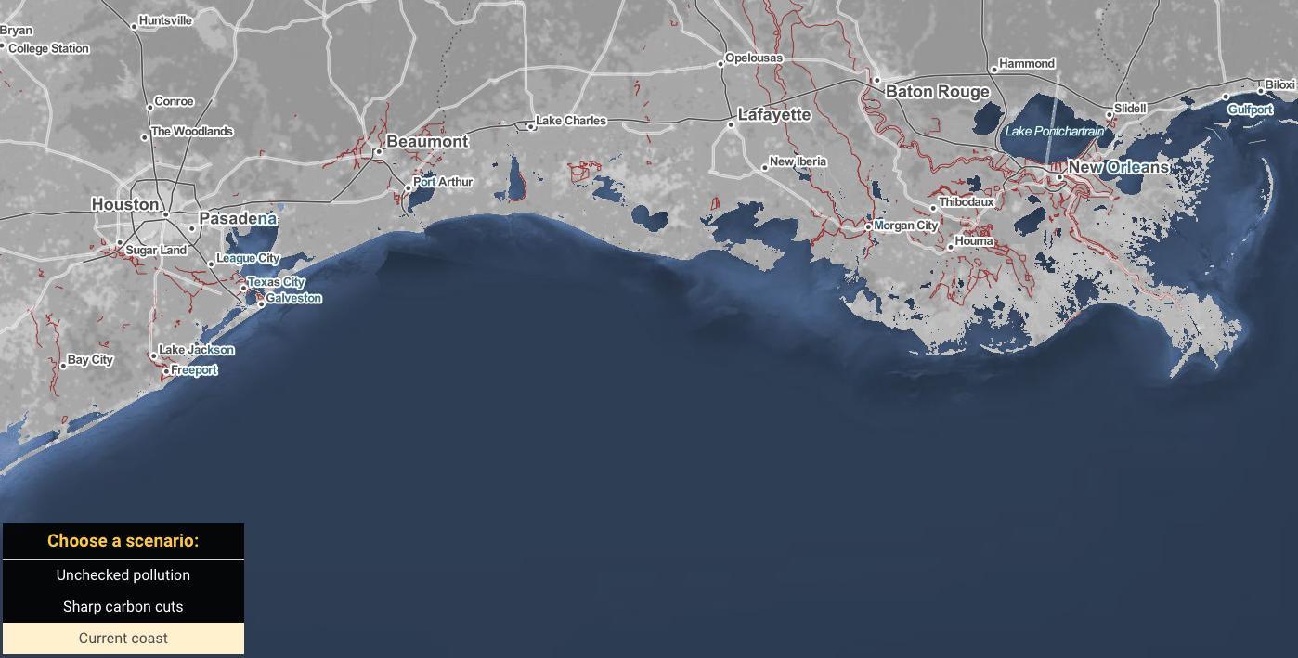
New Orleans & Gulf Coast: Today
Source: Climate Central

Slide 17
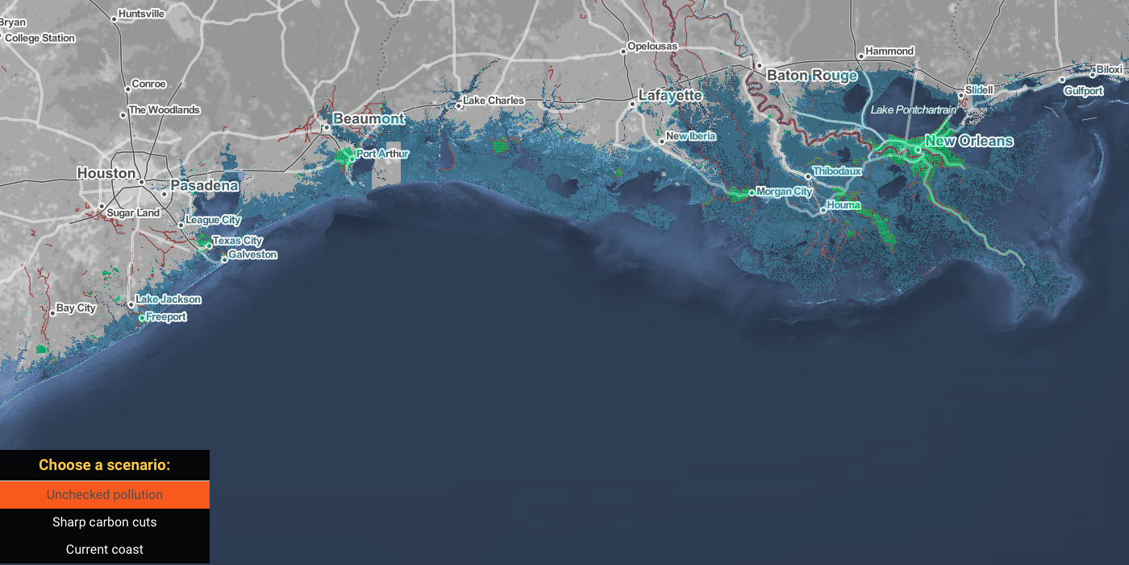
New Orleans & Gulf Coast: Future with BAU emissions
Source: Climate Central

Slide 18
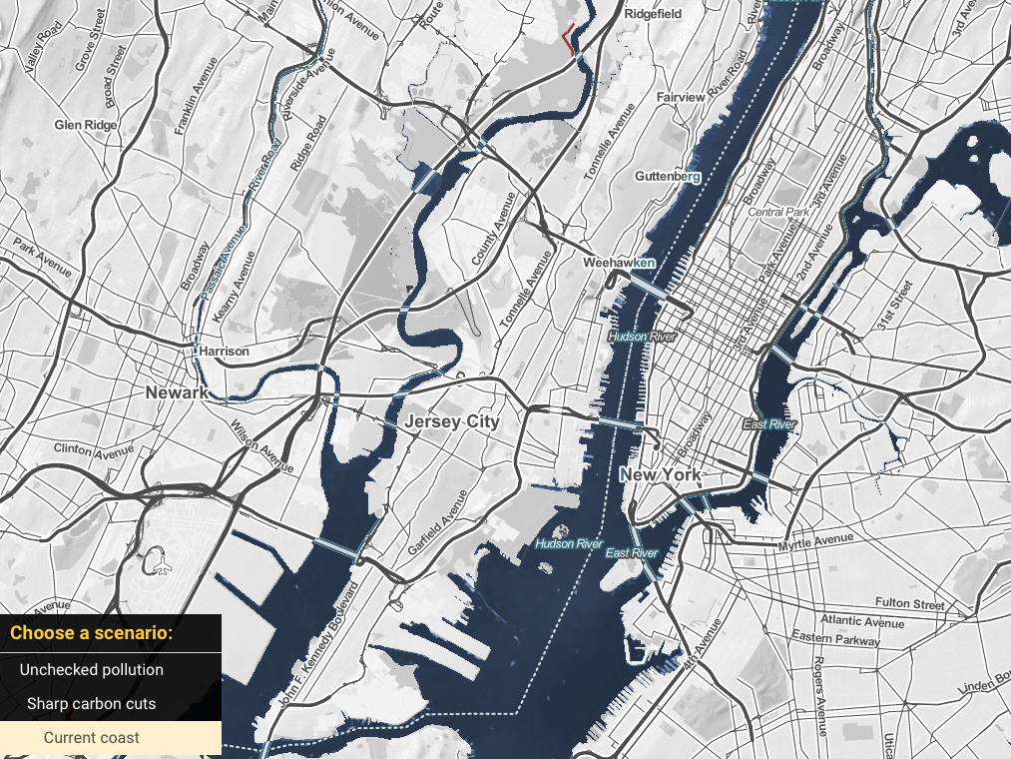
New York & Jersey: today
Source: Climate Central

Slide 19
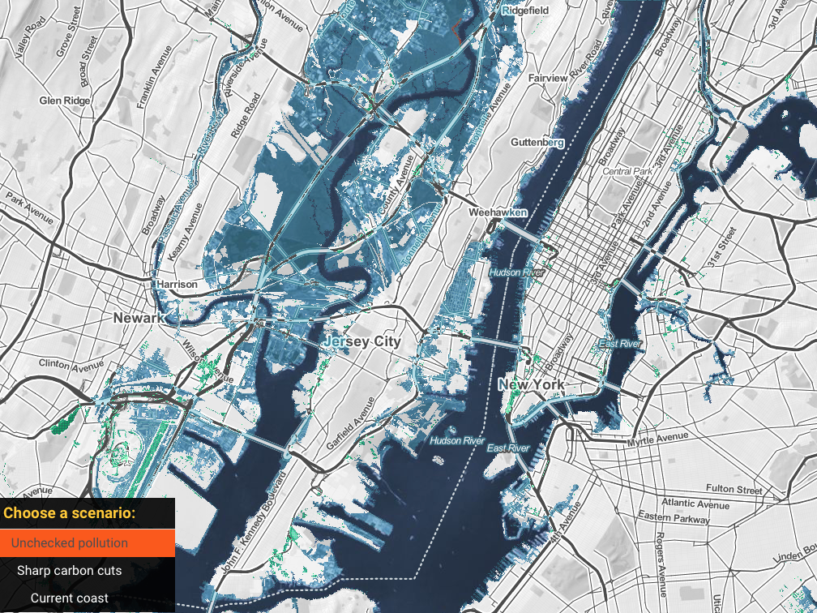
New York & Jersey: future with business as usual emissions
Source: Climate Central

Slide 20
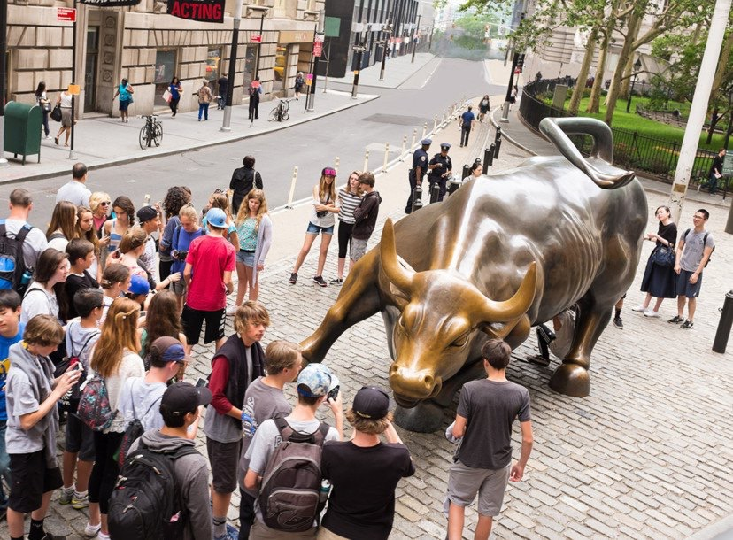
Wall Street today
Source: Climate Central

Slide 21
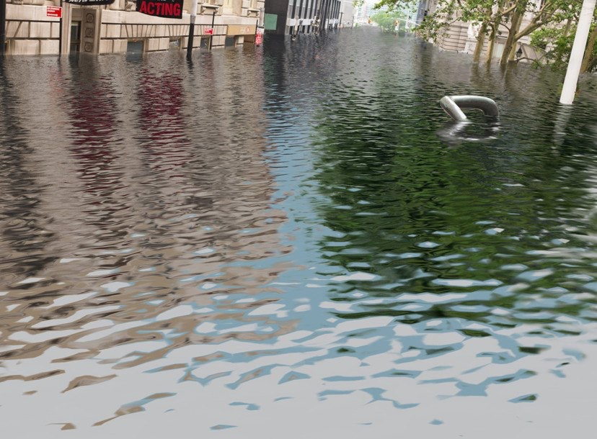
… and with
4ºC of warming
Source: Climate Central

Slide 22
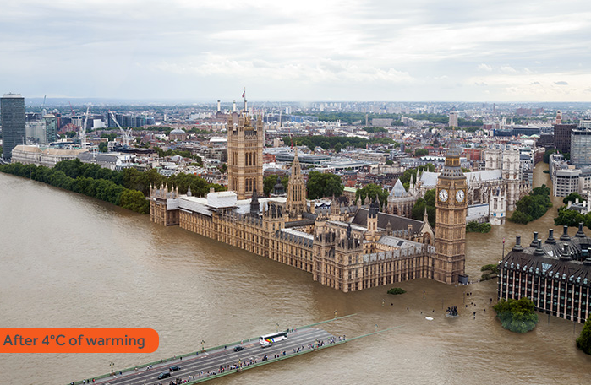
London with 4ºC of warming
Source: Climate Central
Notes:
Script: Here is what the UK’s parliament building with Big Ben would look like with 4 degrees Celsius of warming.

Slide 23
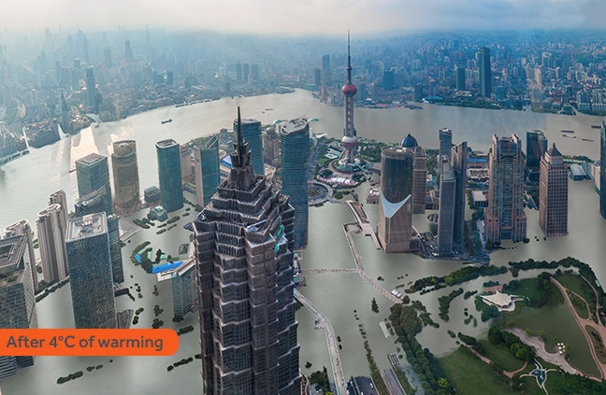
Shanghai after 4ºC of warming
Source: Climate Central

Slide 24
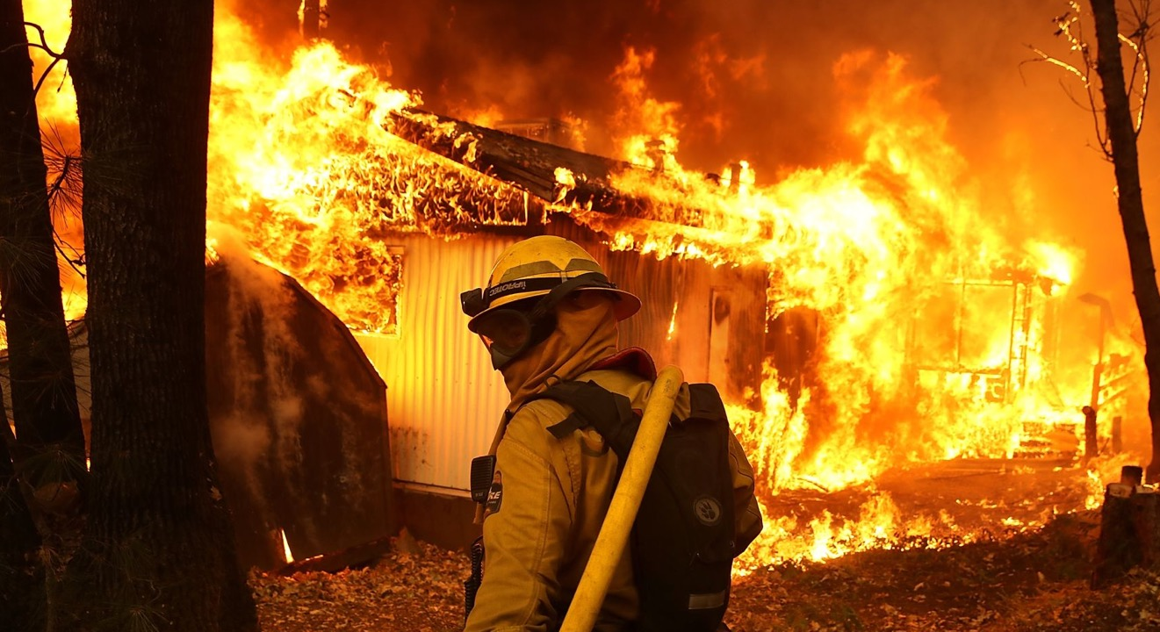
Climate-related disasters have cost the world $650 billion over 2016-2018. Damages associated with global warming could total $54 trillion by 2040, according to a UN panel.
Sources: Morgan Stanley, UN; 2019

Slide 25
2- 3 ºC of warming (or 3.6- 5.4˚F)
Sea level rise this century ~0.90m
~14% reduction of access to freshwater (compared to today)
~ 6% increase in the global proportion of land under drought (compared to today)
    Specifically South America will be most affected
Doubling of wildfire damage compared to +1-2 ºC
~21-52% of plant and animal species committed to extinction
Committed warming (centuries to millennia) +3.5–5.8 ºC
Long-term equilibrium sea level rise ~10-15 m (or ~30-50 ft)
    With a 5 m sea level rise, Miami, most of Manhattan, Central London, Bangkok, Bombay and Shanghai would be flooded.
Notes:
However, I want to be clear. A 2-3 degree future is still very bleak – especially for the world’s most vulnerable nations and communities who experience the impacts of climate change disproportionately. We need to do better. Far better. Here’s what a 2-3 degree future means for our world: [Read bullets from the slide].

Slide 26
~2 ˚C of warming (or 3.6˚F)
Sea level rise this century ~0.50m
Decrease in global production of staple crops:
    Wheat -8-37%
    Maize -6-38%
Severe glacial melting
~8% reduction of access to freshwater (compared to today)
~4% increase in the global proportion of land under drought (compared to today)
9-31% of plant and animal species will be committed to extinction
Committed warming (millennia) +2-3.8 ºC
Long-term equilibrium sea level rise (millennia) ~2-10 m (or ~10 – 30 ft)
~90% of coral reefs undergo coral bleaching
Notes:
By limiting warming to 2ºC, you have come very close to our stated goal and should be very proud of the progress you have made! While there are still some serious impacts that the world will need to adapt to and prepare for, the impacts are FAR less severe than we would have seen under a business-as-usual scenario.
Let’s take a look at the impacts we would expect to see in a 2ºC world: [Read bullets on the slide]
So we’ve come a long way – but in our final round of proposals, I ask us to dig deep and see if we can do even better. Many of the island and low-lying nation states would still be left underwater at 2 degrees. To give them the best chance of enduring, we need to limit warming to 1.5ºC.
Can we get there in our last round of negotiations?
Let’s try our best – the world is looking to you!
[If continuing the negotiations, transition back to Slides 31+32 and repeat Steps 2-4]

Slide 27
~1.5 ºC of warming (or 2.7˚F)
Sea level rise this century ~0.40m (or ~1 ft)
Decrease in global production of staple crops:
    Wheat -6-20%
    Maize -6-26%
Moderate glacial melting
~70% of coral reefs undergo coral bleaching
Notes:
By limiting warming to 1.5ºC, you have achieved our collective goal! This is no small feat and something we should all be proud of.
Congratulations!!! We have arrived at a set of policies that will avert the worst impacts of climate change, especially for the world’s most vulnerable.
While there are still impacts that we will need to adapt to, look at how significantly the impacts were reduced compared to a 4ºC scenario of warming:
[Review bullets on the slide]

Slide 28
Benefits of Climate Action
The US would save billions in health care costs by 2030:
  Prevent ~295,000 premature deaths from air pollution (ozone and particulates) caused by fossil fuel use
  Additional savings could prevent ~29,000 ER visits/yr for childhood asthma and 15M adult hours lost at work/yr
  Diseases and pathogens spread slower in colder climates with less flooding
Development of new technologies for renewable energy sources and transportation
    Cost-savings from monetized health benefits: ~$800B/year for clean power and $400B/year for clean transportation: ~$1.2 Trillion/year
Fewer heat waves resulting in heat strokes and deaths
Preservation of vulnerable ecosystems
Notes:
1. Shindell, Drew T., Yunha Lee, and Greg Faluvegi. "Climate and Health Impacts of US Emissions Reductions Consistent with 2 °C." Nature Climate Change Nature Climate Change 6.5 (2016): 503-507.
2. "Human Health." Climate Impacts on Human Health. EPA.

Slide 29
Scenarios of Climate Success

Slide 30









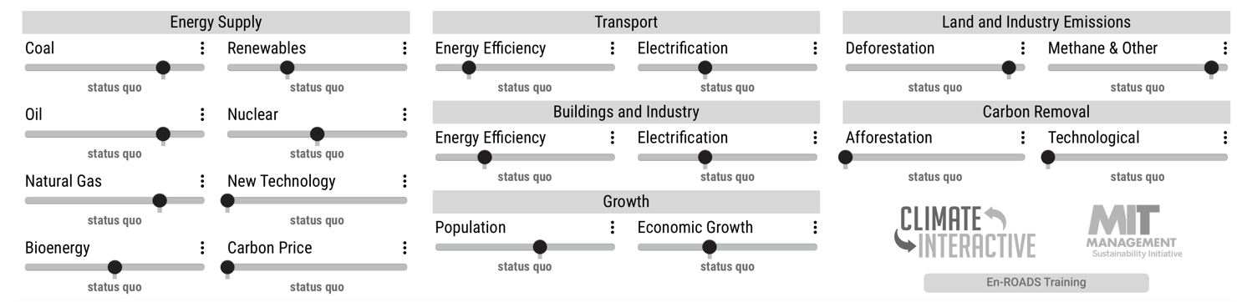









En-ROADS Control Panel
climateinteractive.org
Coal
Renewables
Transport Energy Efficiency
Transport
Electrification
Methane & Other Gases
Discourage or encourage mining coal and burning it in power plants.
Encourage or discourage building solar panels, geothermal, and wind turbines.
Increase or decrease the energy efficiency of vehicles, shipping, air travel, and transportation systems.
Increase or decrease purchases of new electric cars, trucks, buses, trains, and ships.
Decrease or increase greenhouse gas emissions from methane, nitrous oxide, and the f-gases.
Oil
Nuclear
Buildings & Industry
Energy Efficiency
Buildings & Industry
Electrification
Discourage or encourage drilling, refining, and consuming oil for energy.
Encourage or discourage building nuclear power plants.
Increase or decrease the energy efficiency of buildings, factories, appliances, and
other machines.
Increase or decrease the use of electricity in buildings, appliances, motors, and other machines, instead of fuels like oil or gas.
Natural Gas
New Technology
Economic Growth
Afforestation
Deforestation
Discourage or encourage drilling and burning natural gas for energy.
Assume higher or lower growth in goods produced and services provided.
Plant new forests and restore old forests.
Decrease or increase the loss of forests for agricultural and wood product uses.
Discover a brand new, cheap source of electricity that does not emit greenhouse gases.
Bioenergy
Carbon Price
Population
Technological Carbon Removal
Discourage or encourage the use of trees, forest waste and agricultural crops to create energy.
Set a global carbon price that makes coal, oil, and gas more expensive depending on how much carbon dioxide they release.
Assume higher or lower population growth.
Pull carbon dioxide out of the air with new technologies that enhance natural removals or manually sequester and store carbon.
Notes:
Note – Use the En-ROADS control panel guide to help orient participants to their decision variables e.g., 18 levers. Use this time to also briefly orient people to the actual En-ROADS simulator, and show how this Guide relates to the En-ROADS simulator.

Slide 31
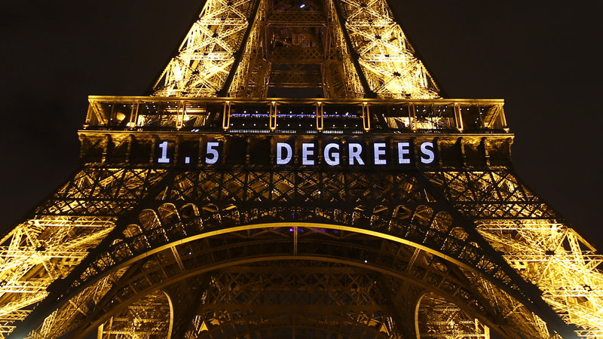
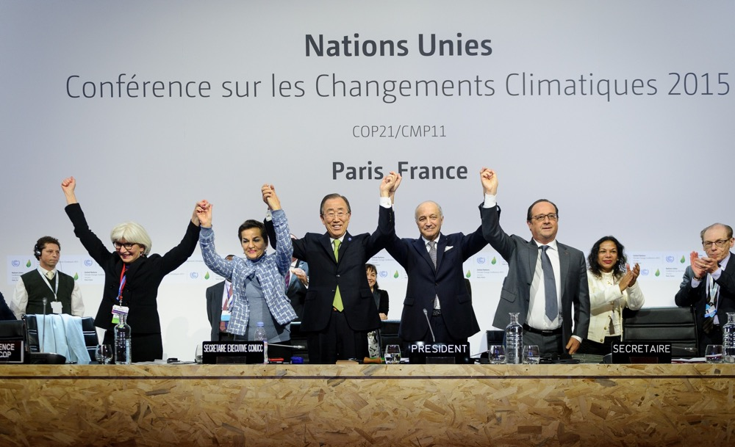
What Will It Take?
What else would it take to limit warming to less than 2 °C or even 1.5 °C?

Slide 32
Activity
We are going to load this up – and try and do our best to bring in the solutions
https://en-roads.climateinteractive.org/scenario.html?v=2.7.19
Talk through options – suggest ideas
How close to 2 degrees can we get?
How quickly?
What are the limitations and issues of our ideas?

Slide 33
Debrief

Slide 34
Reflection
Think of something you would love about being part of this sort of future.
Take one minute of silence to reflect on your experience.

Slide 35
Looking ahead
We have the tools
Solar and wind are growing and getting cheaper
Corporations are investing in clean tech
Countries and states are stepping up
The general public is becoming more educated and engaged

Slide 36









Companies are taking action
“63% of Fortune 100 companies have set one or more clean energy targets… with significant numbers of companies setting 100 percent renewable energy goals and science-based greenhouse gas reduction targets” – WWF Report, 2017
Over 191 top companies have made a commitment to go 100% Renewable
http://there100.org/companies
Notes:
Source - report from World Wildlife Fund (WWF),Ceres, Calvert Research and Management (Calvert) and CDP, April 25 2017
http://www.ceres.org/resources/reports/power-forward-2.0-how-american-companies-are-setting-clean-energy-targets-and-capturing-greater-business-value/view
These 100 Companies Are Responsible for Most of the World’s Carbon Emissions About 100 companies have been responsible for about 71% of the world’s greenhouse gas emissions.

Slide 37
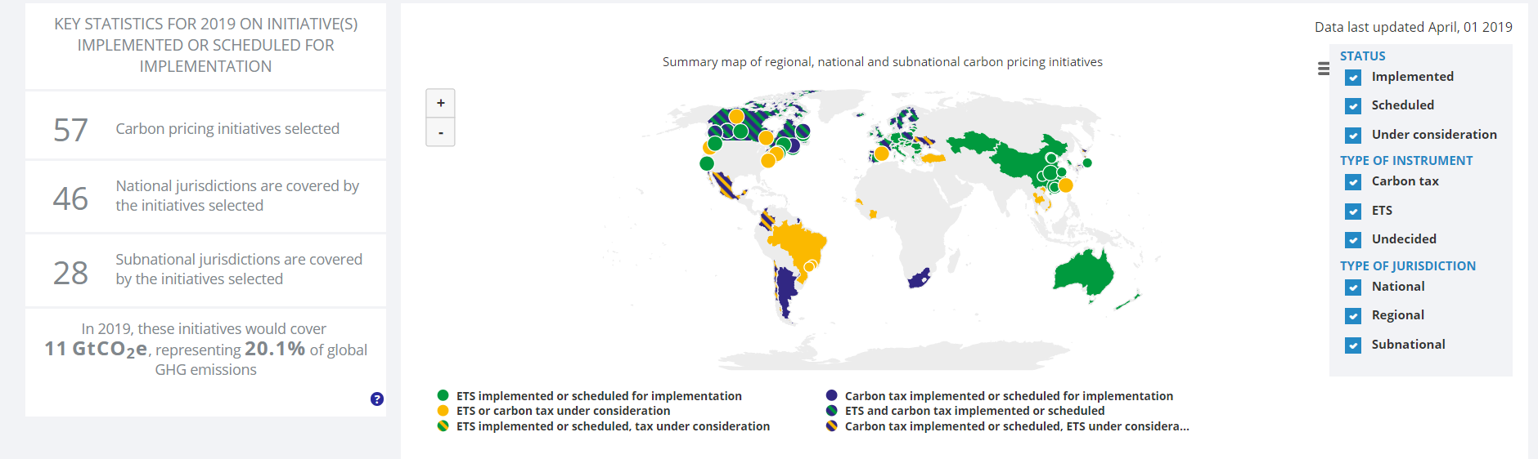
Carbon prices are being enacted around the world
Over 80 jurisdictions (national or regional) have implemented, scheduled or are considering a carbon pricing or ETS policy.
Current and planned carbon pricing covers 20% of global emissions
Source: World Bank, 2019
Notes:
https://carbonpricingdashboard.worldbank.org/map_data

Slide 38
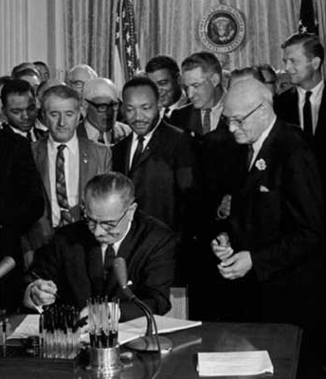
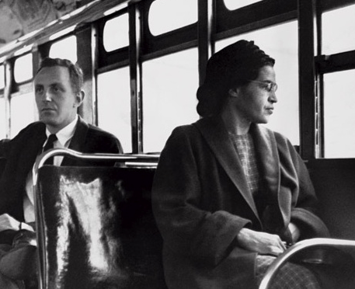
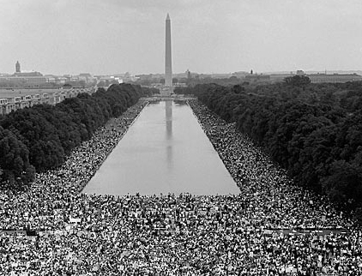
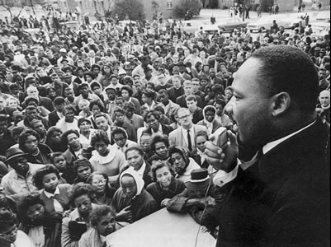
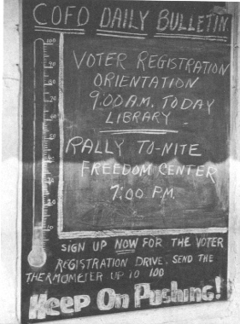
“The world as we have created it is a process of our thinking. It cannot be changed without changing our thinking.”
- Albert Einstein
“Never doubt that a small group of thoughtful, committed citizens can change the world. Indeed, it is the only thing that ever has.”
- Margaret Mead

Slide 39
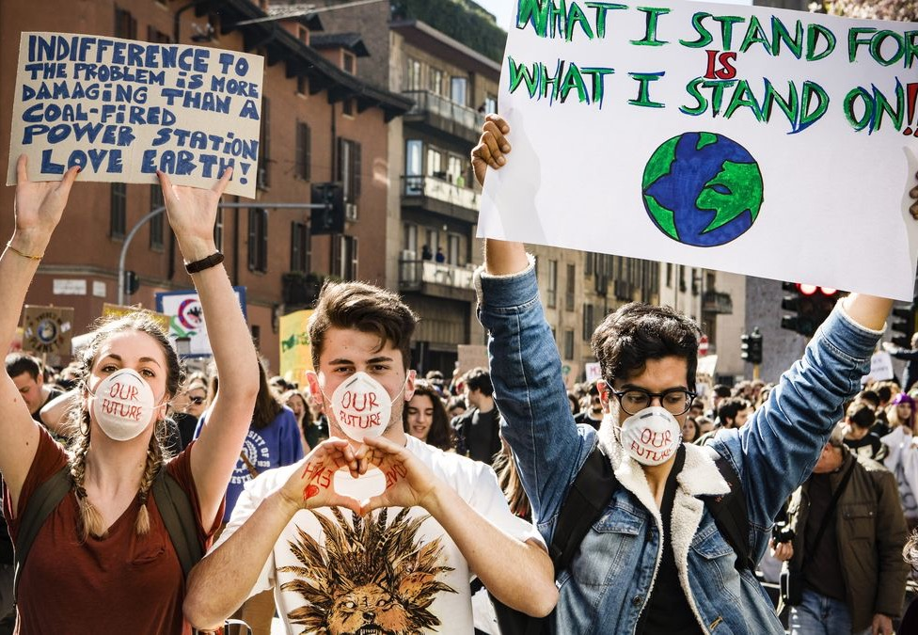
Youth Climate Strike #FridaysForFuture
1.4 million youth
in 123 countries!
March 15th, 2019
Notes:
People are in the streets. You must act.

Slide 40
Debriefing Discussion
What surprised you?
What were your key insights?
What will you take away from today, and how can you apply what you learned to the real world?
Notes:
Note – These are the three basic guiding questions to lead the debriefing discussion. You may choose your own and follow up with more detailed questions. We provide some options for Additional Discussion Questions in the Facilitator’s Guide.

Slide 41
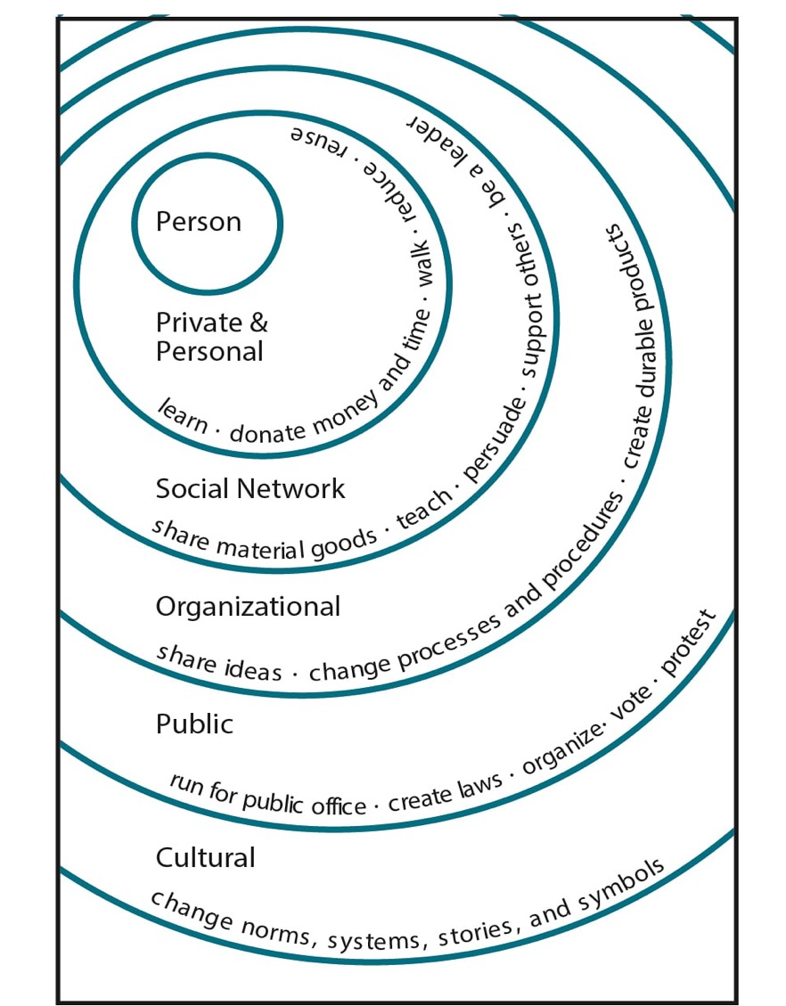
What can you do?
Illustration by Elise Amel
Notes:
Source: https://www.theguardian.com/environment/climate-consensus-97-per-cent/2017/may/19/study-inspiring-action-on-climate-change-is-more-complex-than-you-might-think

Slide 42
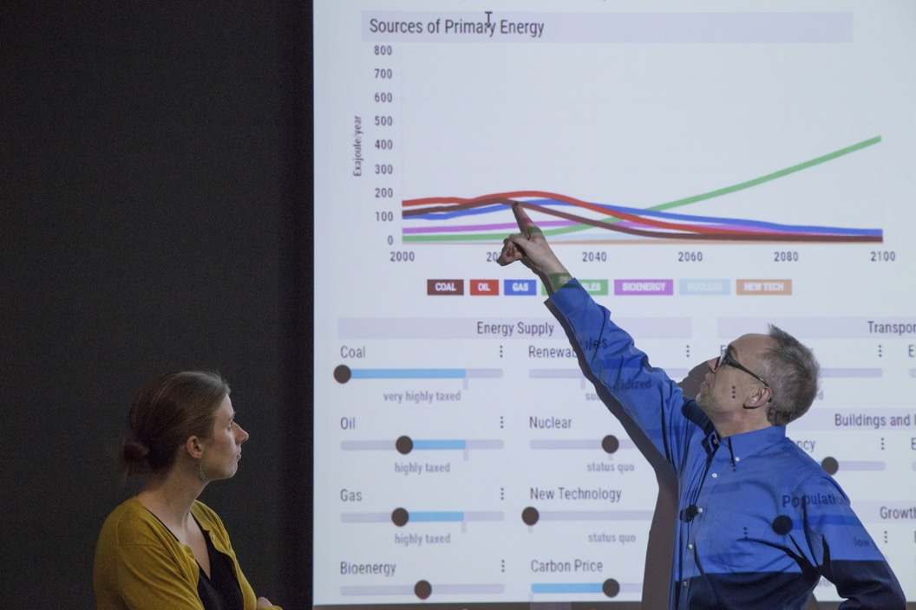
Thank You!
Visit:
climateinteractive.org

