Slide 1
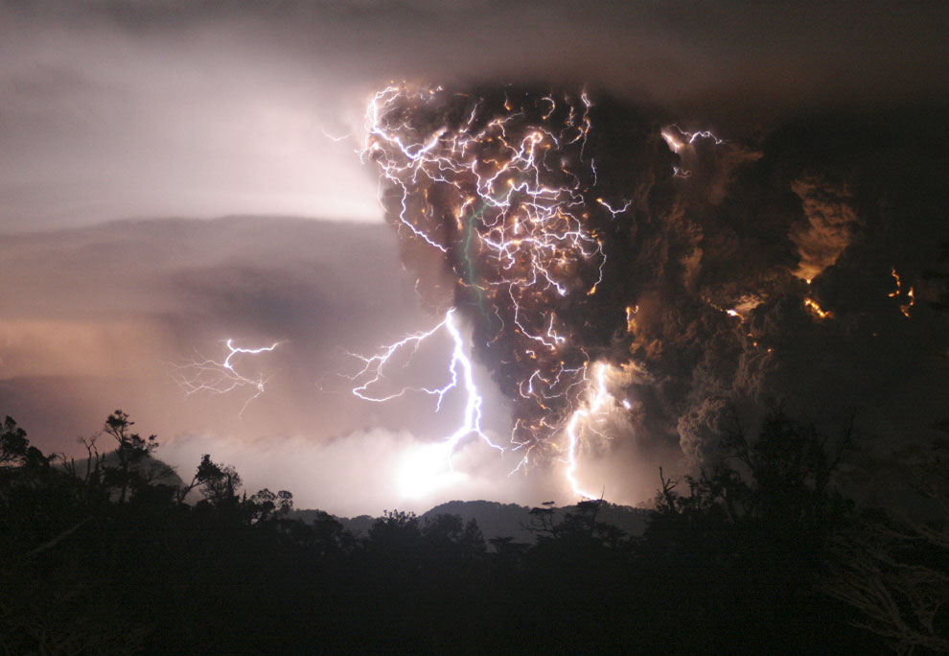
Unit 9. Hazardous Environments

Slide 2
Syllabus Content
9.1 Hazards resulting from tectonic processes
9.2 Hazards resulting from mass movements
9.3 Hazards resulting from atmospheric disturbances
9.4 Sustainable management in hazardous environments

Slide 3
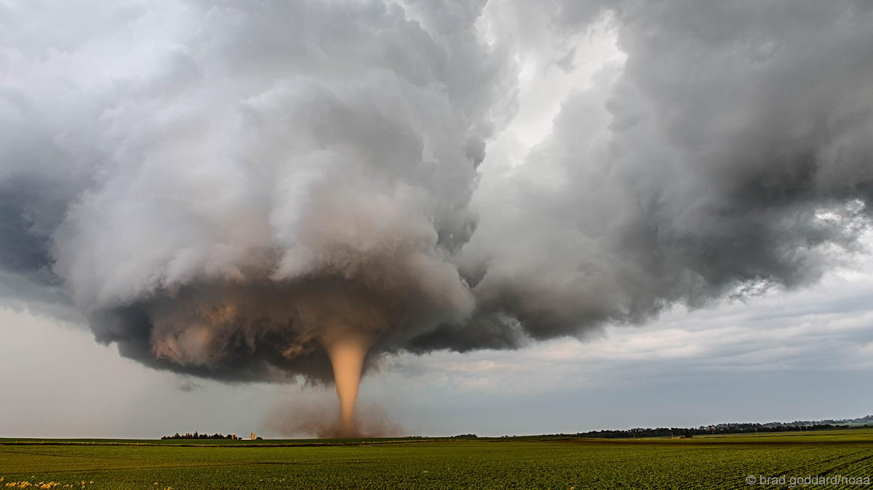
9.3. Hazards Resulting From Atmospheric Disturbances

Slide 4
9.3. Hazards Resulting From Atmospheric Disturbances
Global distribution of areas most at risk from large scale tropical disturbances (cyclones, hurricanes, typhoons) and small scale atmospheric disturbances (tornadoes).
Processes causing the formation and development of cyclones, hurricanes, typhoons and tornadoes.
Hazards from large scale atmospheric disturbances: storm surges, coastal flooding, intense rainfall leading to severe river floods and mass movement, and high winds.
Hazards from small scale atmospheric disturbances: intense precipitation (rain and hail), high winds, and pressure imbalances.
Primary and secondary impacts on lives and property.
Prediction, preparedness and monitoring of large and small scale atmospheric disturbances and perception of risk.
Key is to recognise the two TYPES and SCALES of hazard – and be able to compare/contrast

Slide 5
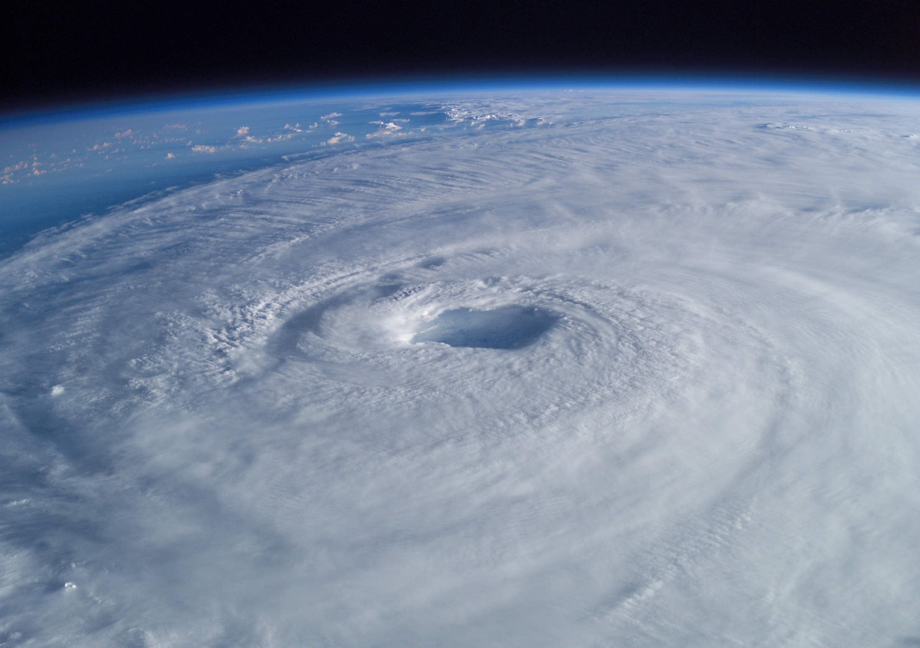
Large Scale Atmospheric Disturbances: Tropical Revolving Storms

Slide 6
What are they? (p46)
Most significant atmospheric hazard in terms of loss of life.
Difficult to predict, track and monitor.
Can release Mt of energy – beyond all we can control

Slide 7
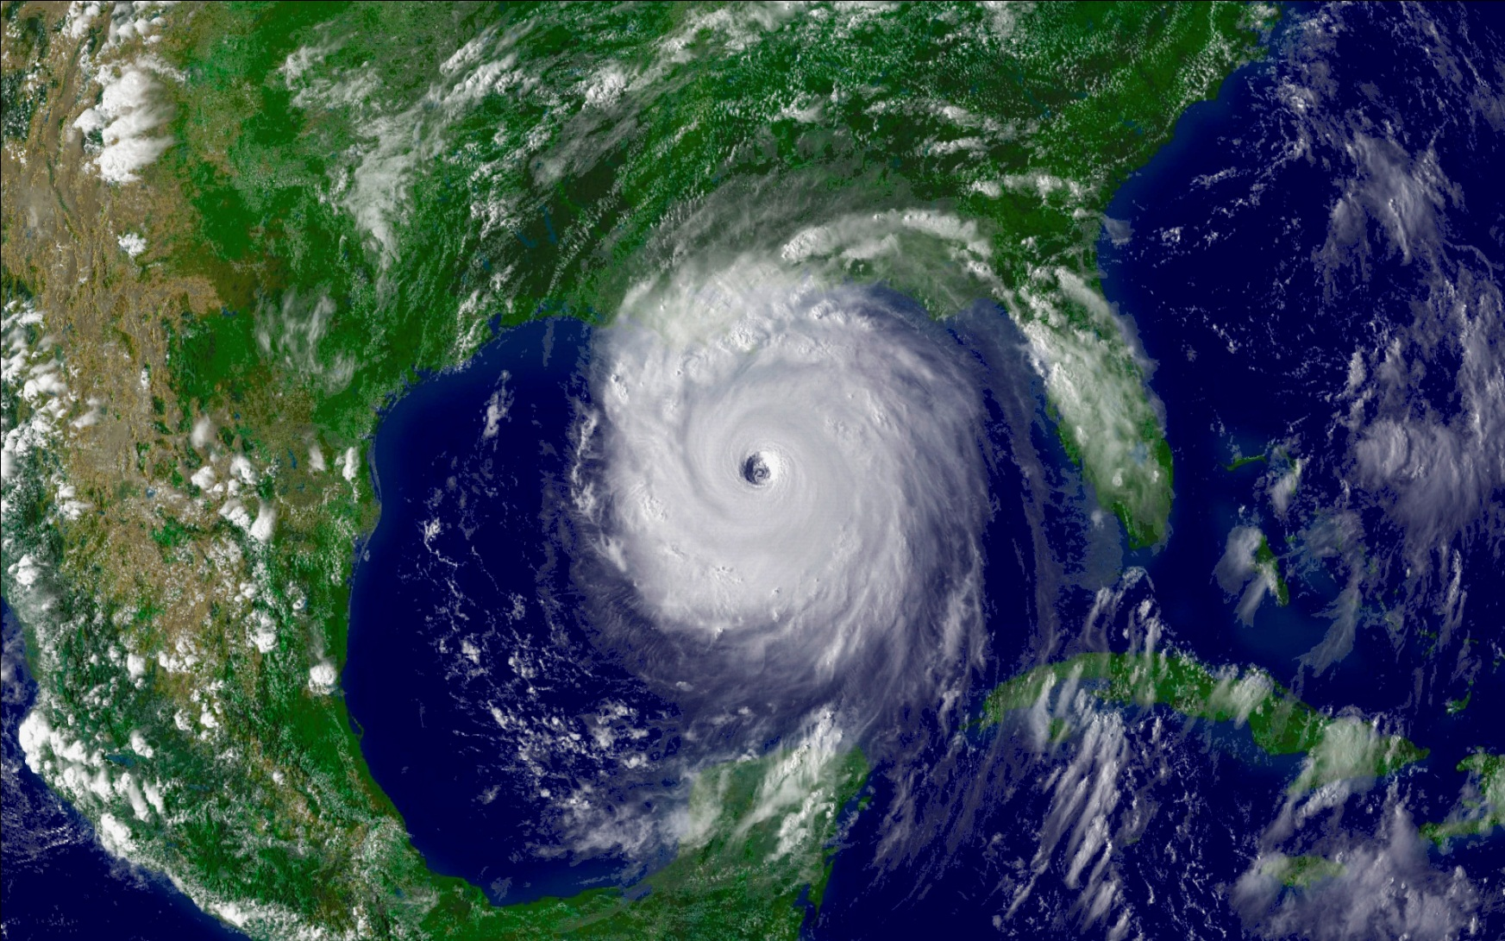

Slide 8
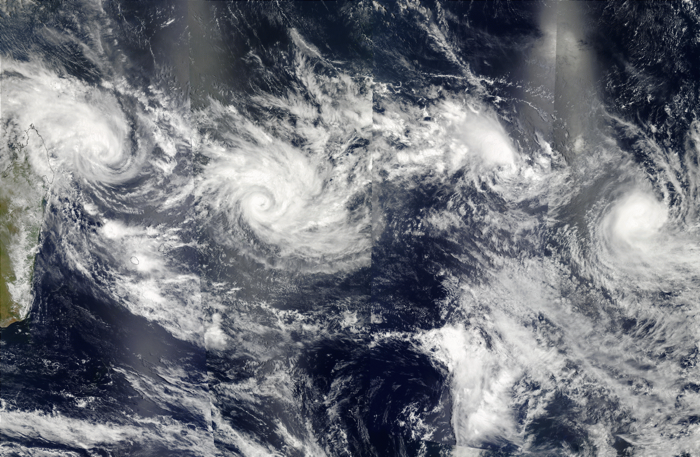

Slide 9
Structure
Distribution – Spatial and Temporal
Formation of Tropical Cyclones
Principal Hazards
Analysis Framework
  Where we go for our case studies

Slide 10
Tropical Revolving Storms
Distribution – Spatial and Temporal
Formation of Tropical Cyclones
Principal Hazards
Analysis Framework

Slide 11
Distribution – Spatial
Look at the map of world distribution, p47
Describe the principal locations
  Consider geography
  Consider atmospheric circulation features
What does this suggest about the features or formation of tropical cyclones?
Names related to geographical area – focus is normally on
  ‘hurricane’ (Atlantic)
  ‘typhoon’ (Pacific)
  ‘cyclone’ (Indian Ocean)

Slide 12
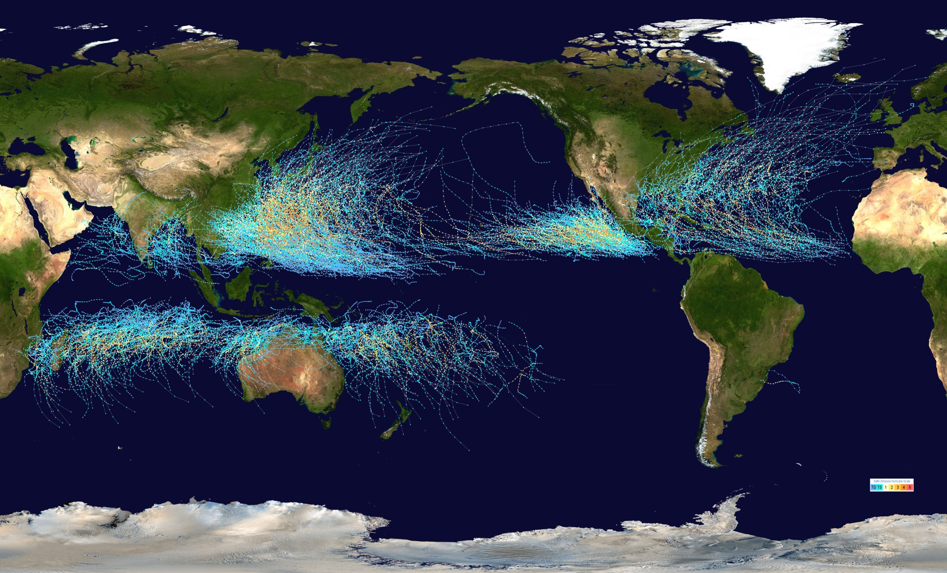

Slide 13
Distribution – Temporal
Tropical storms typically have a ‘season’.
Hurricanes – Atlantic/Caribbean – Aug-Oct
Cyclones – Indian Ocean – Oct-Nov
Typhoons – East Asia – May-Dec
This relates to a variety of features – including the location. Why?

Slide 14
Tropical Revolving Storms
Distribution – Spatial and Temporal
Formation of Tropical Cyclones
Principal Hazards
Analysis Framework

Slide 15
Cyclogenesis
Technical language – formation of cyclone
Not clear what forms cyclones – normally requires environmental conditions plus a trigger event
Maturity and movement are relatively well understood, and can be tracked and predicted.
Forecasters can normally predict how many events will occur in a season – but not when or how big they will be.

Slide 16
Cyclogenesis (Musk, 1988), p46
Ocean heat (normally regarded as over 26degC to depth of 50-75m)
Large Coriolis force
Air convergence in lower atmosphere
Air divergence in upper atmosphere
Unstable, humid air
Disturbance in lower atmosphere circulation

Slide 17
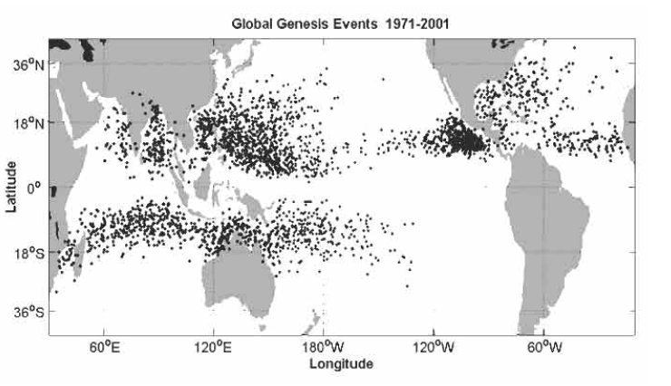

Slide 18
Cyclogenesis (Musk, 1988)
Ocean heat (normally regarded as over 26degC to depth of 50-75m)
  Generates latent heat to drive condensation and convection.
  The source of a tropical cyclone’s power
Large Coriolis force
  Provides the maximum rotation of air – high spinning force
  Fixes cyclones to a band 5-15 deg N/S of the equator
Air convergence in lower atmosphere
  Creates the low pressure zone to start the storm formation
Air divergence in upper atmosphere
  Creates high updraught through centre, and takes away heat
Unstable, humid air
  Creates right conditions for latent heat generation
Disturbance in lower atmosphere circulation
  A “trigger” event that starts it rotating

Slide 19
Maturity & Development (p48)
Exists while the supply of latent heat continues to drive circulation.
Mature cyclones have a central ‘eye’
This is an area of relatively calm conditions, clearer skies, and higher temperatues.
The edge of the eye is the most powerful part of the storm – wind speeds in excess of 300 km/h
“Stadium effect” – where the cloud banks of the eye look like a stadium

Slide 20
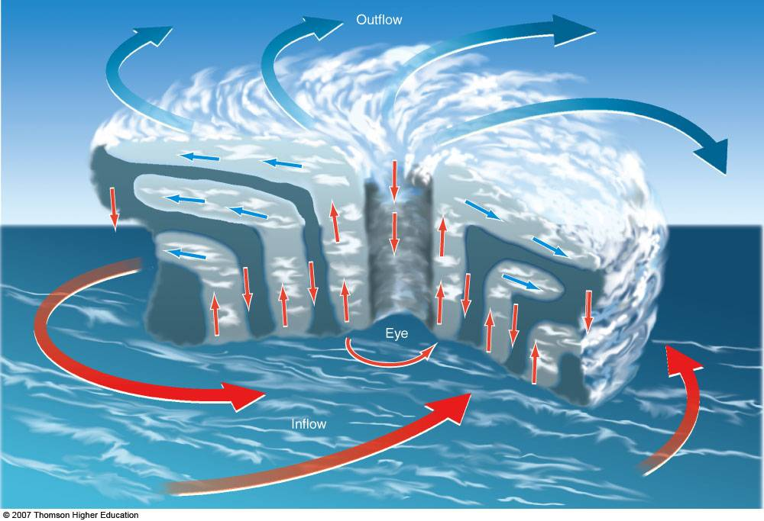

Slide 21
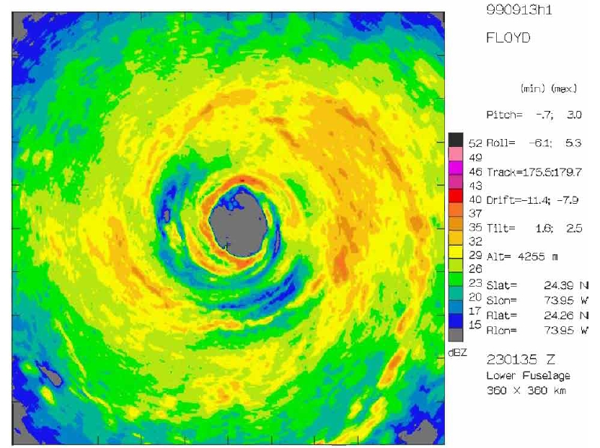

Slide 22
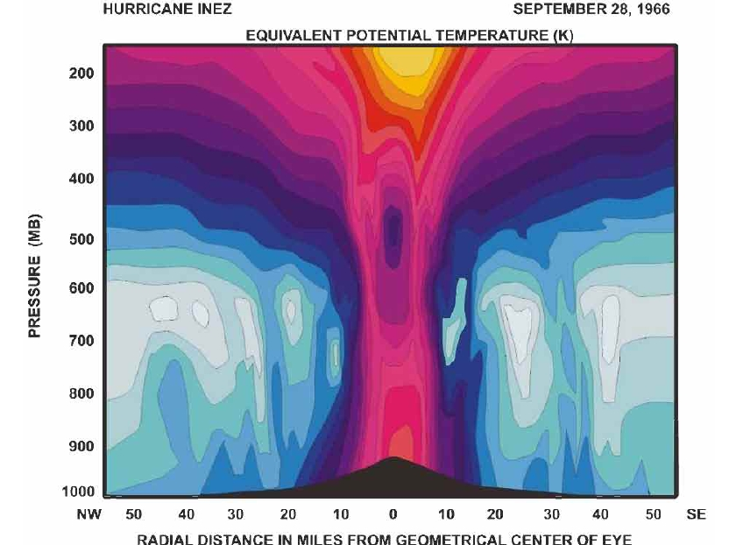

Slide 23
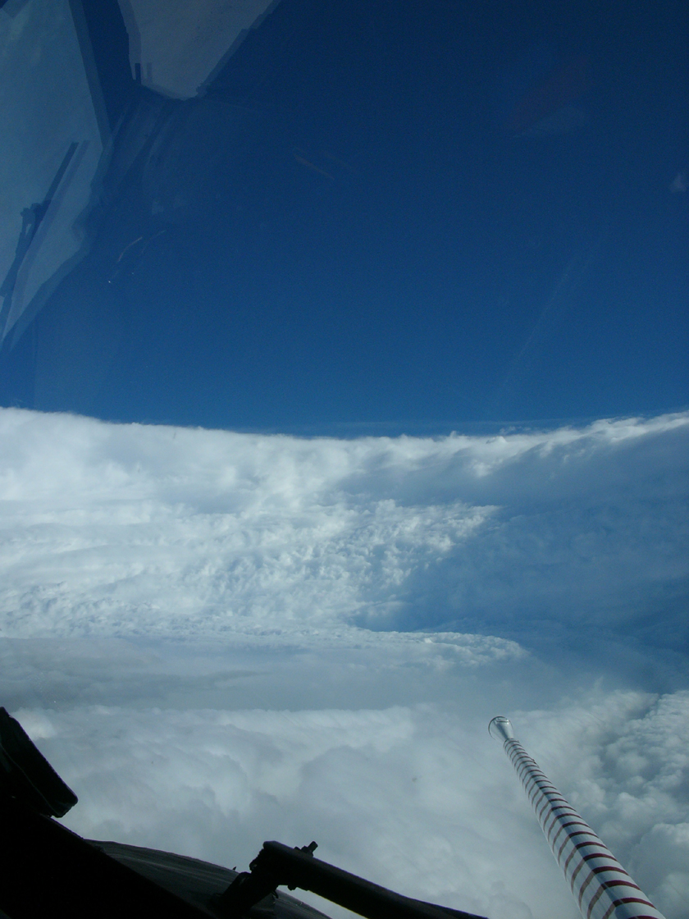

Slide 24
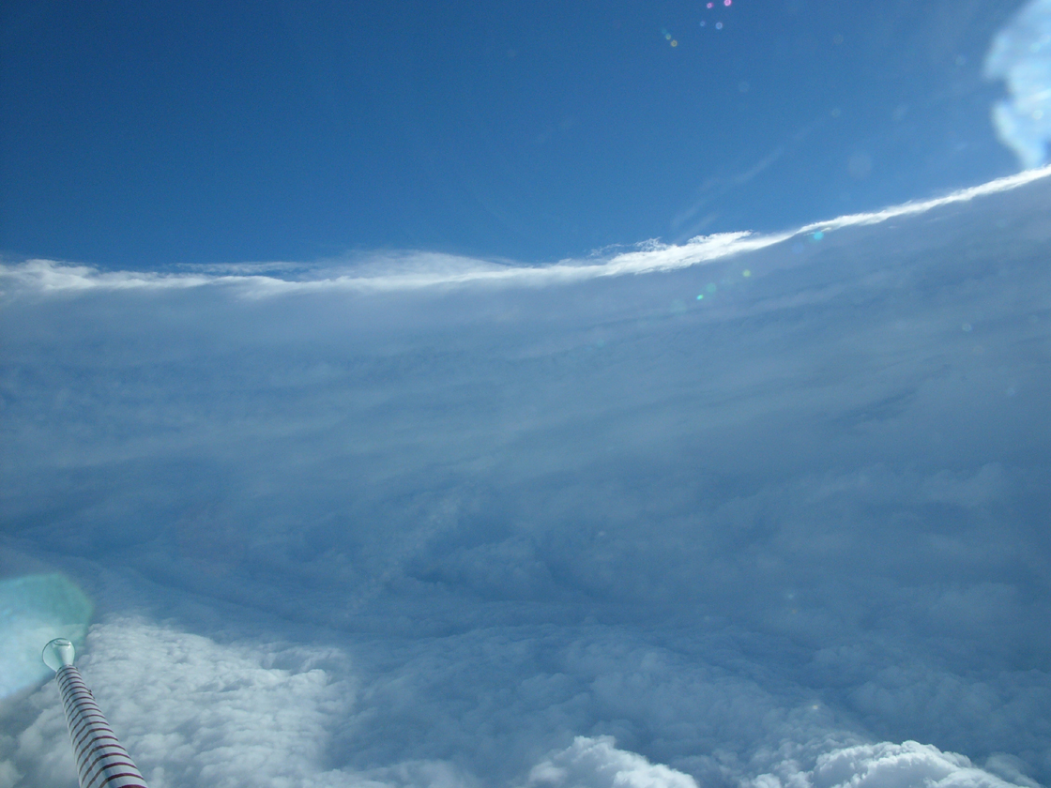

Slide 25
Death
Loss of latent heat:
  If it goes too far north/south, the water cools
  If it goes over land, the heat source disappears
Coriolis deflection:
  Too far north/south and it no longer has rotational power
Steering high level winds & atmospheric constraints:
  Fit within atmospheric circulation model – it can’t cross the ‘cell’ boundaries and the sub-tropical high region
Speed of high level winds
  Controls how fast it crosses an ocean.

Slide 26
Measuring tropical storms

Slide 27
Tropical Revolving Storms
Distribution – Spatial and Temporal
Formation of Tropical Cyclones
Principal Hazards
Analysis Framework

Slide 28
What does a tropical storm bring?
Low pressure
High winds
Intense rainfall
Every year about 70-75 storms develop; of which about 50 will become classified as tropical revolving storms.
They will then be given a name.

Slide 29
Measuring tropical cyclones
Storms are measured using the Saffir-Simpson scale
It combines physical features with potential impact on humans
Five levels (categories) of storm strength.
Uses central pressure, wind speed, storm surge, and damage potential

Slide 30
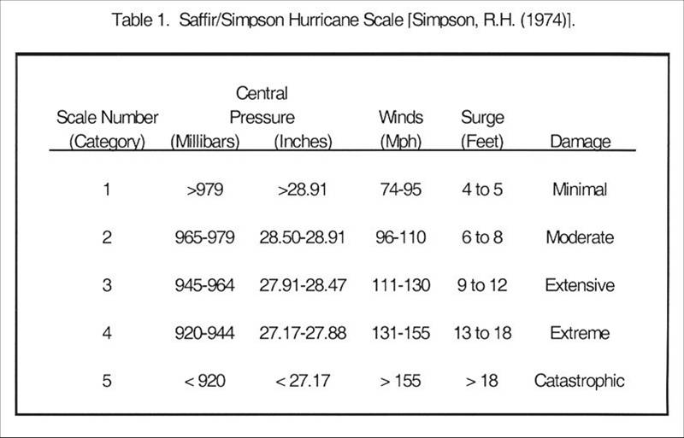
The Saffir-Simpson Scale

Slide 31
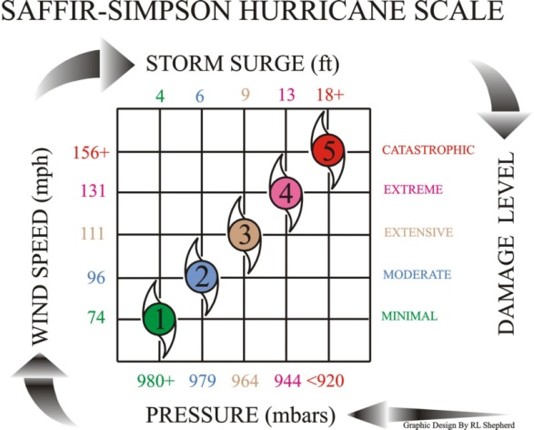

Slide 32
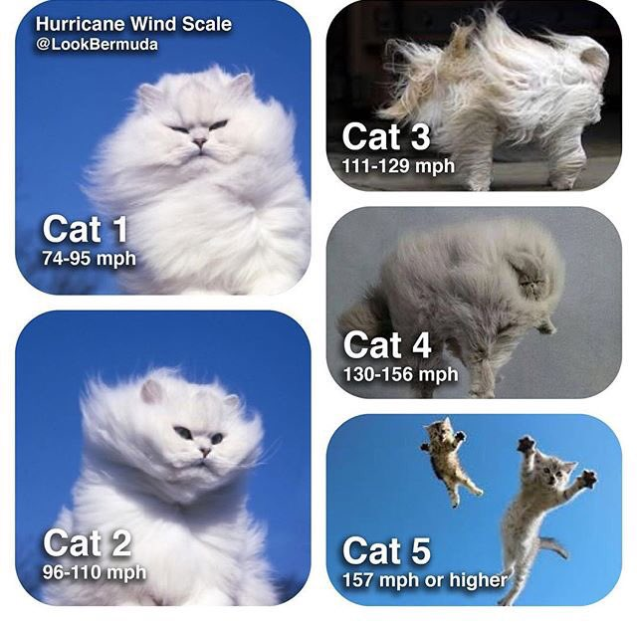

Slide 33
Hazards of trs (p50-51)

Slide 34
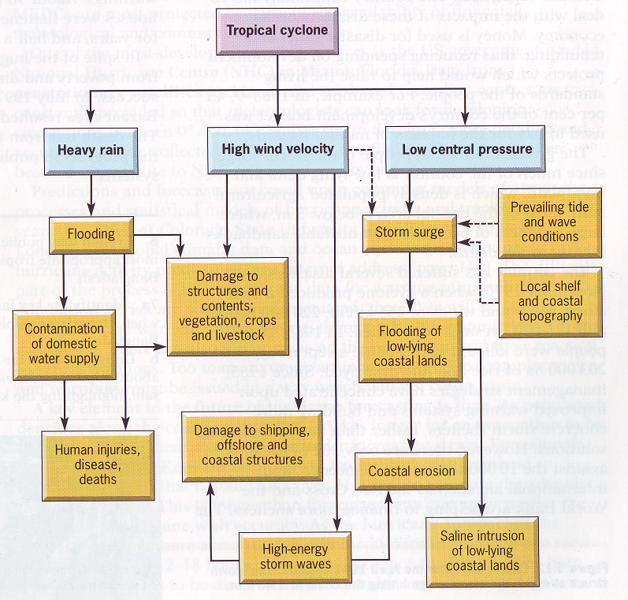
Principal Hazards

Slide 35
Principal Hazards
Winds
  In excess of 150km/h, up to 300 km/h
  Collapse buildings, damage infrastructure
  Debris role
Heavy rainfall
  Often more than 100mm in a day
  Severe flooding – secondary effects of landslides and mudslides
  Areas of particularly high relief have recorded up to 700mm/day
Storm surge
  Combines high winds and extreme low pressure to generate a big wave ahead of the storm
  Flood low lying coastal areas – extend far inland
  Secondary effects – saline contamination

Slide 36
Vulnerability
Physical Factors
  Intensity of the storm
  Speed of movement (length of time over sea builds up more power)
  Distance of area from the sea
  Physical geography of coastal area
Human Factors
  Prediction and management of warnings
  Community preparation - poverty?
  Evacuation plans

Slide 37
Reflection
How does this compare to other hazards?
Relatively high predictability – why?
Relatively high variability of risk depending on the scale of the storm – why?
Relatively complex hazard to identify exact risk – why?

Slide 38
Potential Management (p51)
Prediction & Warning
  Role of NHC/NOAA – key role of development
  Cost of getting warnings wrong
Community preparedness
Land use planning
  Coastal zone limited development – minimises storm surge issues
Hazard resistant design
  Building design
  Coastal defence (Sea wall)
Modifying the loss
  Insurance claims
  Aid and provision

Slide 39
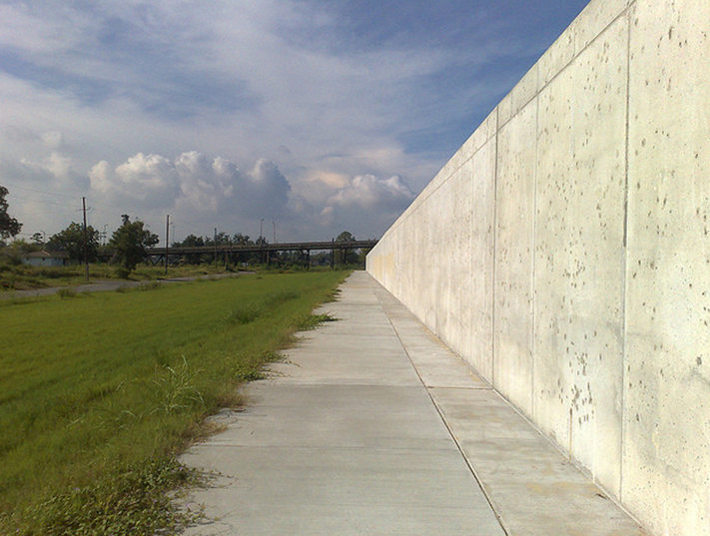
What is this designed to do?

Slide 40
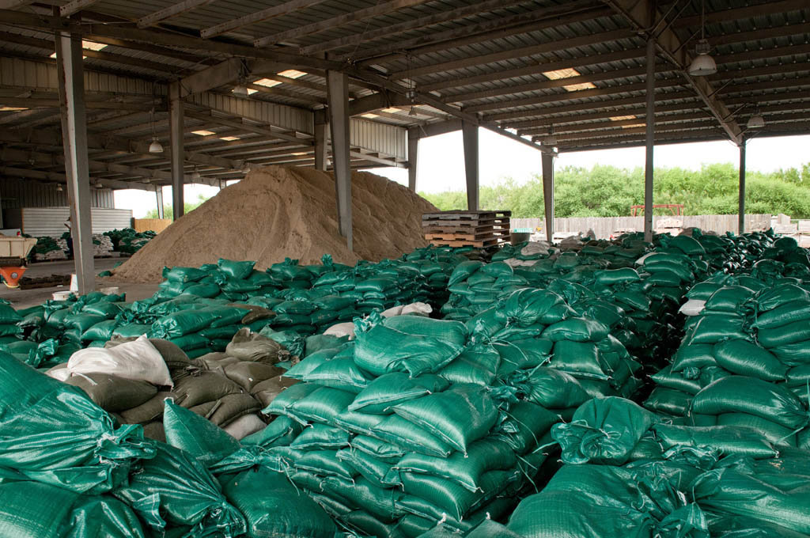
What are these bags for?

Slide 41
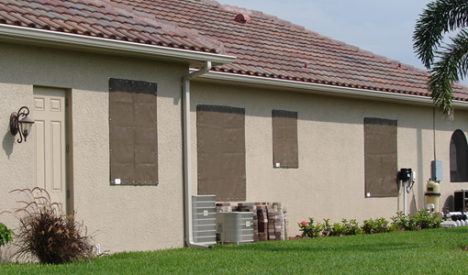
Why are these windows covered?

Slide 42
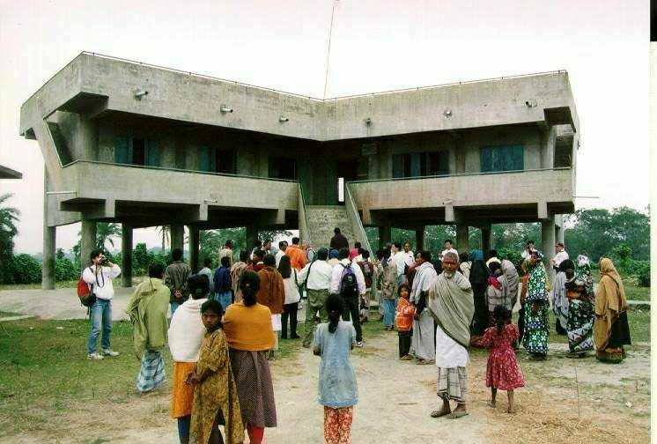
Why is this building designed in this particular way?

Slide 43
Case study: hurricanes in the USA (Katrina onwards, p52-53)

Slide 44
Reading
Content on Teams File and Firefly page – look at the hazard Geofiles, case study detail and videos if you want to
What are the key details that we take away from Hurricane Katrina?
  What were the main lessons to learn for the USA?
Look up Hurricane Isaac (2012) and Florence (2018) – the “wettest from the standpoint of water”
  What does this tell you about the key ability of learning lessons?

Slide 45
Case study: cyclone nargis (p54)

Slide 46
Reading
Content on Teams Files and Firefly
Counter example of how i) not to predict and ii) how not to learn lessons
Why is this useful in terms of direct comparisons?
What does this tell us about HIC/LIC thinking here? Why might this be the case?

Slide 47
Evaluation of trs management

Slide 48
Key Considerations
Prediction is possible
Preparation is possible
Impacts can be managed; recovery is possible
What does it depend on?
  Exposure to risk – taking it seriously
  Willingness to learn lessons & implement change
  Level of economic development

Slide 49
Essay 5: p55

Slide 50
Trs practice questions, p56-57

Slide 51
Video Resources (Hidden):
https://www.youtube.com/watch?v=izBoIs7jww0&safe=active
https://www.youtube.com/watch?v=VoO89cqDgJU&safe=active

Slide 52
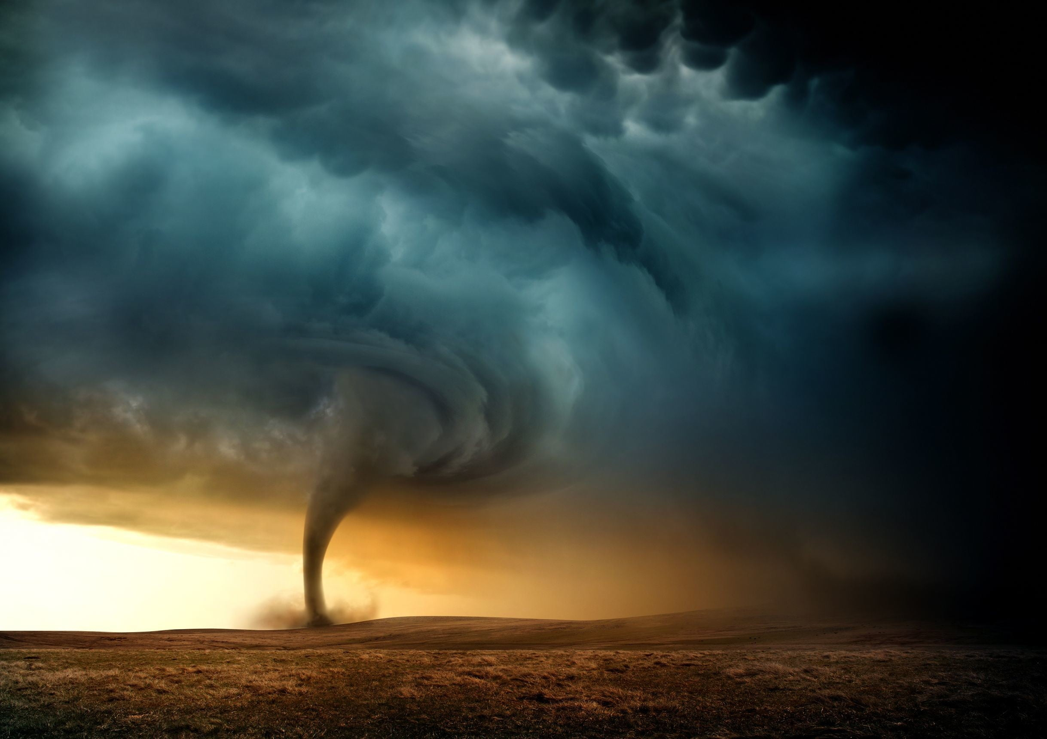
Tornado
Hazards

Slide 53
Outline:
Tornado vs Tropical Revolving Storm – Key Comparatives
Distribution & Characteristics
Formation of a Tornado
Key Hazards of a Tornado
Tornado Management

Slide 54
Outline:
Tornado vs Tropical Revolving Storm – Key Comparatives
Distribution & Characteristics
Formation of a Tornado
Key Hazards of a Tornado
Tornado Management

Slide 55
Tornado vs Tropical Revolving Storm
Feature | Tropical Storm | Tornado
Formation | Slow and evolving | Quick and dramatic
Size | Enormous – up to 600 miles across | Small – maybe 60-100 feet across
Scale | Takes many days, releases millions of joules of energy | Short lived, quick at the base of a thunderstorm
Intensity | Ranges from the edge of the storm towards the eye | Only in the direct funnel
Fuel | Latent heat of evaporation from warm water | Convection swirling around in a dry thunderstorm
Measured by | Saffir-Simpson scale Category 1-5 | Fujita Scale F1-F6

Slide 56
Outline:
Tornado vs Tropical Revolving Storm – Key Comparatives
Distribution & Characteristics
Formation of a Tornado
Key Hazards of a Tornado
Tornado Management

Slide 57
Distribution of tornadoes (p58)

Slide 58
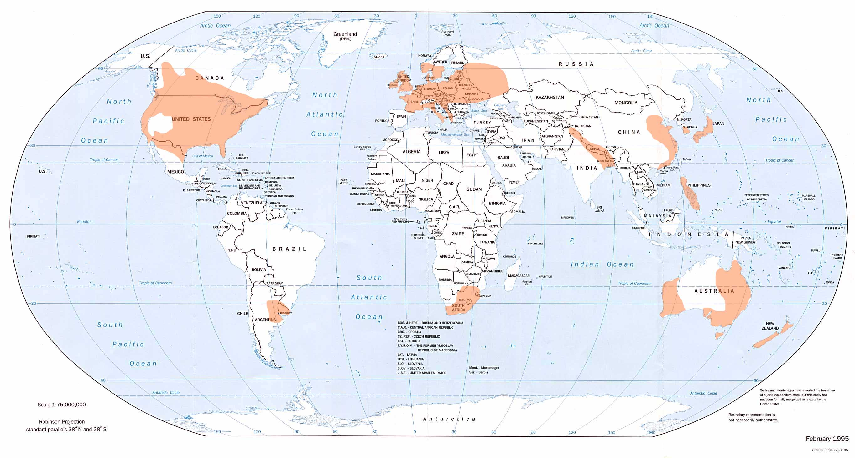

Slide 59
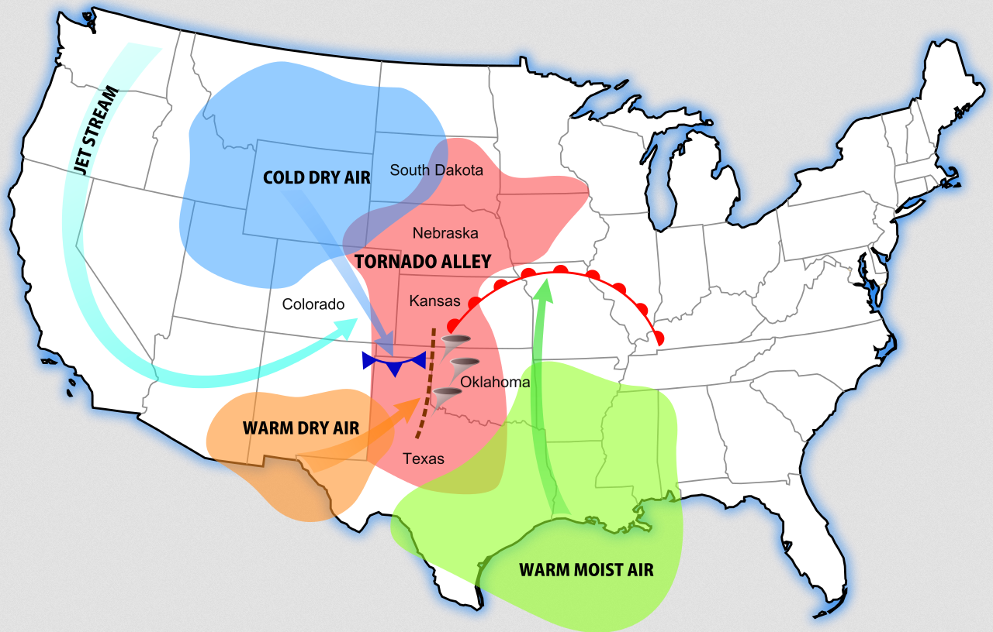
“Tornado Alley” – Central USA

Slide 60
Measurement of tornadoes (p59)

Slide 61
The Fujita Scale – Tornado Intensity
A key point to remember is this: the size of a tornado is not necessarily an indication of its intensity. Large tornadoes can be weak, and small tornadoes can be violent. A good example of a relatively "small" tornado would be the Pampa, Texas tornado of 1995
F-Scale Number | Intensity Phrase | Wind Speed | Type of Damage Done
F0 | Gale tornado | 40-72 mph | Some damage to chimneys; breaks branches off trees; pushes over shallow-rooted trees; damages sign boards.
F1 | Moderate tornado | 73-112 mph | The lower limit is the beginning of hurricane wind speed; peels surface off roofs; mobile homes pushed off foundations or overturned; moving autos pushed off the roads; attached garages may be destroyed.
F2 | Significant tornado | 113-157 mph | Considerable damage. Roofs torn off frame houses; mobile homes demolished; boxcars pushed over; large trees snapped or uprooted; light object missiles generated.
F3 | Severe tornado | 158-206 mph | Roof and some walls torn off well constructed houses; trains overturned; most trees in fores uprooted
F4 | Devastating tornado | 207-260 mph | Well-constructed houses levelled; structures with weak foundations blown off some distance; cars thrown and large missiles generated.
F5 | Incredible tornado | 261-318 mph | Strong frame houses lifted off foundations and carried considerable distances to disintegrate; automobile sized missiles fly through the air in excess of 100 meters; trees debarked; steel re-inforced concrete structures badly damaged.
F6 | Inconceivable tornado | 319-379 mph | These winds are very unlikely. The small area of damage they might produce would probably not be recognizable along with the mess produced by F4 and F5 wind that would surround the F6 winds. Missiles, such as cars and refrigerators would do serious secondary damage that could not be directly identified as F6 damage. If this level is ever achieved, evidence for it might only be found in some manner of ground swirl pattern, for it may never be identifiable through engineering studies

Slide 62
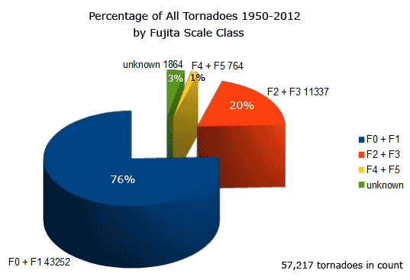

Slide 63
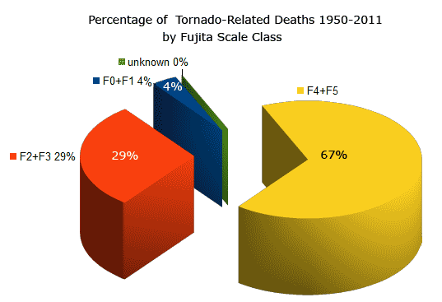

Slide 64
Outline:
Tornado vs Tropical Revolving Storm – Key Comparatives
Distribution & Characteristics
Formation of a Tornado
Key Hazards of a Tornado
Tornado Management

Slide 65
Formation of a Tornado (p60-63)
https://www.youtube.com/watch?v=lmWh9jV_1ac&safe=active
Tornadoes form from very tall thunderstorm clouds called cumulonimbus clouds – with massive convective uplift that makes it a “supercell” storm.
The typical steps for the formation of a tornado are as follows:
  A large thunderstorm occurs in a cumulonimbus cloud
  A change in wind direction and wind speed at high altitudes causes the air to swirl horizontally
  Rising air from the ground pushes up on the swirling air and tips it over
  The funnel of swirling air begins to suck up more warm air from the ground
  The funnel grows longer and stretches toward the ground
  When the funnel touches the ground it becomes a tornado

Slide 66
Stage 1: Storm development
Local heating & convection forms a violent thunderstorm
Convection, cumulonimbus clouds begin
This has deep and strong updraught currents, cause by convection

Slide 67
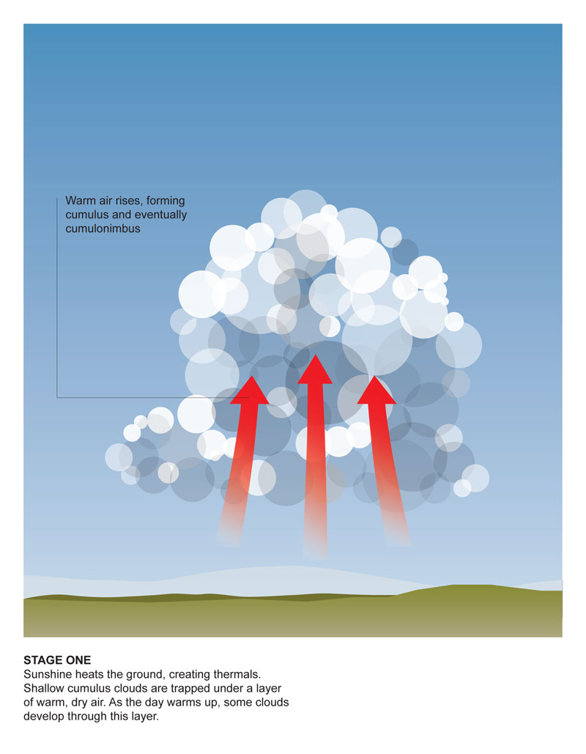

Slide 68
Stage 2: Storm Organisation
When the above process occurs in an environment where winds increase strongly with height (strong vertical wind shear), the thunderstorm updraught may begin to rotate.
This happens because the strong wind shear creates a horizontal spin in the atmosphere.
The strong updraught tilts this rolling motion into the vertical, so that the spin occurs about a vertical axis, in the same sense as the rotation of a merry-go-round.
Thunderstorms that exhibit persistent and deep rotation are called 'supercells'.

Slide 69
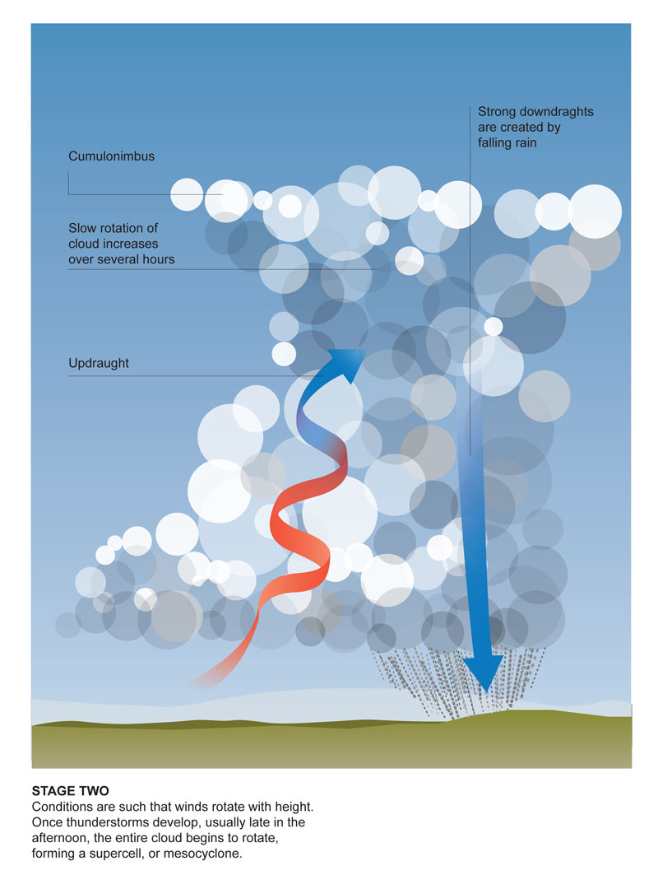

Slide 70
Stage 3: Tornado Formation
Downdraughts within the supercell storm (descending currents of relatively cold, dense air) help to concentrate the rotation and to bring it down to lower levels.
Eventually the rotation may become so strongly-focused that a narrow column of violently rotating air forms. If this violently-rotating column of air reaches the ground a tornado is born.
The tornado is often visible because of the presence of a condensation funnel - a funnel-shaped cloud which forms due to the much-reduced pressure within the tornado vortex.
Dust and other debris lofted by the intense winds can also help to make the tornado visible.

Slide 71
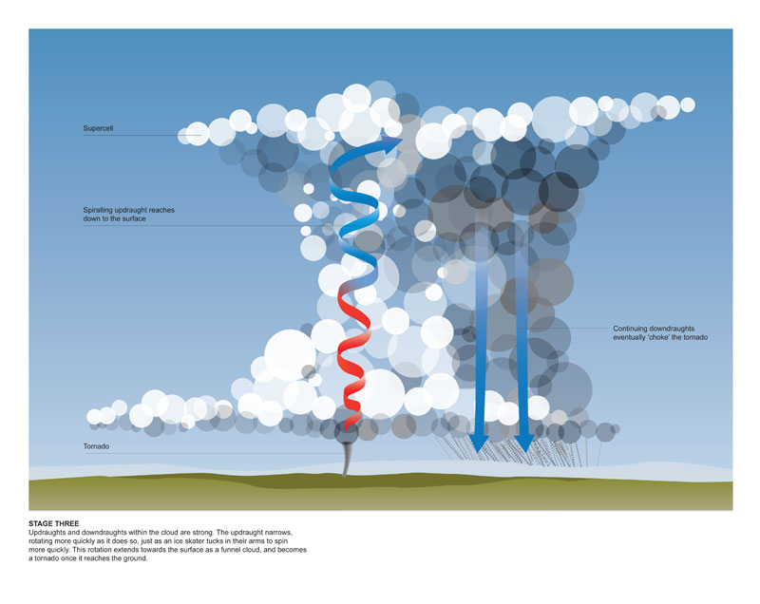

Slide 72
Stage 4: Tornado Dissipation
Cold downdraughts eventually wrap around the tornado, cutting off the supply of warm air.
The tornado typically narrows during this stage, and eventually the vortex dissipates.
This process can take as long as one hour – relatively quick compared to TRS!

Slide 73
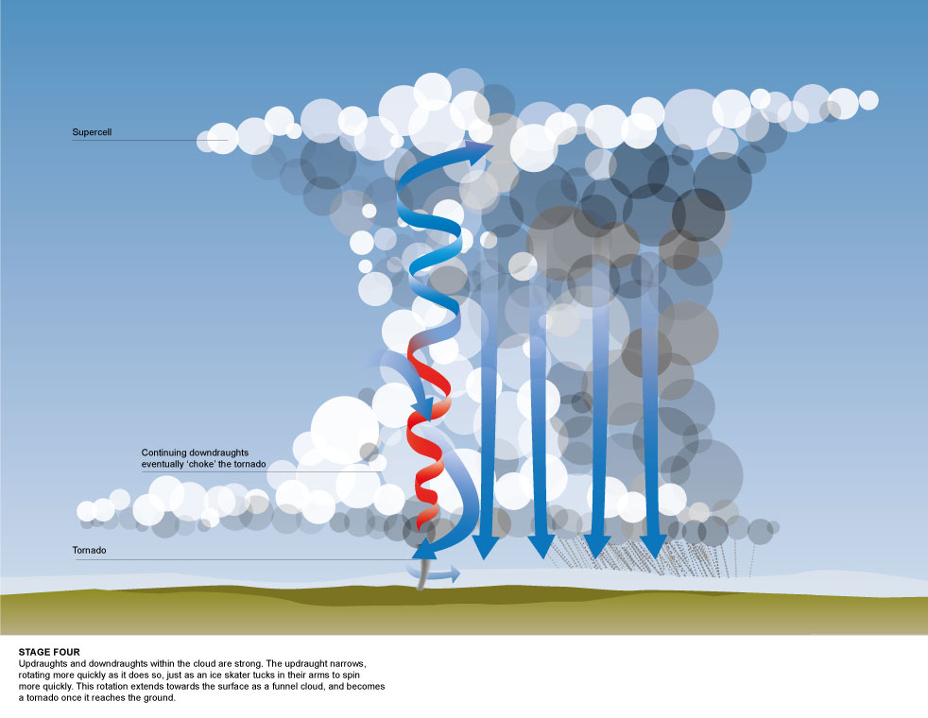

Slide 74
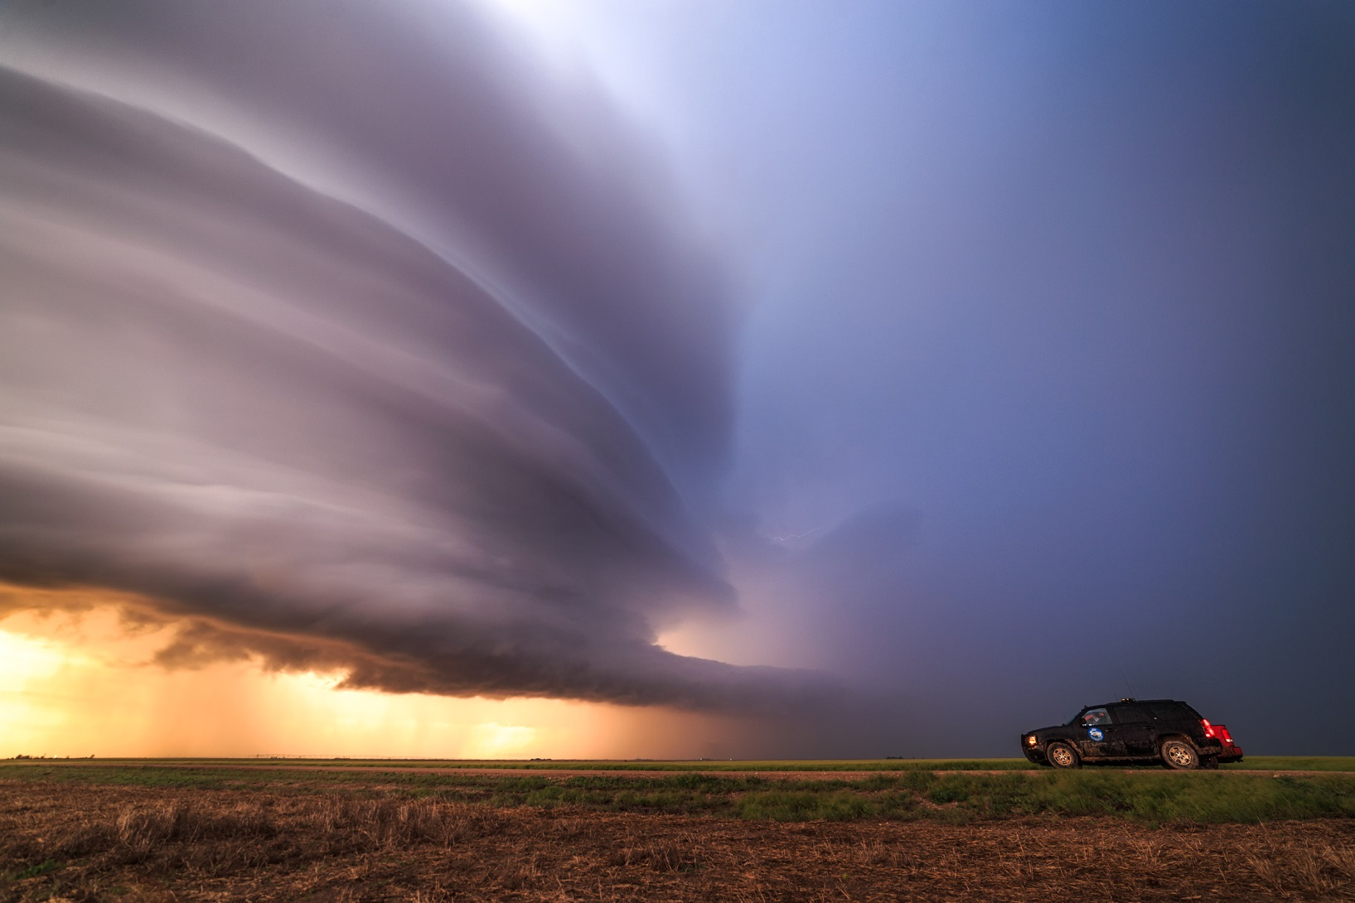

Slide 75
Outline:
Tornado vs Tropical Revolving Storm – Key Comparatives
Distribution & Characteristics
Formation of a Tornado
Key Hazards of a Tornado
Tornado Management

Slide 76
Key Hazards of a Tornado (p64):
Low pressure
High wind speeds
Majority of damage is secondary and a result of direct contact of the funnel
  Flying debris
  Damage to infrastructure (power lines very susceptible!)

Slide 77
Major Tornadoes
“Tri State Tornado” – Missouri, Illinois & Indiana in 1925. Killed 695 people, injured 2025.
“Natchez Tornado” killed 317 people and injured 109 in Mississippi in 1840
“Tupelo Tornado” killed 216 and injured 700 in Mississippi in 1936
“Gainesville Tornado” killed 203 and injured 1600 in 1936
What do we notice about them?

Slide 78
Management of tornadoes (p65)

Slide 79
Management (p65):
Prediction:
  Forecast supercell storms and issue warnings – good quality prediction normally available, esp in USA
  Warnings and public information normally readily available – managed at local/state level in USA
Preparation:
  Design of buildings to resist high winds
  Basements/shelter areas as optional/mandatory requirements (state dependent, building dependent)
Recovery:
  Make safe the damaged infrastructure, especially power outages
  Clear debris
  Usually quite fast – only short life span of the tornado
Speed and intensity of the storm changes everything: it all has to be ready to go and recover very quickly!

Slide 80
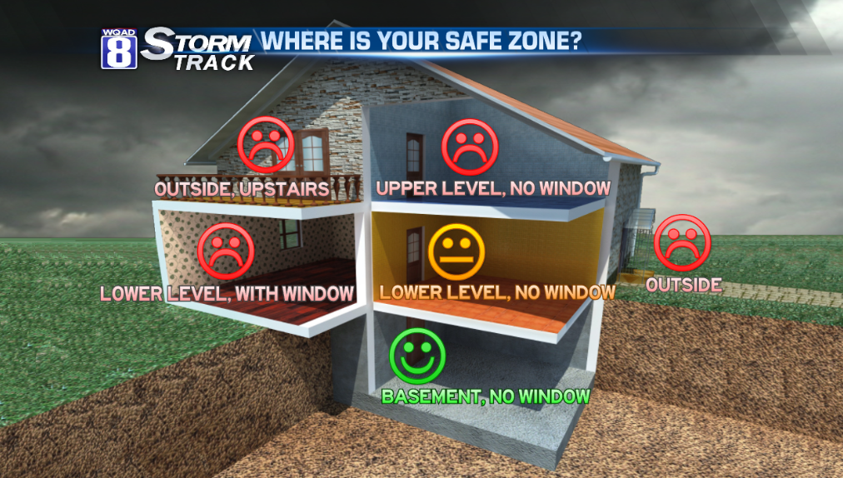

Slide 81
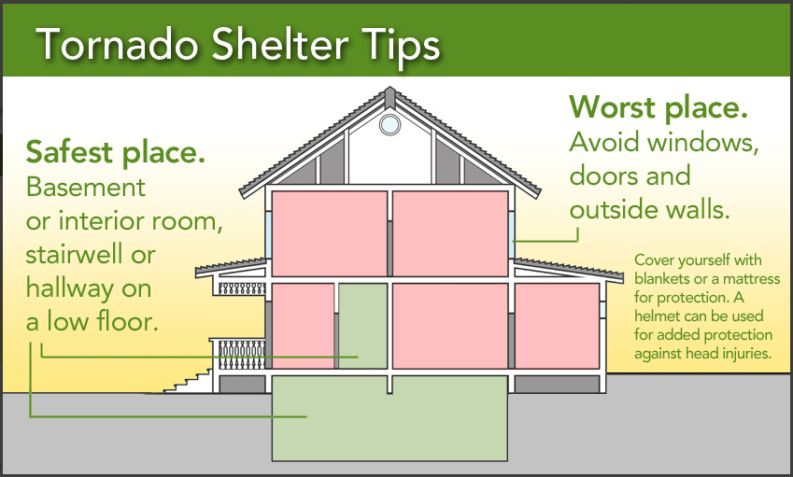

Slide 82
Case study of a tornado

Slide 83
Moore, OK, 2013 (p66)
F5 tornado struck in afternoon of May 20, 2013 in Moore, Oklahoma
Peak winds of 210 mph
Killed 24 people, injured 344 – part of a larger weather system that had hit the region over two days
Estimated $2 bn damage – including two schools and a hospital destroyed
Stayed on the ground for 37 minutes, travelled 17 miles. Was 1.3 miles wide at maximum (“wedge tornado”)
https://edition.cnn.com/2014/05/20/us/oklahoma-moore-tornado-anniversary/index.html
https://news.nationalgeographic.com/2015/07/150708-twister-storm-chasers-moore-oklahoma-weather-tornado-alley-ngbooktalk/
https://www.theatlantic.com/photo/2013/05/photos-of-tornado-damage-in-moore-oklahoma/100518/
https://edition.cnn.com/videos/weather/2019/03/04/alabama-tornadoes-walk-through-blackwell-nr-vpx.cnn
https://edition.cnn.com/videos/weather/2019/03/04/alabama-tornadoes-walk-through-blackwell-nr-vpx.cnn
https://edition.cnn.com/2019/03/06/us/alabama-tornadoes-before-and-after/index.html
https://www.theguardian.com/us-news/2019/mar/04/alabama-tornado-deaths-catastrophic-damage

Slide 84
Essay plan: Management of tornadoes (p67)

Slide 85
Tornado practice questions (p68)

Slide 86
Comparisons of Atmospheric Hazards (p69)
We can compare hazards at a number of feature/process/scales:
  Formation rate
  Size/scale/measurement technique (name)
  Intensity
  Fuel
How would you compare…
  Physical features
  Global distribution
  Prediction of the two events
  Preparation for the two events
Which is the greater threat?

Slide 87
Comparison of atmospheric hazards essay (p70)

