Slide 1
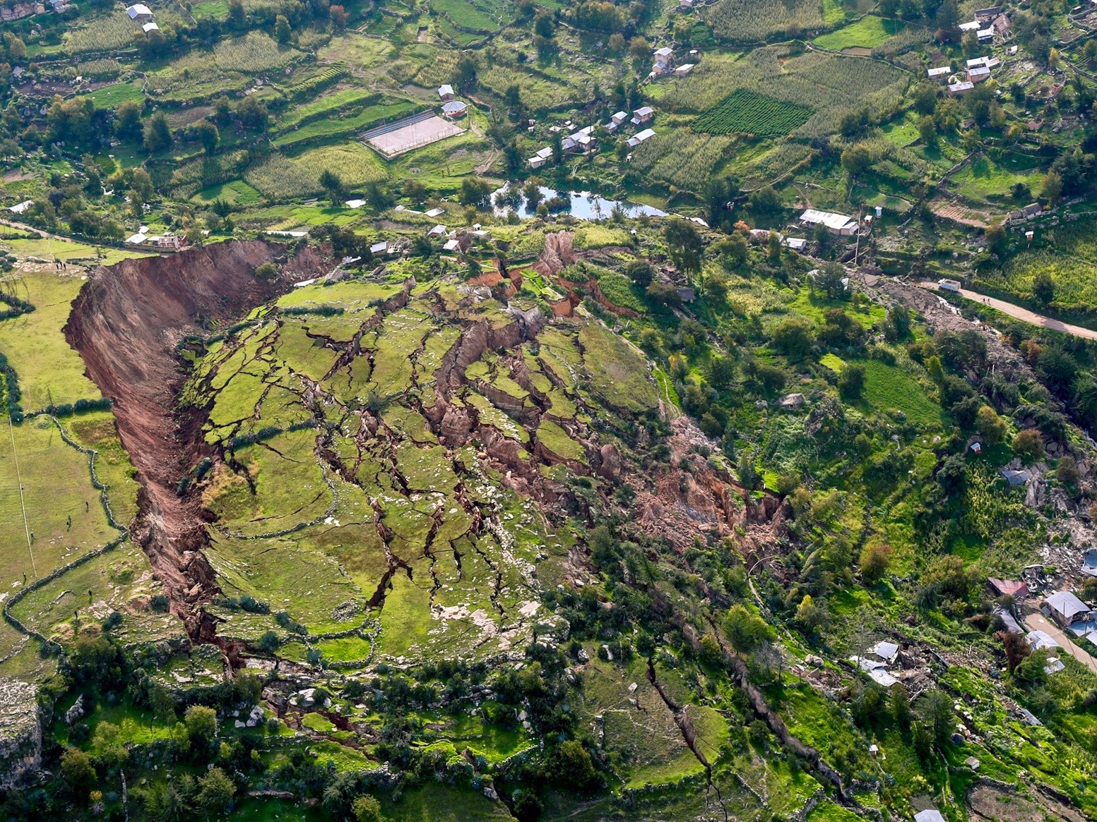
Mass Movement Hazards

Slide 2
Context:
Mass movements are caused by a combination of:
  Instability factors – things that mean the slope is vulnerable to failure. This is a result of many factors, plus long term weathering and erosion.
  Trigger event – this is the reason that the slope failed in a particular place and time.
Can classify them and regard them differently based on water and speed

Slide 3
Surface Creep (Dry/Slow)
This is the slow, downslope movement of unconsolidated material and soft rocks down a low grade slope.
It may also be the slow deformation of material under pressure and stress.
This movement is rarely more than 1-2 centimetres per year. It appears to be very slow and continuous, but is actually lots of little slipping processes caused by gravity overcoming friction.
Processes include:
  Plastic flow for clay-rich sediment: this is where saturacted, thick surface deposites deform along bedding lines. It can be affected by pressure from overlying cap rocks or human constructions
  Freezing and thawing in the surface layers can produce heave. The expansion of water causes the surface to bulge parallel to the slope; then it drops back vertically, producing a net downslope movement.
  Wetting and drying can also produce heave in the same way.
In permafrost, the melting in summer (waterlogging) can lead to accelerated creep called solifluction.

Slide 4
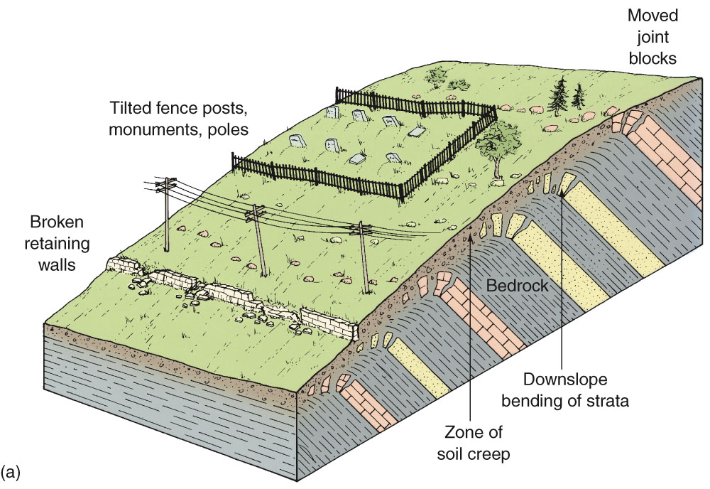
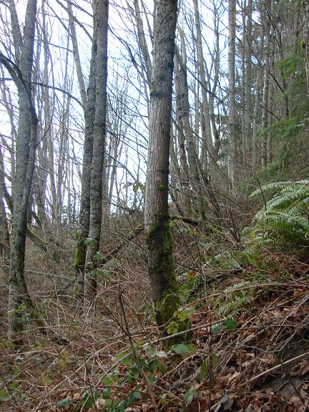
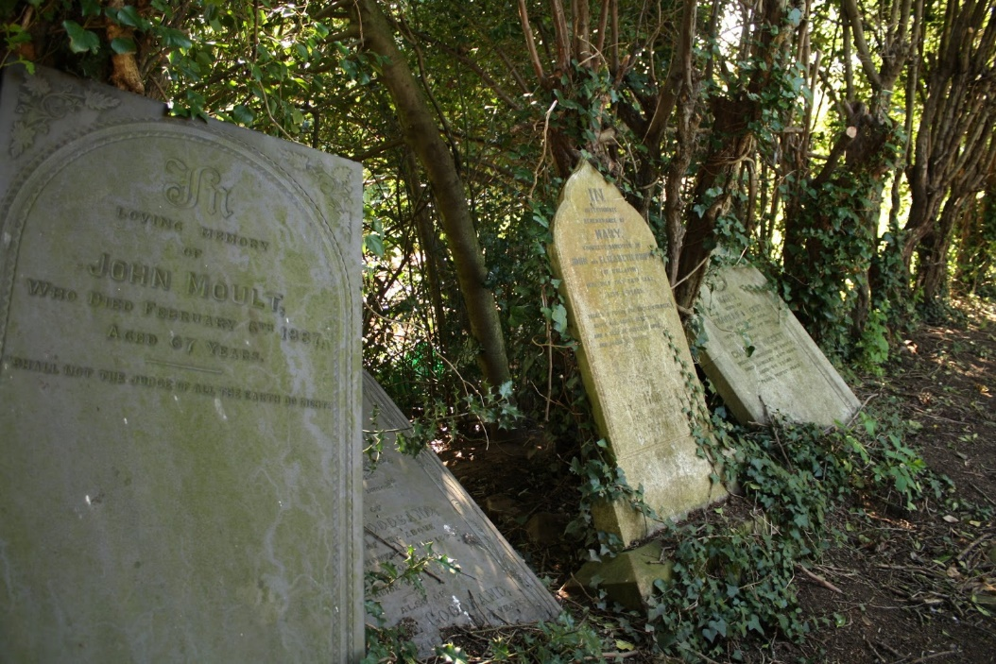
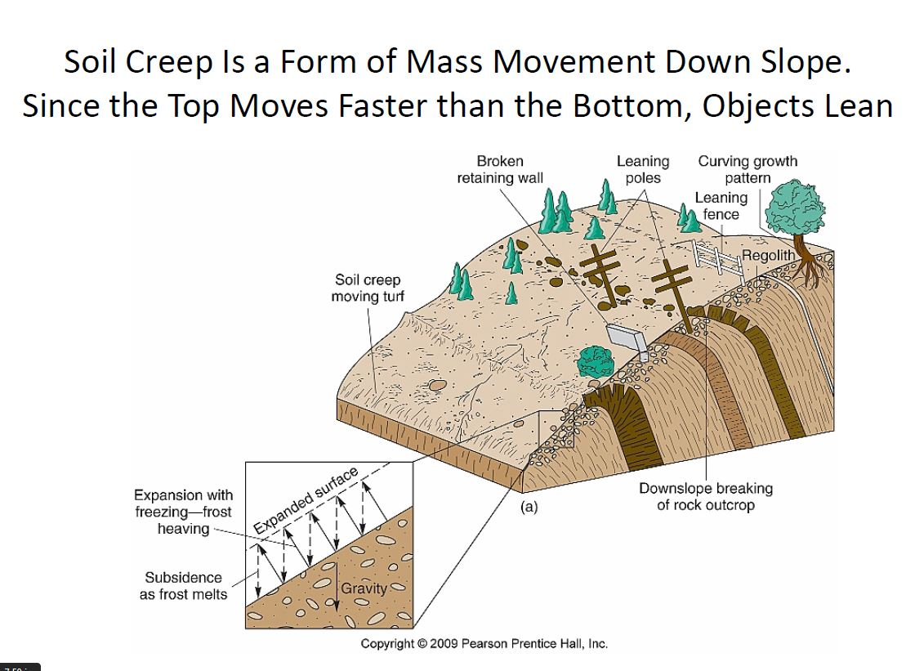

Slide 5
Flows (Fast/Wet)
A mudflow or mud flow is a form of mass wasting involving "very rapid to extremely rapid surging flow" of debris that has become partially or fully liquefied by the addition of significant amounts of water to the source material.
Mudflows contain a significant proportion of clay, which makes them more fluid than debris flows; thus, they are able to travel farther and across lower slope angles.
Other types of mudflows include lahars (involving fine-grained pyroclastic deposits on the flanks of volcanoes) and jökulhlaups (outbursts from under glaciers or icecaps).

Slide 6
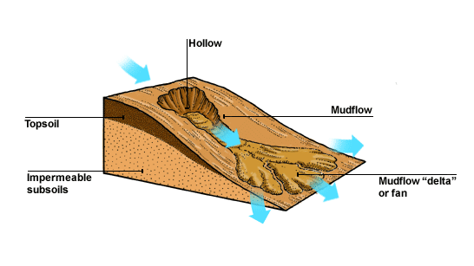
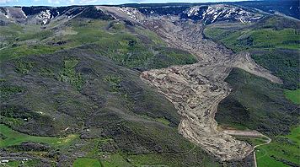
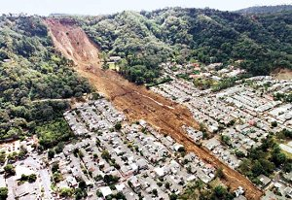
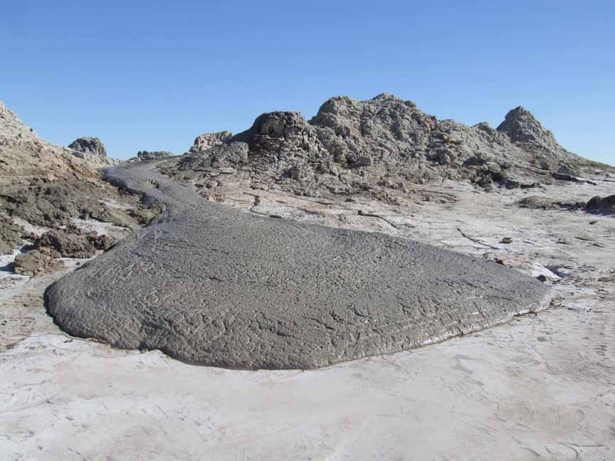
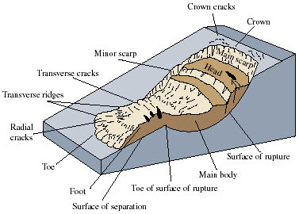

Slide 7
Slope Failure (Landslide)
Landslides are dramatic events (high magnitude, low frequency), where a section of hillside becomes unstable, shears away, and moves down hill.
The shear stresses in the slope exceed the shear strength of the rock.
Many landslides occur after heavy or prolonged rainfall. This normally is associated with single events (e.g. passage of cyclone, or significant thunderstorm). 90% of landslip events were triggered this way.

Slide 8
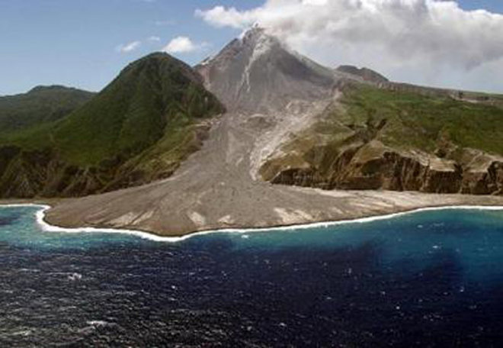
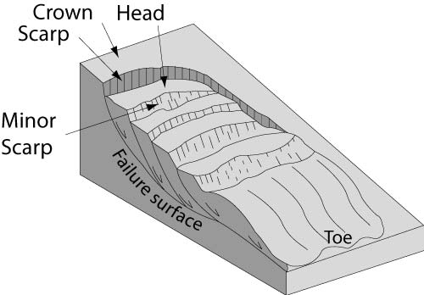
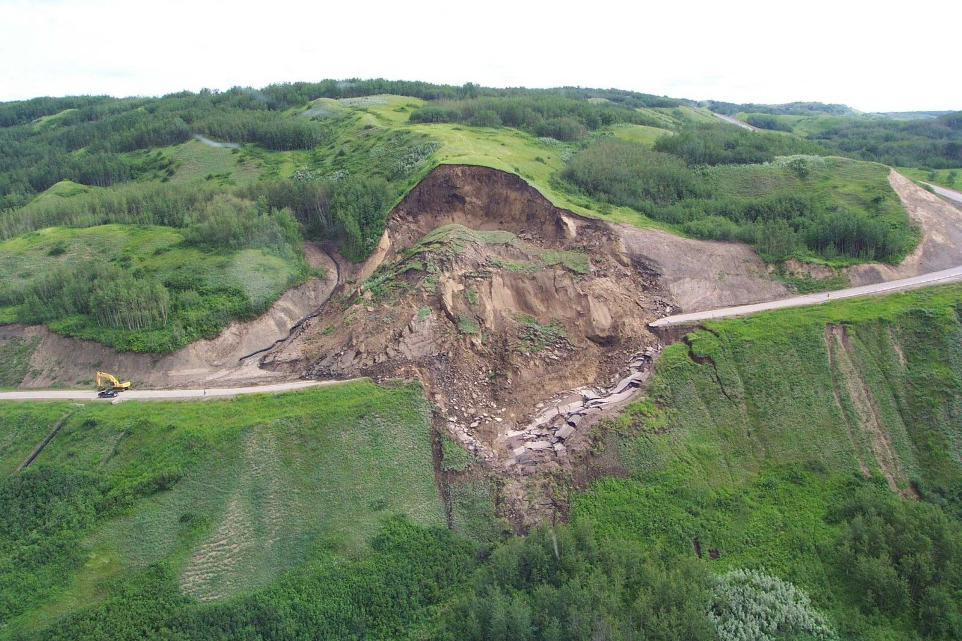
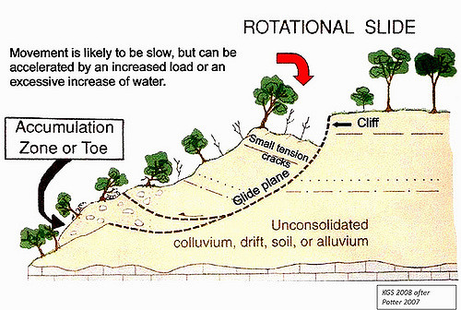
Landslide

Slide 9
Slope Failure (Fall; Fast/Dry)
Rock falls from vertical faces share many factors and characteristics with landslides. They also suffer from undercutting (e.g. coasts!)
These are high magnitude-low frequency events
Rock falls reduce horizontal pressure on a cliff, leading to the growth of vertical cracks. This leads to further rock falls.
A cliff that has vulnerable geology to a rockfall may be said to be incompetent. One that is not vulnerable to a rockfall, which is better consolidated, may be said to be competent.
Scree is a collection of broken rock fragments at the base of crags, mountain cliffs, volcanoes or valley shoulders that has accumulated through periodic rockfall from adjacent cliff faces.
Landforms associated with these materials are often called talus deposits.

Slide 10
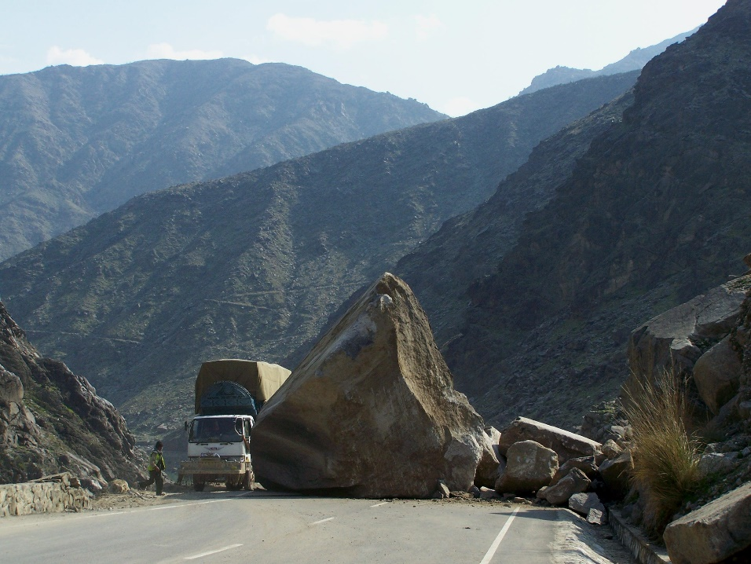
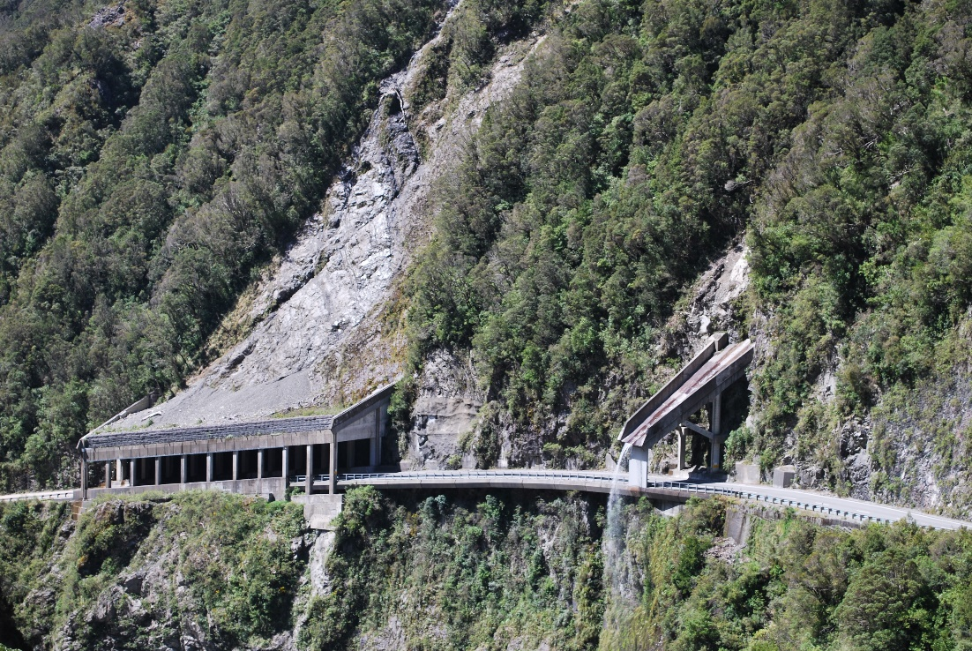
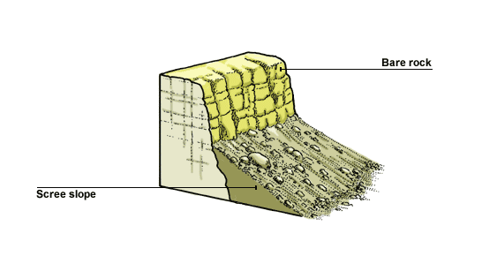
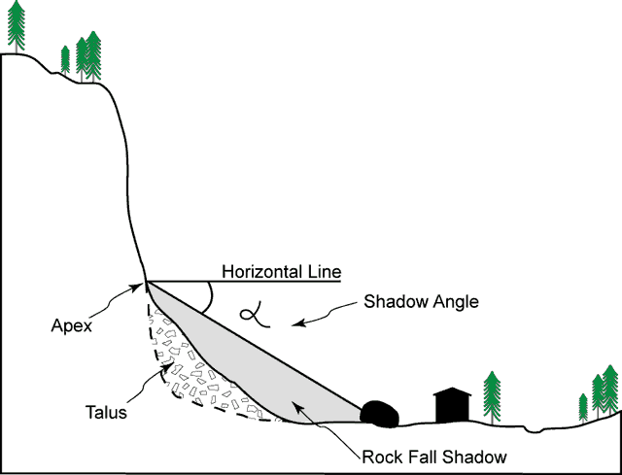
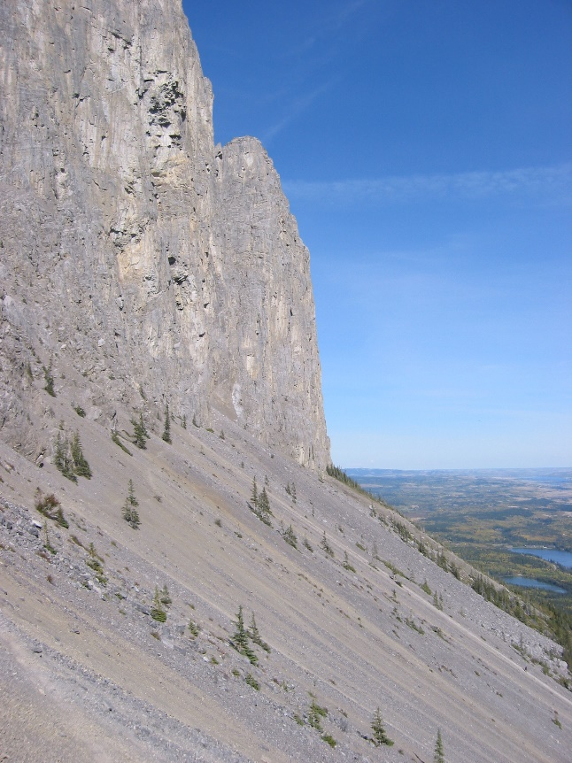

Slide 11
Context – Instability Factors
Slope angle
Geological structures (e.g. fractures, bedding planes, and dip angles)
Rock types, and permeability. Layers of trapped water can increase vulnerability to slides
Amount of water present; water increases the weight of rock, and decreases the shear strength of the material.
Vibrations from other events (e.g. earthquakes, volcanoes traffic, shock wave events)
Removal of the supporting “toe” of the landslip, which can reduce natural block support for the slope
Loading of the top of the slope (e.g. by construction, building or accretion of weight of snow, ice etc.)

Slide 12
Monitoring of Slopes
Monitoring slopes is possible: some landslides give warning signs (cracking, bulging)
If we know a slope is vulnerable, we can measure it regularly (GPS, satellite, laser surveys) to see if there are potential changes
Long term surveys show strength and maps of the slope, and can show the trends
Microscale changes can be measured using rainfall sensors, pore pressure sensors, and even strain or tilt meters to show weight change
USGS Live Data
Evaluation: most of this requires significant investment!

Slide 13
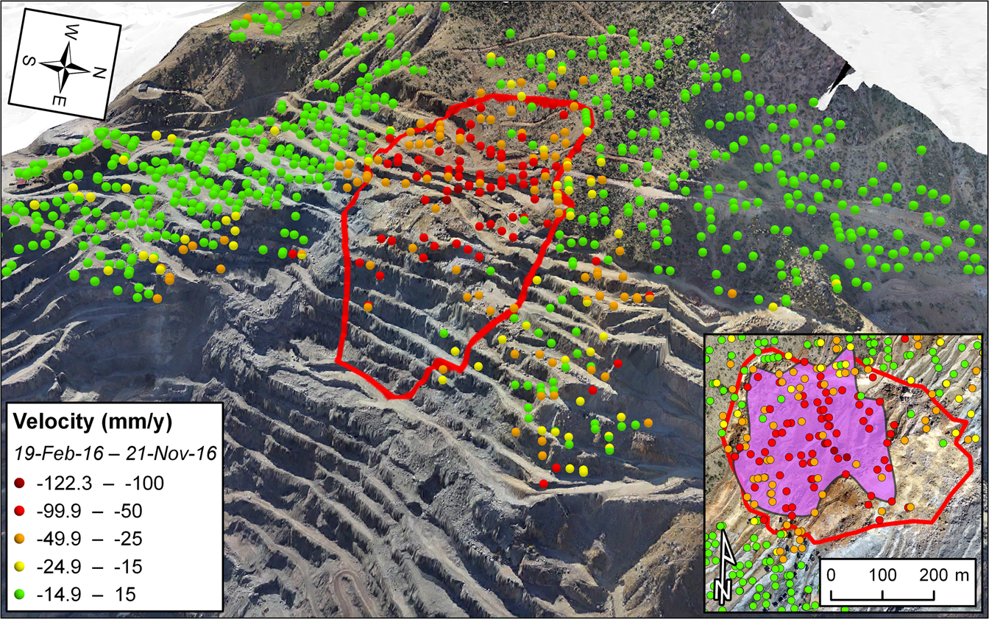

Slide 14
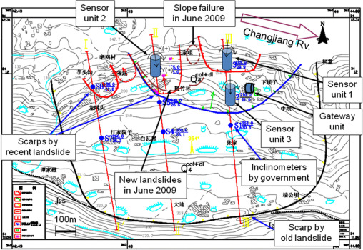

Slide 15
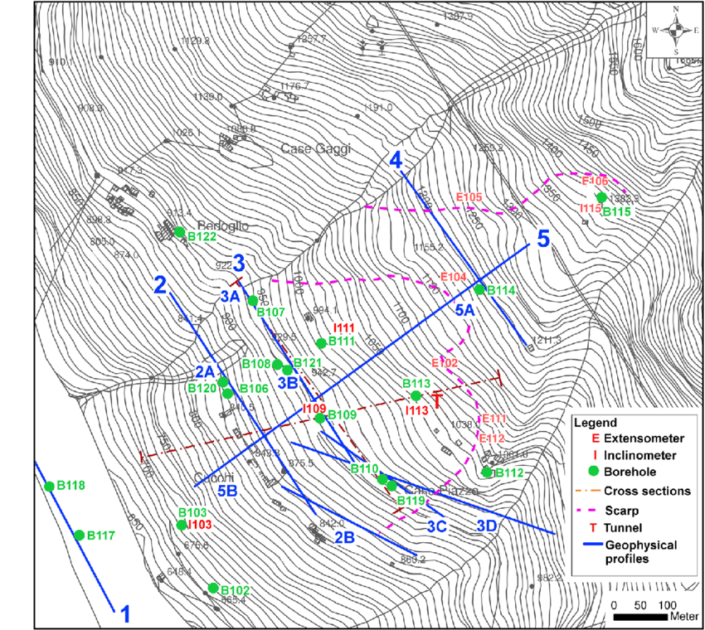

Slide 16
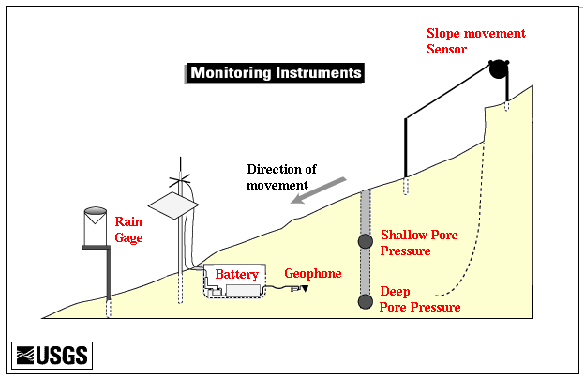
Slope Monitoring

Slide 17
Rainfall Forecasting
Links to 2.3 Atmosphere & Weather Unit
With rainfall being a major trigger of slope instability, having accurate forecasts of weather and rainfall is critical in understanding landslip potential
HICs have well developed systems and forecasting (UK: Met Office, Environment Agency) and this also includes river levels
However, very difficult to separately measure saturation levels, and the amount of water in the soil!
LICs may have similar technology, but not always: and implications/communication/infrastructure management not quite so useful.

Slide 18
Hazard Mapping
Used far more for landslide hazards than almost anything else – though theoretically can be applied to volcanoes and floods from TRS too.
Uses local data (previous landslides, slope, geology, human, risk factors) to create a map
Often done with GIS (Geographic Information Systems) online to create complex maps with multiple layers
Useful for two things:
  Prediction: identifying areas at risk, human areas most likely to be affected
  Preparation: identifying hazard routes, evacuation strategies. In the long term or HICs, you can also use it to plan land use zoning, and legislation/building restrictions etc.

Slide 19
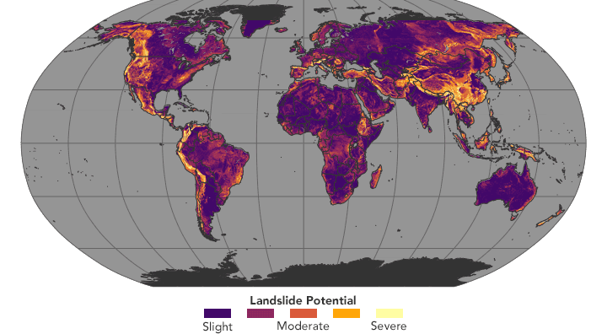

Slide 20
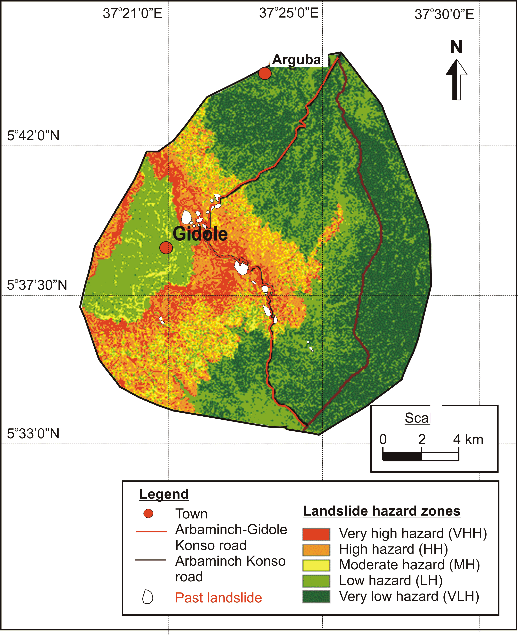

Slide 21
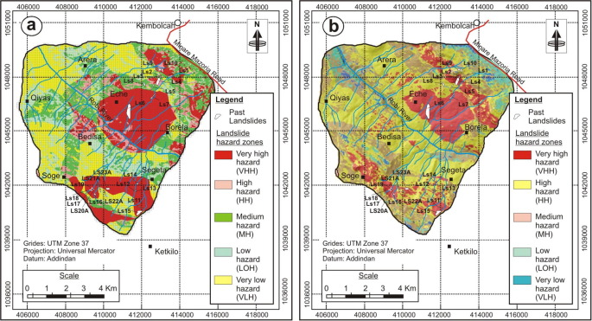

Slide 22
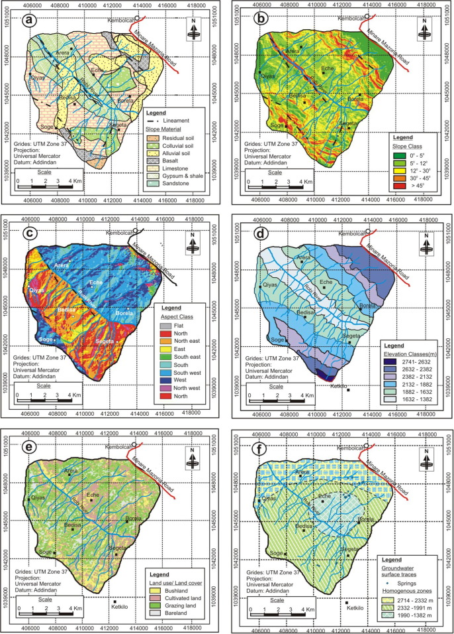

Slide 23
Management Techniques
Range of techniques, designed to stabilise slopes in the long term
These are designed to reduce the instability factors, and include:
  Measures designed to reduce the gradient of the slope, and redistribute loading
  Measures designed to reduce the gradient through terracing or walls
  Measures designed to reduce the water volume in the slope
  Measures designed to increase afforestation and stability

Slide 24
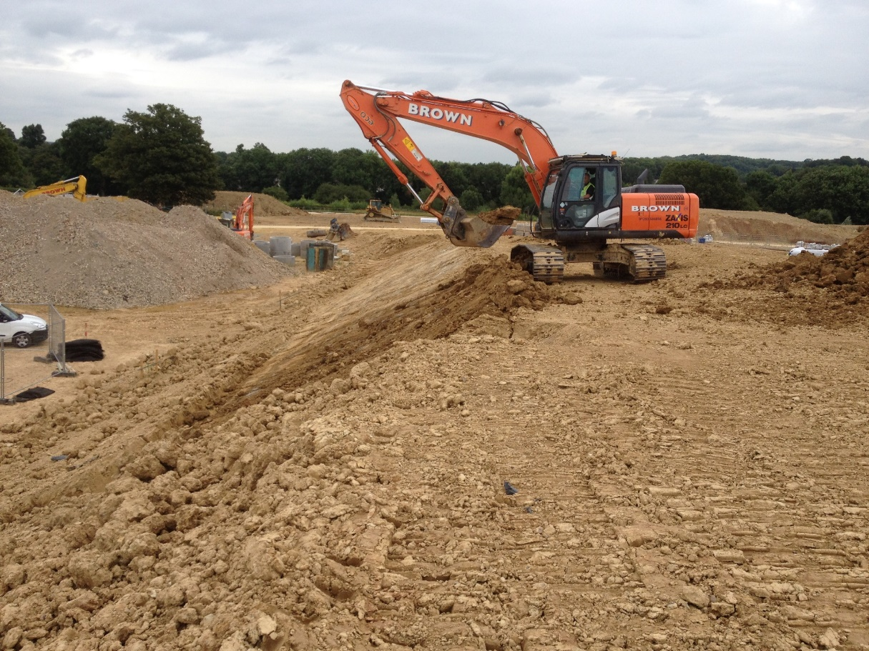
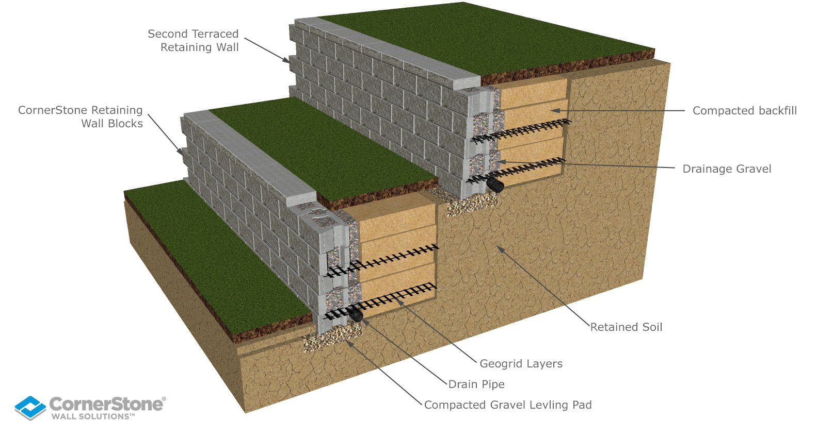
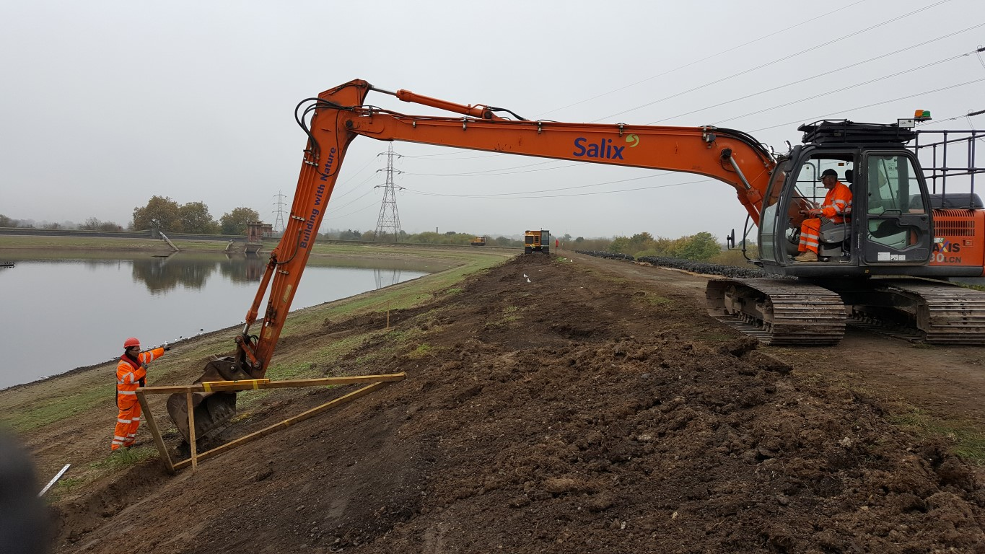
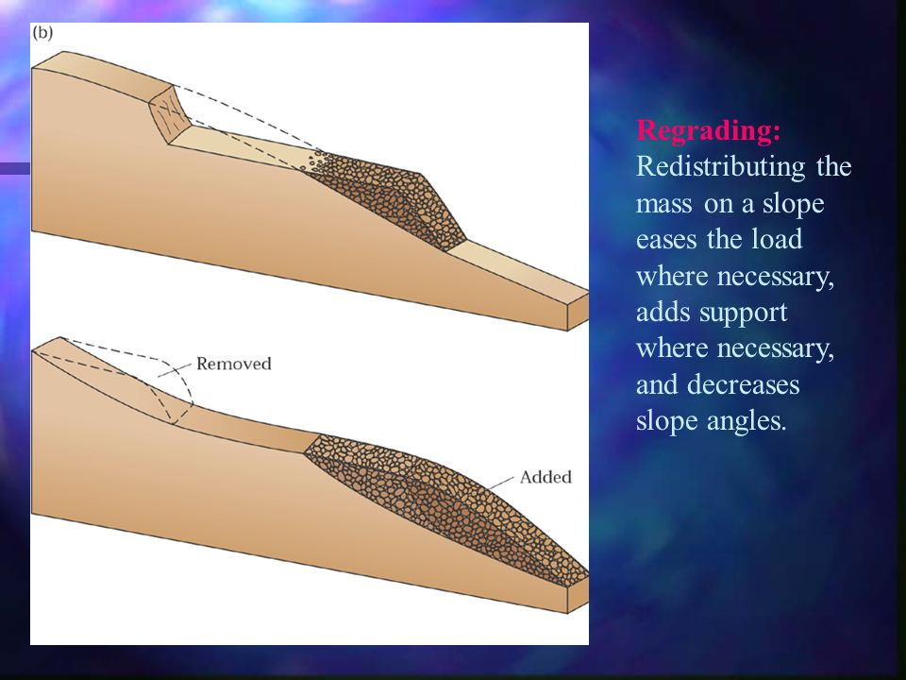

Slide 25
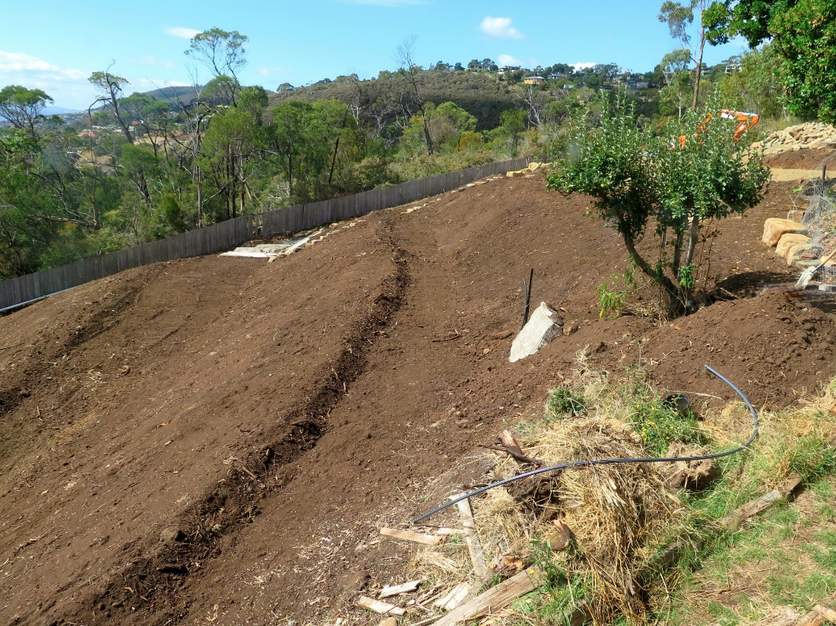
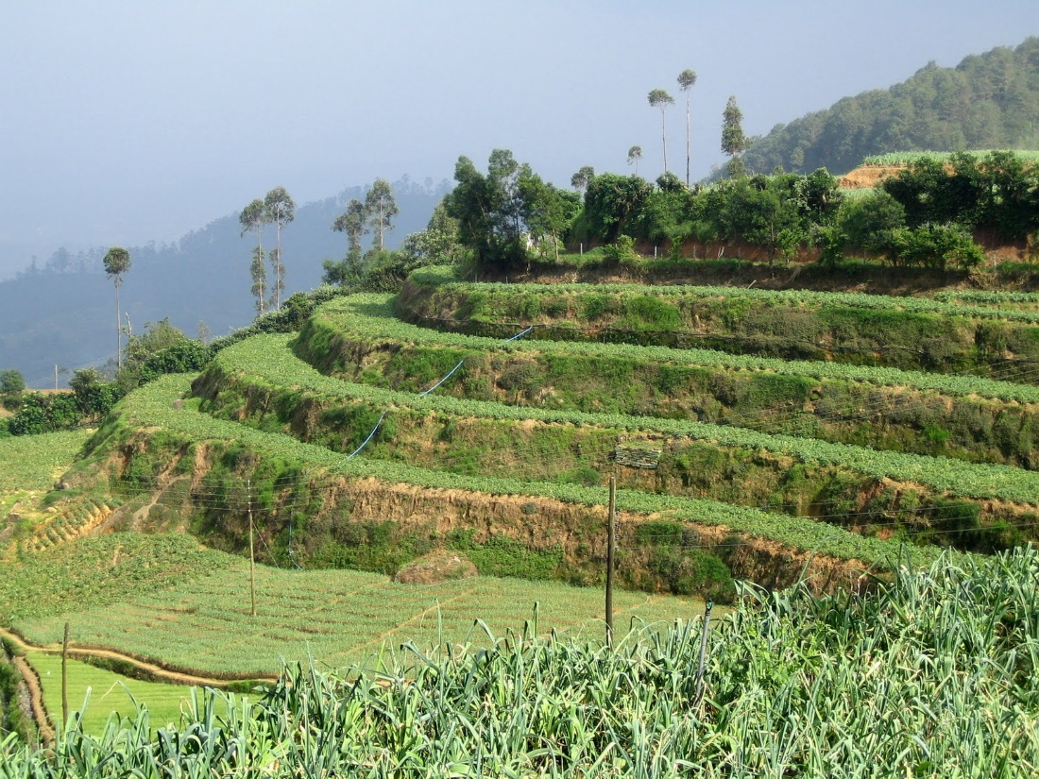
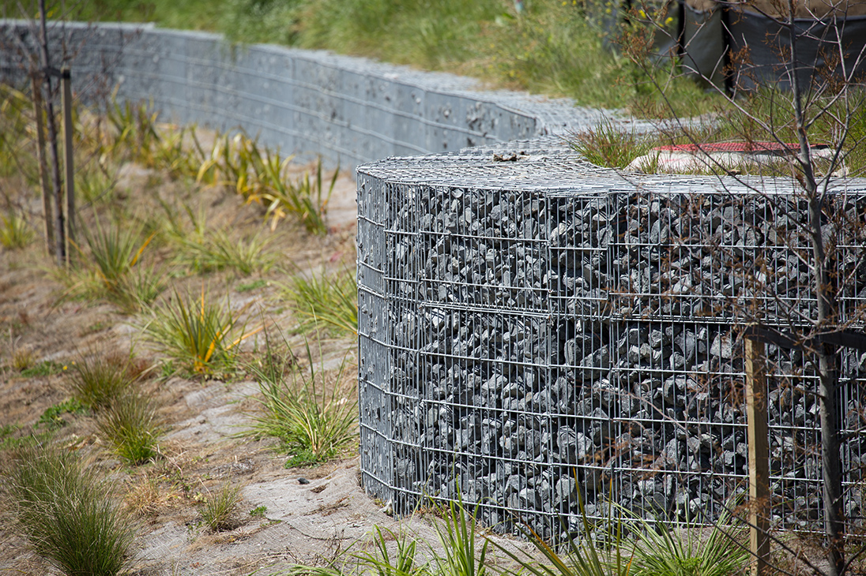
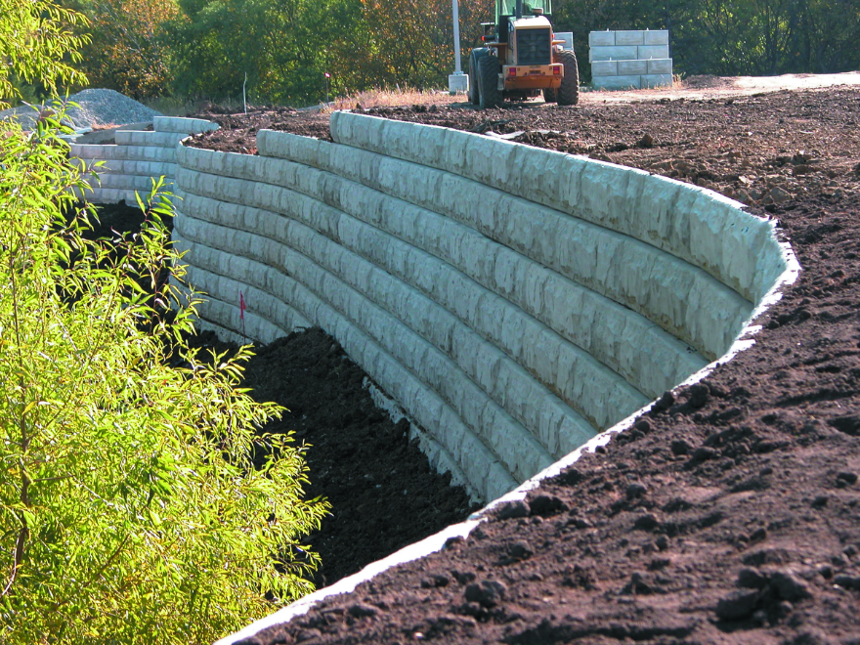

Slide 26
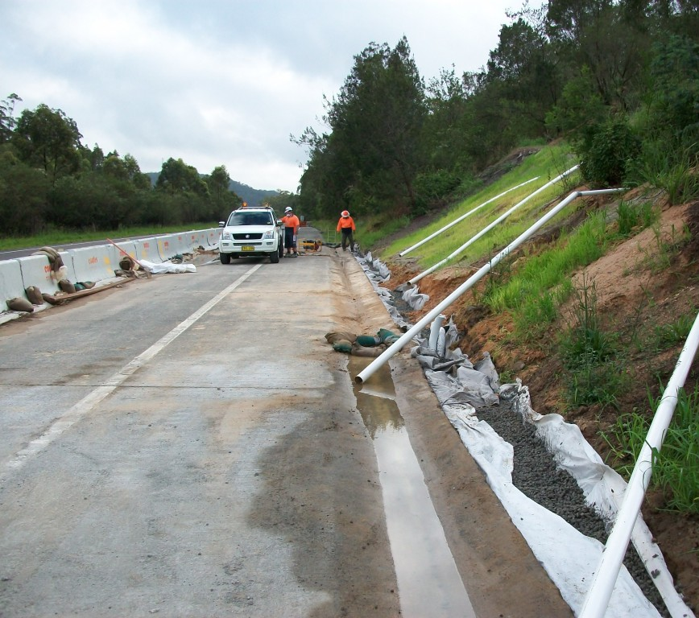
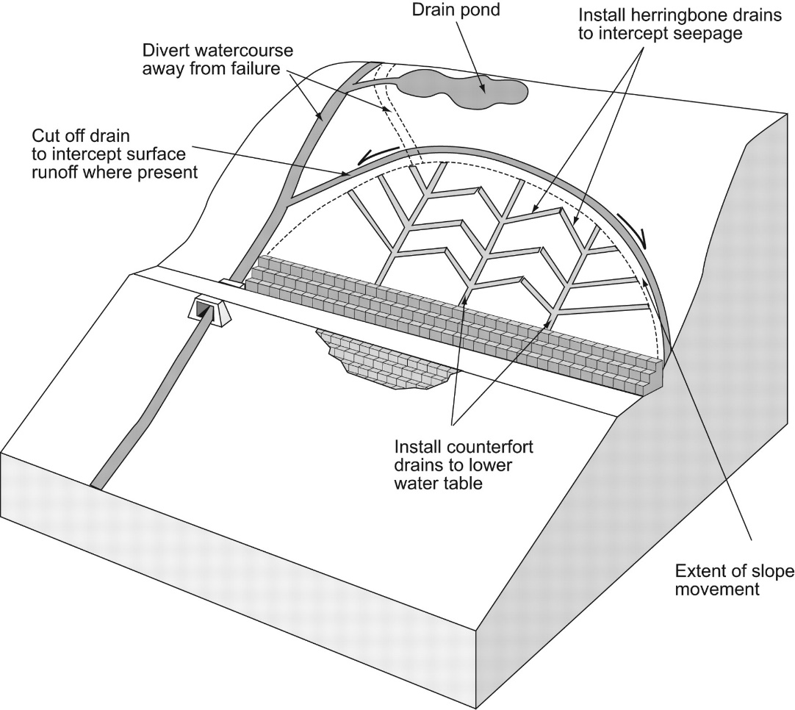
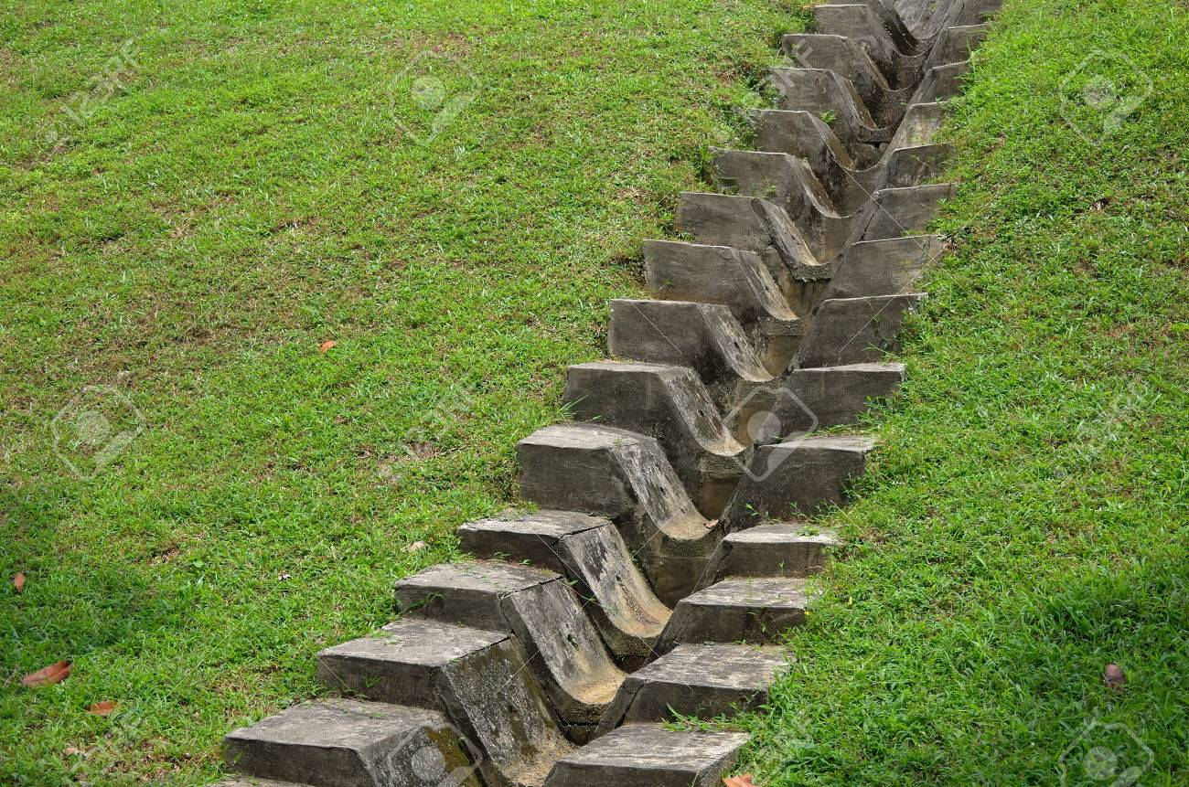
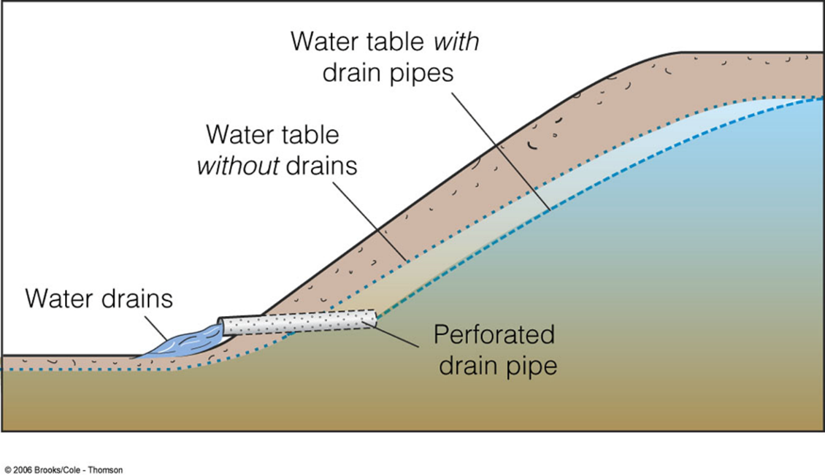

Slide 27
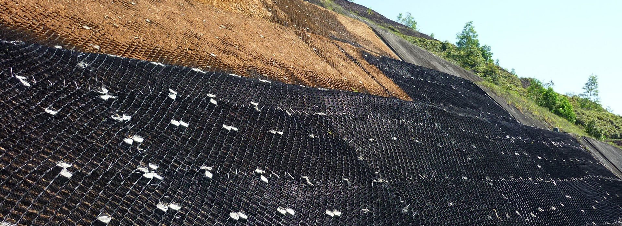
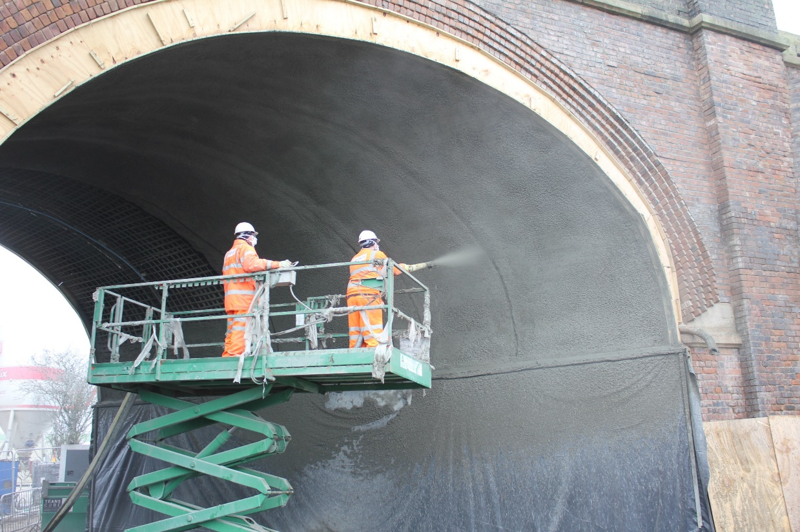
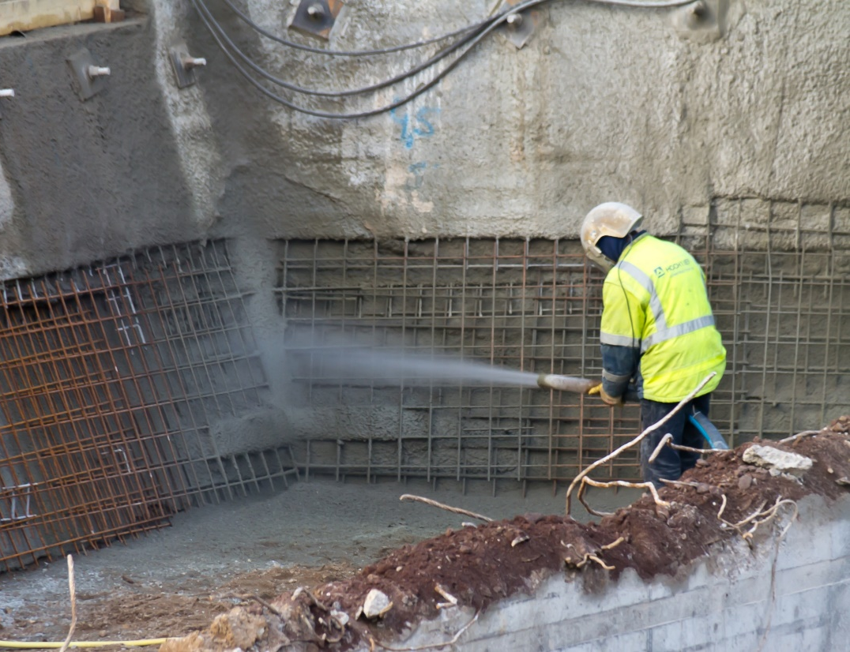
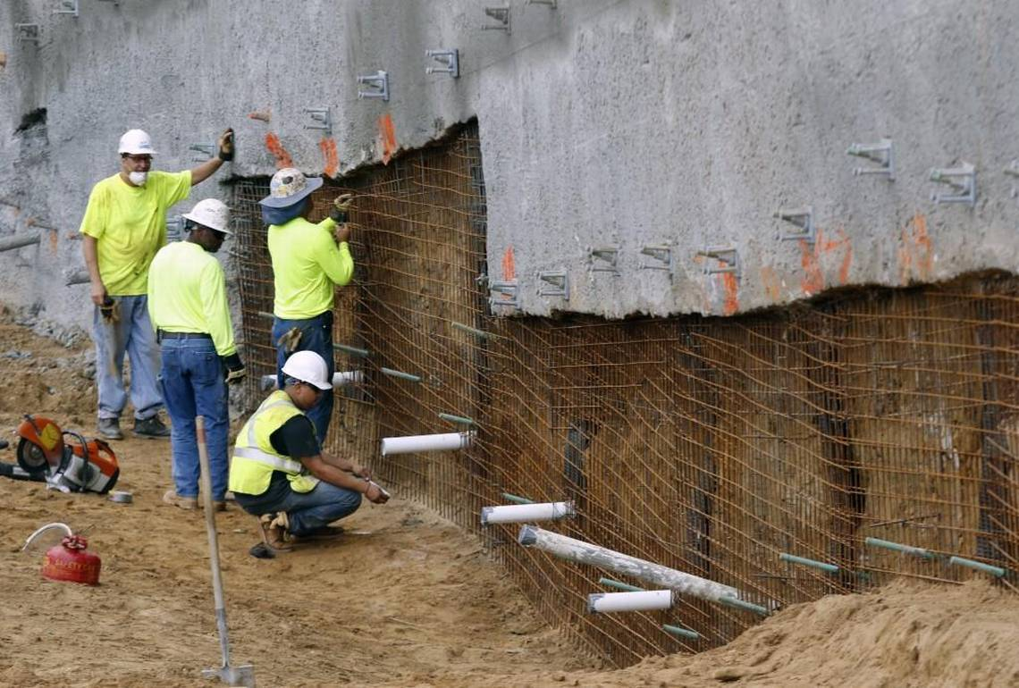

Slide 28
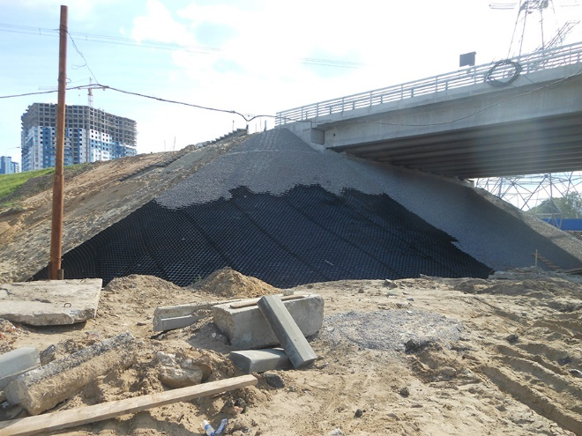
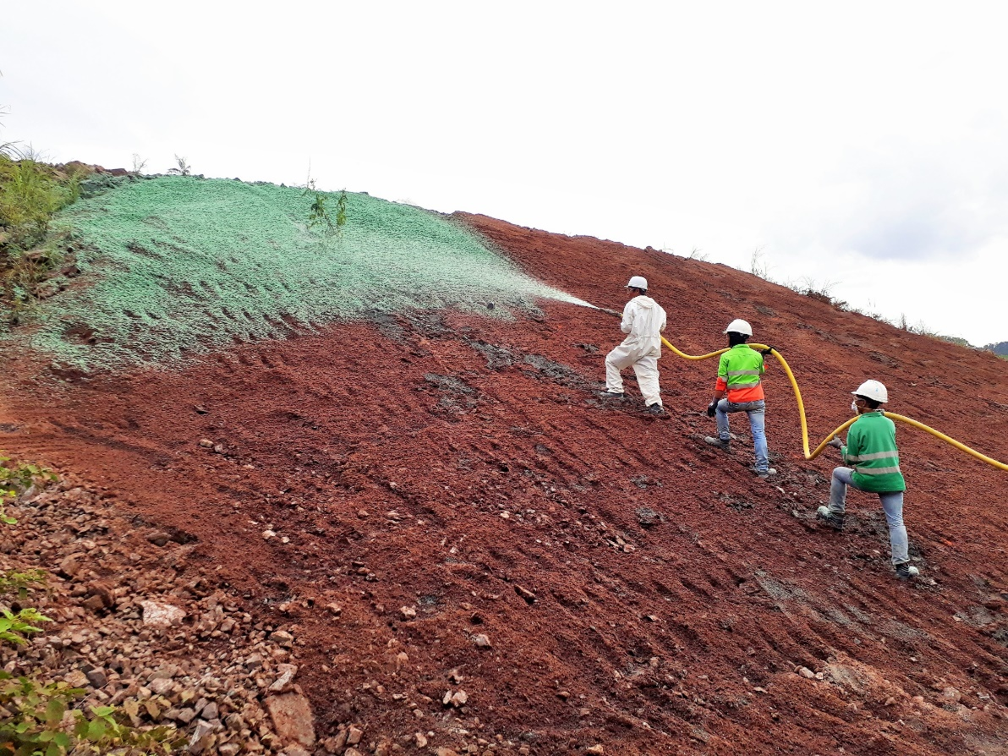

Slide 29
Factors to consider
What kind of slope failure are we talking about? Fast/slow? Wet/dry? Different extent of management challenge
What kind of ‘hazard’ is this? Landslides in some places will affect major cities (e.g. in rapid urbanisation, e.g. in Haiti), but in other places are mainly rural. To what extent are people affected?
What level of development is required for the management and fairly high-tech monitoring, mapping techniques? Why?

Slide 30
Management of Hazard
Prediction:
  Hazard mapping to identify vulnerable slopes
  Prediction of rainfall as one of the major instability events
  Monitoring & warning techniques
Preparation:
  Hazard mapping to generate areas at risk (for further action, e.g. legislation and building restriction)
  Management of the slope through engineering techniques, to reduce the instability factors
    Examples, effectiveness, evaluation
What does it depend on?
  Type of slope problem (wet/dry, fast/slow)
  Type of instability (trigger, longer term)
  Levels of development (and associated issues, e.g. rapid urbanisation, wider problems)

