Slide 1
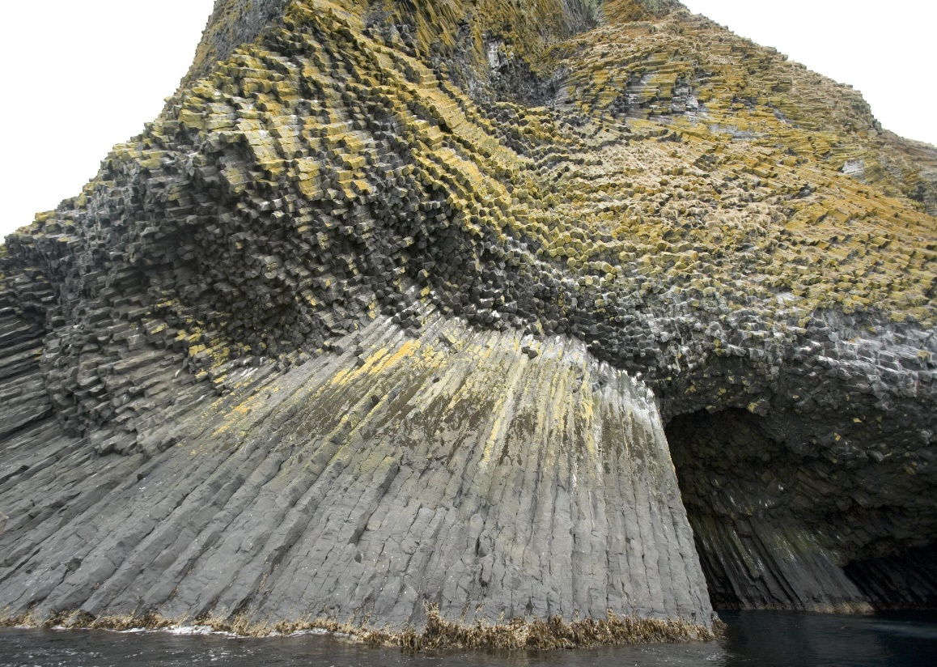
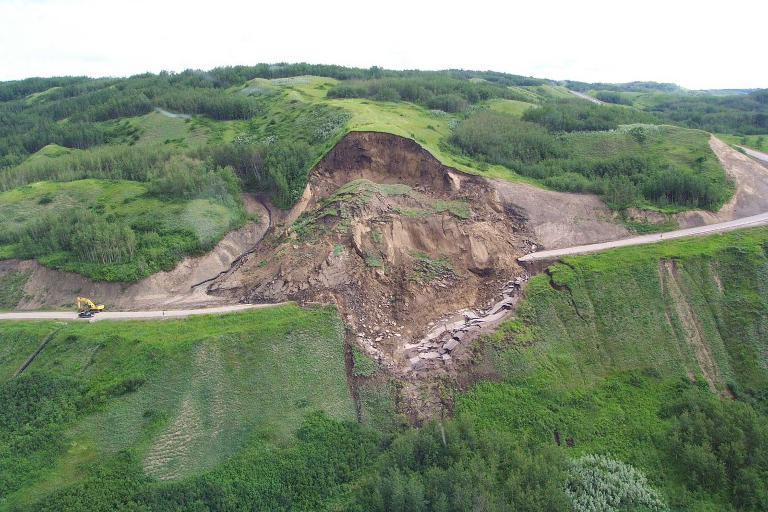
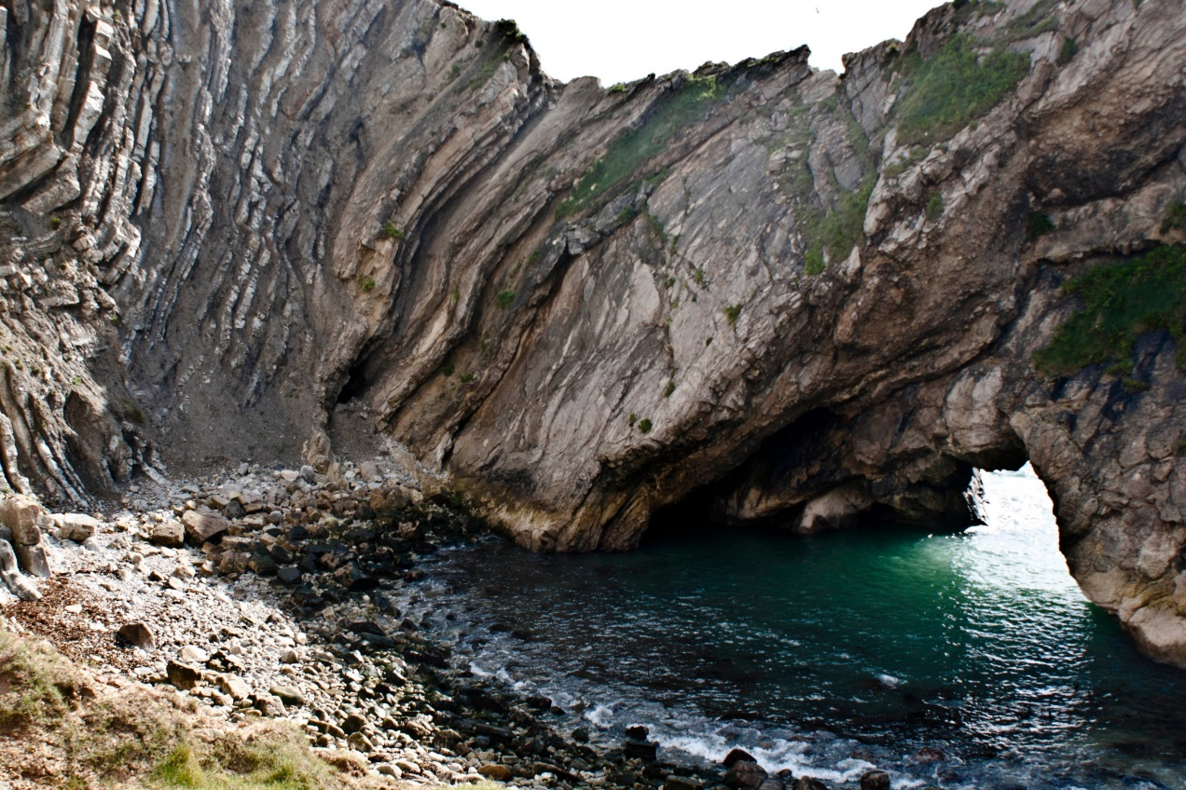
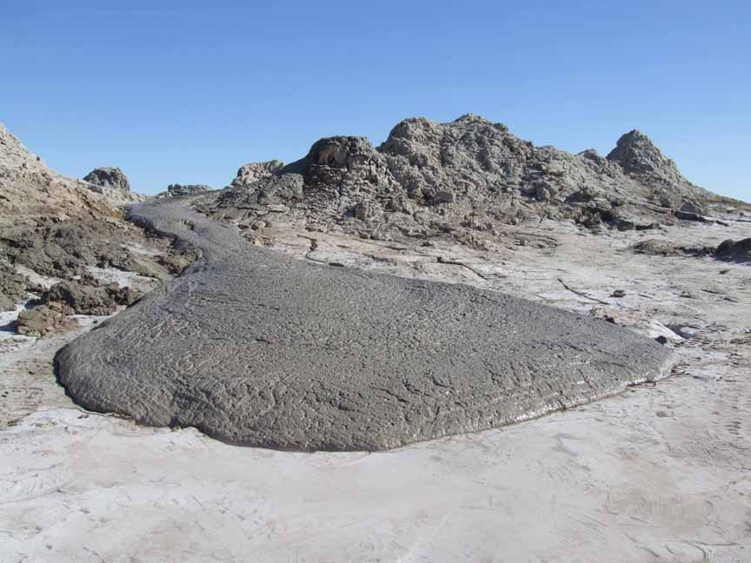
Core Physical Unit 3
Rocks & Weathering

Slide 2
Syllabus Content
3.1. Plate tectonics
3.2. Weathering
3.3. Slope processes
3.4. The human impact

Slide 3
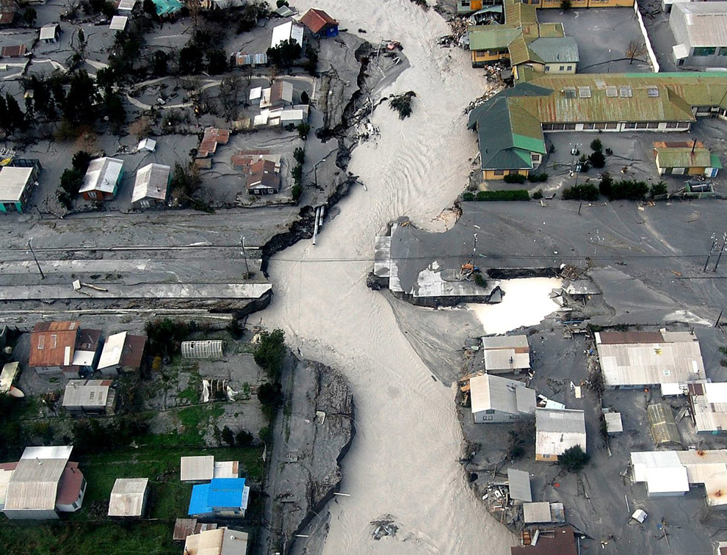
3.1. Plate Tectonics

Slide 4
Unit 3.1. Plate Tectonics
Nature of tectonic plates and their global patterns.
Types of plate boundaries: divergent (constructive), conservative and convergent (destructive).
Processes and associated landforms: sea floor spreading, subduction, fold mountain building, ocean ridges, ocean trenches, and volcanic island arcs.

Slide 5
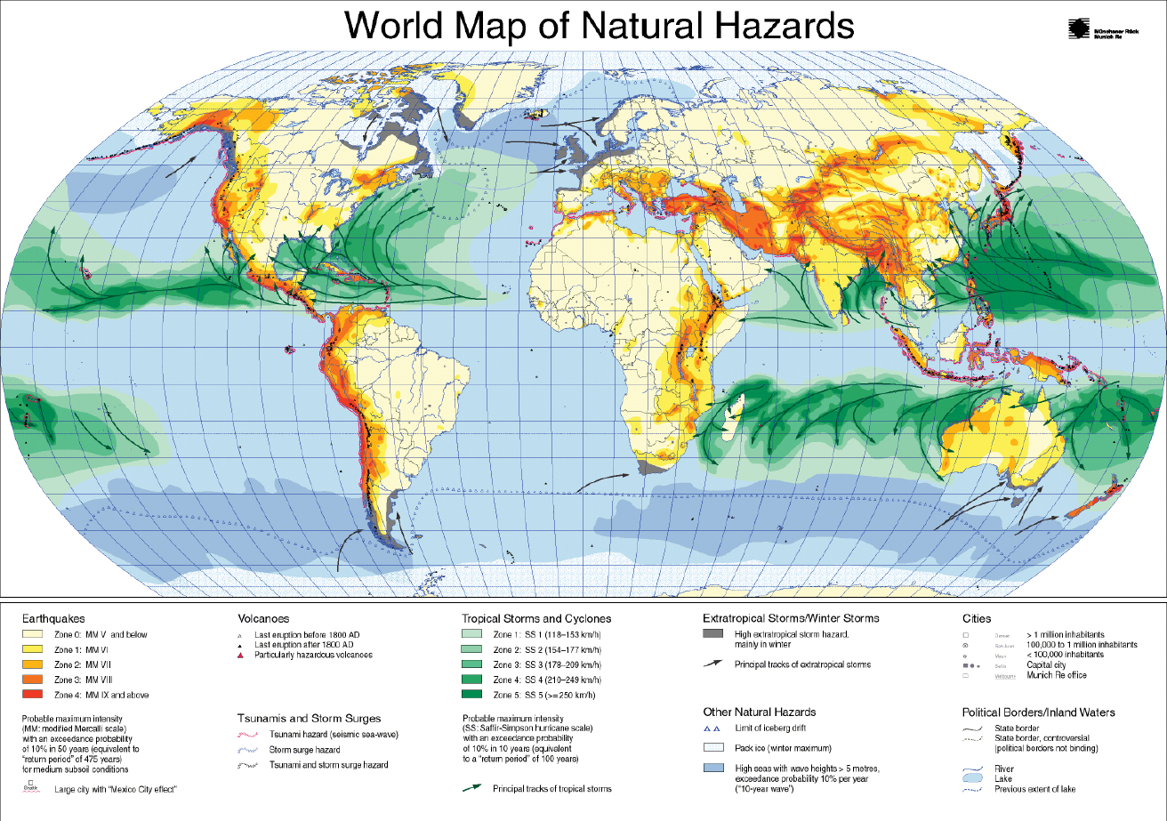
Annotate & describe patterns
Where are most hazards? Why?

Slide 6
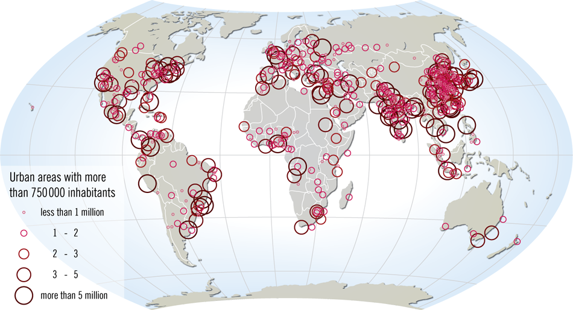
Distribution of the World’s Largest Cities

Slide 7

What is the structure of the earth?

Slide 8
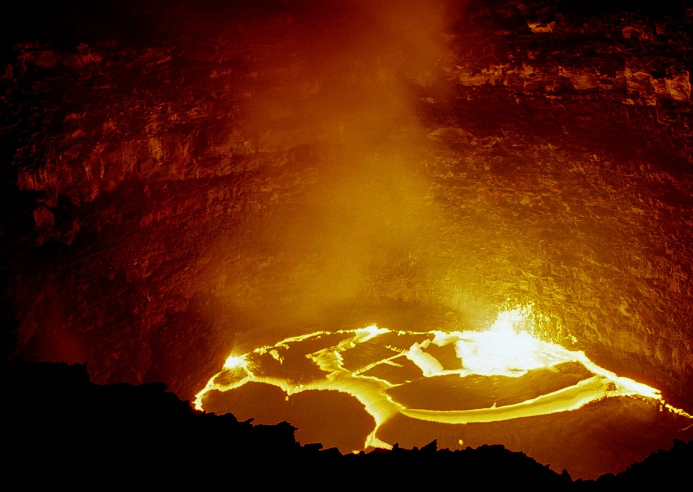
How do we know the Earth’s Structure?

Slide 9
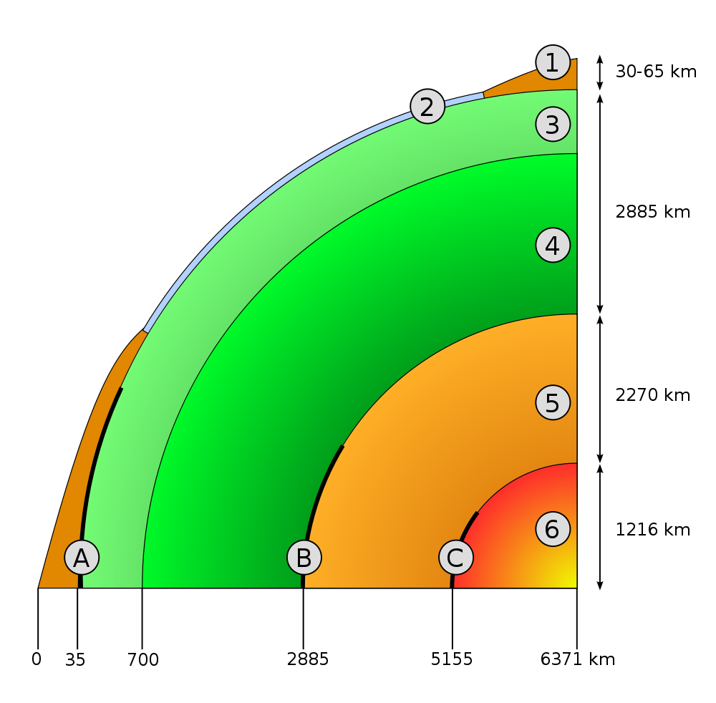
STRUCTURE OF THE EARTH
Key :
Continental crust
Oceanic crust
upper mantle
lower mantle
outer core
inner core
Mohorovičić discontinuity
Core–mantle boundary (Gutenberg discontinuity)
The outer-core–inner-core liquid–solid transition once called the Lehmann discontinuity

Slide 10
How could we find out the content of the Earth?
Aim: To create a diagram showing the detail of the Earth’s layers, which also explains how we know this.
Start by what we see…
Or can get to: deep mines.
What can they tell us?

Slide 11
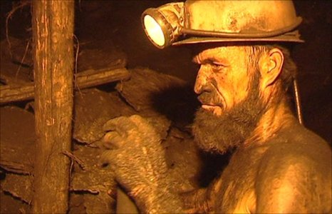

Slide 12
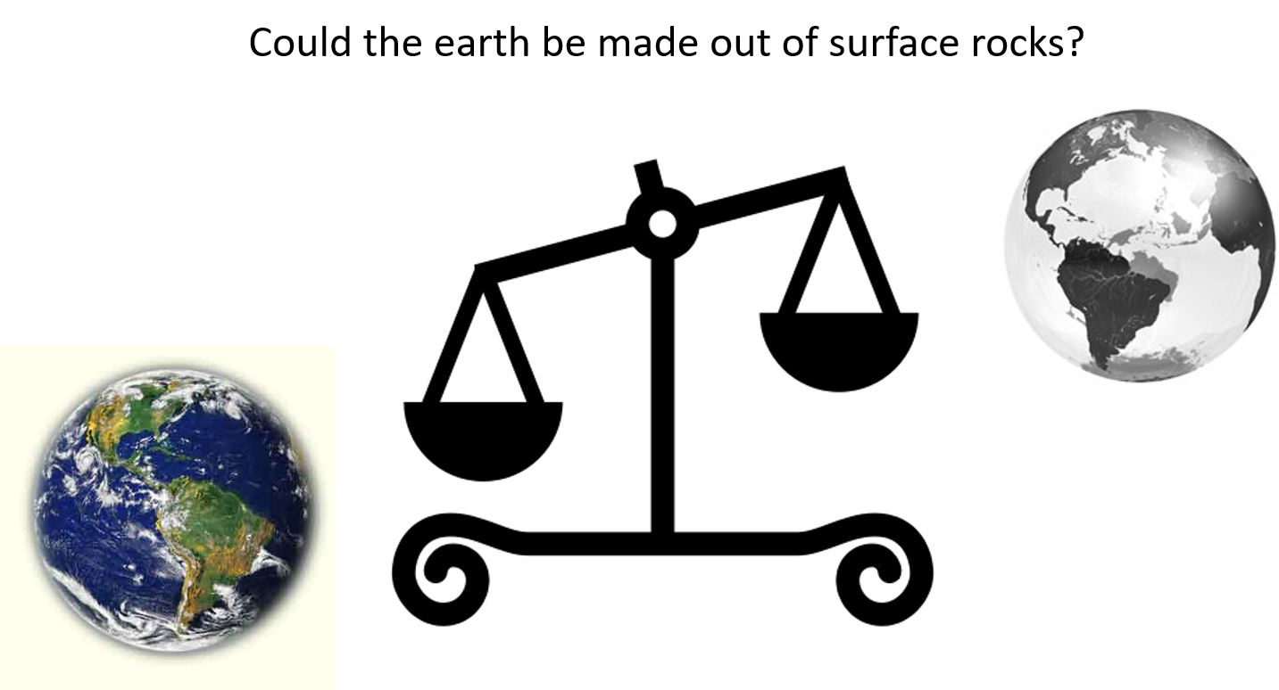

Slide 13
Could earthquakes help?
Transmission of waves
P wave (demo)
S wave (demo)
Implications?

Slide 14
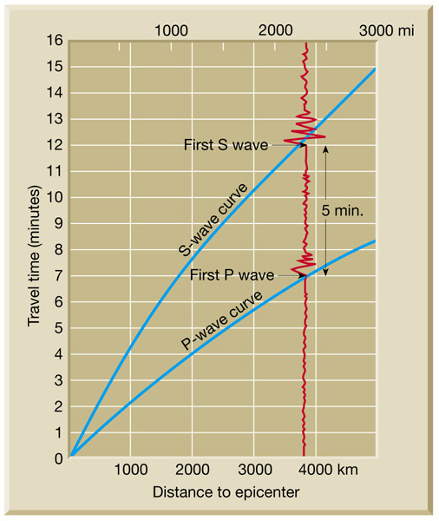

Slide 15
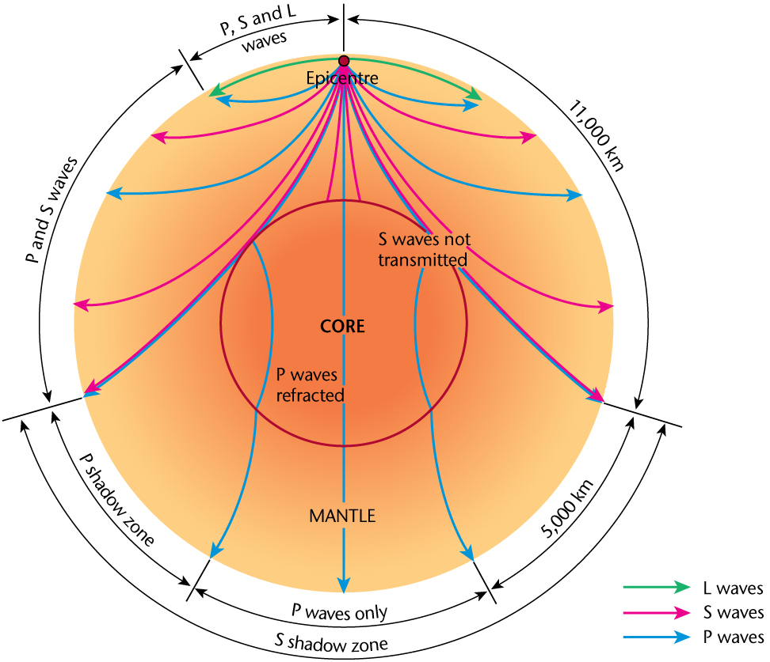
Charles Oldham realised that earthquake (sound) waves could travel through Earth.
Different waves had different properties.
“Shadow” of P wave showed the core existed
No S waves showed that it was liquid.

Slide 16
What does this tell us?
Solid and liquid – but not what it’s made of.
Solution… volcanoes

Slide 17
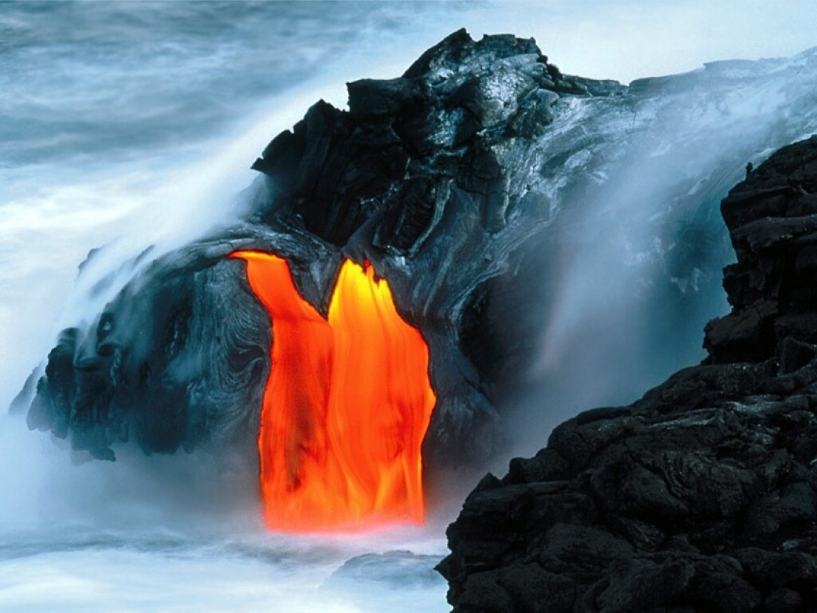

Slide 18
Peridotite
Dense, coarse-grained igneous rock, contains less than 45% silica.
Found in certain basalts and diamond pipes; sometimes brought up by volcanoes
Brought up from depths from about 30 km or so to depths at least as great as about 200 km
Peridotite is the dominant rock of the upper part of the Earth's mantle.

Slide 19
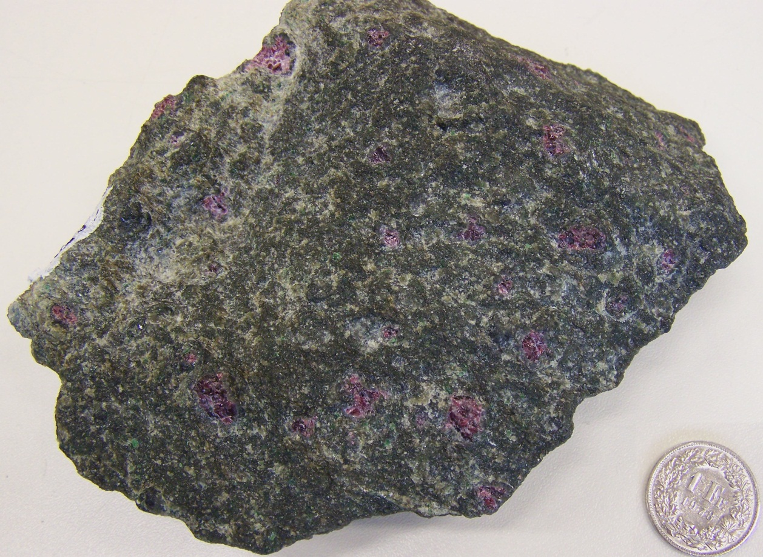

Slide 20
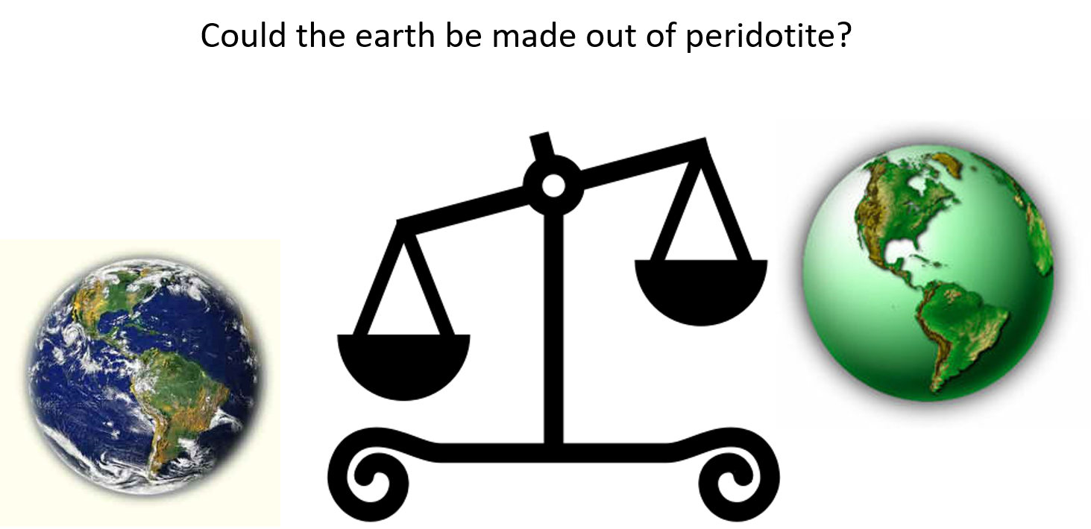

Slide 21
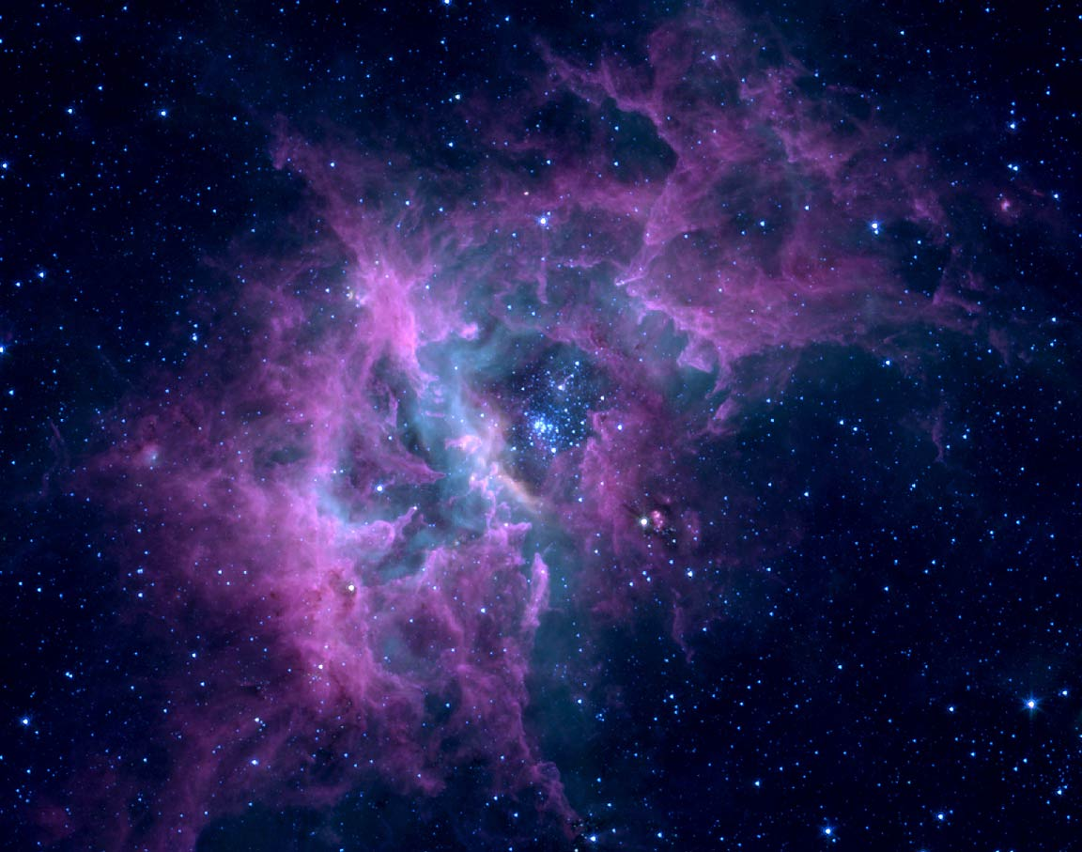

Slide 22
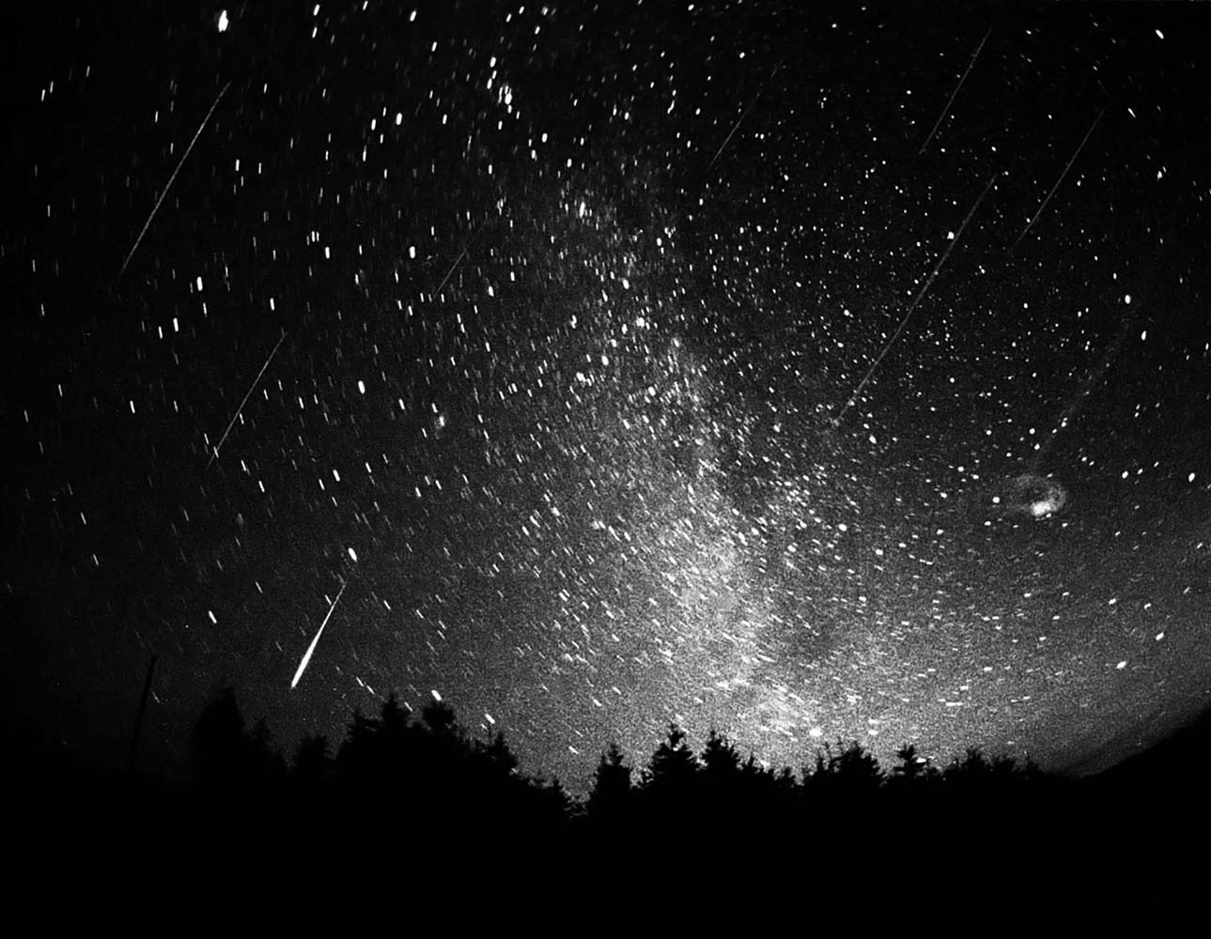

Slide 23
The Evidence of the Stars…
Meteorites can be analysed – and contain very different material to that which is found in surface rocks.
Lots of iron.
If surface was covered, it’d be 300km thick.
Could it be an iron core?

Slide 24
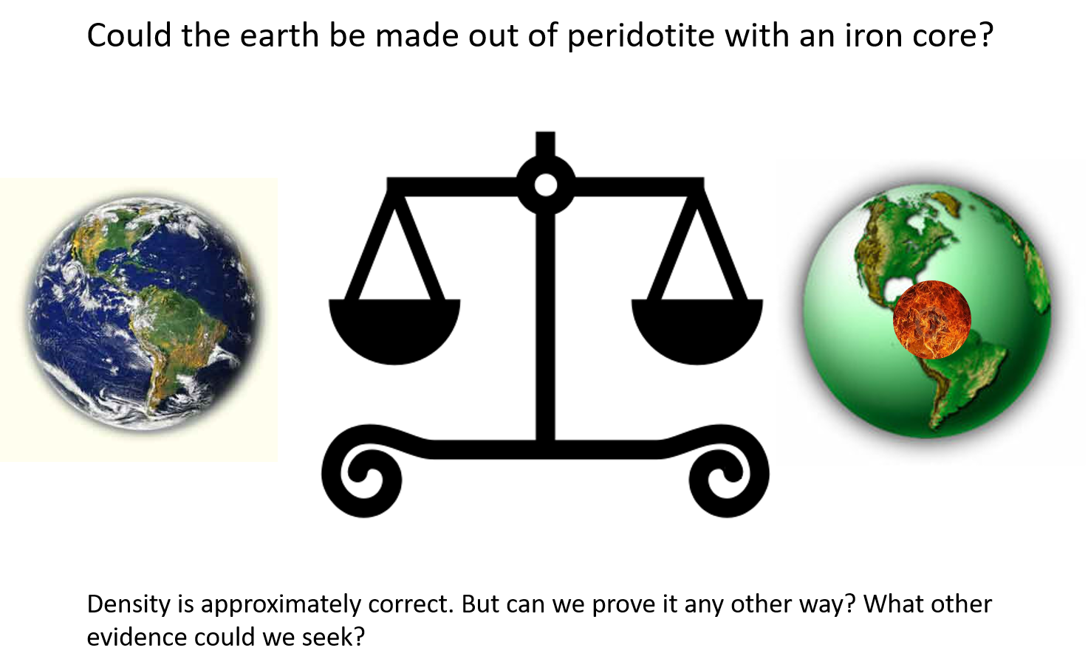

Slide 25
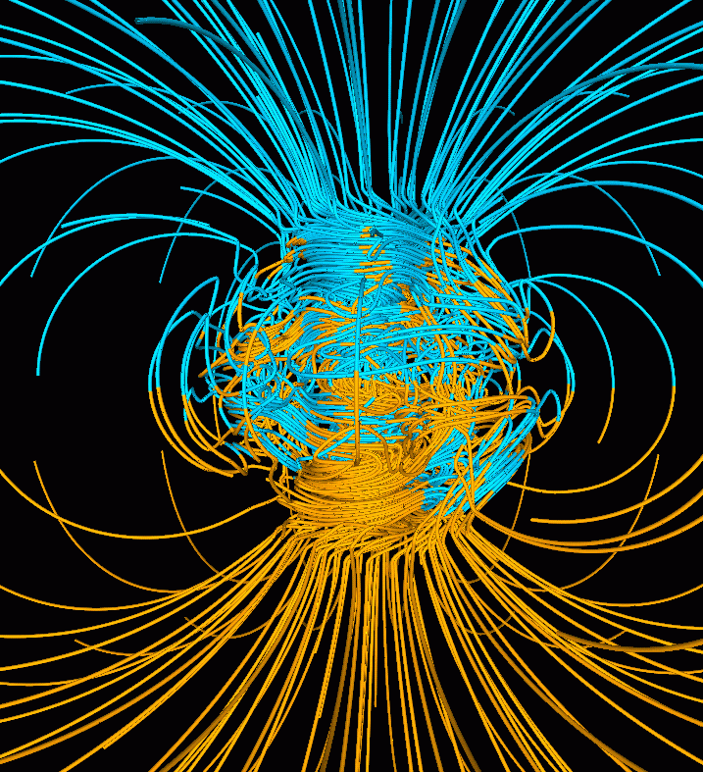

Slide 26
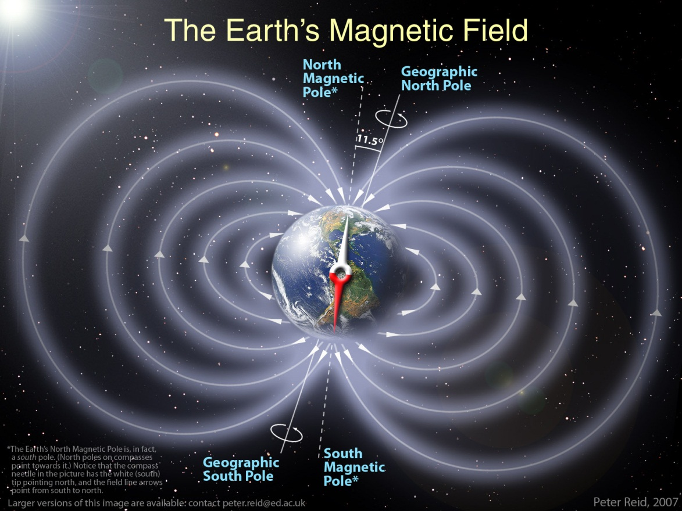

Slide 27
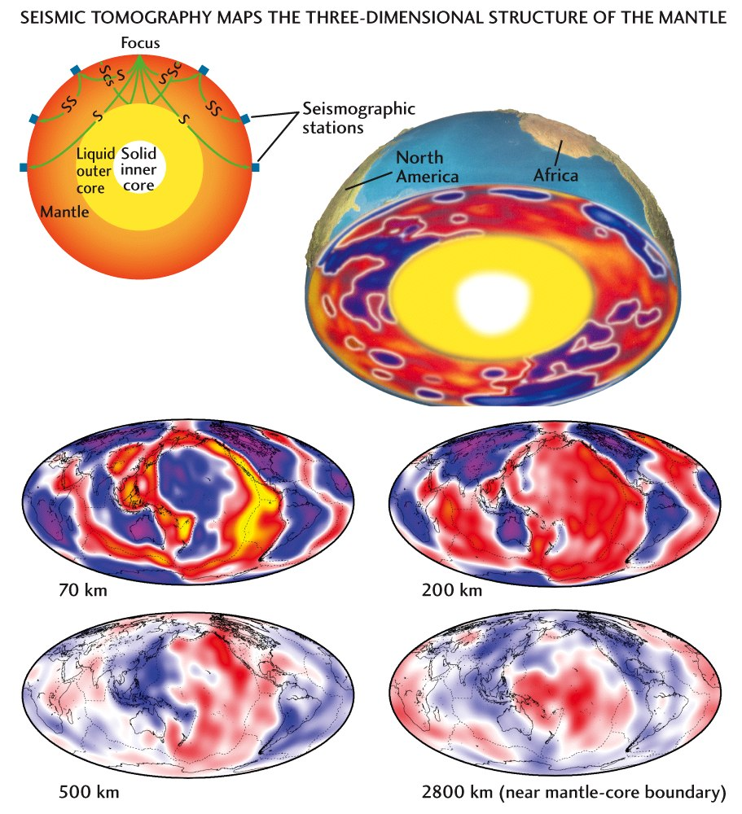

Slide 28
What have we learned?
Structure of the Earth:
  Thin crust which is surface rock
  Solid mantle made of peridotite (green rock)
  Liquid outer core made of iron and
  Solid inner core made of iron
Evidence from:
  Earthquakes
  Volcanoes
  Asteroids and meteorites
  Magnets

Slide 29
STRUCTURE OF THE EARTH
Key :
Continental crust
Oceanic crust
upper mantle
lower mantle
outer core
inner core
Mohorovičić discontinuity
Core–mantle boundary (Gutenberg discontinuity)
The outer-core–inner-core liquid–solid transition once called the Lehmann discontinuity

Slide 30
Characteristics of the Crust

Slide 31
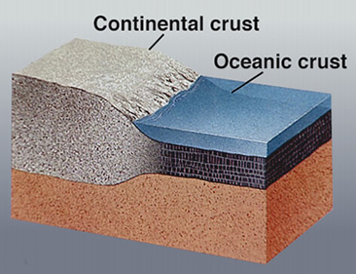
Properties of the Crust
Continental Crust (SIAL)
Oceanic Crust (SIMA)
Silicon-Aluminium
‘Felsic’ or feldspar. Granites.
“Sticky” lava – does not flow far
Thick (10-70km) – has very deep “roots”
Mostly old rock (up to 4.2 Bn yrs)
Density – 2.7g/cm ³
Silicon-Magnesium, some iron
Basaltic lava: flows and runs easily (low viscosity)
Thin (~7-10 km)
Mostly young (up to 250 m yrs)
Density – 3.3 g/cm³

Slide 32
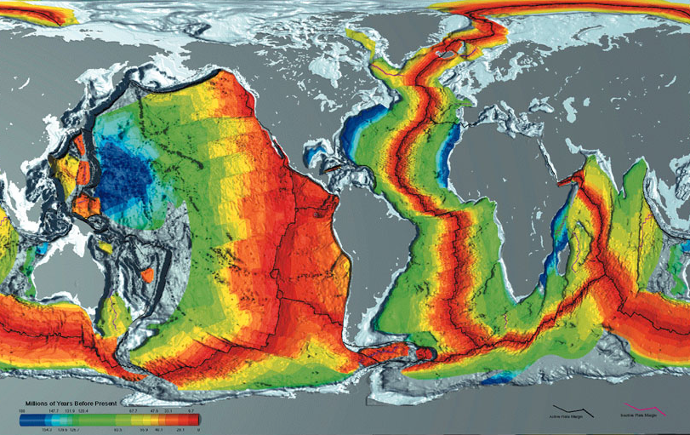

Slide 33
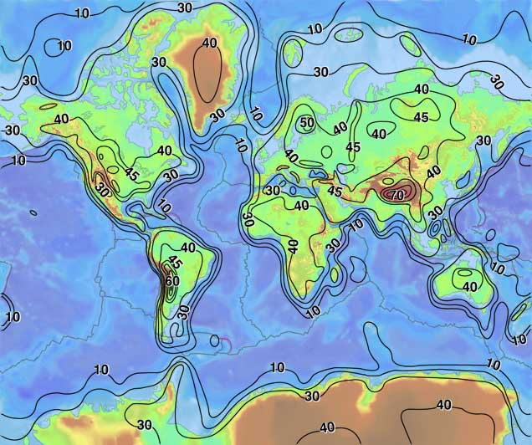

Slide 34
The Theory of Plate Tectonics

Slide 35
Context: Development of Theory
Concept of Continental Drift Theory proposed in 1912, by Alfred Wegener, but does not catch on – no mechanism
Some evidence (US Navy, mapping, earthquakes) only released in 1960s
Not until Vine-Morley-Matthews (1963) do we figure out some evidence for how it might work
This means it’s a very young theory – lots of work still being done, and changes are common. We don’t “know the answers” yet

Slide 36
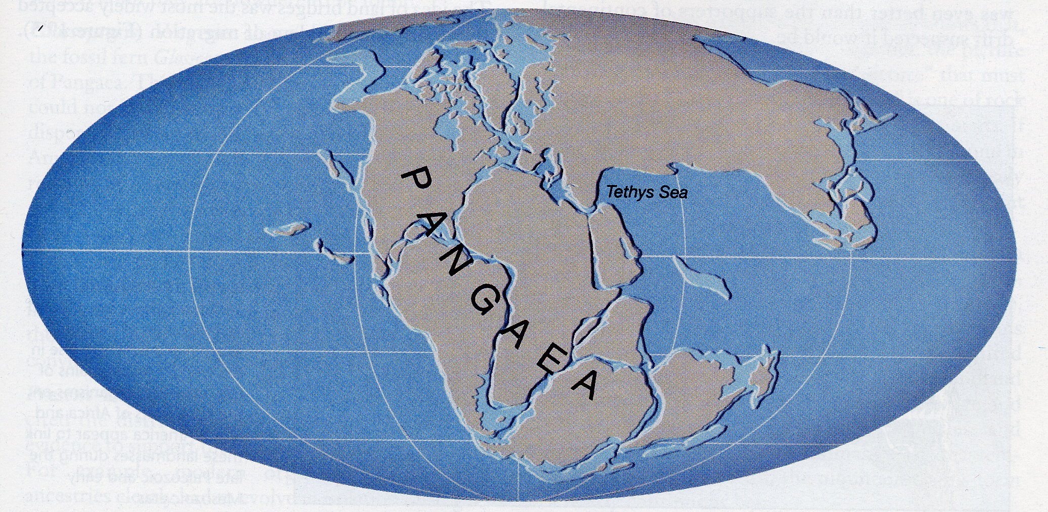
Continental Drift
Theory formulated by Alfred Wegener in 1912
Theory involved the break-up of a giant supercontinent – Pangaea

Slide 37
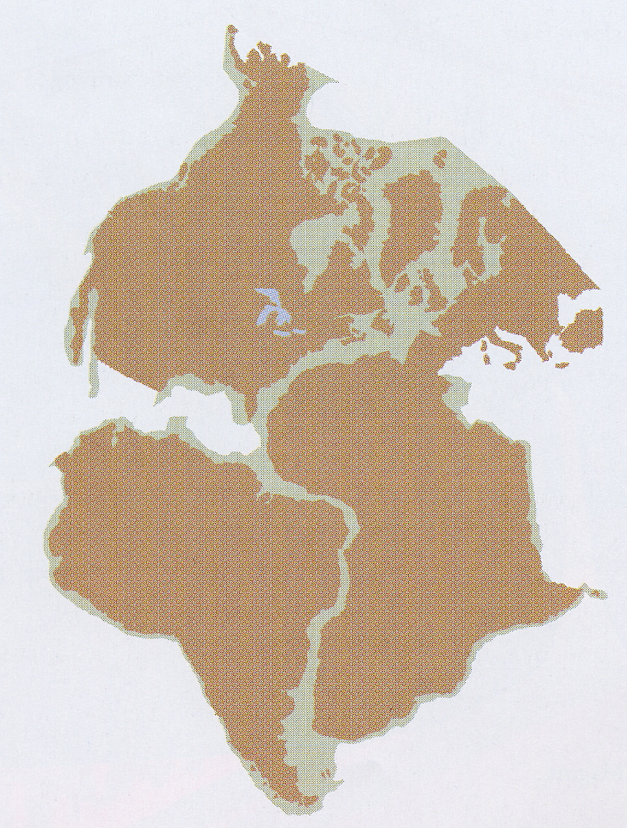
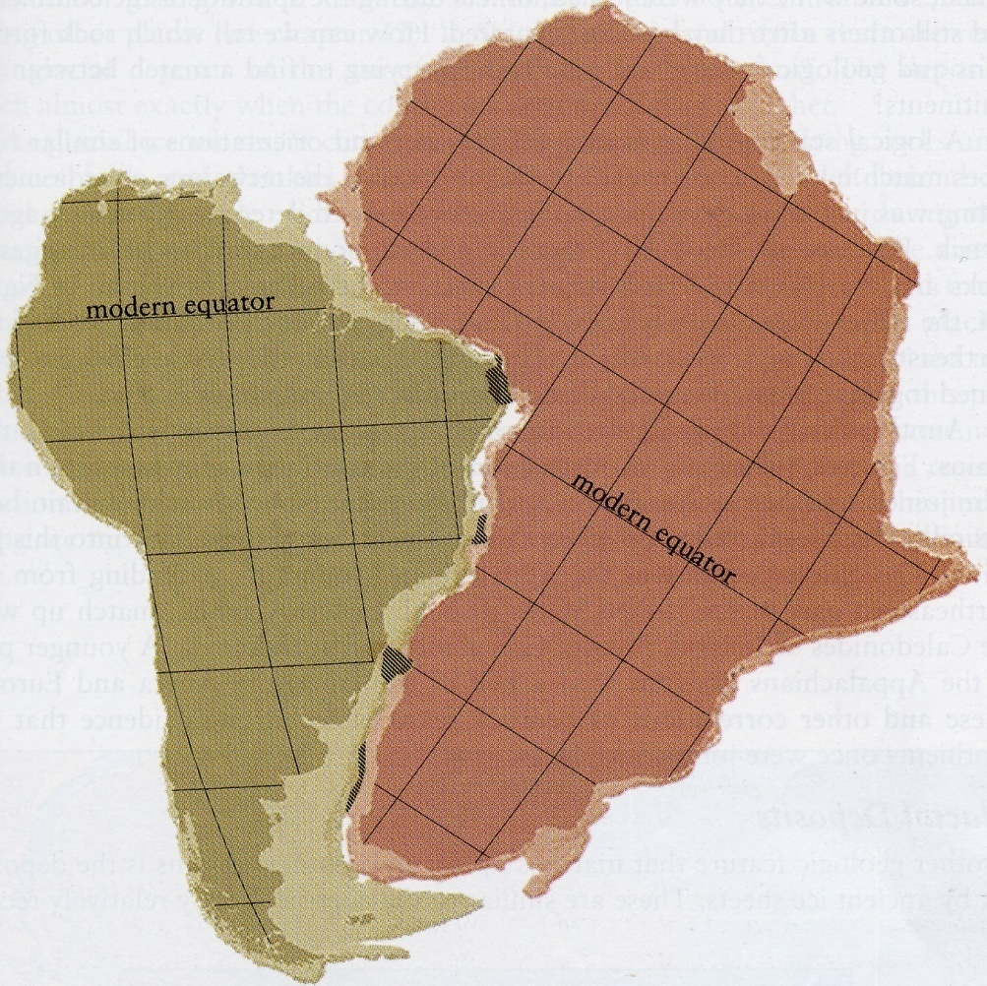
Shape of Continents
Notes:
Coastal outlines are simply determined by sea level
Edge of continental shelf marks edge of continental crust

Slide 38
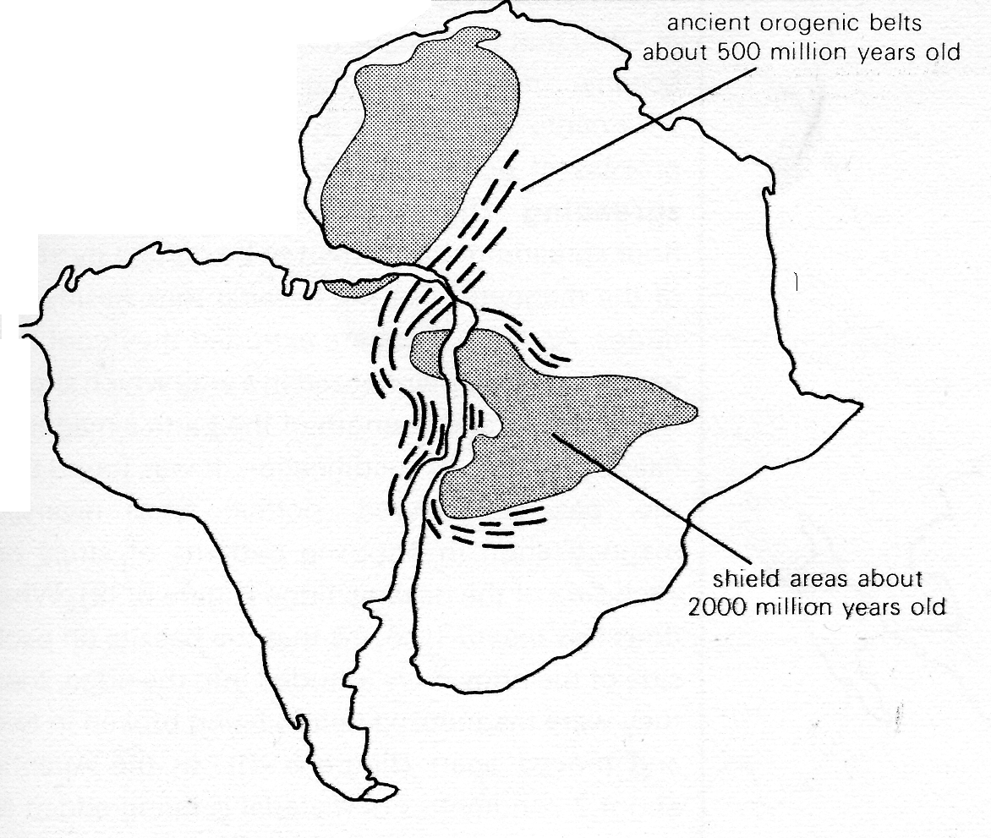
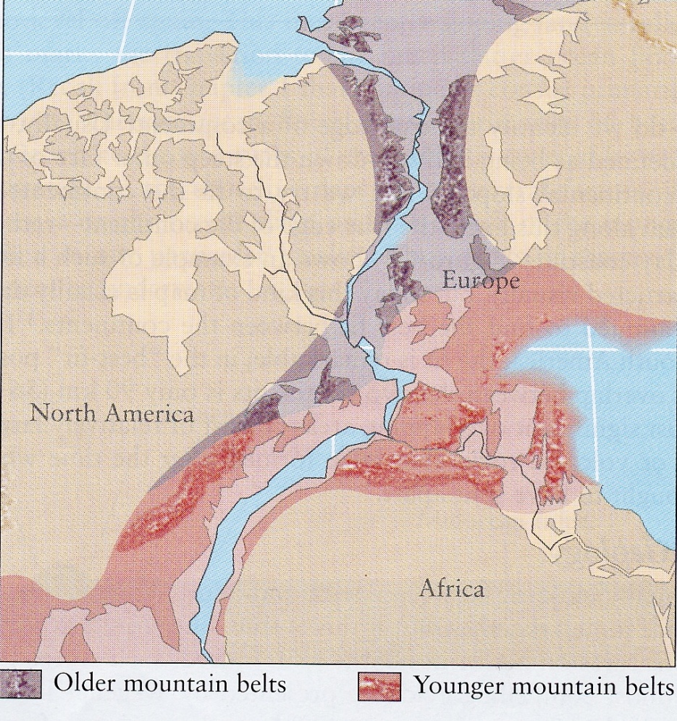
Geological similarities
Notes:
Ancient shield areas and fold mountain ranges of Africa and South America match (left)
In Northern continents (Laurasia) there are remnants of a mountain chain which extends from Greenland and Scandinavia through northern Britain (Scottish Highlands) into eastern North Canada and USA (Appalachians) and north Africa

Slide 39
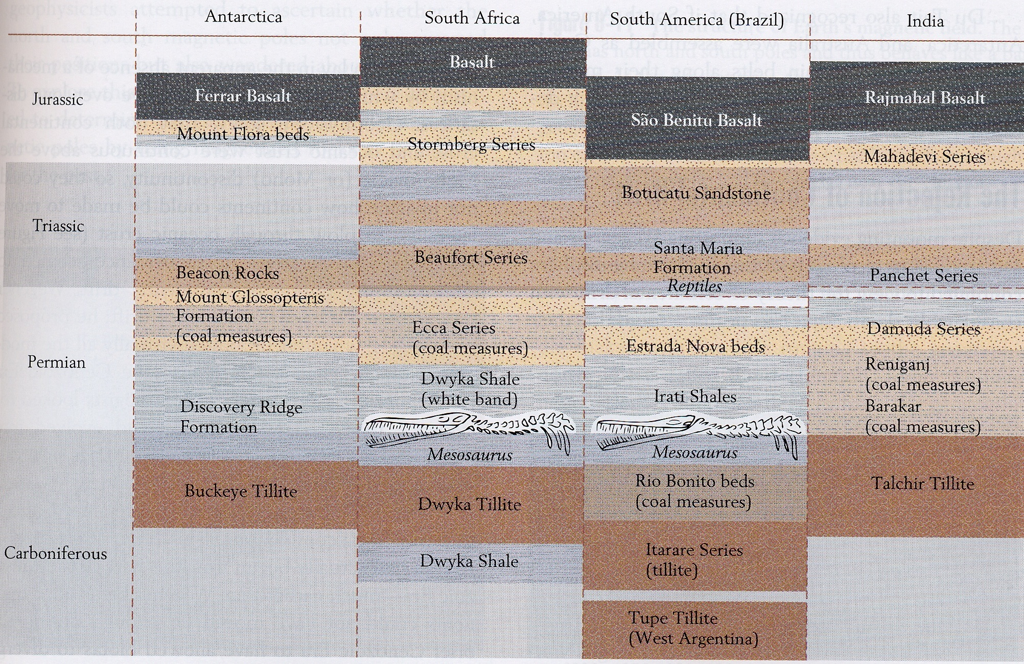
Geological Similarities

Slide 40
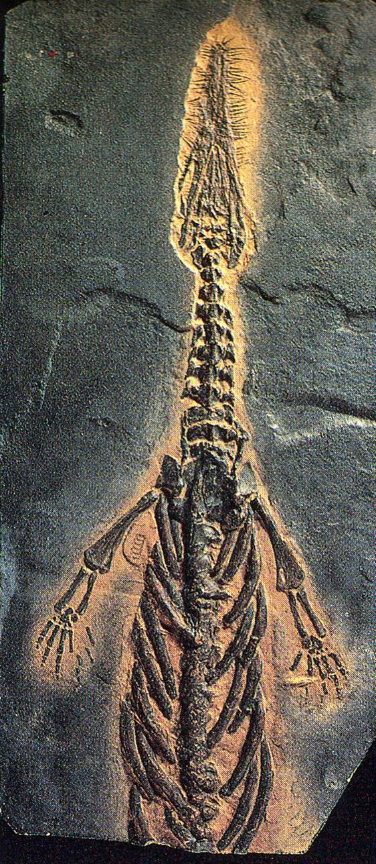
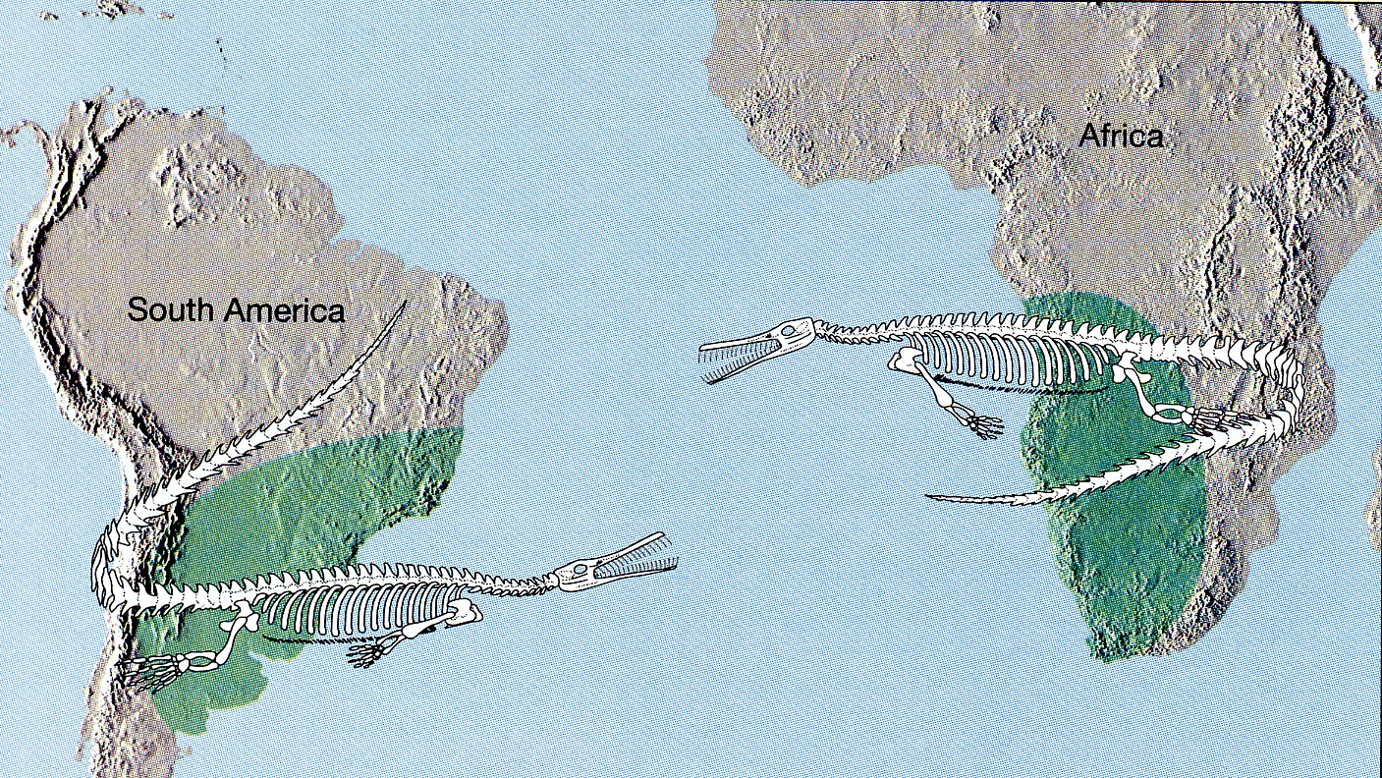
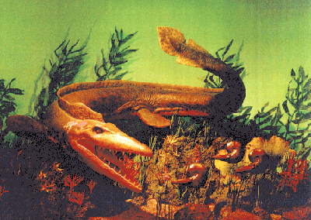
Pattern of Evolution
Notes:
Mesosaurus is a freshwater reptile which could not cross oceans
Fossils only found in Africa and South America – continents must have been joined

Slide 41
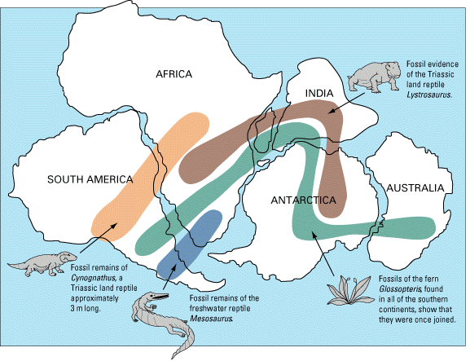

Slide 42
What components do we use to build theory?
Evidence of continental drift and significant change
Understanding of structure of the Earth
Understanding of mantle behaviour, and semi-plastic flows of aesthenosphere

Slide 43
Video Clips to Help:
Clip: What are Plates
Properties Demonstration: Mantle Flow
Clip: How do continents move?
Extension:
PofP: Volcanoes Ep - full episode for enrichment
Geol Soc

Slide 44
Activity: Annotation
Use the information and notes to annotate the diagrams to understand and remind yourself of the key points of the theory
Some annotations are place-specific, and need to be put where they are taking place
Others do not have a specific location, and just contribute to the overall understanding of the theory

Slide 45
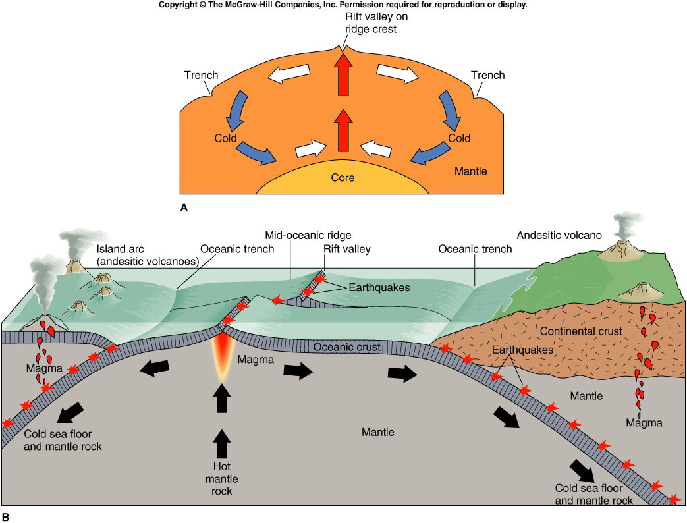
Review of Plate Tectonic Theory
Structure of the Earth
Constructive Boundaries
Destructive Boundaries
Hotspots
Conservative margins
Relationship between boundaries and lava type

