Slide 1
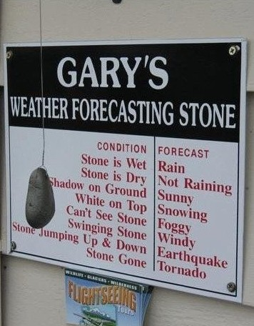
Unit 2. Atmosphere and Weather

Slide 2
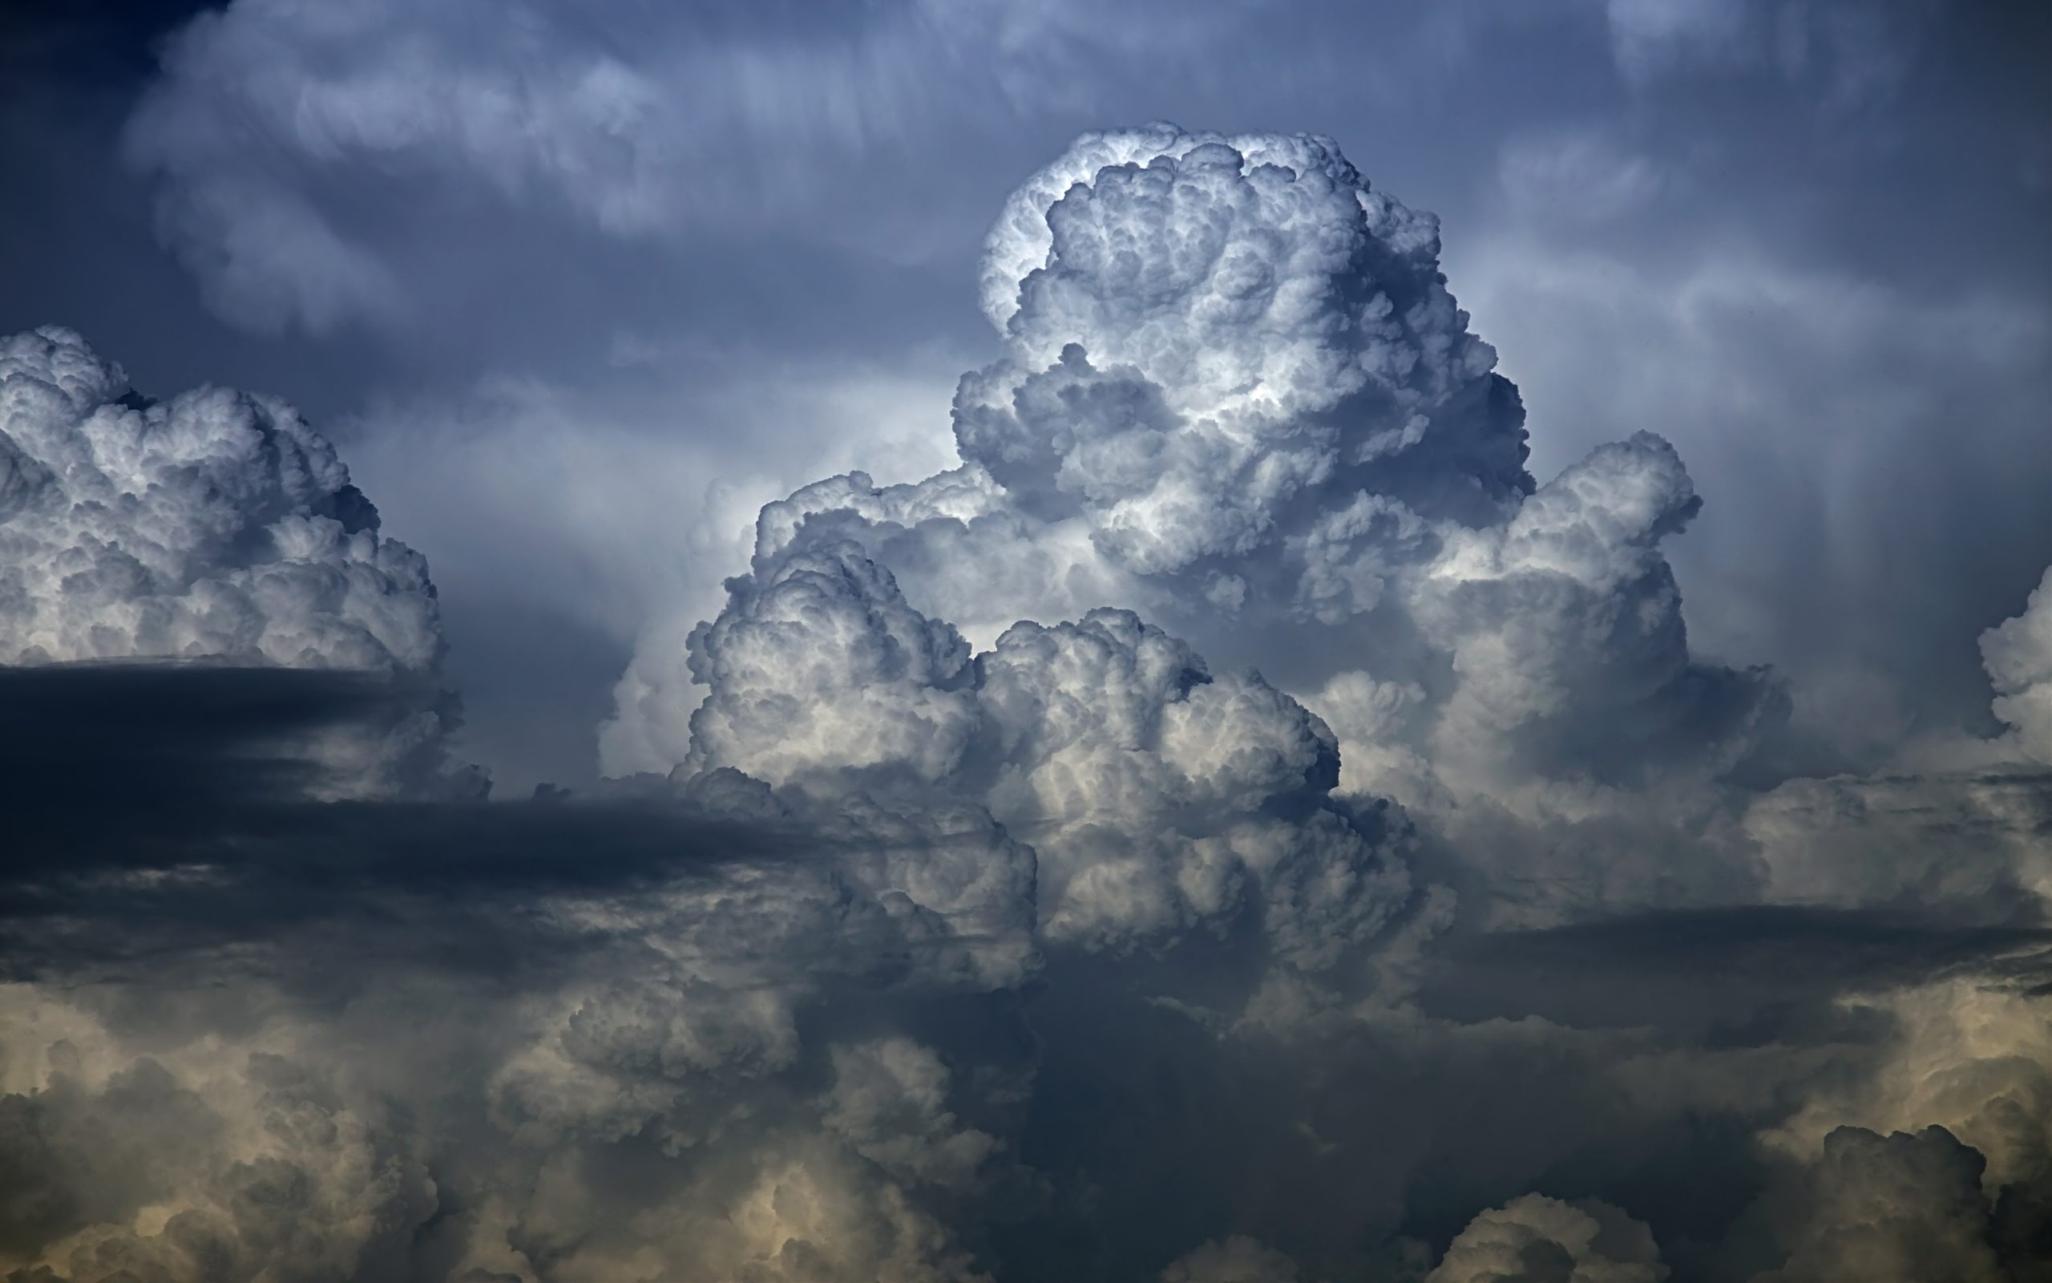
2.3. Weather Processes & Phenomena

Slide 3
Key Concepts:
Phases of atmospheric moisture – what are the stages and the changes between them?
Water forms in the atmosphere – fog, dew and clouds
Causes of precipitation
  Convection
  Orographic
  Frontal

Slide 4
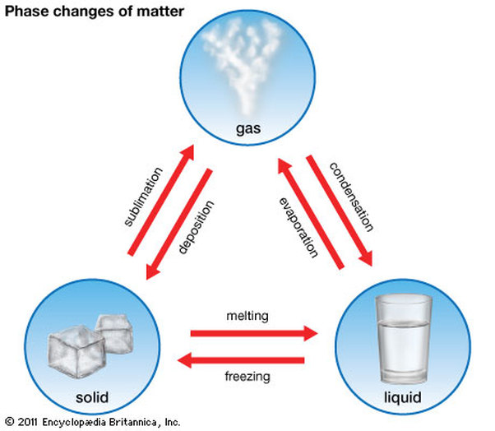
Phase Changes of Matter

Slide 5
Causes of Change: Evaporation
Caused when the substance is heated, and the air is unsaturated
Rates of evaporation increase with temperature, and with aridity

Slide 6
Causes of Change: Condensation
Dew point temperature: atmospheric temperature at which water condenses – subject to pressure & humidity (not only temperature!)
Cooling below the dew point temperature causes water to condense on to condensation nuclei – particles on which water can form
Produces water in droplet form on a surface or on nuclei
Can be done in one of three ways:
  Conduction/contact cooling: moist air comes in to contact with a colder surface (below the dew point) – most commonly a cold land surface or a cold sea surface
  Radiation cooling: air loses heat to space when there are no clouds (night time – no insolation to warm the air)
  Expansion cooling: air is forced upwards, expands, and cools.
  https://www.metoffice.gov.uk/videos/4485747776001

Slide 7
Causes of Change to/from solid
Sublimation
  Change from solid to gas without passing through the liquid state
  Best example is the ‘dry ice’ of Carbon Dioxide
Deposition
  Much rarer experience
  Change from gas directly to a solid – ice forming on a very cold surface

Slide 8
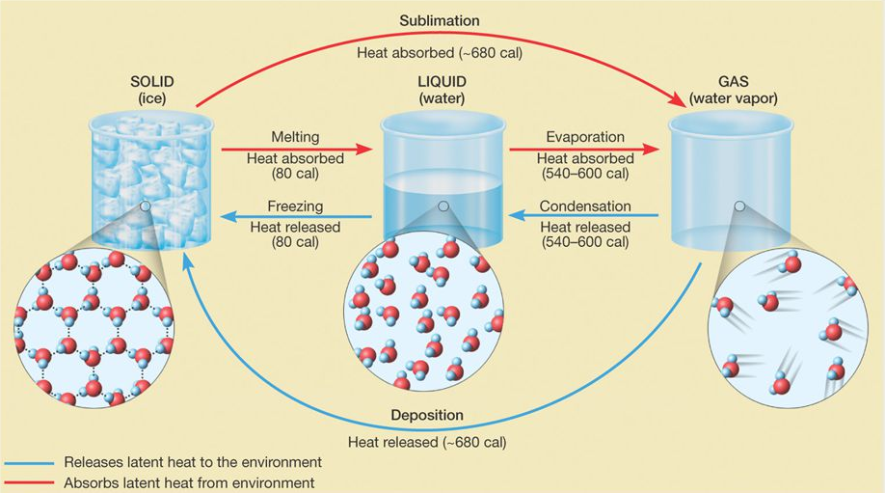
Phase Changes & States of Matter
In order for something to cool down, it has to give off energy (release latent heat)
In order for something to warm up, it has to absorb energy (take in latent heat)
This is why we sweat…
This has huge consequences for the atmospheric processes

Slide 9
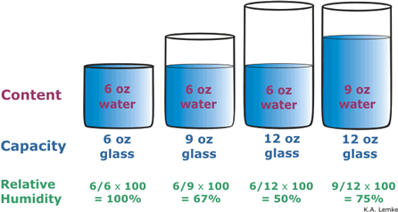
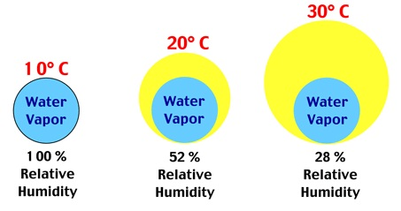
Moisture Content: Humidity, RH & Saturation
Absolute humidity is the amount of water vapour in a given volume of air
  Not useful – why?
Relative humidity is the relationship between the absolute humidity and the maximum capacity for a given temperature and pressure, i.e:
  Relative H = Moisture Content
  Saturation Moisture Content
Saturation is the point at which the air is “full” of moisture – and can hold no more!

Slide 10
How do we make clouds?

Slide 11
What is a cloud?
Visible representation of matter change
Water cools and condenses below the dew point
  Goes from vapour state to liquid state
Requires:
  Decrease in temperature
  Condensation nuclei in atmosphere

Slide 12
What is the role of altitude?
As we know, the atmosphere gets colder away from the surface
  Environmental Lapse Rate
Formally, this is known as an adiabatic lapse rate, because there is not a volume change
There are two types:
  Dry adiabatic lapse rate – how dry air behaves
  Saturated adiabatic lapse rate – how wet air behaves
As bits of air rise, they cool and produce liquid - clouds

Slide 13
Diagram of lapse rates

Slide 14
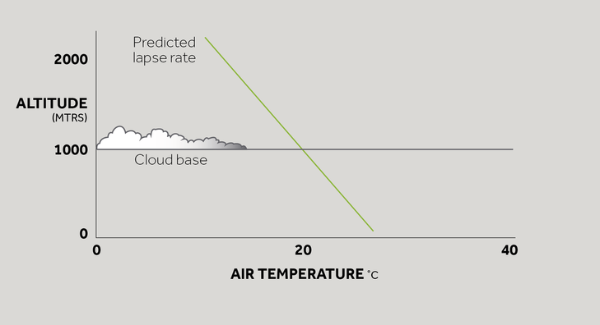
Lapse Rates vary with temperature, dew point, pressure and airflow – giving different cloud heights at different moments!

Slide 15
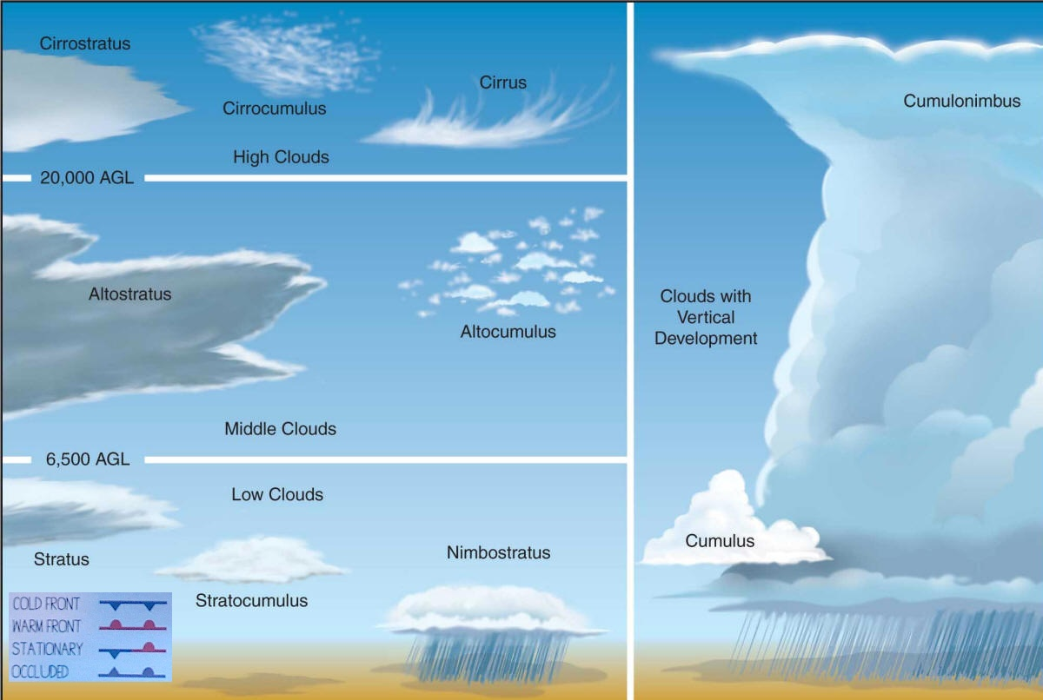
What types of cloud are there?
Height
Cirro-
Alto-
Strato-
Water?
Nimbo-
Features:
Lumpy
Wispy
Vertical

Slide 16
How do clouds produce rain?
Competing theories as to how this works – what we need is saturated clouds, and then the droplet to become too heavy to be held aloft by the rising air currents
Collision Theory:
  Droplets in the cloud collide together until they are too heavy
  Coalescence – two water droplets join to form a rain drop.
  Aggregation – two ice crystals collide to form snow
  Accretion – ice crystal collides with water to form hail
Bergeron-Findeisen Theory:
  Air is saturated with ice before it gets saturated with water
  Clouds form between -12 and -40 degC, and water droplets evaporate, and the vapour is deposited on to ice crystals
  Falling ice crystals melt in warmer levels of atmosphere to fall as rain; if the atmosphere is cold, they stay as snow/ice

Slide 17
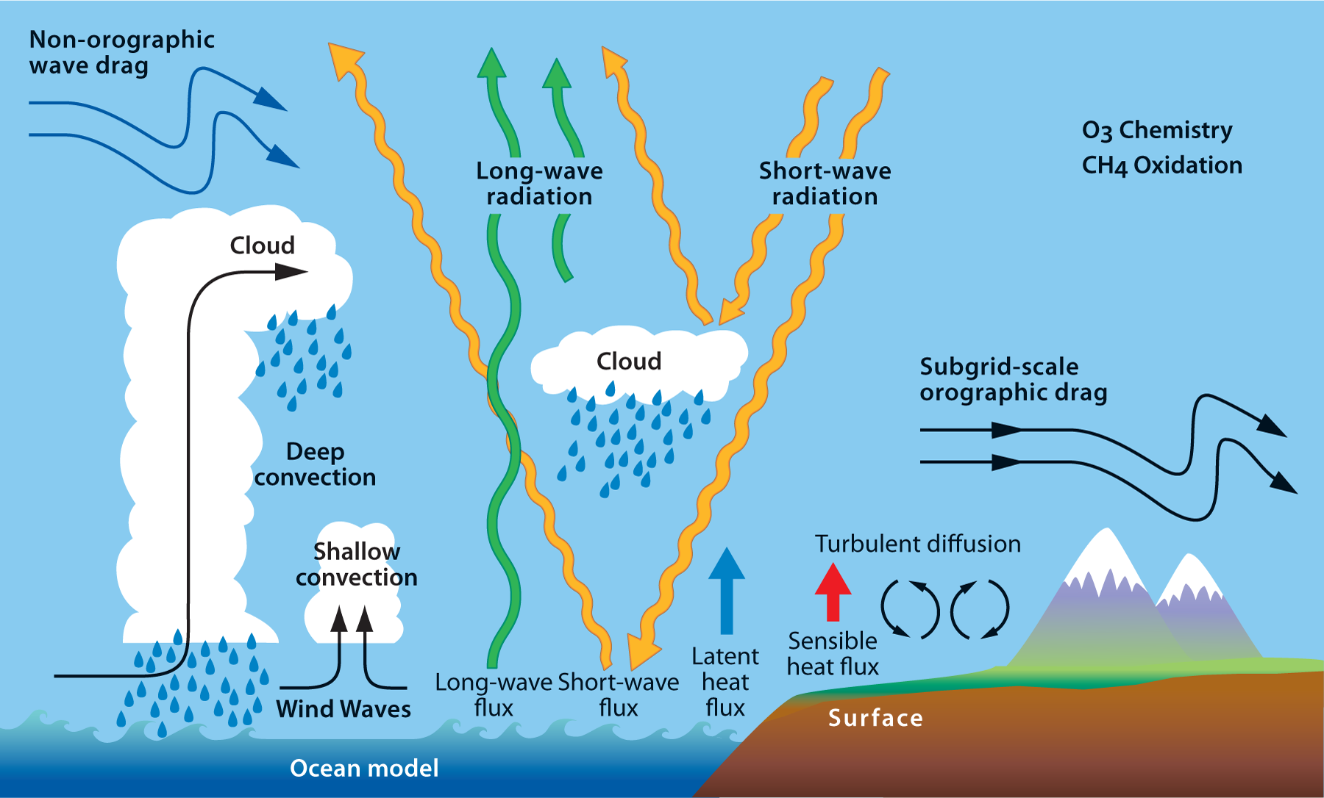

Slide 18
1. Convection
Occurs over a warm surface – can be any size & scale (e.g. hot land surface, or individual power station chimney)
Air is warmed by contact (conduction) with heat source
Heated air expands, becomes less dense, rises and cools
Clouds form as moisture condenses, latent heat released to add further warmth – enhances convection “current”
Powerful convection causes cumulonimbus cloud – vast vertical “anvils” of cloud that hit the tropopause
Responsible for vast amounts of cloud/rain in tropics
https://www.youtube.com/watch?v=yfmZbOSpOWA&safe=active

Slide 19
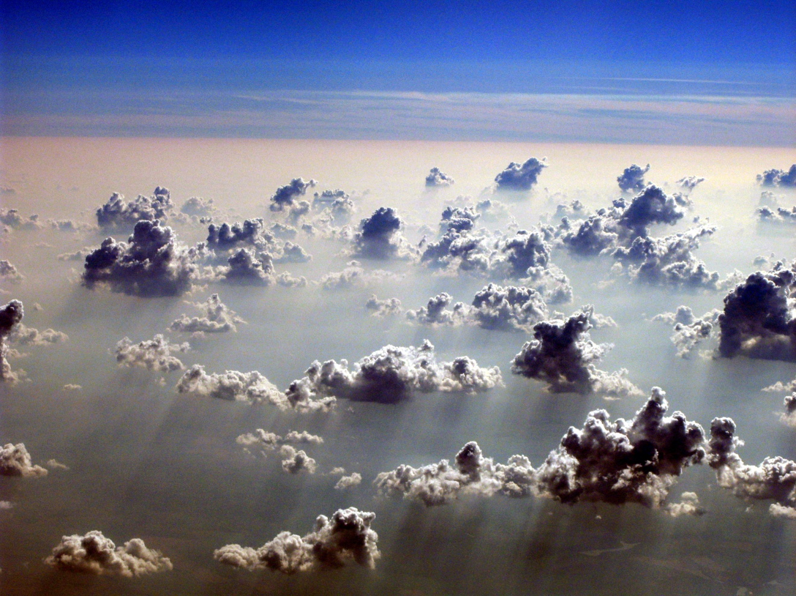

Slide 20


Slide 21
2. Orographic Rainfall
Pressure force/wind is strong enough to push air up over a gradient (hill, mountain, incline)
As the air rises up the windward slope, it cools, hits dew point temperature and condenses
Cloud and precipitation may form if thick enough
On the lee slope (sheltered side), the descending air sinks, compresses and warms – humidity reduces, and dew point exceeded – and the cloud may clear

Slide 22
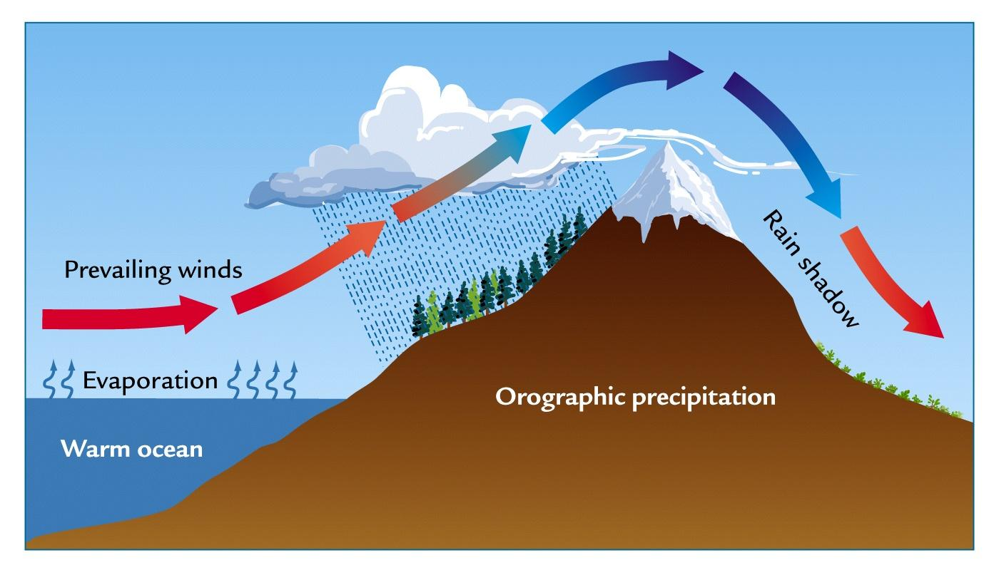
Level at which dew point temp is reached
Dry area

Slide 23
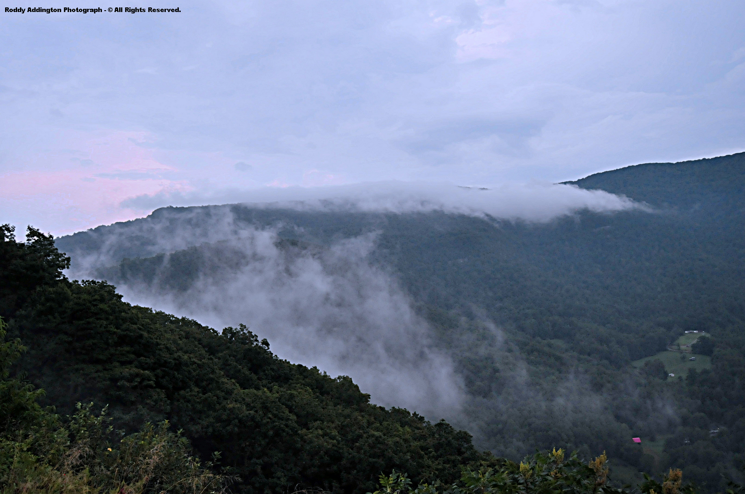

Slide 24
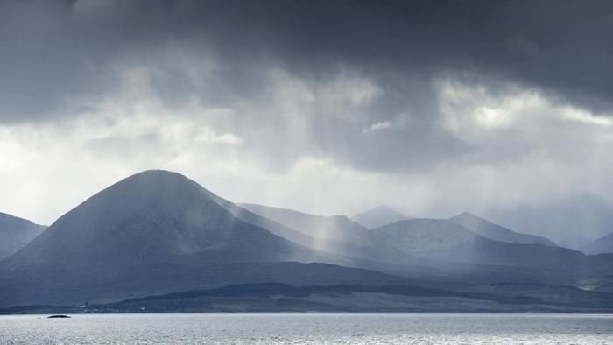

Slide 25
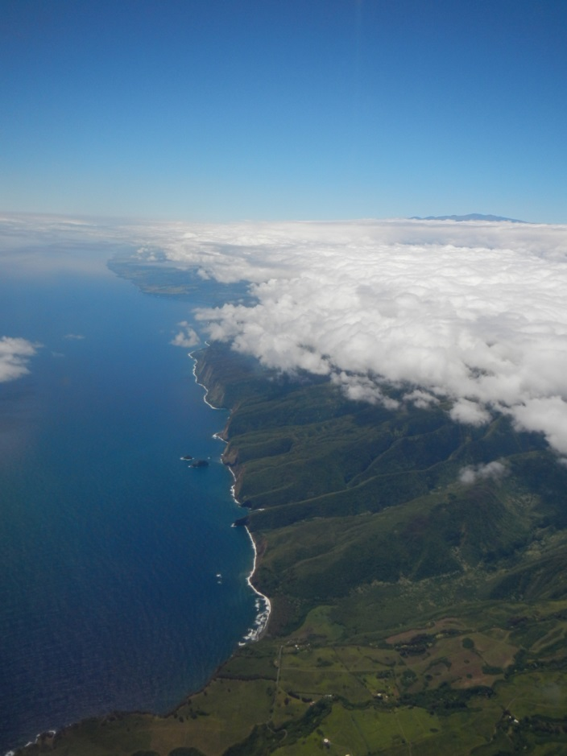

Slide 26
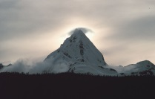

Slide 27
3. Frontal Rainfall
Complex interaction of different types of air from different sources
Most common at mid-latitudes & Ferrel-Polar boundary
Need warmer and cooler air to meet; preferably with moisture content already
Forms a boundary where two air masses are pushed up against each other; rising air causes rain to form in a specific way
Linked to atmospheric depressions and formation sequence

Slide 28
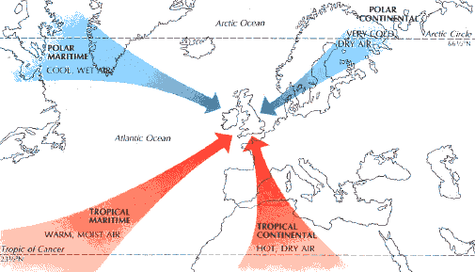
UK Air Masses
Link: EU Met Sat and Jet Stream Map

Slide 29
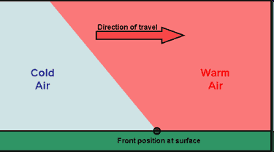
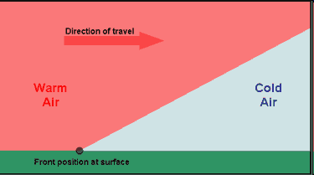
Formation of Fronts
Fronts – the boundary between different air masses
  Video link
Cold front – where cold air travels faster than warm air
Warm front – where warm air travels faster than cold air
Animation and crazy hands…

Slide 30
Stages of a Frontal Depression
Origin (infancy, birth)
  Different air masses start to rotate
Maturity
  Tighter isobars
  Formation of distinct fronts
Occlusion
  Fronts link together, signals the end of the depression
Death
  Fades away, dispersal of fronts

Slide 31
Stages of a Depression
Origin
Depression
Maturity
Occlusion

Slide 32
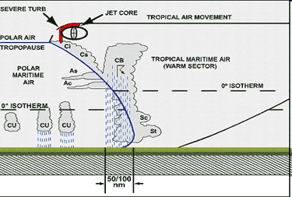
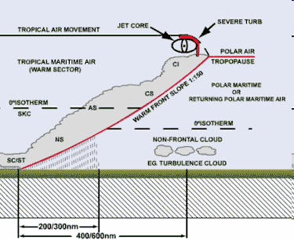
Formation of Frontal Rainfall

Slide 33
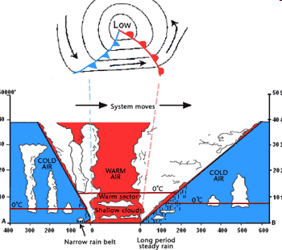

Slide 34
Summary of Rainfall Approaches
Key components to all elements
  Need to have water vapour
  Need to take water vapour below the dew point temperature to form droplets (enough to drop out of cloud)
  Can do this by cooling the cloud – various ways to do that!
Should be able to describe and explain the processes – you can use diagrams if it’s easier?

Slide 35
Forms of Water in the Atmosphere
Fog
Dew
Frost
Snow
Hail

Slide 36
Weather | Description | Origin & Process
Fog | Tiny water droplets suspended in the air, close to surface level Reduce visibility, may be apparent as a ‘bank’ of fog | Radiation fog: under high pressure, cloudless skies, temperature drops overnight below dew point, and fog forms close to the cold ground Advection fog: winds containing moisture move over a colder surface (e.g. ocean, blow over cold current, from sea to cold land)
Dew | Small droplets of water forming on cold surface e.g. leaves, grass | Water vapour condenses on to cold objects. Still conditions (low wind) allow prolonged contact: does not blow away
Snowflakes | Ice crystals in hexagonal patterns | Water vapour cooled to ice (slowly). When crystals fall, they collide and combine (aggregation)
Hailstones | Roughly circular forms, alternate layers of ice and rime | Ice particles fall and rise in Cb cloud; supercooled water droplets collide and freeze around nuclei

Slide 37
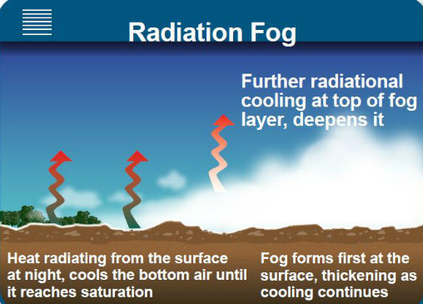

Slide 38
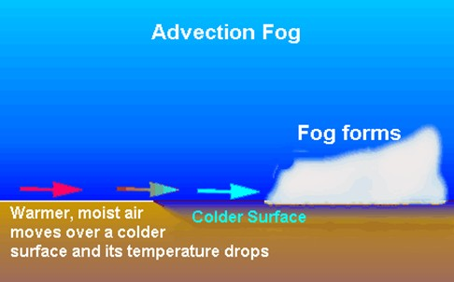

Slide 39


Slide 40
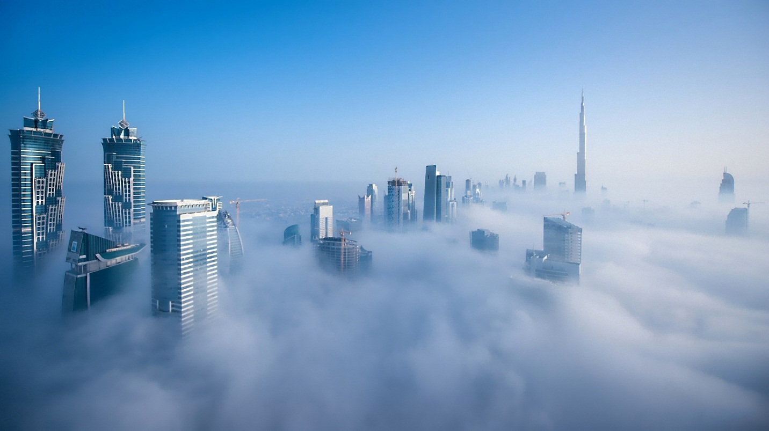

Slide 41
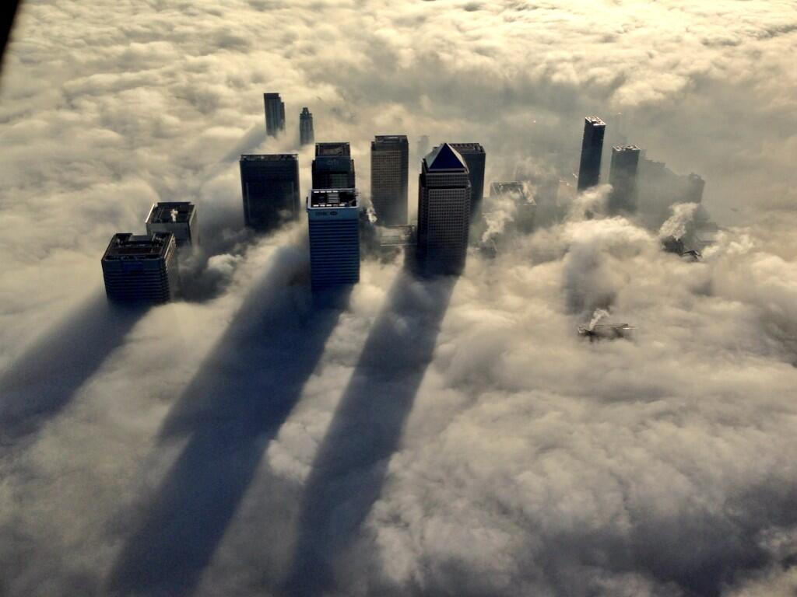

Slide 42
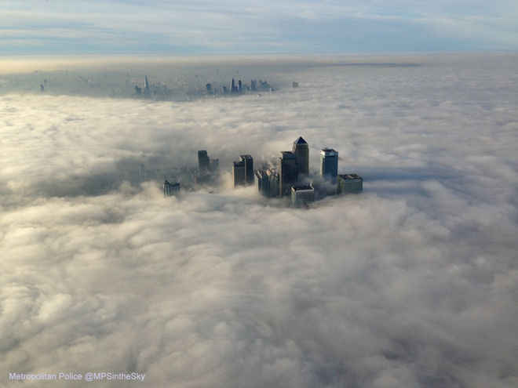

Slide 43


Slide 44
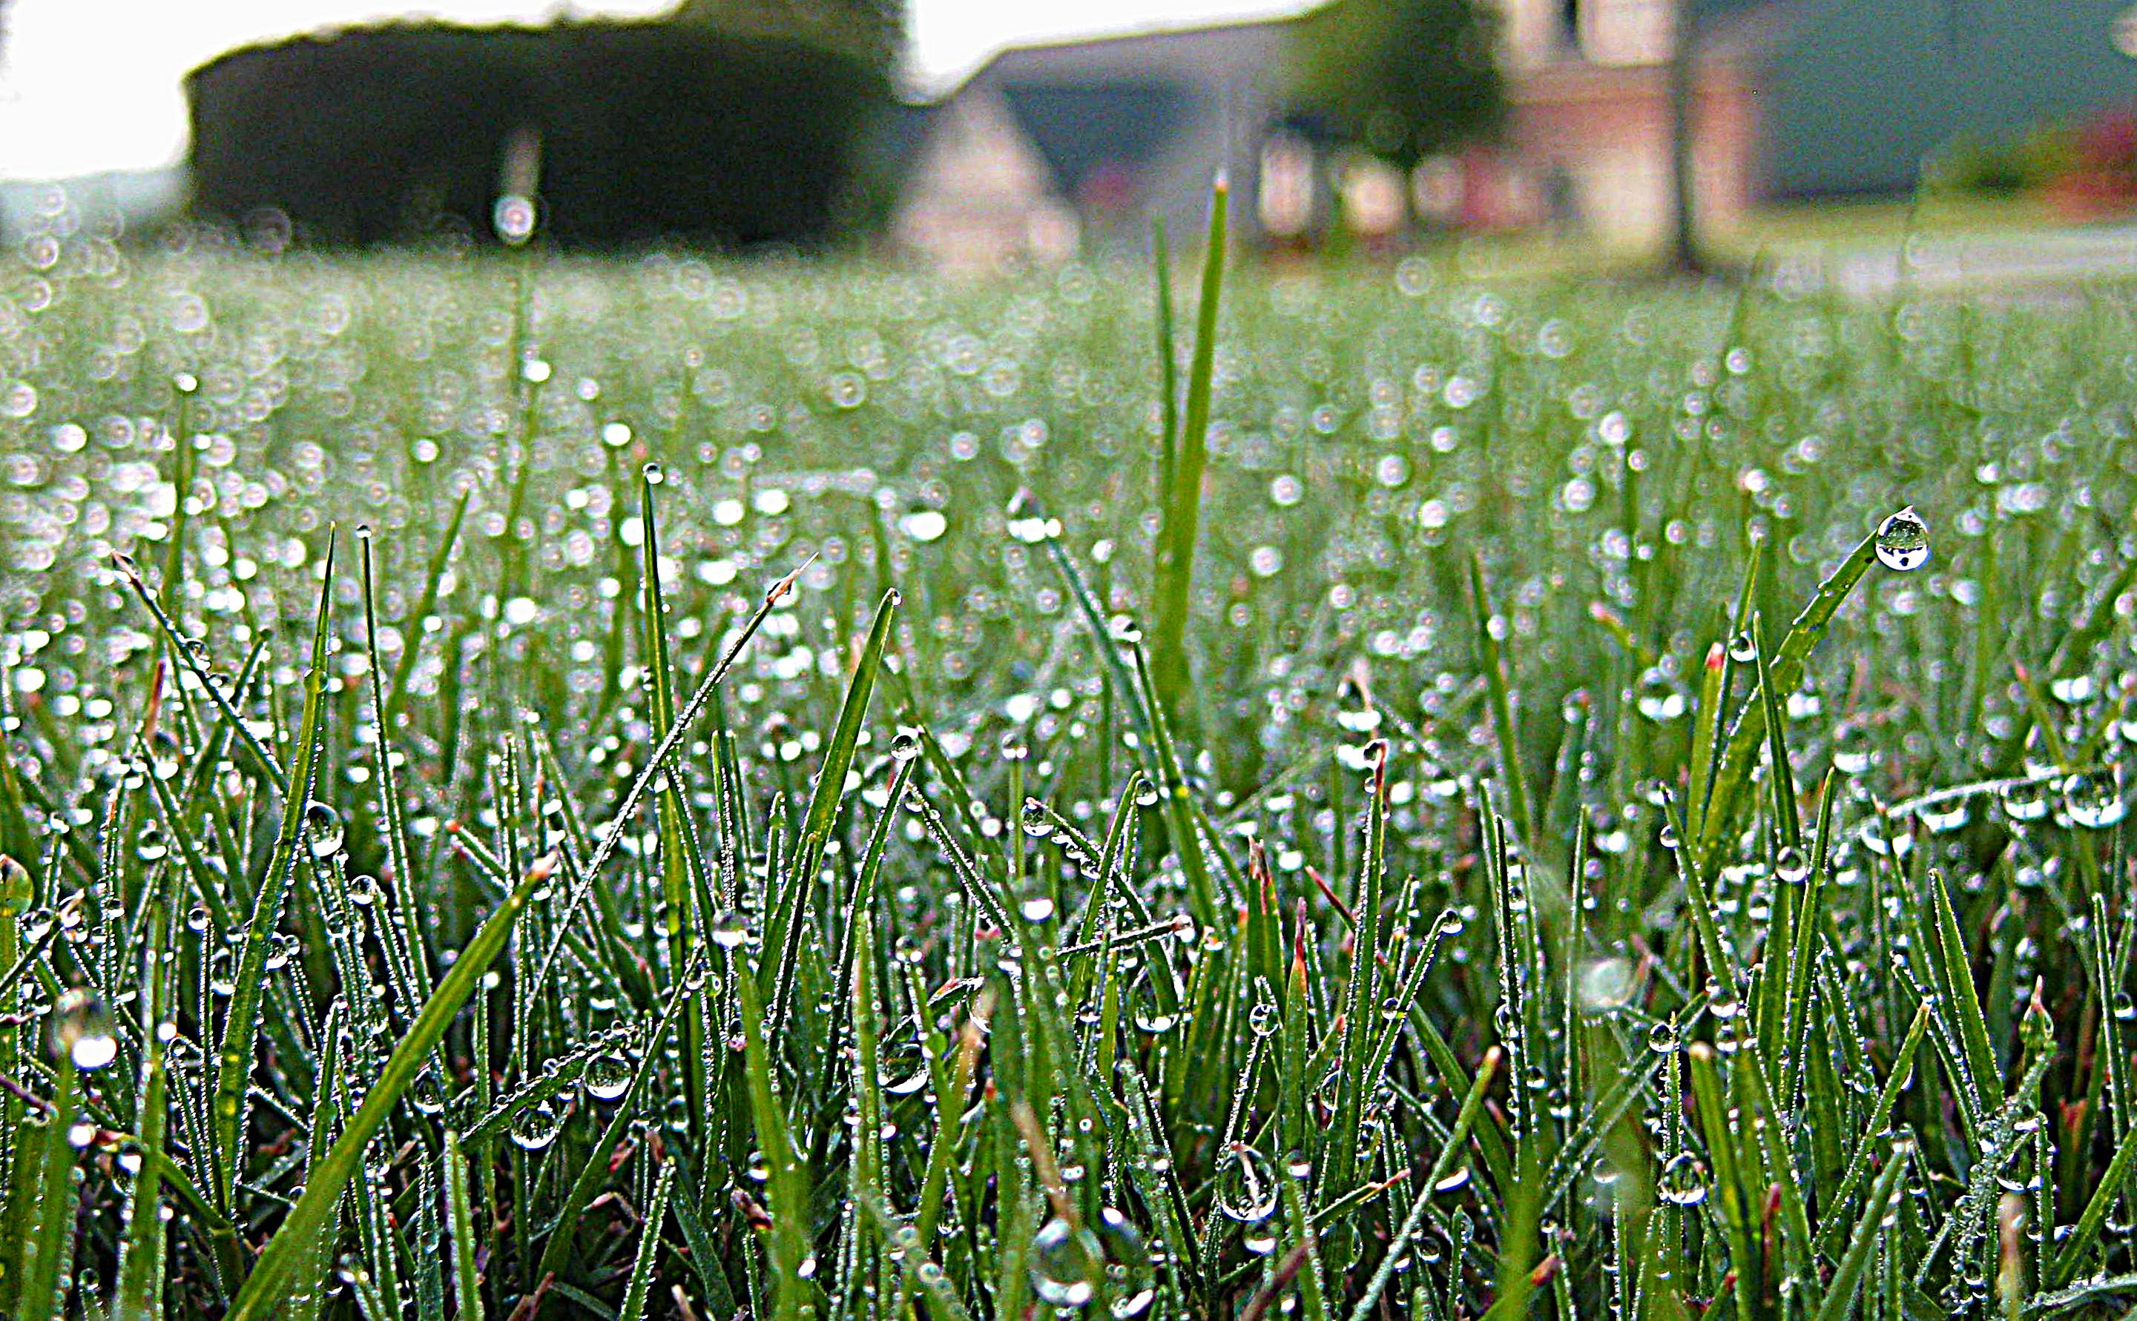

Slide 45


Slide 46


Slide 47
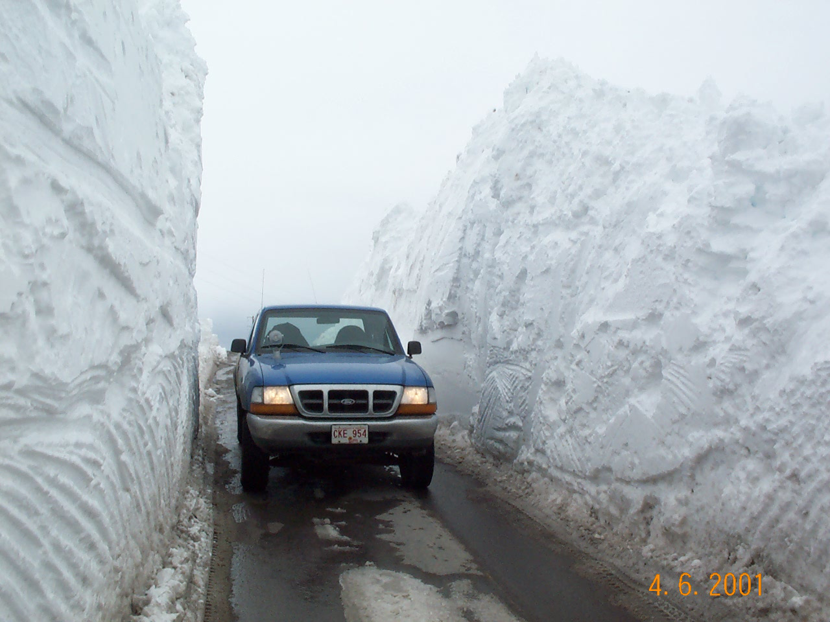

Slide 48
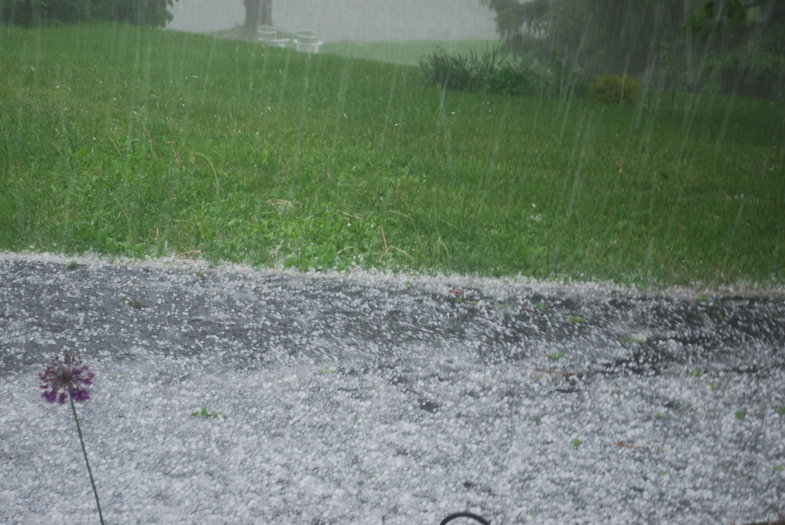

Slide 49
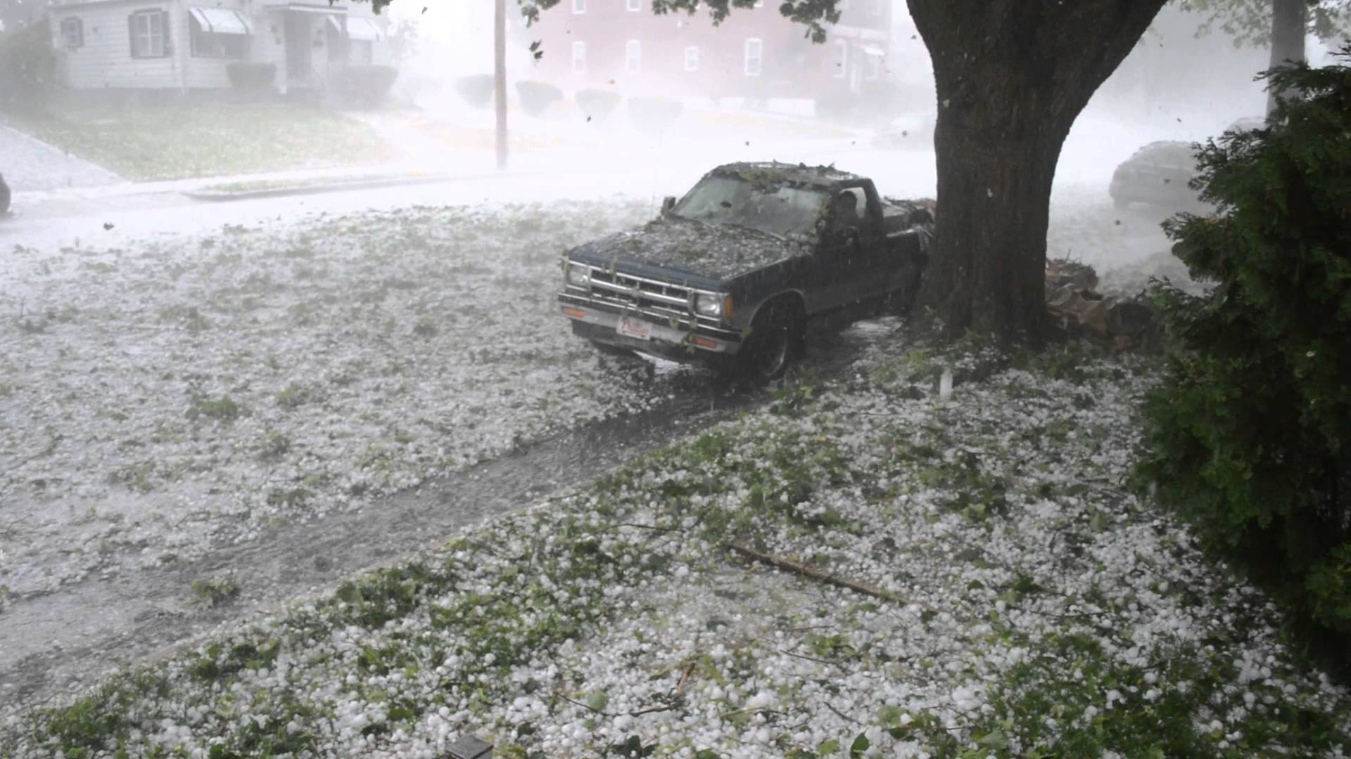

Slide 50
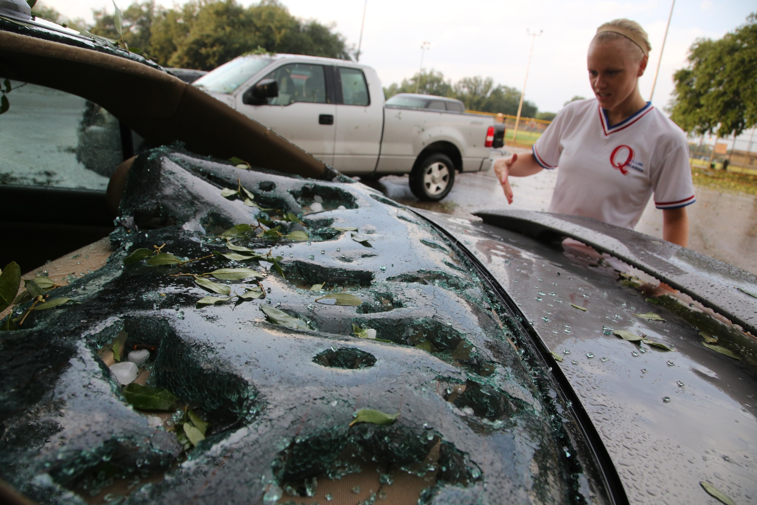

Slide 51
5. Explanation of rainfall (p46)

Slide 52
2.3. practice questions (p47-48)

