Slide 1
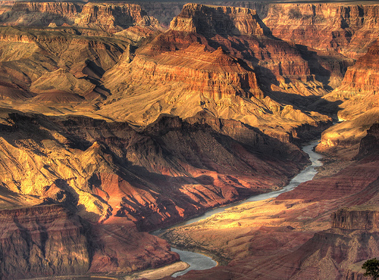
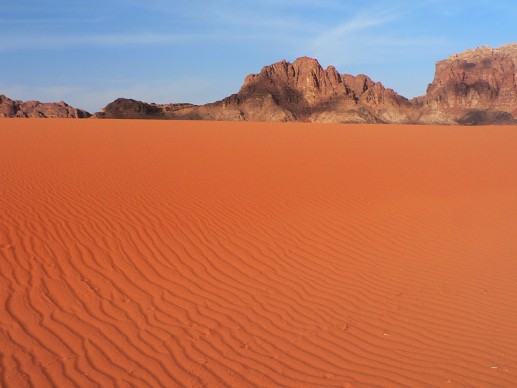
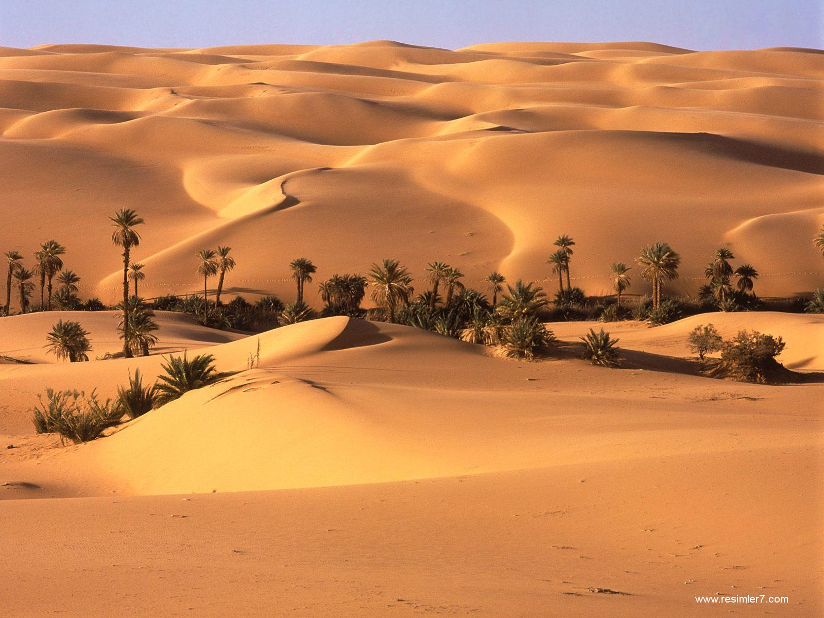
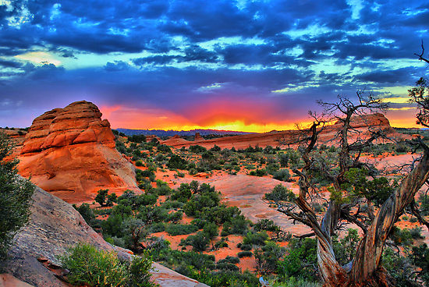
Advanced Physical, Paper 3
10. Hot arid and semi-arid environments

Slide 2
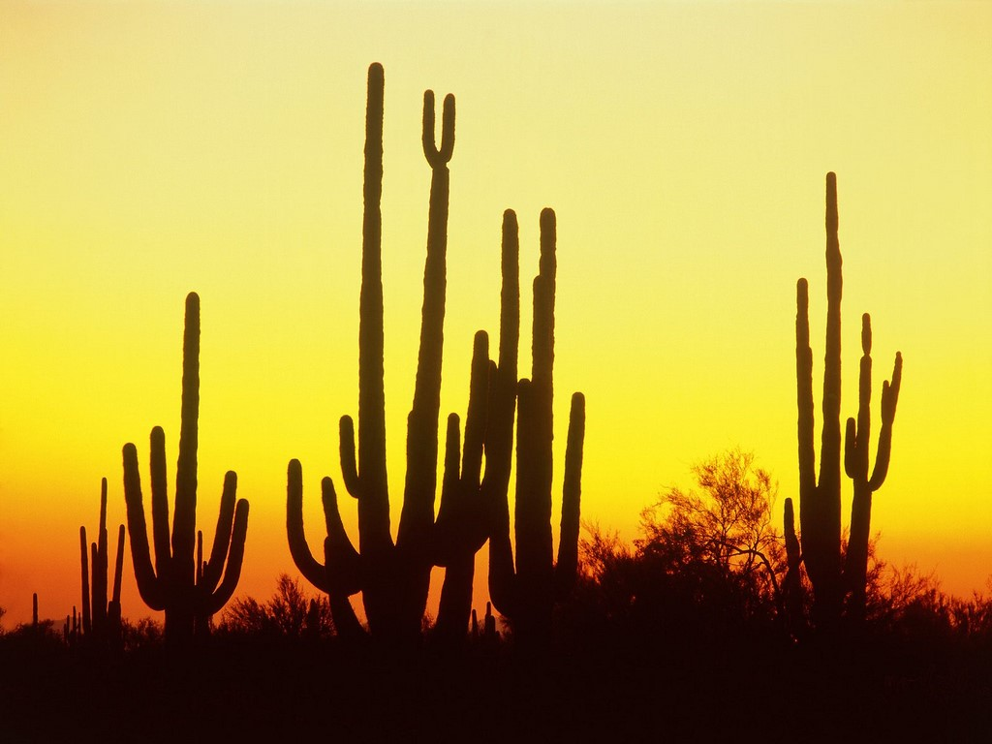
Advanced Physical, Paper 3
10.3. Soils and Vegetation

Slide 3
Videos
https://www.youtube.com/watch?annotation_id=annotation_2555738991&feature=iv&src_vid=B3NbPUTD5qA&v=PGZuE0H82Gg&safe=active
https://www.youtube.com/watch?annotation_id=annotation_3700600641&feature=iv&src_vid=joR4OL_mQnE&v=B3NbPUTD5qA&safe=active
https://www.youtube.com/watch?v=joR4OL_mQnE&safe=active
https://www.youtube.com/watch?v=XsgHYfulv2g&safe=active
https://www.youtube.com/watch?v=A6L3korqXb4&safe=active

Slide 4
10.3. Soils and Vegetation
Vegetation: biomass productivity (biodiversity, limited nutrient cycling, fragility), adaptation of plants to extreme temperatures, physical and physiological drought.
Soils processes: upward capillary movement of water and minerals (salinisation).
The process of desertification (both natural and human factors) leading to the degradation of soils and vegetation in semi-arid environments.

Slide 5
Key Questions to Answer:
What challenges does the environment of the desert face?
What evidence do we have that it is a difficult environment to be productive?
What adaptations and techniques can we see from plants, animals and people to adjust to these challenges?
What is the future of the desert? How does desertification work, and what are the consequences?

Slide 6
What challenges are faced in desert environments?

Slide 7
Why do we need to know this?
Characteristics of the desert environment can create ‘problems’ to be adapted to
Environmental variables drive the majority of the characteristics – some directly, some indirectly
This helps us to explain the processes, adaptations and management in many instances
Remember – there is more than one type of desert: it will depend on levels of aridity!

Slide 8
Key Characteristics
Aridity, which causes:
  Lack of available moisture (physical vs physiological drought)
  High salt content (salinization)
Temperature, which causes:
  Diurnal temperature variability
  Winds (impact on transport process?)

Slide 9
Consistent characteristics?
Physical drought is balance between precipitation & evaporation – which type of desert has the biggest imbalance?
Physiological drought is when plants have too much salt in the soil, and it is drawn out by soil – which type of desert has the biggest gradient?
Salinisation results from the capillary rise of soil moisture; which happens when water is evaporating off the soil. Which deserts have the most?
Which desert type is the hottest?
Which desert type has the highest diurnal range?
Which desert type has the most powerful winds?

Slide 10
Conclusions?
The challenges of deserts are quite different
  Range of problems
  Range of scales – depending on desert type
  Range of impacts – depending on season
  Response to multiple problems, rather than just one
Can anything survive in this environment? How do we know?

Slide 11
What evidence do we have of desert challenges?

Slide 12
Principles of Ecosystems:
Ecosystem consists of a community of living (biotic) organisms plus the physical (abiotic) environment (water, air and soil)
Matter, energy and nutrients flow through the system in a constant movement – by living, predatory relationships, dying and shedding organic matter.
These are represented through trophic layers – each tier represents a different level of consumption in the biome
This is often shown as a pyramid: with each tier representing total dry weight (g/m²) – or biomass – of all species.
Most pyramids narrow sharply from “producers” at the base to the apex predator/consumer at the top.
Pyramids show trends in food: the lowest level having the greatest biomass, with the higher levels having less.

Slide 13
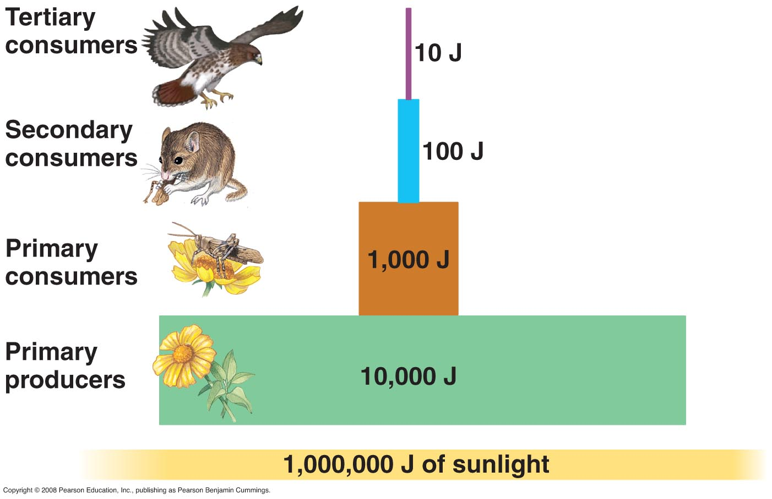
Typical Biome Pyramid

Slide 14
What about deserts?
How do you think deserts will compare to the “normal” trophic processes?
Why?
Why might it be different in the different types of desert? What is the primary controller?

Slide 15
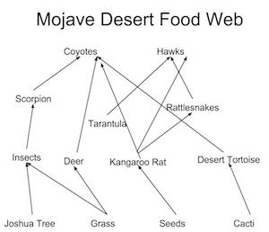

Slide 16
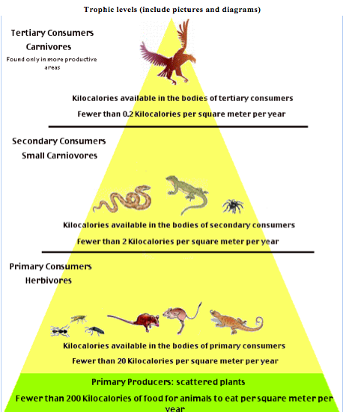
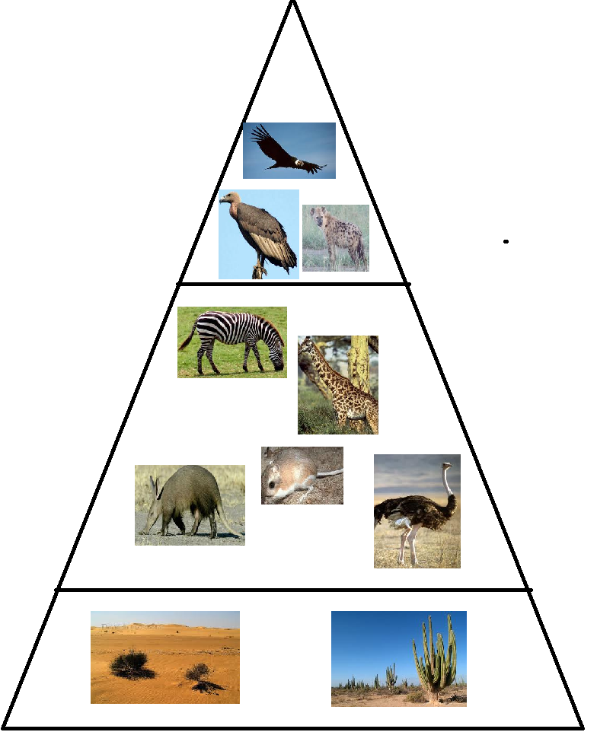
Desert Trophic Pyramids

Slide 17
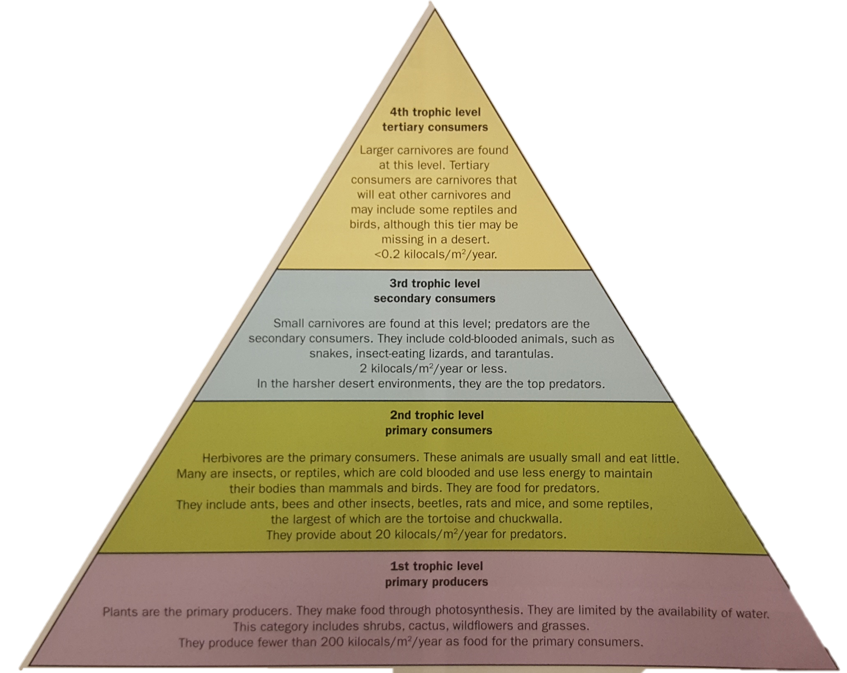

Slide 18
How can we measure the desert’s lower trophic output?
We have two approaches to measure output and biome effectiveness
The first is simply to count the species supported by this particular ecosystem
This is called biodiversity. For example, in the semi-arid Sonoran desert, there are 60 mammals, 350 bird and 20 amphibian species.
However, biodiversity can some times be deceptive: showing the wide range of ecosystem diversity rather than true diversity
This is brought about when there is significant abiotic variation in a region – and so we get lots of different micro-climates and ecosystems (e.g. a wadi floor compared to a wadi side, compared to the intermontane basin; or areas of erg vs hamada desert)
It can sometimes be more meaningful to use net primary productivity instead.

Slide 19
What is net primary productivity?
Net primary productivity is the rate at which organic matter is produced by plants and animals
It is measured in g/m²/year, and gives a good indication of how big the primary layer of the trophic pyramid is.
Clearly - this has consequences on the rest of the pyramid – and the species diversity and extent that can be found in deserts.
In general, arid environments have:
  Sparse vegetation (widely spread, not many layers) – increasingly distributed as aridity increases
  Well adapted and very specific vegetation
  Well adapted and very sparse animal life

Slide 20
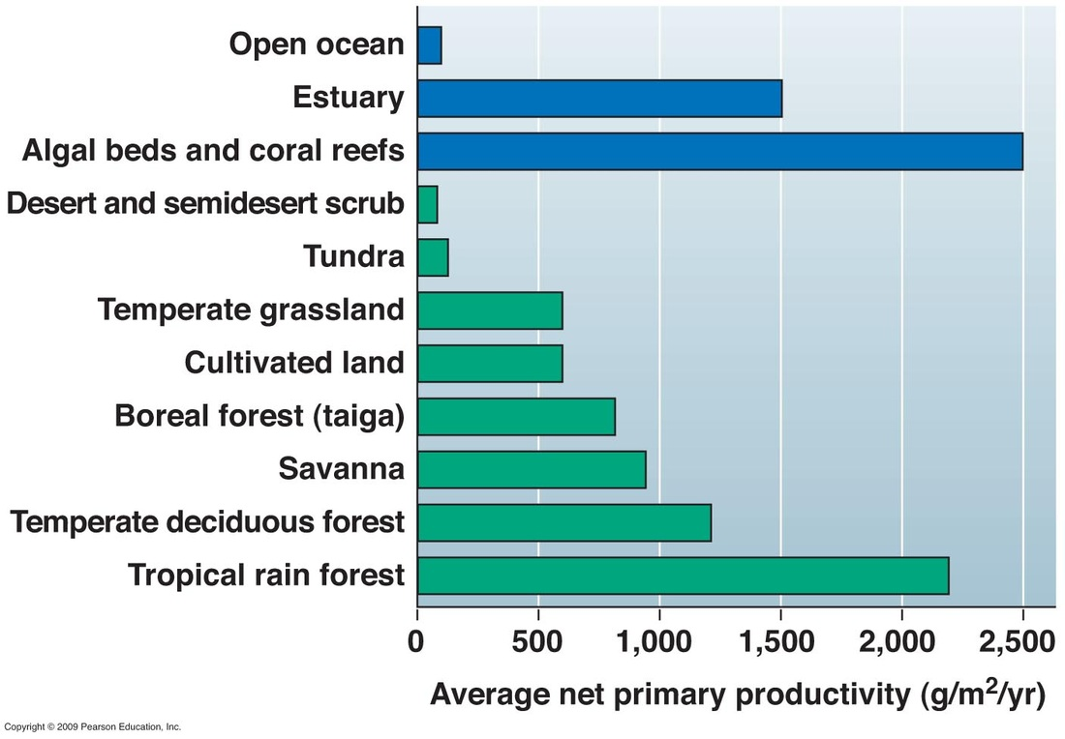
Coral reef; highest anywhere (2500)
Deserts – lowest NPP at 40g/m/yr
TRF – highest on land (2200)

Slide 21
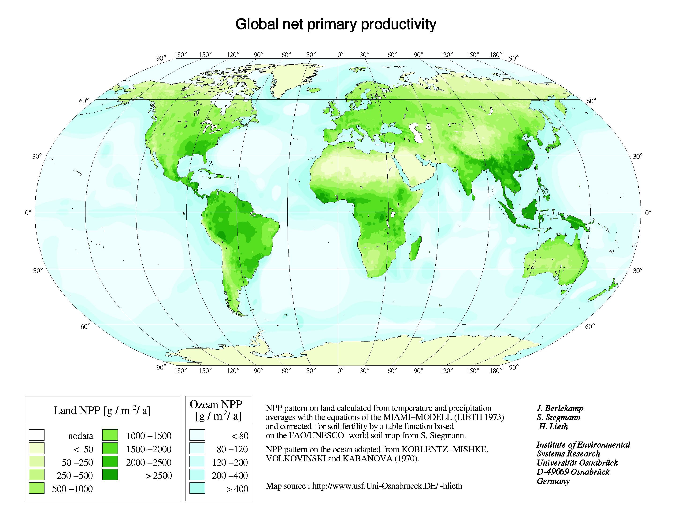
Q: Describe the trends shown
Important to recognise the “grading” of NPP, as it links to the distribution of aridity. There isn’t an “on/off” – it’s a gradient from most productive to the hyper-arid environments!

Slide 22
However… it is not barren!
Plants and animals can survive and thrive in arid/semi-arid environments if they are well adapted
Need to be able to deal with:
  High diurnal ranges
  High temperatures
  Low moisture levels – physiological and practical drought (access to water as well as amount of water that exists)
  High salt levels and capillary action

Slide 23
How do ecosystems adapt to the desert challenges?

Slide 24
How to cope: adaptations
Evolutionary and adaptive response to ensure the key characteristics can be dealt with
You should know details of how it works for each stage of the ecosystem:
  Desert soils
  Plants
  Animals
  Humans – links to desert management

Slide 25
Desert soils
Soil formation (pedogenesis) is complex and takes a long time
Normal soil is a mixture of rock, weathering and breakdown of material.
But needs organic content – decomposing plant matter – to make a fertile soil
Desert soils tend to be thin, fragile and slow to build (but easy to erode).
Dominated by the salt and water balance

Slide 26
Key Processes of Soil Formation
Weathering
  Break down of the bed rock and mineral material, provides the non-organic basis for soil
Decomposition
  Break down of organic matter (plant, leaf detritus) provides the ‘fertile’ minerals to a soil mixture
Eluviation
  Minerals are moved through the soil layers by water
Illuviation (leaching)
  Salts, minerals are washed down in to the lower layers of the soil
Capillary action
  Water and minerals are drawn to the surface by evaporation

Slide 27
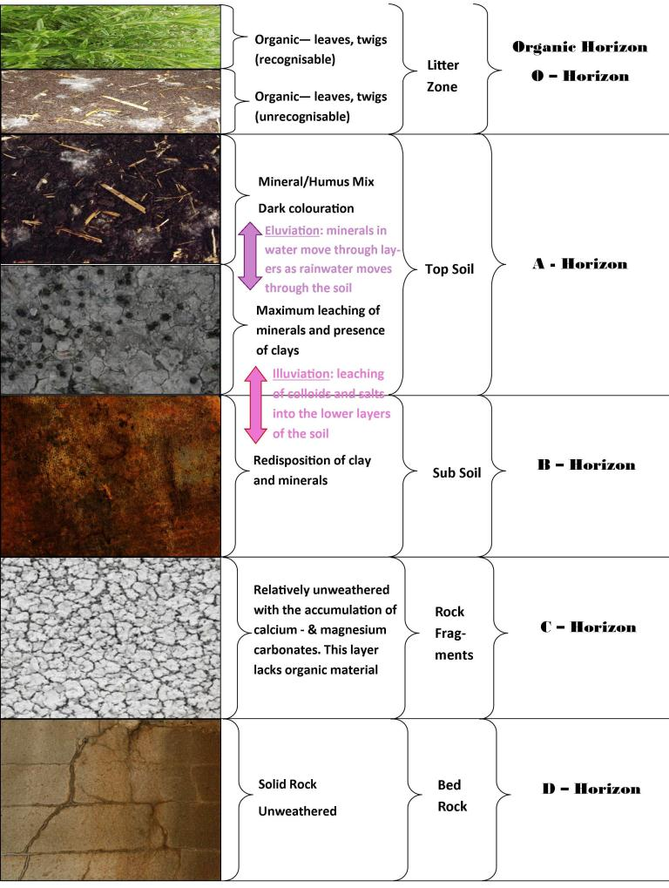
What does a normal soil look like?
Relatively thick and well developed, showing evidence of a decent formation time
Multiple and distinct layers which all have different organic matter levels (shown in different colours)
Clear evidence of water leaching and moving material through soil layers

Slide 28
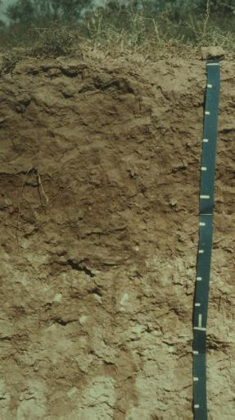
Soil Profile – Aridisol
Cover 1/3 of Earth’s surface
Dry soil, alkaline, only small amounts of organic material (1-2%)
Very dusty – v similar to loess in approach
Mainly mineral – can have hard mineralised crust that prevents root development (or duricrust surface)
High salinity through the whole mixture – no specific layers

Slide 29
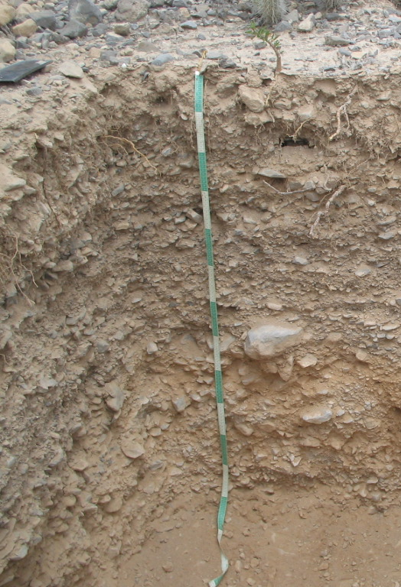
Soil Profile: Solonchak
Very high salt content – mainly on high evaporation areas.
Salt brought to the surface – thick crust and limited fertility
Creates a ‘duricrust’ layer – like a thick desert pavement – out of salty materials
Prevents further infiltration and leaching development

Slide 30
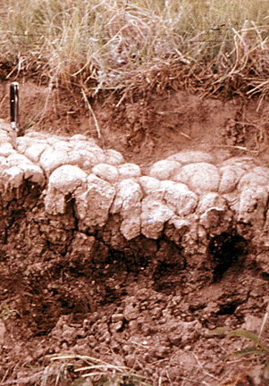
Soil Profile: Solonetz
Leaching moves salt down in to the sediment layers – forms a B horizon of significant salt
Formed in deserts with ephemeral water – semi-arid? – where sometimes the salt is being leached downwards, and that’s balanced by other times where it is being drawn up

Slide 31
Key Consequences of Desert Soil:
Soil formation (pedogenesis) is complex and takes a long time
  Desert soils tend to be thin, fragile and slow to build
  Any erosion or damage takes a long time to repair and rebuild
  Very difficult to accumulate a significant soil over time.
Normal soil is a mixture of rock, weathering and breakdown of material, plus needs organic content – decomposing plant matter – to make a fertile soil
  Weathering is fine in desert environment, but limited vegetation decomposition means that most desert soils are very thin and poor quality
  Negative feedback loop: can’t grow much because of soil quality; therefore no decomposition to produce organic matter to improve soil
  Leads to desertification if held unchecked
Dominated by the salt and water balance
  Significant variation in levels of aridity: very different in semi-arid!

Slide 32
Plant Adaptations
75% of deserts support vegetation – only extreme hyper arid or sand sea (erg) do not
Large range of vegetation – specific to location, climate and conditions – adapted through evolution over significant amount of time
Responding to soil conditions: limited fertility and development potential
In most cases, the desert adaptations are based on:
  Small, low complexity plants
  Sparse vegetation – lots of separation between plants
  Groups of species, but not layers or structure

Slide 33
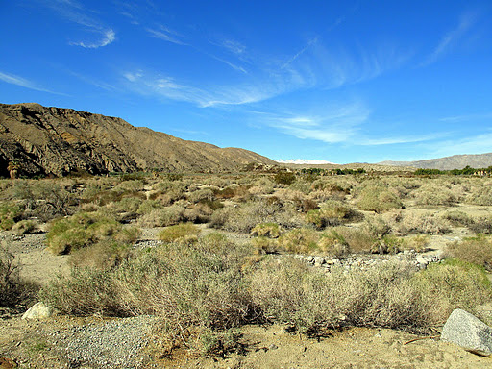

Slide 34
Plants - Key Adaptations
Main physical adaptations:
  Root systems to get access to moisture
  (Short life systems, following rainfall)
  Storage of moisture
  Prevention of water loss
Three key categories (-phyte, -phytic)
  Xerophytes – adapted to withstand drought – through storage, reduced transpiration and roots
  Ephemerals – only short life immediately after rain
  Halophytes – adapted for salt

Slide 35
Xerophytes
To withstand drought
How?
  Store water – chunky structure, physical stems, leaves & roots – CACTUS (SAGURO)
  Reduce evapotranspiration – minimal leaves, pointy spines, can only open stoma at night when it’s cooler – CACTUS (PRICKLY PEAR)
  Long root systems, to search out as much water in the ground as possible (phreatophytes). Normally found where there is some water (e.g. Wadi) – CREOSOTE BUSH

Slide 36
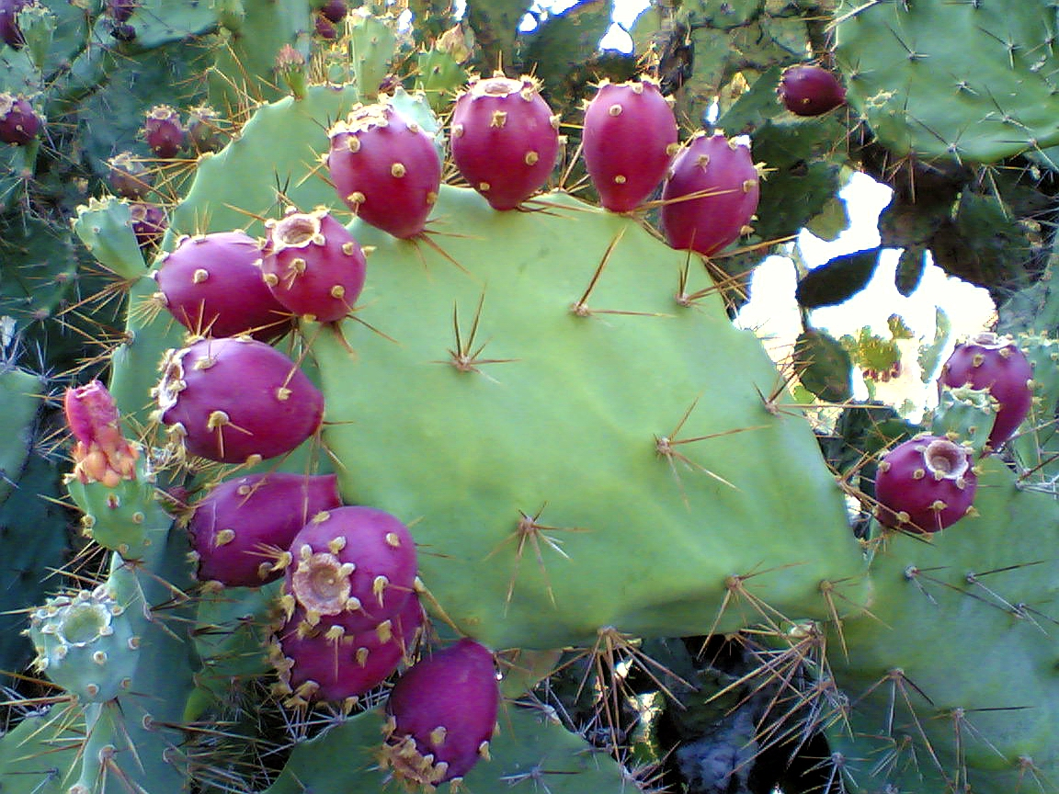

Slide 37
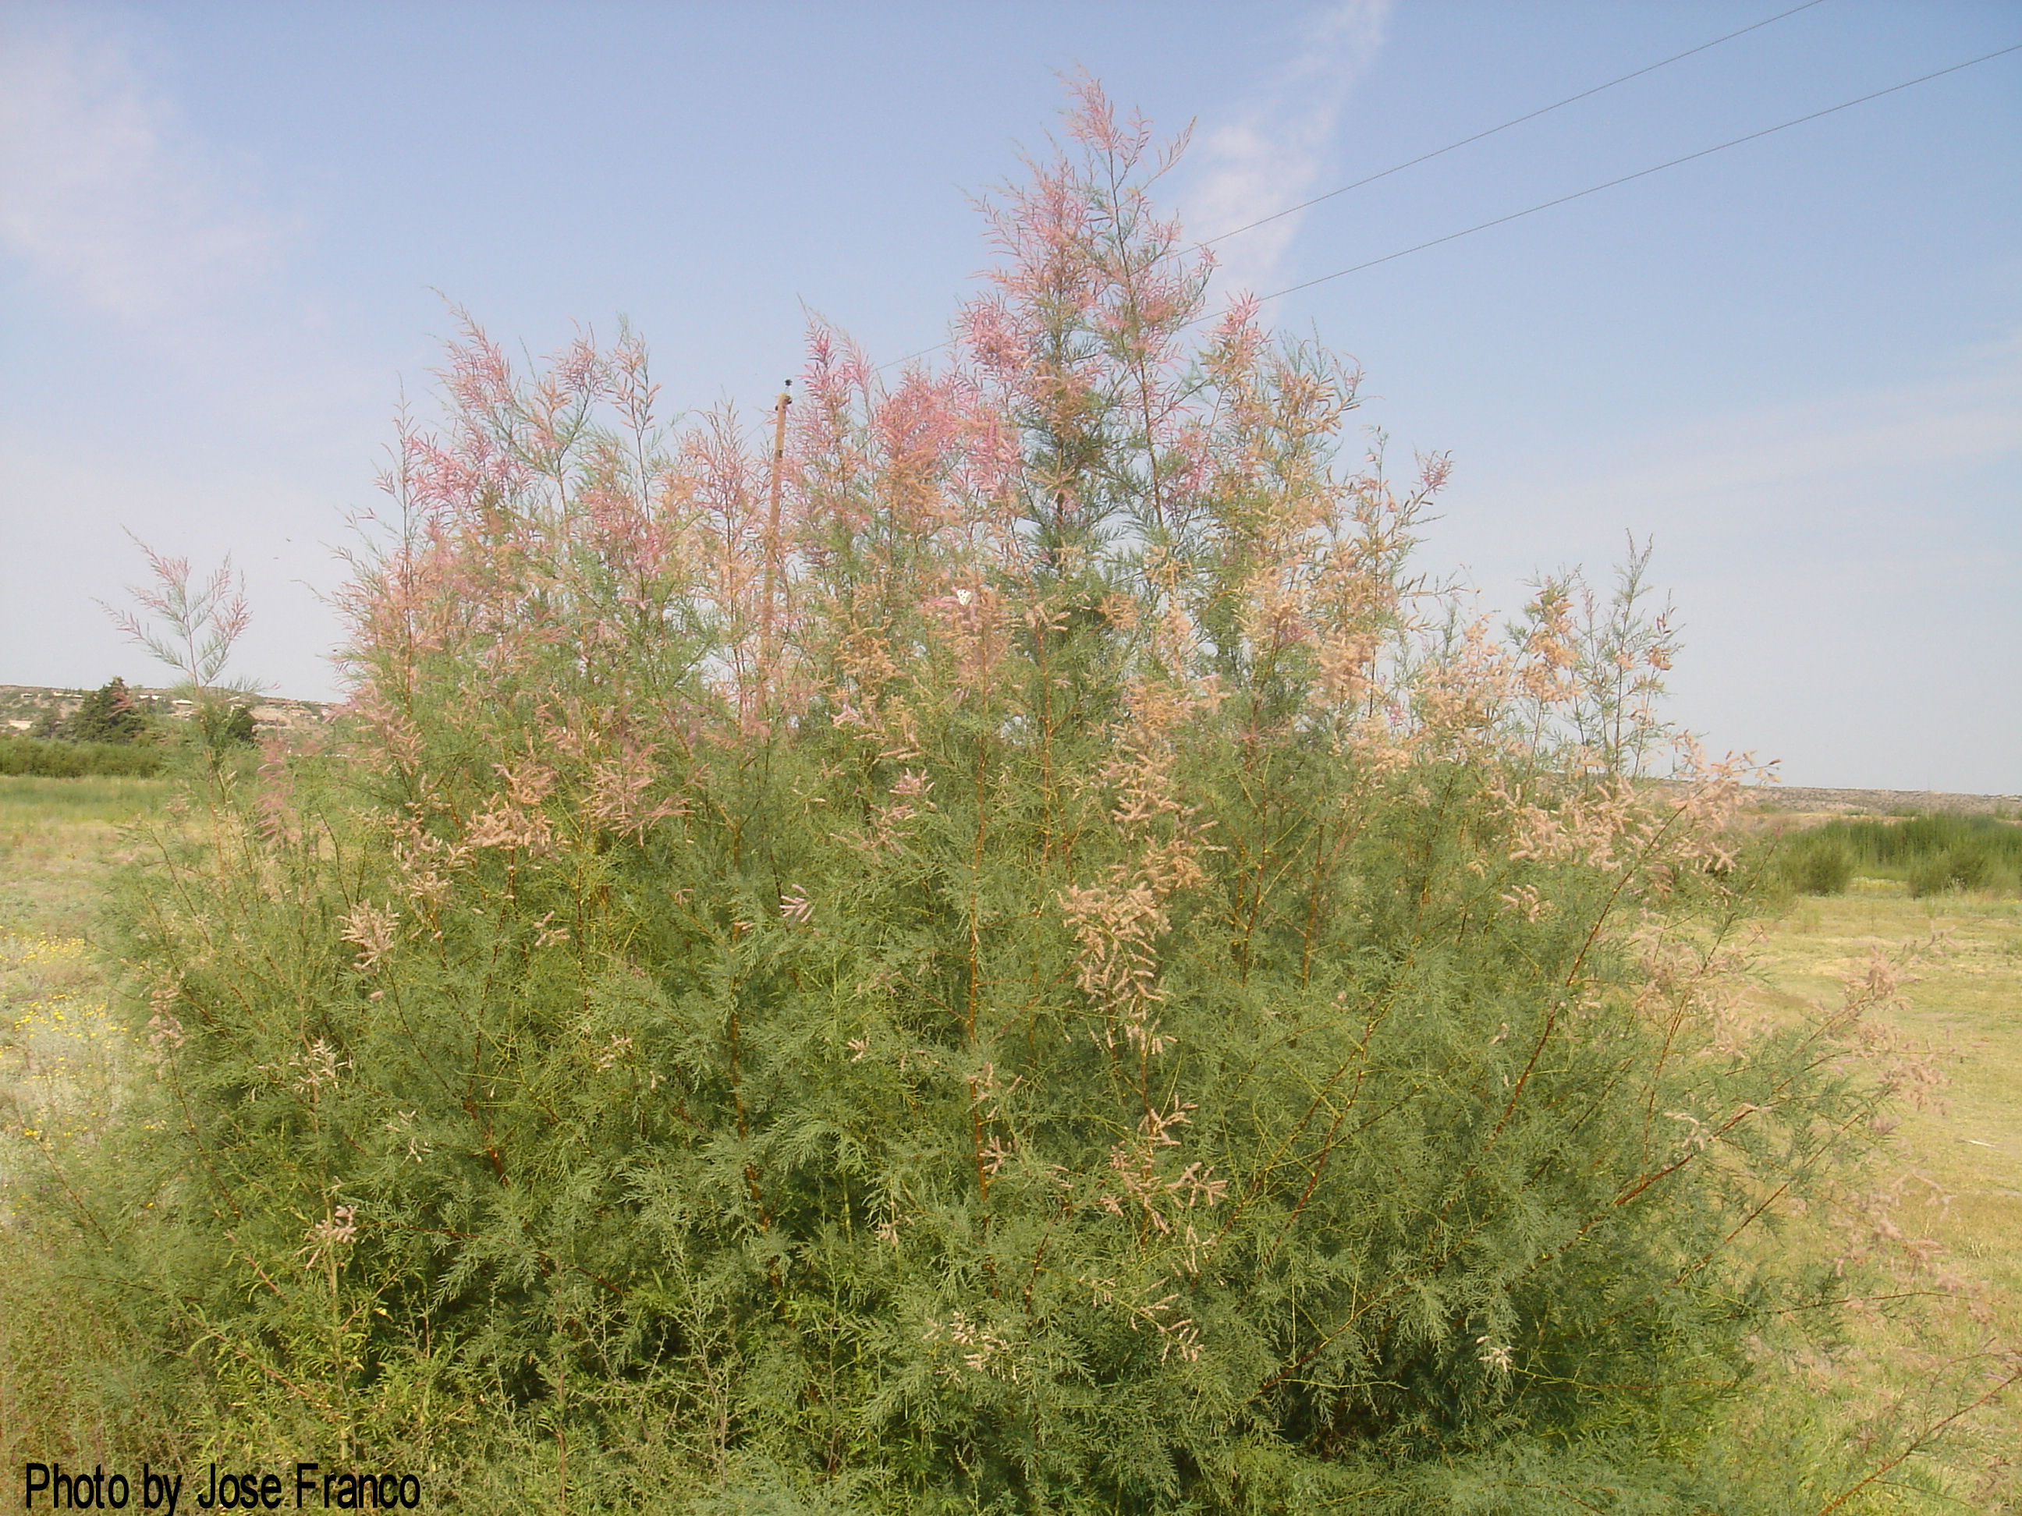

Slide 38
Ephemerals
Seasonal vegetation – tends to be only around when there is rainfall.
  Annuals – plants that have a short life span that coincides with rainy season
  Perennials – short flowering season
Escape drought by remaining as seeds until the rain falls
Bloom after rainfall, then seeds lie dormant until the next rain.

Slide 39
Halophytes
‘halos’ – Greek for salt
Low precip plus high evapotranspiration leads to high salt content
  Salts = mineral content, not NaCl specifically!
Adaptations similar to coastal plants – tolerance of salt is higher
Relatively low species diversity

Slide 40
Unique adaptations:
Give off chemicals that prevent other plants flowering near by, and protect water (allelopathy, creosote bush)
Take water & nutrient from other plants (e.g. Orobanca)
Seed dispersal – by wind, by animals - tumbleweed

Slide 41
Animal adaptations
Need to be able to function
  Within temperature range
  Challenges of water, food supply
  Environment challenges
Animals – much more than plants – show a range of options:
  Evolutionary response: selection of particular desirable characteristics leads to the spread of that characteristics
  Behavioural response: specific actions or approaches that can be ‘learned’ or taken by an animal

Slide 42
Behavioural changes
Migration – move away from the hottest part of the year, seasons – KANGAROO, ELEPHANT
Hibernation to avoid the hottest part of the year – DESERT TORTOISE
Nocturnal activity – only hunt, eat and come out at night – DESERT FOX
Avoid the midday heat – SHOVEL SNOUTED LIZARD

Slide 43
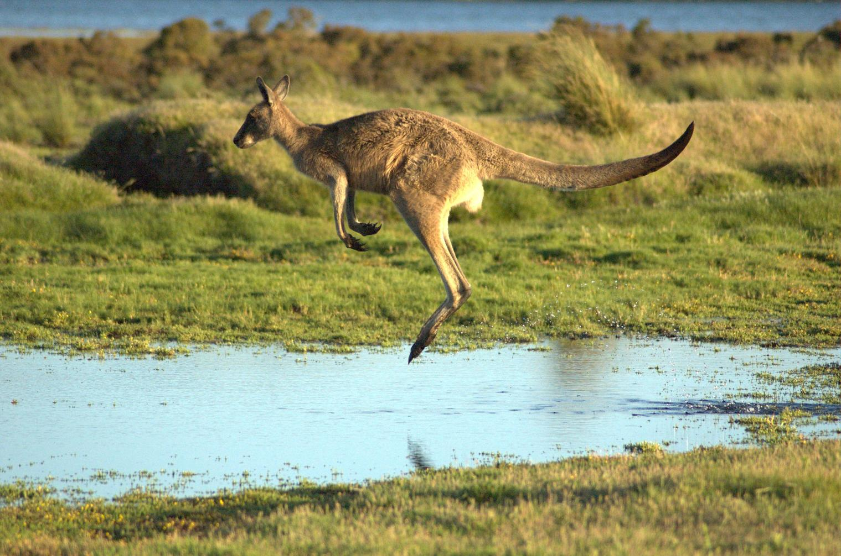

Slide 44
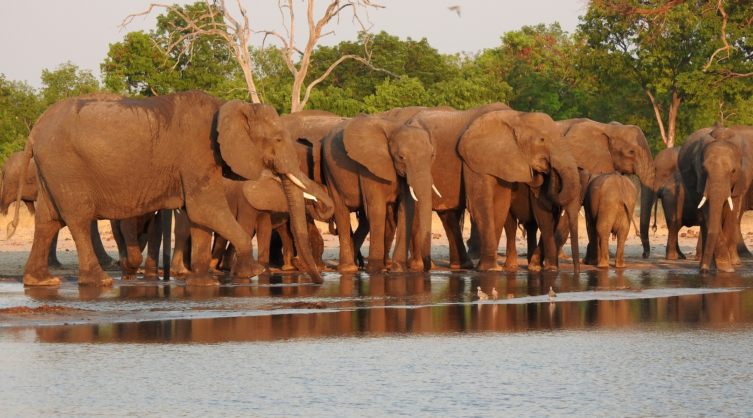
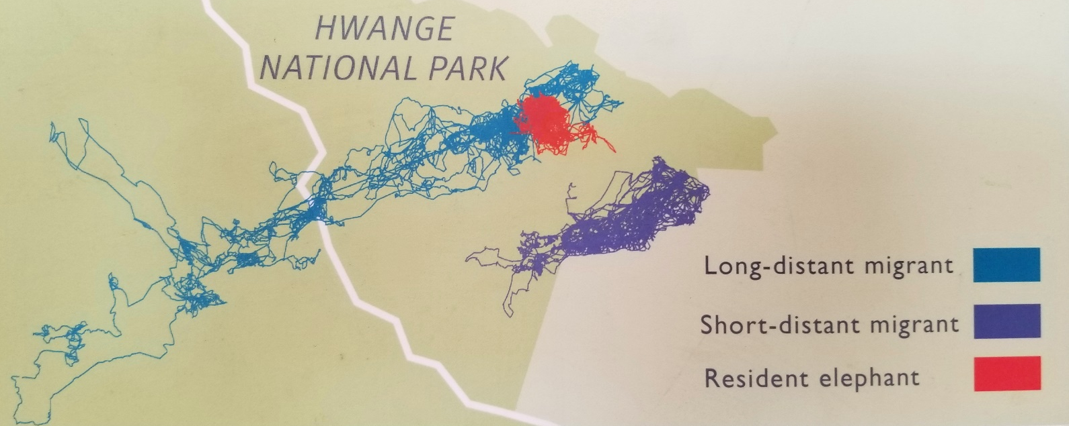

Slide 45
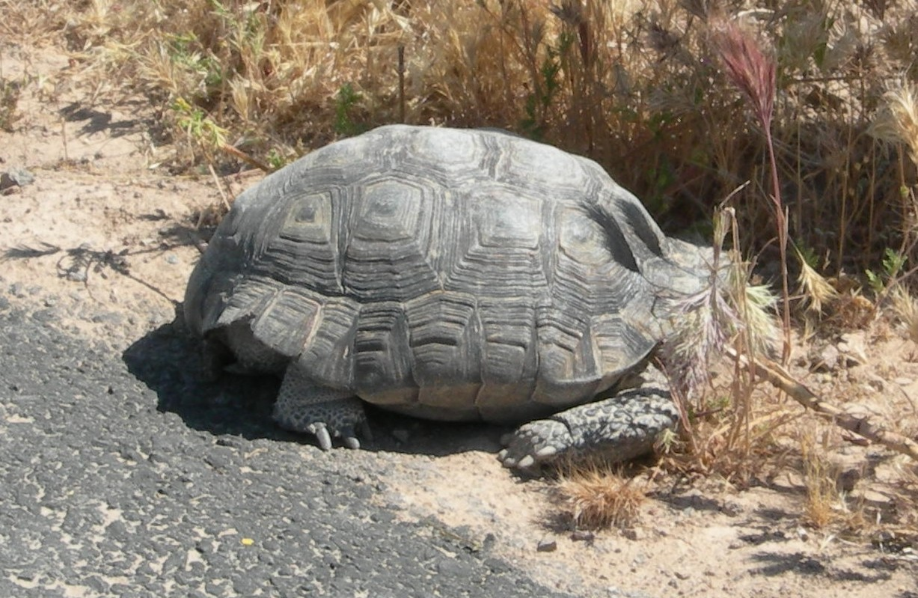

Slide 46
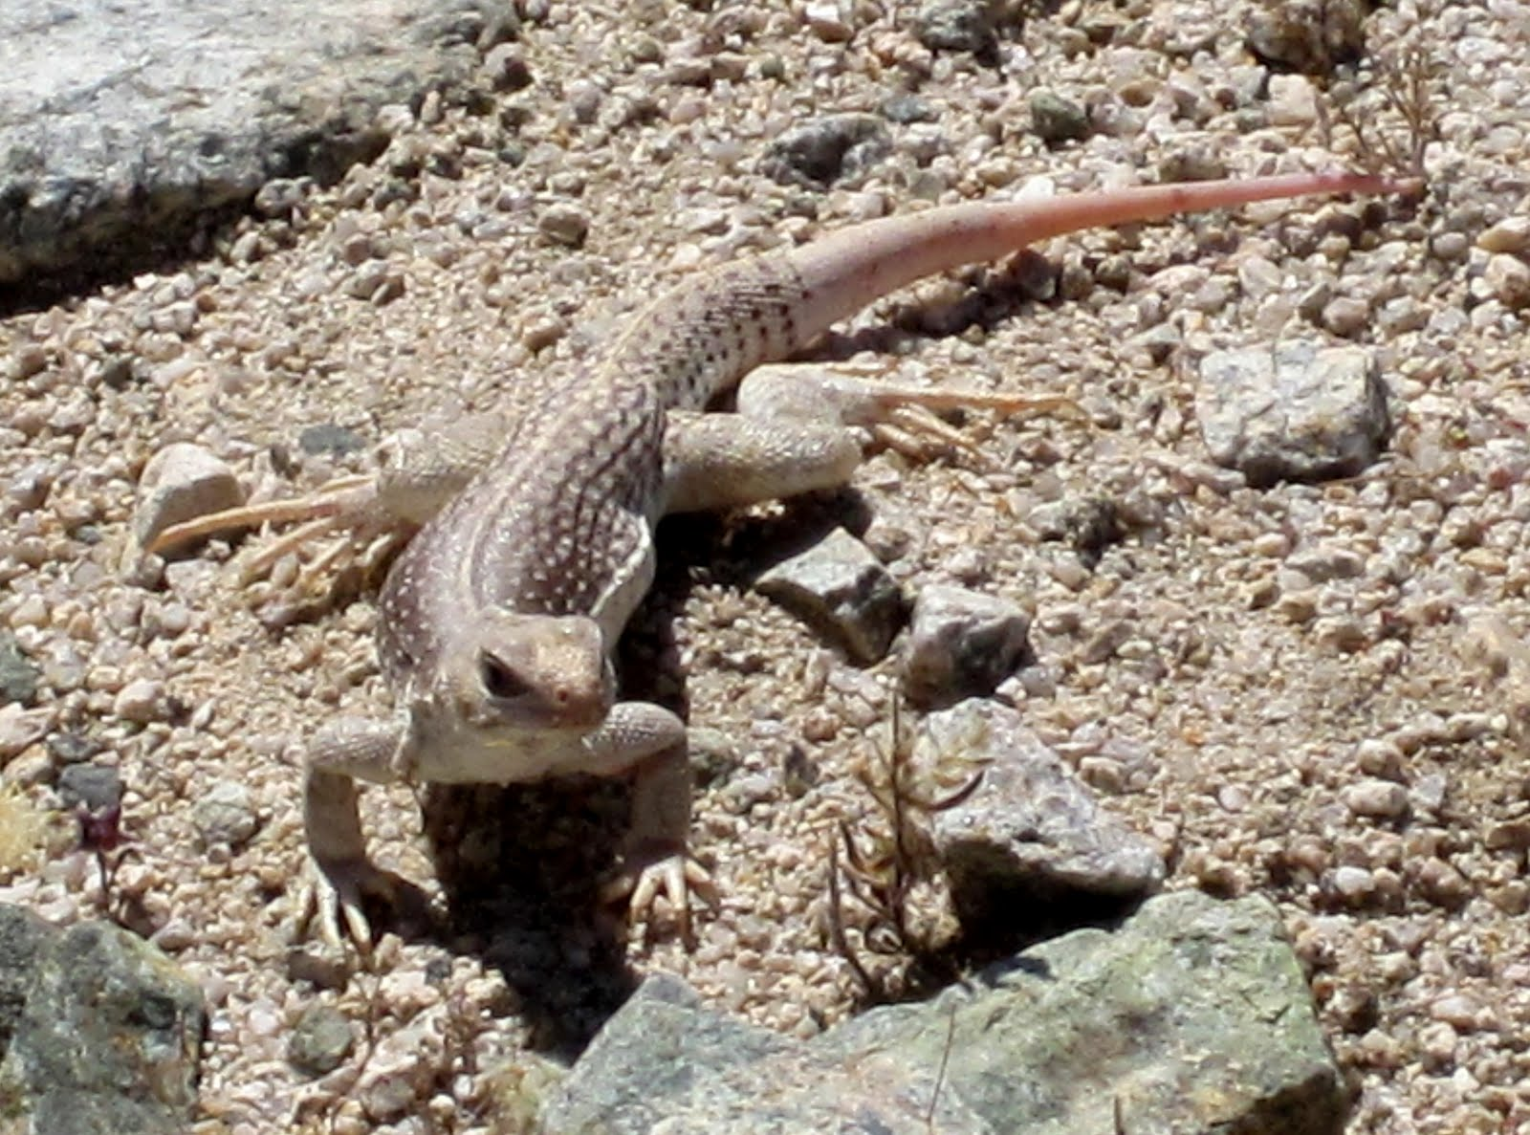

Slide 47
Physiological Adaptations
Body functions or features which help the animal cope with the desert
  Ears – structures to dissipate heat, like the DESERT FOX
  Furry feet – to spread the load and not sink in to sand, or be burned by hot sand – THE AMAZING CAMEL!

Slide 48
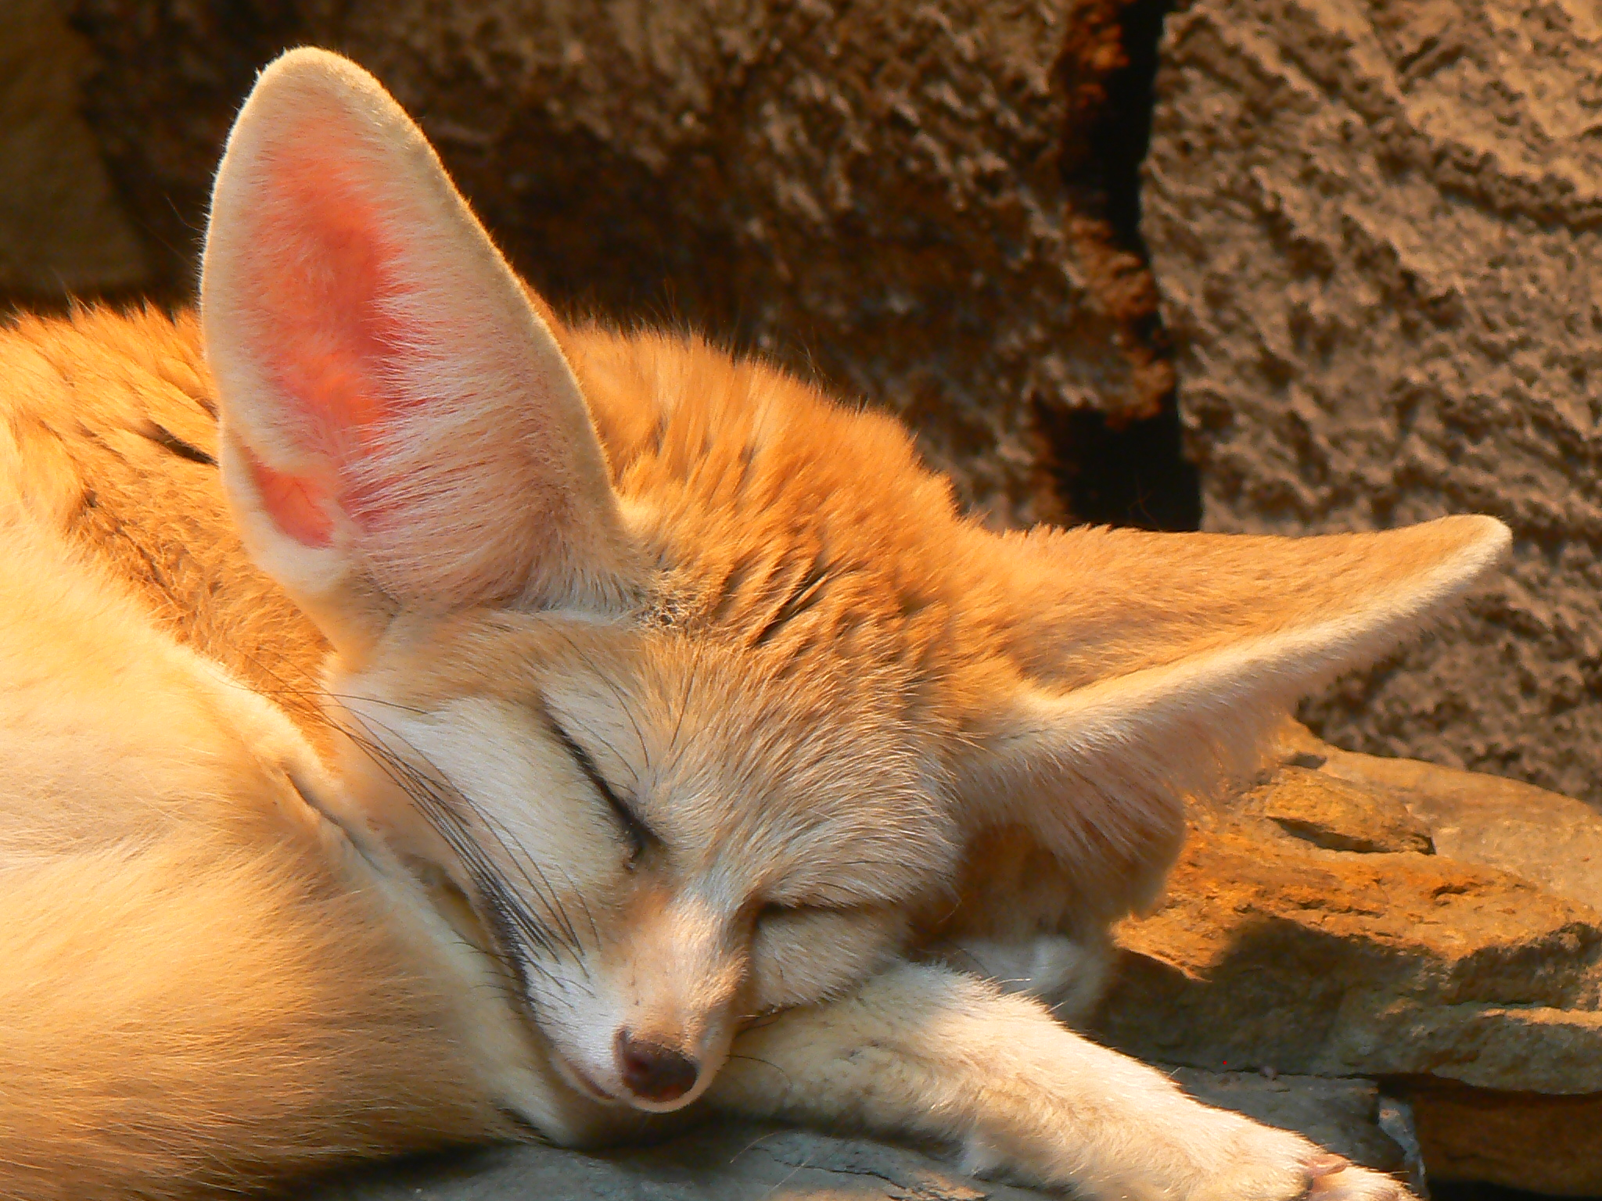

Slide 49
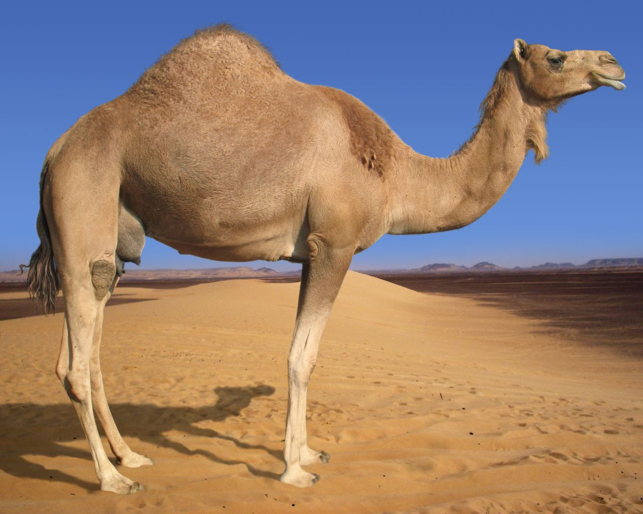
The amazing camel!

Slide 50
Human Adaptations
The vast majority of human adaptations to the desert environment are behavioural.
Some elements of this overlap with management approaches – brief introduction only here!

Slide 51
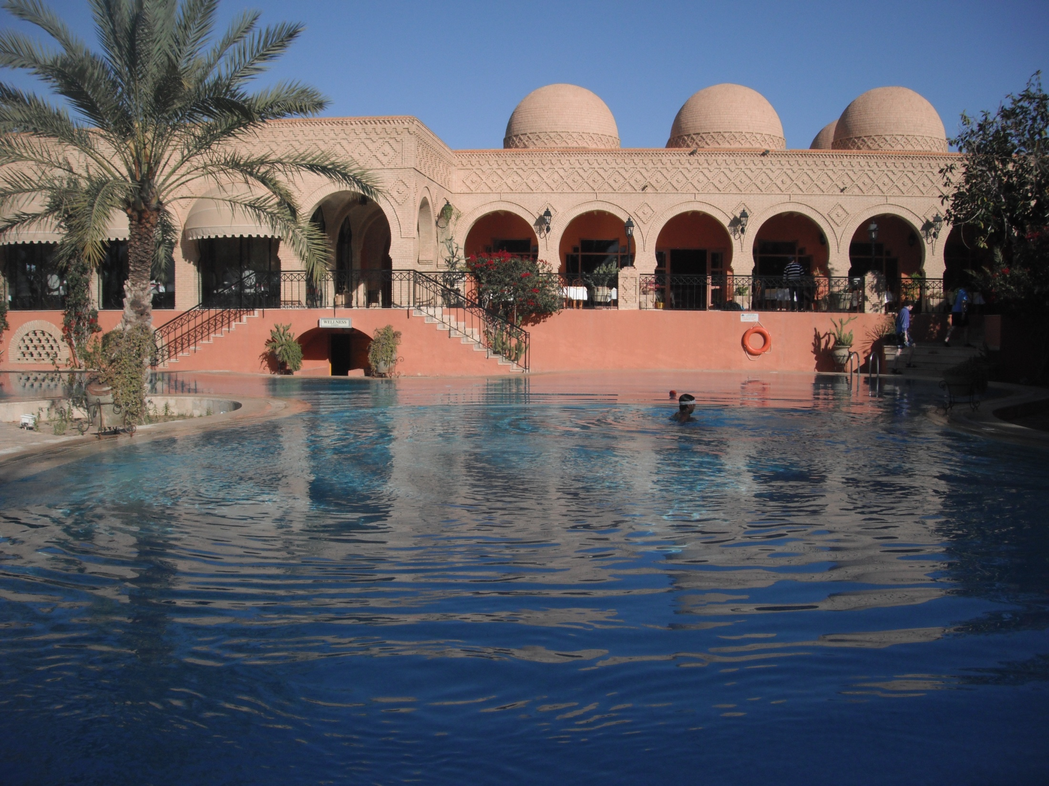

Slide 52
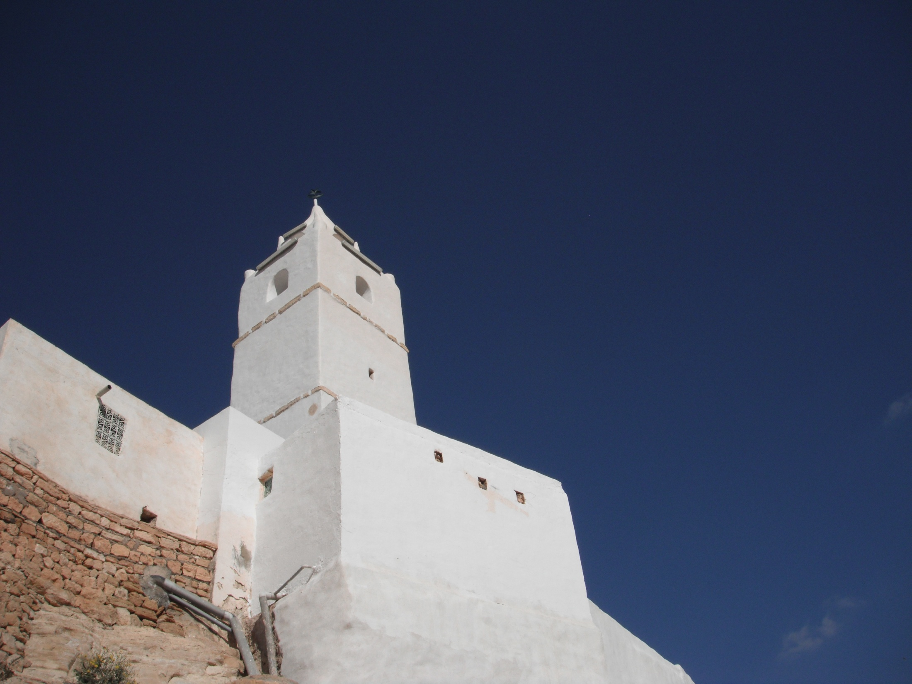

Slide 53
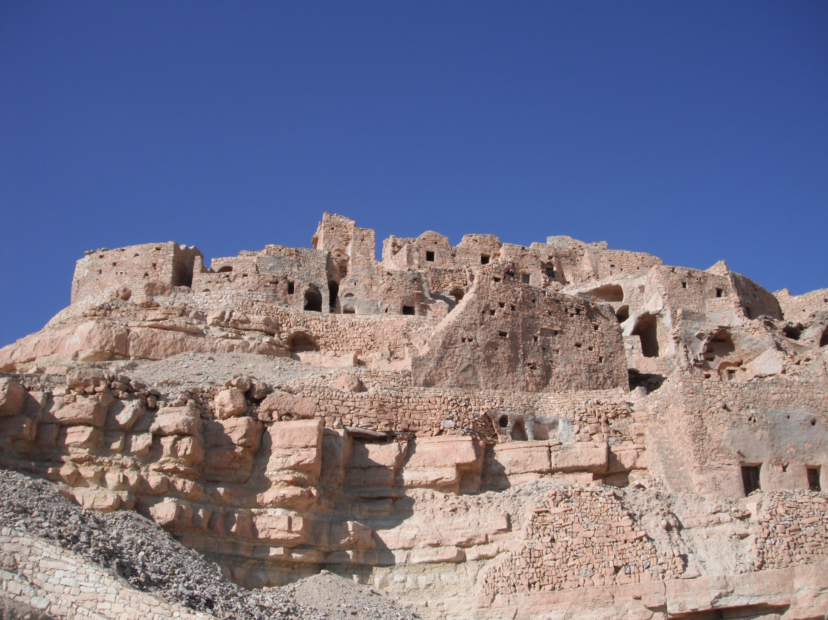

Slide 54
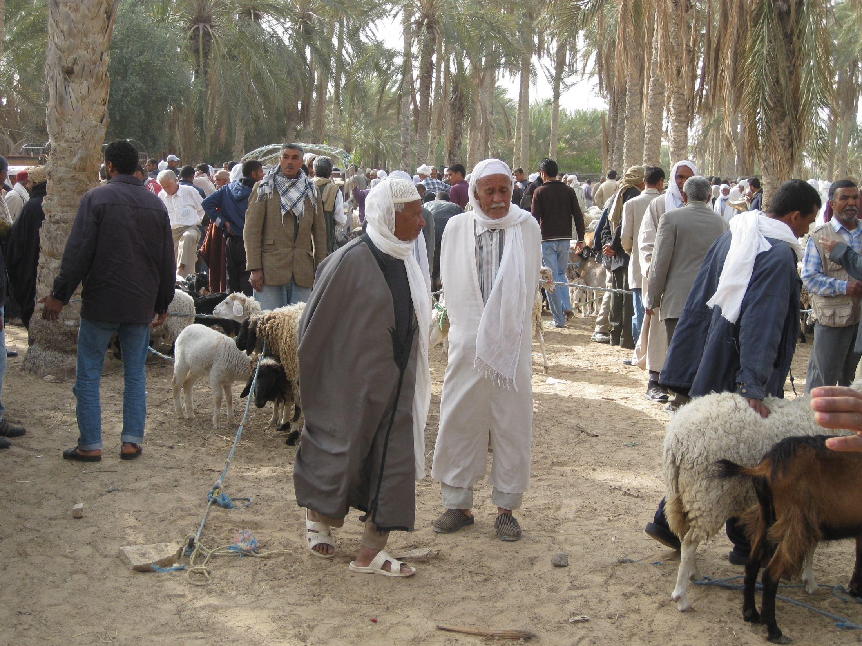

Slide 55
Questions & Key Thoughts
What are the problems? Why are they issues?
How does the system respond (soil, plant, animal), and how does that address the specific problems?
What might make it more complex or varied (e.g. types of desert, types of approach)?

Slide 56
Desert adaptation questions

Slide 57
How does this change? desertification

Slide 58
What have we learned?
Identified the comparative nature of desert soils, and described that they are, in general:
  Thin
  Poor organic matter
  Very slow to form, and hence
  Fragile
Recognised that the loss of soil is the primary component in desertification: major threat to human populations in arid & semi-arid regions

Slide 59
What is desertification?
Desertification is used to describe the reduction or degradation of the productivity and biological potential of the land
Given how fragile the soils are, and how slow soil formation is, we normally consider it to be “permanent” relative to human timescales
It is not always just expansion or further growth of desert regions – though there is often overlap!

Slide 60
Where is desertification most likely?
What does the map show in terms of areas of highest risk?
Common factors?

Slide 61
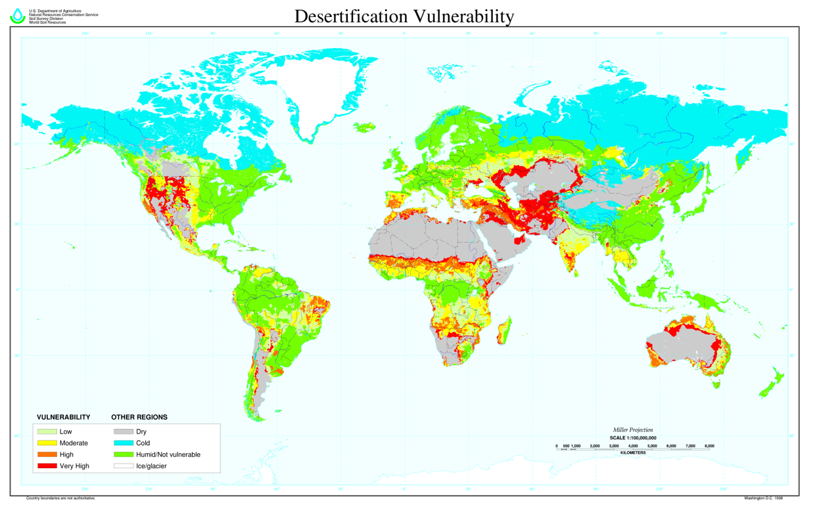

Slide 62
Where is desertification most likely?
What does the map show in terms of areas of highest risk?
Common factors:
  Proximity to existing desert regions
  Similar conditions for desert formation
  Human factors including overpopulation and poverty

Slide 63
What causes desertification?
Desertification is a simple process, but with complex causes
At the most basic level, it is caused by the loss of soil productivity – normally caused by the death or removal of the structures of vegetation
However, there are lots of reasons why the soil might be removed – human and physical components, and they are different in each example of desertification

Slide 64
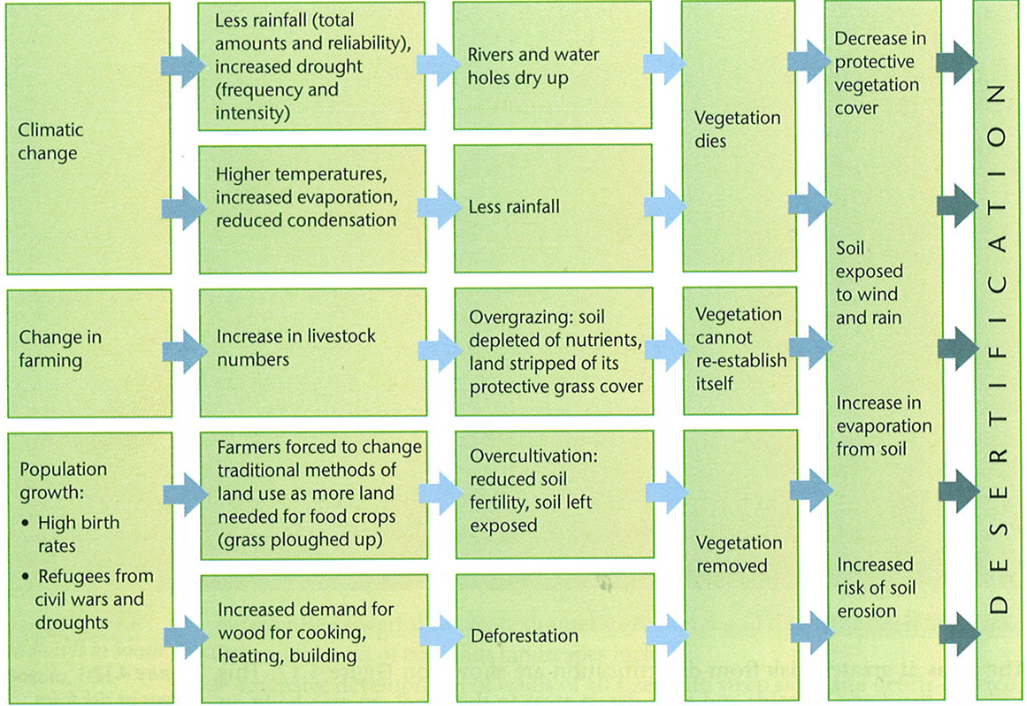

Slide 65
Examples from the sahel

Slide 66
Why does the Sahel suffer from desertification?
DESERTIFICATION
Increase in population
Increase in cattle
Deforestation for fire wood
Grassland grazed more intensively
Roots no longer hold soil together
Roots may be eaten as well as grass
Less vegetation means less protection from weather
Leaves no longer protect soil from weather
Loose top soil blown away by wind
(Soil Erosion)
=
Loose top soil blown away by wind
(Soil Erosion)
=
DESERTIFICATION

Slide 67
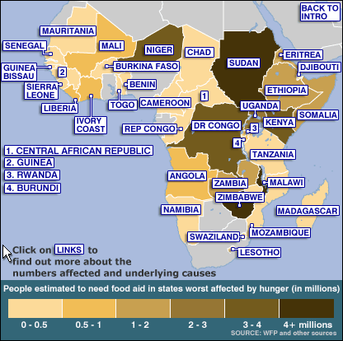

Slide 68
ETHIOPIA
NIGER
Estimated population: 77.43m
Projected number needing food aid: 1.7m
Key underlying reasons:
Drought
Refugees
High food prices
Overpopulation
Estimated population: 13.95m
Projected number needing food aid: 3m
Key underlying reasons:
After-effects of 2004 drought and locusts

Slide 69
DEMOCRATIC REP. OF CONGO
SUDAN
Estimated population: 36.23m
Projected number needing food aid: 6.1m
Key underlying reasons:
Conflict in western Darfur region has displaced 2m people
South recovering from long-running civil war
Drought in parts
Where farming is taking place, it is on a very small scale with most people cultivating with a simple hand tool called a 'maloda'.
Estimated population: 57.54m
Projected number needing food aid: 3m
Key underlying reasons:
Conflict
Refugees
War, malnutrition and disease have killed at least 3.8m people in the Democratic Republic of Congo in the last seven years.

Slide 70
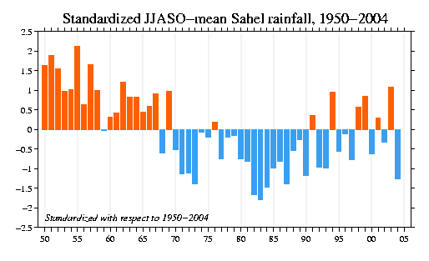
Physical Background – Decadal Rainfall
Period of high rainfall
Variability of modern
rainfall
Sustained period of drought
No identified single cause – complex interaction

Slide 71
Natural Causes: Decadal Rainfall
Variability of the climate is a normal part of the atmosphere (e.g. El Nino)
Rainfall variability in Africa is linked to monsoon/ITCZ style patterns, and is well modelled as a 18-20 year oscillation
It is not thought to be directly linked to anthropogenic “climate change” – it is a natural state
However, effects are massively significant – influence is on the whole desert system
There is *no* known solution and mitigation strategy – this is not something we can fix

Slide 72
Cause: Impact of Droughts
Most recent major drought in the Sahel was 2012
Valerie Amos, UN Humanitarian Chief during 2012, released a statement during the year stating that over 15 million people were malnourished in West Africa and the Sahel region.
The main contributor to the famine was the drought of Sahel, ensued from a combination of failing crops and El Niño.
Mauritania and Chad recorded a loss in crop yield of over 50% when compared to 2011.
Food reserves in the areas affected were very low and combined with corn prices soaring by 60-85% compared to averages over the last five years.
In Chad alone this food crisis affected some 3.6 million people.
In places like Burkina Faso over 2.8 million were suffering from famine and in Senegal over 800,000 did not have enough to eat.

Slide 73
Cause: Change to traditional lifestyles
Traditional lifestyle is pastoral nomadism or subsistence agriculture. This is changing.
Most Africans live in rural areas, where many are subsistence farmers, dependent on a good harvest to get enough food to eat.
There are hardly any irrigation systems, so people rely on the rains.
If one rainy season fails, people have very few savings - in either food or cash - to see them through.
Even in good years, there is a "hungry season", when last year's harvests have run out and the next crops are not yet ripe.
While people were starving in parts of Niger last year, shops in the capital, Niamey, were full of food but many could not afford to buy it.
In both the Horn of Africa and Niger, some of the most vulnerable were pastoralists, whose animals quickly succumbed when there was nothing left to graze.
When the animals die, their owners have no other way of getting enough food to eat.

Slide 74
Cause: Overpopulation
Sub-Saharan Africa has one of the world's fastest growing populations (approximately 2.2% a year), and is expected to be home to over a billion people by 2025.
Population density, measured by number of inhabitants per sq km, is low in the Sahel.
    The Gambia has 85 people per sq km (by comparison, Germany has 223 people per sq km).
    Senegal has 38, Burkina Faso 34, and the remaining four have an average of less than seven people per sq km.
However, only a small portion of the total land area of the Sahel is suitable for ecologically and economically sound agriculture. The ratio of inhabitants to available agricultural land thus presents a much darker picture than the low population density might suggest.
    The highest population densities relative to cultivable land are 633 people per sq km in Mauritania, 293 in Mali, and 228 in Burkina Faso.
    In Senegal the rate is lowest at less than 100 people per sq km

Slide 75
Cause: Management Techniques
More effective economic policies in many sub-Saharan African countries since the mid-1990s have led to improved economic development and performance.
  During 1995-98, real GDP growth averaged 4.25% a year, an increase from less than 1.5% a year during 1990-94.
Economists say that modernising agriculture is the best way forward, so farmers use more efficient techniques, such as irrigation.
This is different to the balance of traditional sustainable techniques and requires significant investment
In many countries, rural land is held on trust by tribal chiefs and handed out to individual families.
Some say the key would be to give farmers title-deeds to their land, so they could use it as collateral to borrow money to invest.
But changing systems such as this would take many years to take hold in more remote areas, where people's lives have hardly changed for hundreds of years.

Slide 76
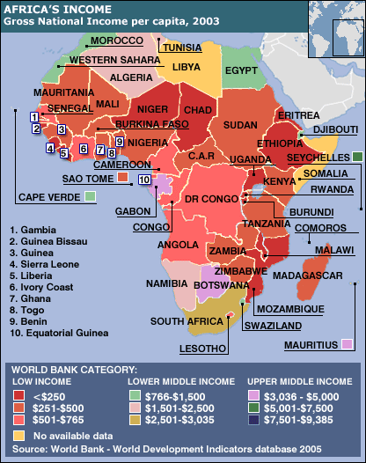
Poverty

Slide 77
Poverty
Poverty is at the heart of Africa's problems. This is an overview of some of the economic challenges facing the continent.
Most of Sub-Saharan Africa is in the World Bank's lowest income category of less than $765 Gross National Income (GNI) per person per year. Ethiopia and Burundi are the worst off with just $90 GNI per person.
Even middle income countries like Gabon and Botswana have sizeable sections of the population living in poverty.
North Africa generally fares better than Sub-Saharan Africa. Here, the economies are more stable, trade and tourism are relatively high and Aids is less prevalent.
Development campaigners have argued that the rules on debt, aid and trade need reforming to help lift more African nations out of poverty.

Slide 78
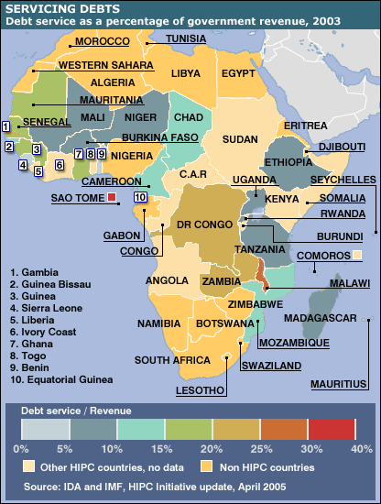
Debt

Slide 79
Debt
The Heavily Indebted Poor Countries initiative (HIPC) was set up in 1996 to reduce the debt of the poorest countries.
  Poor countries are eligible for the scheme if they face unsustainable debt that cannot be reduced by traditional methods. They also have to agree to follow certain policies of good governance as defined by the World Bank and the IMF.
  Once these are established the country is at "decision point" and the amount of debt relief is established.
  Critics of the scheme say the parameters are too strict and more countries should be eligible for HIPC debt relief.
This map shows how much "decision point" HIPC countries spend on repaying debts and interest.
Fourteen African HIPC countries had their debts totally written off under a plan drawn up by the G8 finance ministers in 2005.

Slide 80
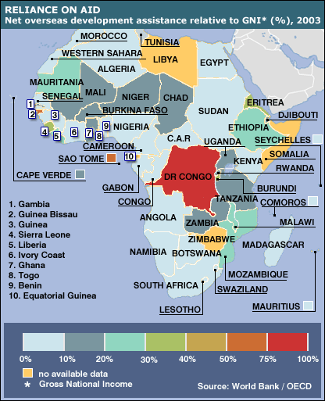
Reliance on aid

Slide 81
Aid
Africa receives about a third of the total aid given by governments around the world, according to the Organisation for Economic Co-operation and Development.
Much of this has conditions attached, meaning governments must implement certain policies to receive the aid or must spend the money on goods and services from the donor country.
The World Bank, which is reviewing its conditionality policies, argues that aid is far more effective, and less vulnerable to corruption, when coupled with improved governance.
There was a sharp drop in rich countries' relative spending on aid in the late 1990s.
The Make Poverty History campaign urged the G8 to raise an extra $50bn more in aid per year and to enforce earlier pledges for developed countries to give 0.7% of their annual GDP in aid.

Slide 82
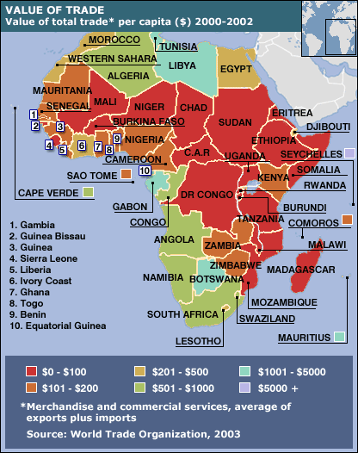
Trade

Slide 83
Trade
Africa is rich in natural resources such as minerals, timber and oil, but trade with the rest of the world is often difficult.
Factors include poor infrastructure, government instability, corruption and the impact of Aids on the population of working age.
Poorer countries and agencies such as Oxfam also argue that international trade rules are unfair and favour the developed world.
  They say rich countries "dump" subsidised products on developing nations by undercutting local producers.
  They accuse the World Trade Organisation (WTO) of forcing developing nations to open their markets to the rest of the World but failing to lower rich countries' tariff barriers in return.
  But the WTO says that low income countries receive special treatment, including exemption from some regulations that apply to richer nations.
Most African economies are geared to low-value production as a consequence – cash crops and simple produce. This is not long term sustainable.

Slide 84
Complication: Politics
Some three million people are going hungry in Zimbabwe, which used to be the region's bread basket. Most donors say the government's seizure of productive, white-owned farms has worsened the effects of poor rains.
Political co-operation between the countries in the Sahel is limited – they should be more united against the major challenges they face – but most are struggling to cling on to power
Government actions are limited by four key factors:
  Poverty
  Debt
  Aid
  Trade

Slide 85
Complication: Instability & Terrorism
Political instability has plagued some of the Sahel’s countries for years. In Mali, the military coup of March 2012 brought an abrupt halt to 20 years of stable democracy. In its aftermath, terrorists who had occupied most of the northern region started heading south, intent on taking control of the whole country. In January 2013 a French-led and Chad-supported intervention stopped their advance. The conflict compounded the security and humanitarian crisis, in part by disrupting supply routes and causing food shortages.
The crisis in neighbouring Darfur, Sudan, and the presence of an armed rebellion in the east did damage to Chad’s security that will last for many years. During Niger’s 50 years of independence, notes a report by the International Crisis Group, a think tank, the country has seen two armed rebellions, four coups, seven governments and periods of promising democratic change as well as reversals.
In a region with porous borders, a political or security crisis in one country is often a serious threat to neighbours.
These borders have benefited criminal networks and drug traffickers. The UN Office for Drugs and Crime (UNODC) has estimated that major illicit flows linked to criminal activities in the Sahel amounted to $3.8 billion annually.
Regional governments do not have the ability to solve the crises – inexperienced and under-funded military forces, and no training to deliver counter-insurgencies
Brief Analysis Video and CSIS Summary Website
https://www.bbc.co.uk/news/resources/idt-sh/war_in_the_desert

Slide 86
Complication: Civil War & Conflict
Tuareg conflicts in Mali, Libya and across the Sahel
Sudan, and the formation of South Sudan
Mali, and the fight against Boko Haram (support from Chad)
Alliance (G5) – Burkina Faso, Chad, Mali, Mauritania and Niger (5000 troops)
Multinational Joint Task Force (Benin, Cameroon, Chad, Niger, Nigeria, 7500 troops) – fighting Boko Haram
UN interventions by UN, USA, French (links to former colonial regions: Op Barkhane), military support by NATO including UK
Look at networks & relationships:
  Analysis of Conflict
  Sahel Insurgent Groups

Slide 87
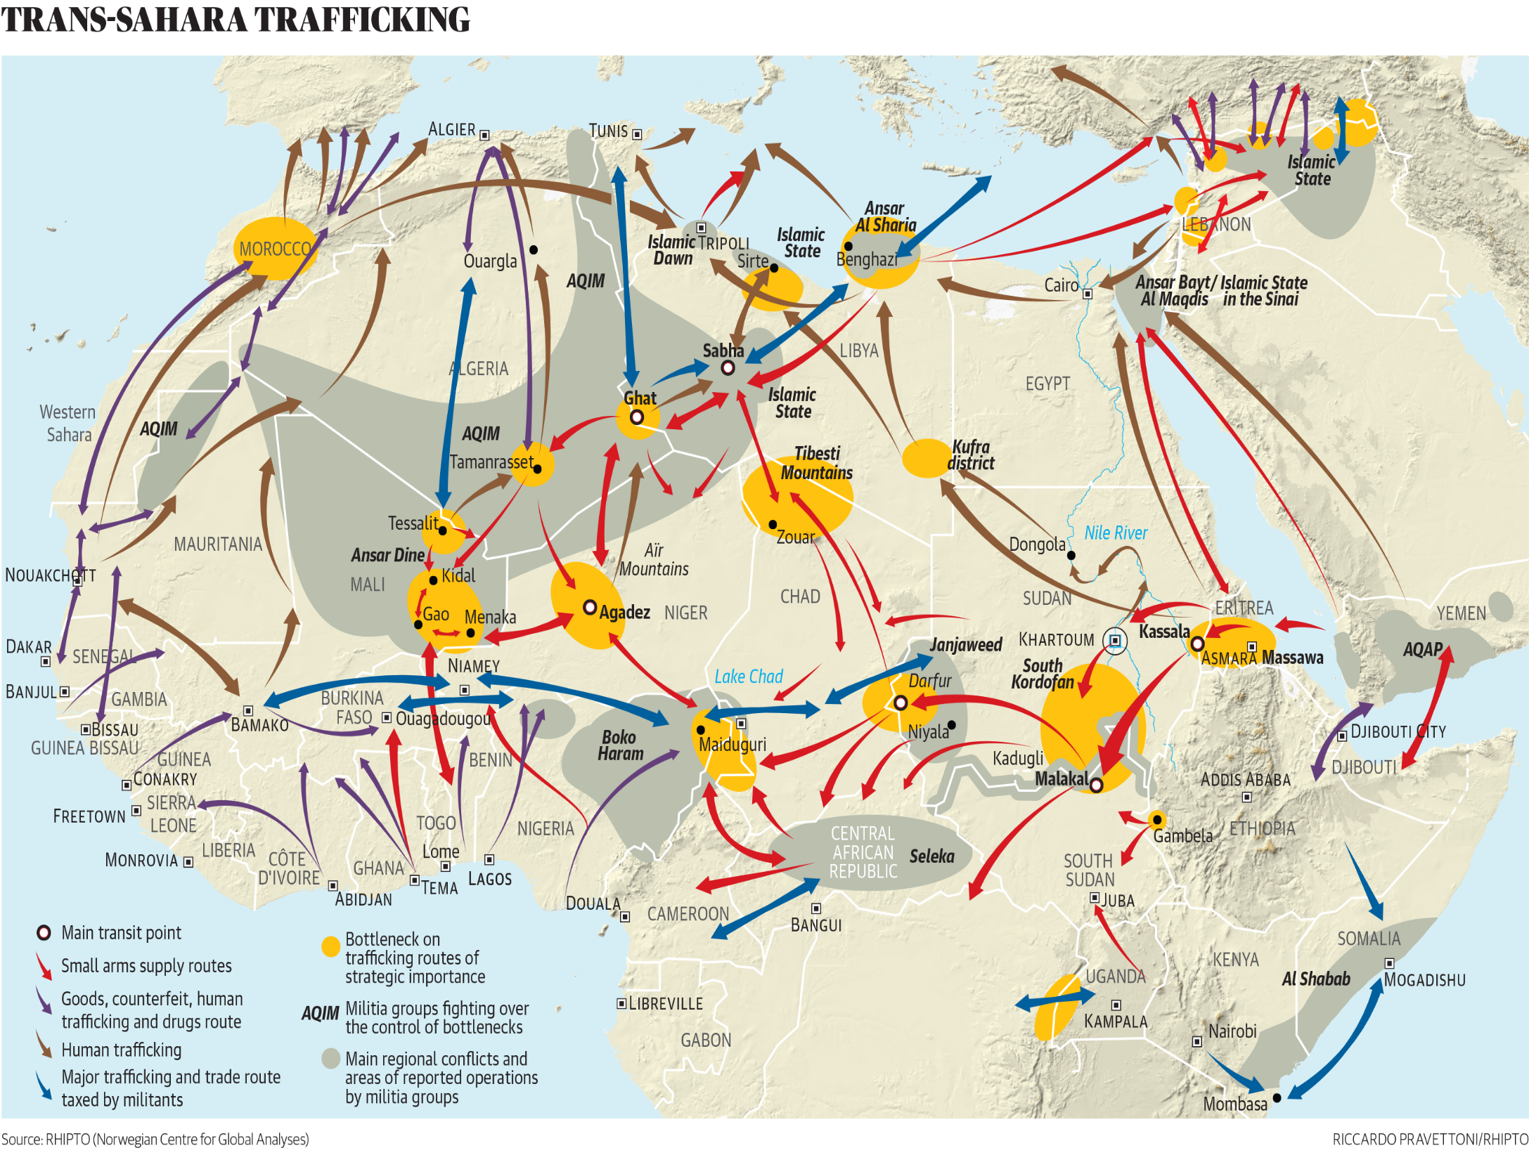

Slide 88
What are the other reasons?
Many farmers say that rains have become less reliable in recent years, which could be the result of global warming.
The Sahara desert is certainly expanding to the south, making life increasingly difficult for farmers and pastoralists in places like Niger.
Rising populations have led people to farm on increasingly marginal land, even more at risk from even a slight decline in rainfall.
Complicated by other issues: Southern Africa has the world's highest rates of HIV/Aids and this is a major factor in that region's food crisis.
Some of those who should be the most productive farmers - young men and women - are either sick or have died, so their fields are being left untended, while their children go hungry.

Slide 89
Human vs Physical – Causes?
It is particularly striking that the FAO highlights political problems such as civil strife, refugee movements and returnees in 15 of the 27 countries it declares in need of urgent assistance.
By comparison drought is only cited in 12 out of 27 countries.
The implication is clear - Africa's years of wars, coups and civil strife are responsible for more hunger than the natural problems that befall it.
What makes this so difficult to fix? Elements of wider complication that need to be considered!

Slide 90
Essay plan: With reference to examples, explain to what extent desertification is a physical problem.

Slide 91
Desert management

Slide 92
What is the point?
Consider the PURPOSE of management:
  Halt/reduce physical problem (e.g. desertification)
  Provide sustainable ecological support for environment
  Provide sustainable agriculture
  Provide tourism opportunities
  Provide wider economic opportunities
Which are most likely for HICs?
For LICs?

Slide 93
Looking at Examples
Key is to understand the range of examples – there are lots of different methods, and we need to be able to consider:
  Context
  What works about this approach to management?
  What are the limits of this management type?
Some examples are going to be worked through in class – others can be read up on

Slide 94
1. The Great Green Wall
Aim: to halt desertification
  https://www.youtube.com/watch?v=HVOYN70scS8 – Great Green Wall, Newsnight
  https://www.youtube.com/watch?v=4xls7K_xFBQ
What are the challenges?
Why does this seem unlikely?
Modern tree planting rates?
  https://www.bbc.co.uk/news/world-africa-49266983

Slide 95
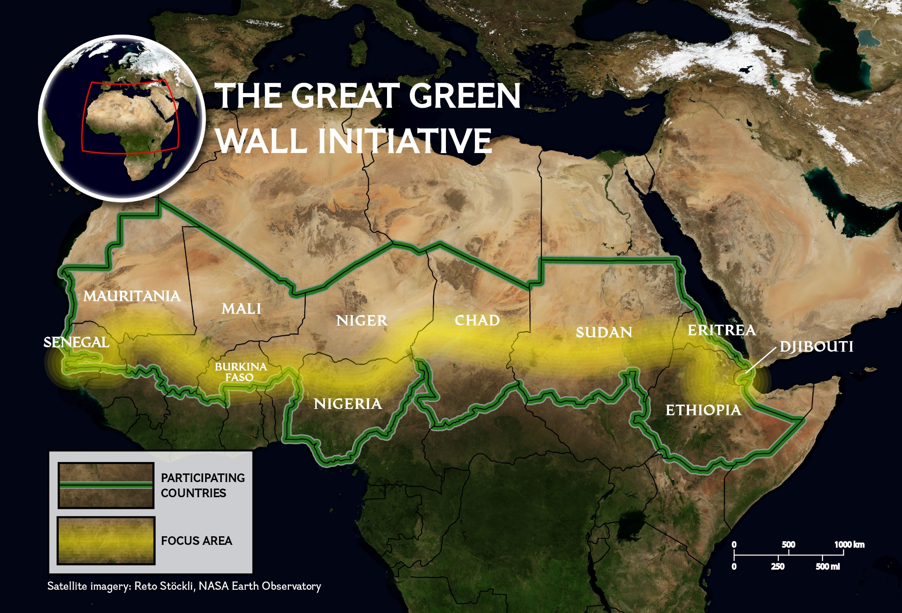

Slide 96
2. Diguettes, Burkina Faso
Great example of work by Oxfam to produce a low-cost, local scale, bottom up focused approach
  https://www.youtube.com/watch?v=RQkiv_U5AoU – stone lines documentary
Aim to reduce moisture loss and reduce desertification
What are key elements of success?
What are limits of this (bottom up?) approach?

Slide 97
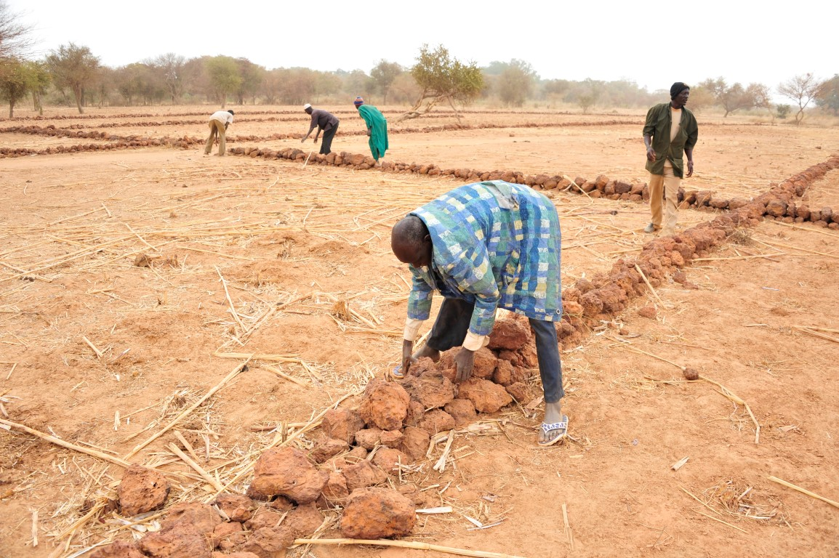

Slide 98
3. Agriculture Changes, Eastern Cape SA
Economics driven decision – interesting counterpoint to previous examples
Finding most suitable/sustainable agriculture for future development
Move away from non-adapted crops:
  Tropical fruits (with irrigation)
  Cape Aloe (Aloe ferrax) – natural desert plant
Why is this positive?
What are the limits of this?

Slide 99
Videos:
https://www.youtube.com/watch?v=M1OjKvidjAA – fruit farming, Eastern Cape
https://www.youtube.com/watch?v=Stn1flEwV2o 0 Eastern Cape

Slide 100
4. Multi-National Aid Programmes
Refer to textbook (p352)
Short term solution to problems (e.g. drought)
What are the key issues with doing this?
Why is it unsustainable as an approach?

Slide 101
5. Desert Mgt in SW USA
Very different experience in the USA – aiming to urbanise and preserve development (and/or use economic tourism!)
Why does this change the approach?
How does this show in what they do?
Is this ‘sustainable’?

Slide 102
6. Desert Mgt in Dubai
Textbook, p355
Another example of a very different purpose and a very different outcome and approach
How sustainable is this?
Why does sustainability seem to matter more for Dubai than the USA?

Slide 103
Evaluation Points
Desert management is not all the same
Any response is a combination of:
  Different challenges (levels of aridity, physical cause, desertification)
  Complex factors (e.g. Sahel)
  Purpose of management (e.g. tourism vs survival, economic vs environmental)
Should be able to USE and EVALUATE these examples to show the range of responses!

Slide 104
Essay plans – desert management

Slide 105
Practice questions

