Slide 1
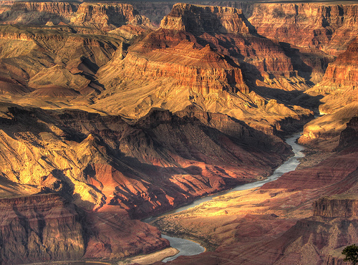
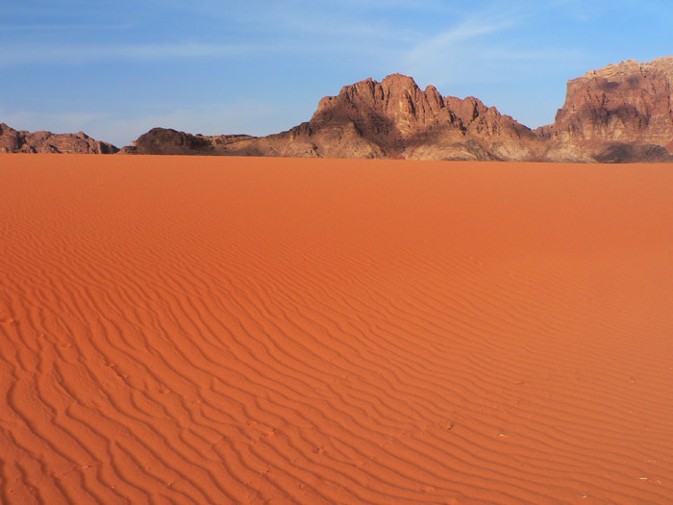
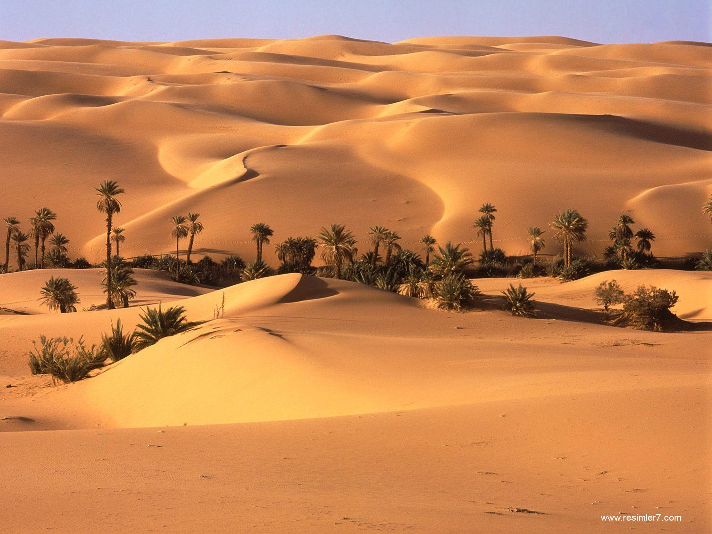
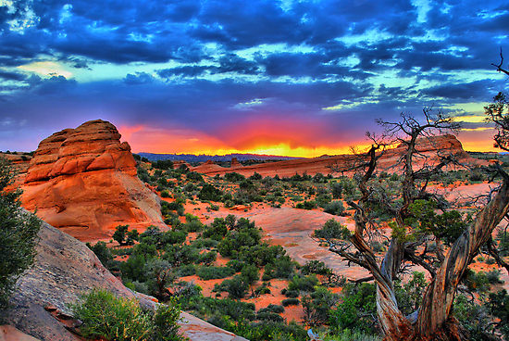
Advanced Physical, Paper 3
10. Hot arid and semi-arid environments

Slide 2
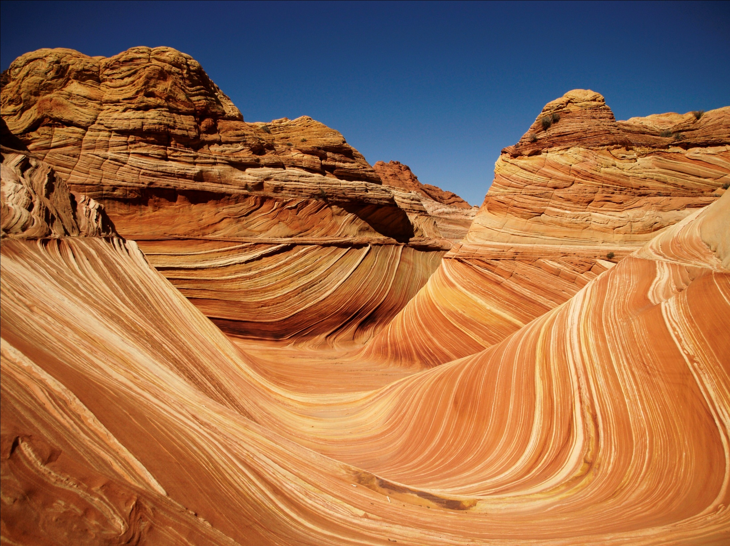
Advanced Physical, Paper 3
10.2. Landforms of Arid Environments

Slide 3
10.2 Landforms of Arid Environments
Weathering processes: thermal fracture, exfoliation, salt weathering, chemical weathering, and their effects.
Processes of erosion, transport and deposition by wind: corrasion/abrasion, deflation, traction, saltation, and suspension.
Erosion, transport and deposition by water action: hydrological regime, episodic rainfall, sheet and flash floods.
Characteristic landforms: sand dunes, wind sculptured rocks (yardang, zeugen), wadis, alluvial fans, arroyos, pediments, and piedmont zone (bahadas, playas, salt lakes, inselbergs).
Relative roles of aeolian and fluvial processes: evidence for past climate change (Pleistocene pluvials), and the role of past processes in the development of landforms.

Slide 4
Key Concepts
Deserts are formed by a combination of factors, including: their base material, weathering and different forms of erosion
All of these factors will be location-specific: and will create a range of desert features and landforms within the context of aridity
Understanding the interaction of different processes is important at a range of spatial and temporal scales.

Slide 5
Key Questions to Answer:
What does the desert consist of?
How is it broken down?
How is it eroded?
How is it transported?
How is it deposited?
How can we compare the relative roles of water and wind in the desert

Slide 6
What does the desert consist of?
Base material (underlying geology) of desert affects the nature of what forms in the area.
Types of deserts include:
  Erg: sandy desert
  Hamada: rocky desert surface
  Reg (regolith): stony, scattered surface
Material must be broken up (weathered) and then moved (erosion, transport).
These processes create most of the major landforms.

Slide 7
How is the desert broken down?
Weathering is the degradation of material in situ
This involves the (structural) weakening of material to be broken in to smaller pieces (enhanced surface area)
There are different types of weathering that take place:
  Mechanical (physical) weathering
  Chemical weathering
  Biological weathering

Slide 8
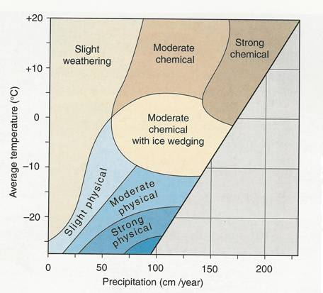
Weathering Controls (Peltier, 1950)
What can we predict will happen in deserts?

Slide 9
Mechanical Weathering: Diurnal Cycle
Diurnal temperature cycle is key to understanding the majority of the physical weathering options
High temperatures in the day time, with rapid cooling overnight, creates a cycle of hot-cold that has influences on the material in the desert.
Differential absorption of the heat/thermal properties makes the driving force for substantive weathering

Slide 10
Mechanical Weathering
Granular disintegration – where light/dark minerals within a rock heat/cool at different rates.
Exfoliation weathering – where layers of rock (surface/deeper) heat/cool and expand/contract at different rates.
Causes layers to ‘flake off’ like an ‘onion-skin’
Block disintegration – where rocks heat/cool and fracture along larger joints (needs jointed rock)

Slide 11
Mechanical Weathering
Salt weathering/crystallisation
  Temperatures draw salt in the rock to the surface
  Growth of salt crystals can exert a pressure on the joints of rocks in the same way as water.
  Important in drier deserts, hyper arid especially
Freeze-thaw weathering
  Specific form of diurnal cycle, involving crossing the freezing point
  Only possible where there is moisture and freezing temperatures
  Often in higher altitude deserts (e.g. SW USA)

Slide 12
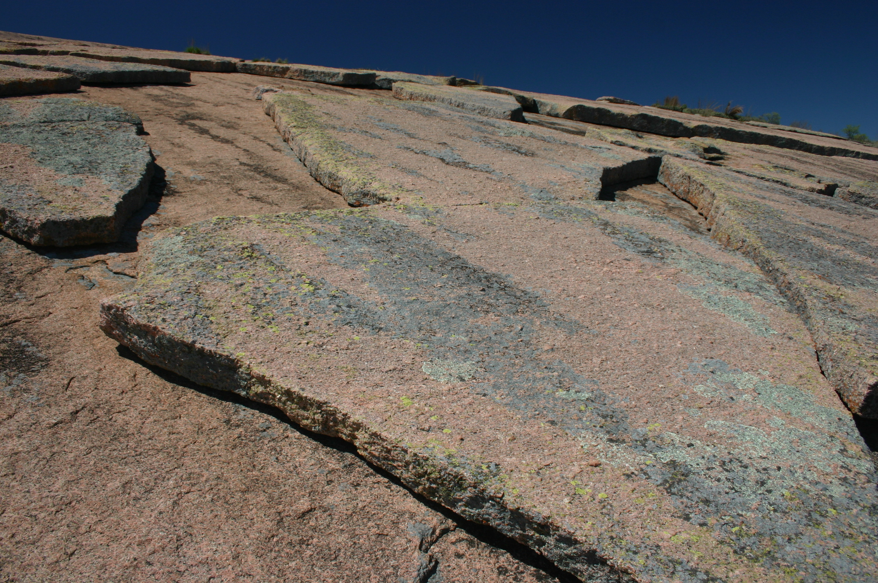

Slide 13
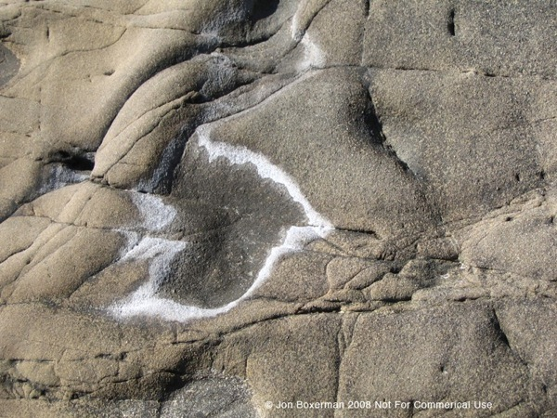

Slide 14
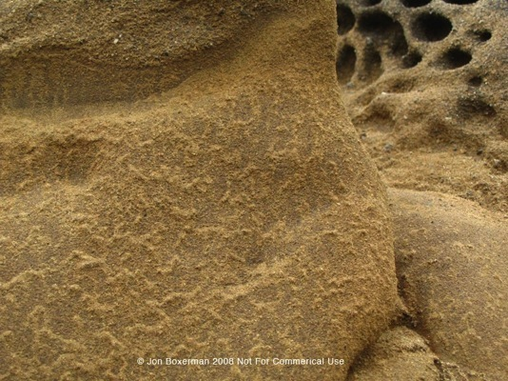

Slide 15
Other Weathering Types (Limited)
Chemical Weathering
  Variety of methods involving water in the desert
  Wetting and drying; Hydration; Oxidation; Solution
  Relatively rare – occur only in short bursts following water input.
Biological Weathering:
  Relatively limited – problems of vegetation cover in deserts
  Some desert plants (by nature) have long root systems which can cause disintegration
  Some algae/lichen can cause micro-weathering

Slide 16
Weathering Summary
Weathering is the breakdown of rock in situ
It DOES NOT move anywhere
Can be thought of as the preparation for erosion.
Various types operate in the desert – linked to characteristics.
Mechanical (heating) weathering dominates, by diurnal range
So, what happens next?

Slide 17
Geophysical Fluid Dynamics
Underlying principle of how we can operate across physical geography
Helps you to work in deserts quite effectively
All fluids behave in broadly similar ways, and operate with similar characteristics.
Air (wind) is a fluid.
Principle of equifinality
[Evidence]

Slide 18
Aeolian Processes of Erosion
Aeolian = wind; Fluvial = water
  Start using the technical language – will help in exams
Because of fluid dynamics, we see many of the same processes from the river in the desert:
  Corrasion (abrasion) – the small particles driven against another surface to ‘sandpaper’ down the rock. Larger particles, limited energy means that abrasion largely confined to 2-3 metres above the ground. Can take 100 yrs/mm.
  Attrition – grains of sand colliding with each other to reduce in size and angularity.
We also see new processes take place that have no fluvial parallel

Slide 19
Aeolian Processes – Deflation
Dominant process in the desert
Energy curve removes light particles, and leaves heavier material behind.
Loose/fine regolith blown away, and progressively reduces in coverage.
Leaves large, stony desert surface to operate on – desert pavement.
Provides further barrier to soil/layer development
Creates a landform called a deflation hollow
[Evidence]

Slide 20
Aeolian Transport
Similar to fluvial processes
Occur when the velocity exceeds the threshold of force required. Influenced by:
  Wind speed/duration/direction
  Turbulence
  Surface material nature, size, density
  Vegetation cover
Three key processes:
  Suspension
  Saltation
  Creep

Slide 21
Aeolian Transport – what do we expect?
Suspension
Saltation
Creep

Slide 22
Aeolian Transport – what do we expect?
Suspension
  Transport of fine materials; dust/clay or fine sand.
  Particles less than 0.15mm.
  Can create dust clouds/sandstorms.
  Can be transported a long way (dust plume, UK ‘red rain’)
Saltation
  Particles moving along the ground in small leaps – 0.15-0.25 mm.
  Limited to near ground (below 2m) levels – restricted by weight of particles.
Creep
  Larger particles (above 0.25mm), rolled or pushed along the ground.
  Too heavy to be lifted

Slide 23
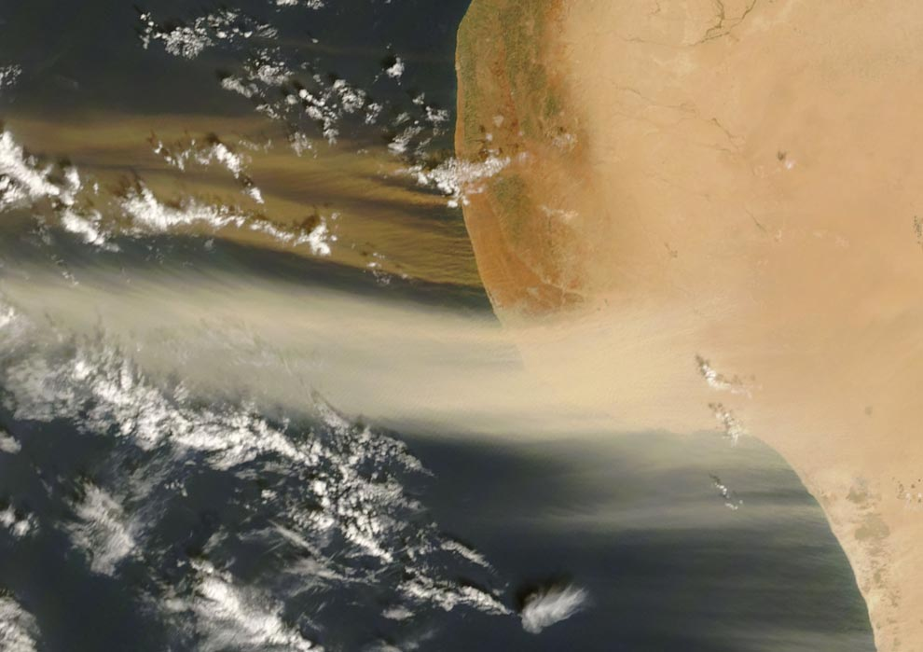

Slide 24
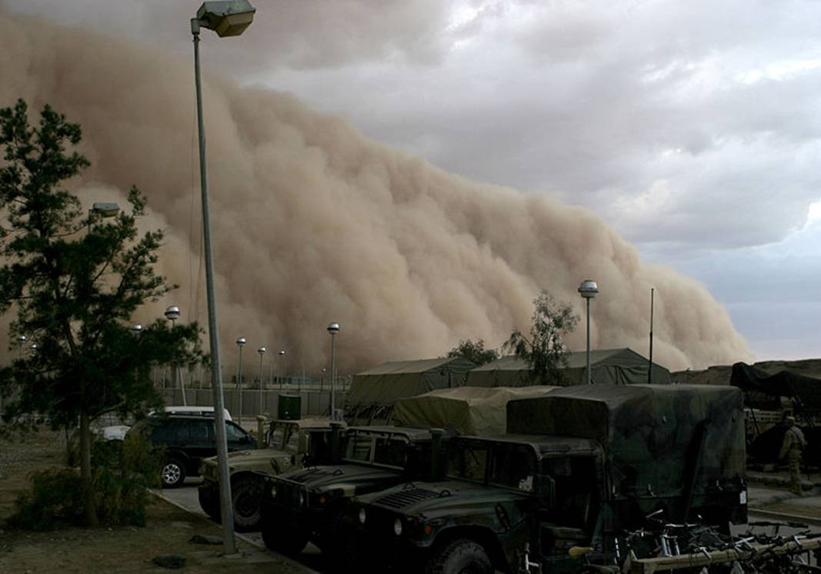

Slide 25
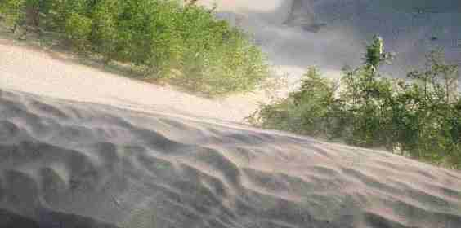

Slide 26
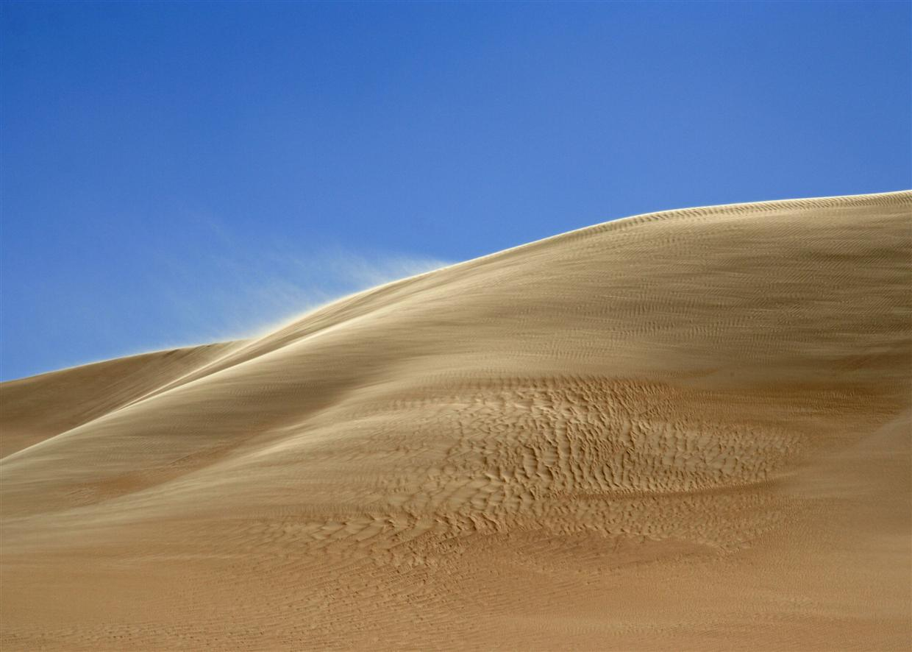

Slide 27
Deposition:
When particles become too heavy to be transported, they are deposited
Particles tend to be unsorted and ungraded, and are put down without compaction – they are often unconsolidated deposits
Sometimes, this material is called loess
Most often, they will be “drift aligned” with the wind or water – you should be able to see evidence of a direction
Frequently, you will see evidence of ‘turbulence’ – waves of erosion/deposition in a cycle in the desert

Slide 28
Key Considerations for Aeolian Process
Wind is never particularly powerful (low magnitude).
  It can only pick up quite light particles
  It can only transport the finest materials
  It does not operate much more than 2-3m off the ground
What makes wind more or less effective?
  Consistency – tends to have a prevailing wind direction, which gives high frequency. Deserts with multiple prevailing winds get less effective processes
  Time – deserts which have consistent climatic conditions allow wind to operate for a long time, and hence increase their effectiveness
  Turbulence – allows wind to have ‘waves’ of higher and lower energy. This can create specific features.
  Spatial scale – wind operates over a very large area. The potential to impact on a large desert is significant.
  The prior extent of weathering – the more finely weathered the particles, the more effective wind will be
  Extent of aridity – wind is less effective in vegetated, or semi-arid landscapes. Hyper arid conditions are more suited to aeolian process

Slide 29
For the following images: water or wind?
But it’s not the only process operating in deserts…

Slide 30
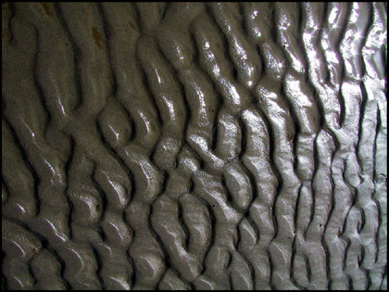

Slide 31
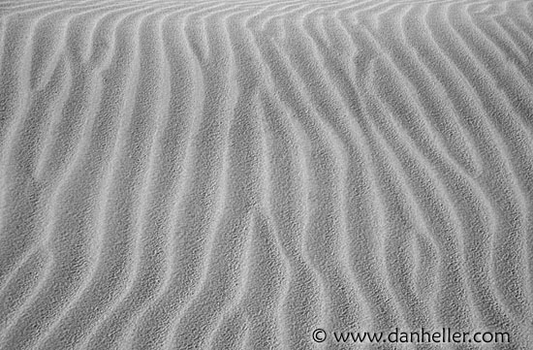

Slide 32
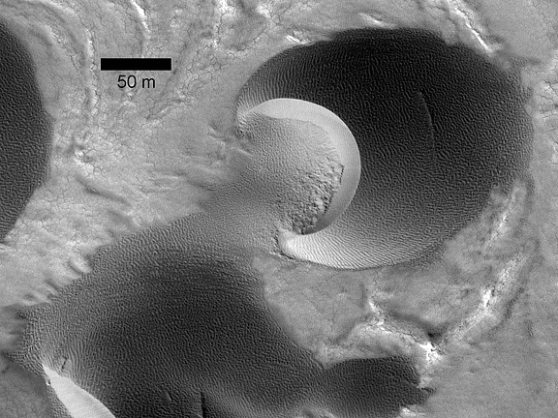

Slide 33
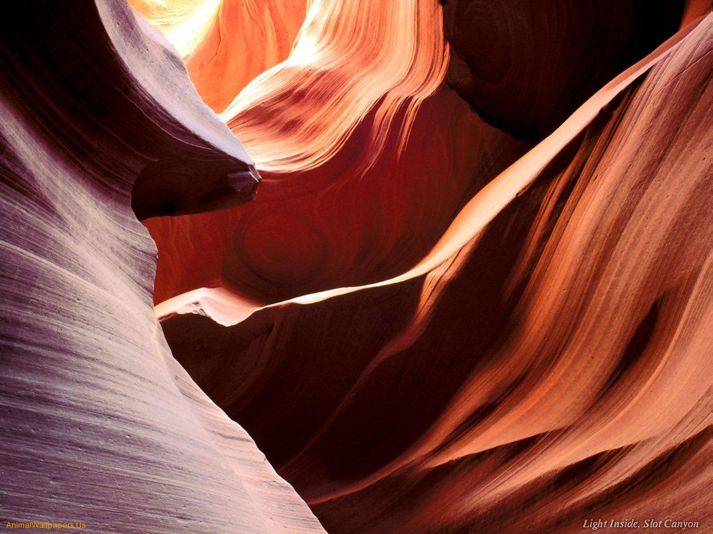

Slide 34
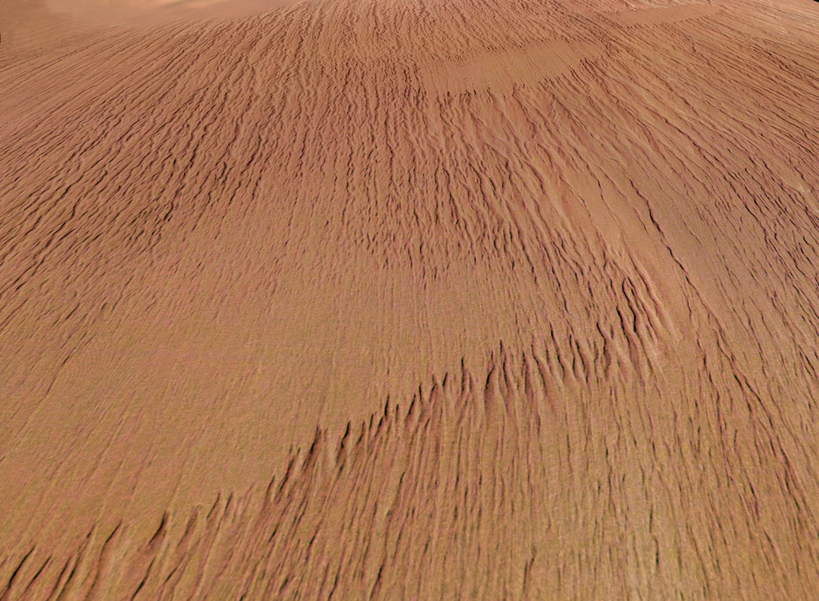

Slide 35
Concept of Equifinality
When a landform (or series, landscape etc.) can be generated by a number of alternative processes
Shape & descriptive features alone cannot always explain process
Often very important in desert landforms – particularly with the role of wind vs water in shaping land

Slide 36
Water? In the deserts?
Water in the desert is, by definition, relatively rare – aridity is what defines the desert environment
  However, is this true of all deserts? Again, think about scale of aridity – hyper vs semi-arid.
Water can come from two time scales
  Modern water sources: finding a way for water to exist in relatively small quantities in present day
  Past water sources: recognising that climate changes have led to different conditions in deserts

Slide 37
Where does the modern water come from?
Exogenous
  Water sources from outside of the desert area
  e.g. The Nile forms in Ethiopia and then flows through Egypt
Endoreic
  Drainage systems or basins which end in the desert
Ephemeral
  Streams/rivers that only exist after major storm periods
Aquifers
  Deep water underground – from movement or past water
Coastal mist
  Relatively rare – not really a way of making land forms, but potentially important for human water sources

Slide 38
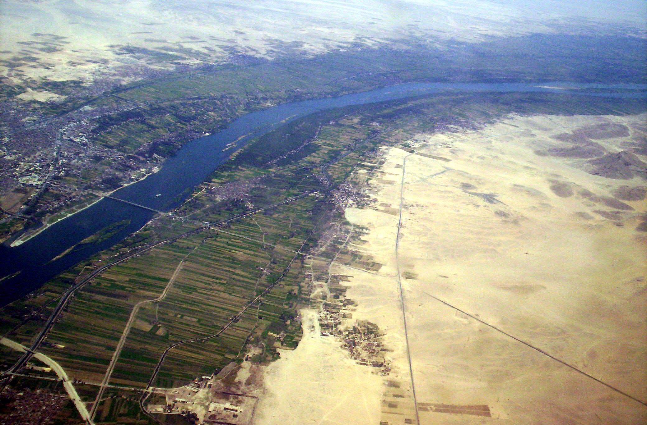

Slide 39
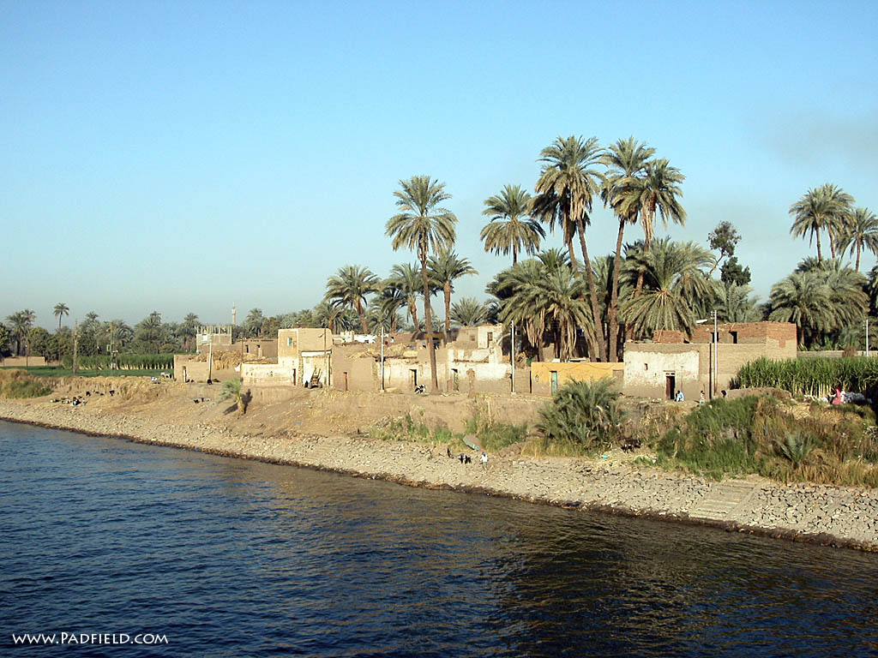

Slide 40
Where does past water come from?
Evidence in the deserts of past wet conditions (known as “pluvials” – wet periods)
Most recent pluvial period was in the “Pleistocene” – the previous glacial epoch (800kya-20kyaBP)
Fossil evidence from crocodiles, cave drawings, all sorts of animals from the Sahara
Often most important in the creation of the aquifers – groundwater storage
However – during the wet periods, there was time for significant water and fluvial action – tends to create major fluvial features and large scale landscapes!

Slide 41
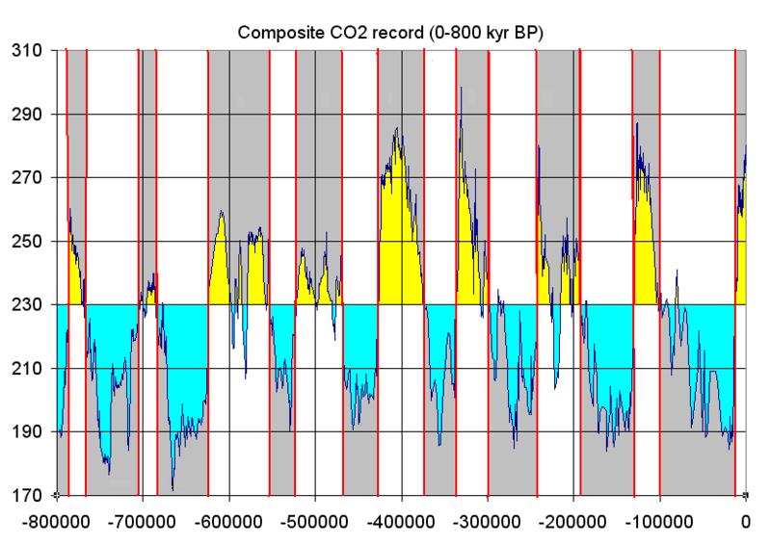
Pleistocene Variability (800-20kyaBP)

Slide 42
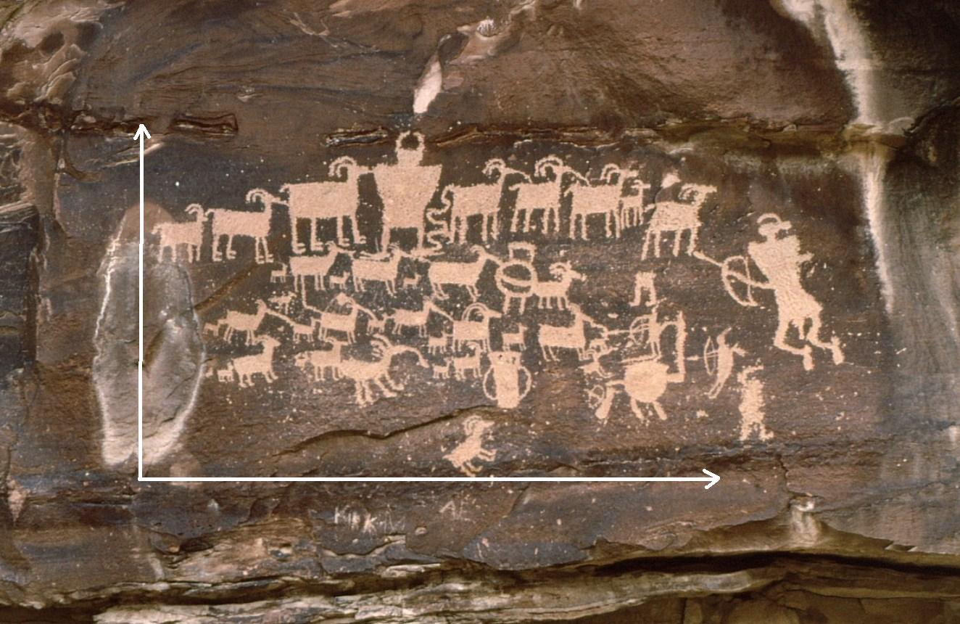

Slide 43
What does the water do?
Landforms very similar to fluvial landforms – created in equifinal process
Features are shaped in the same way – and the standard fluvial processes operate (erosion, transport, deposition)
Remember that they are often short-lived – input is brief, and stormy
Rivers need to do a lot of work very quickly

Slide 44
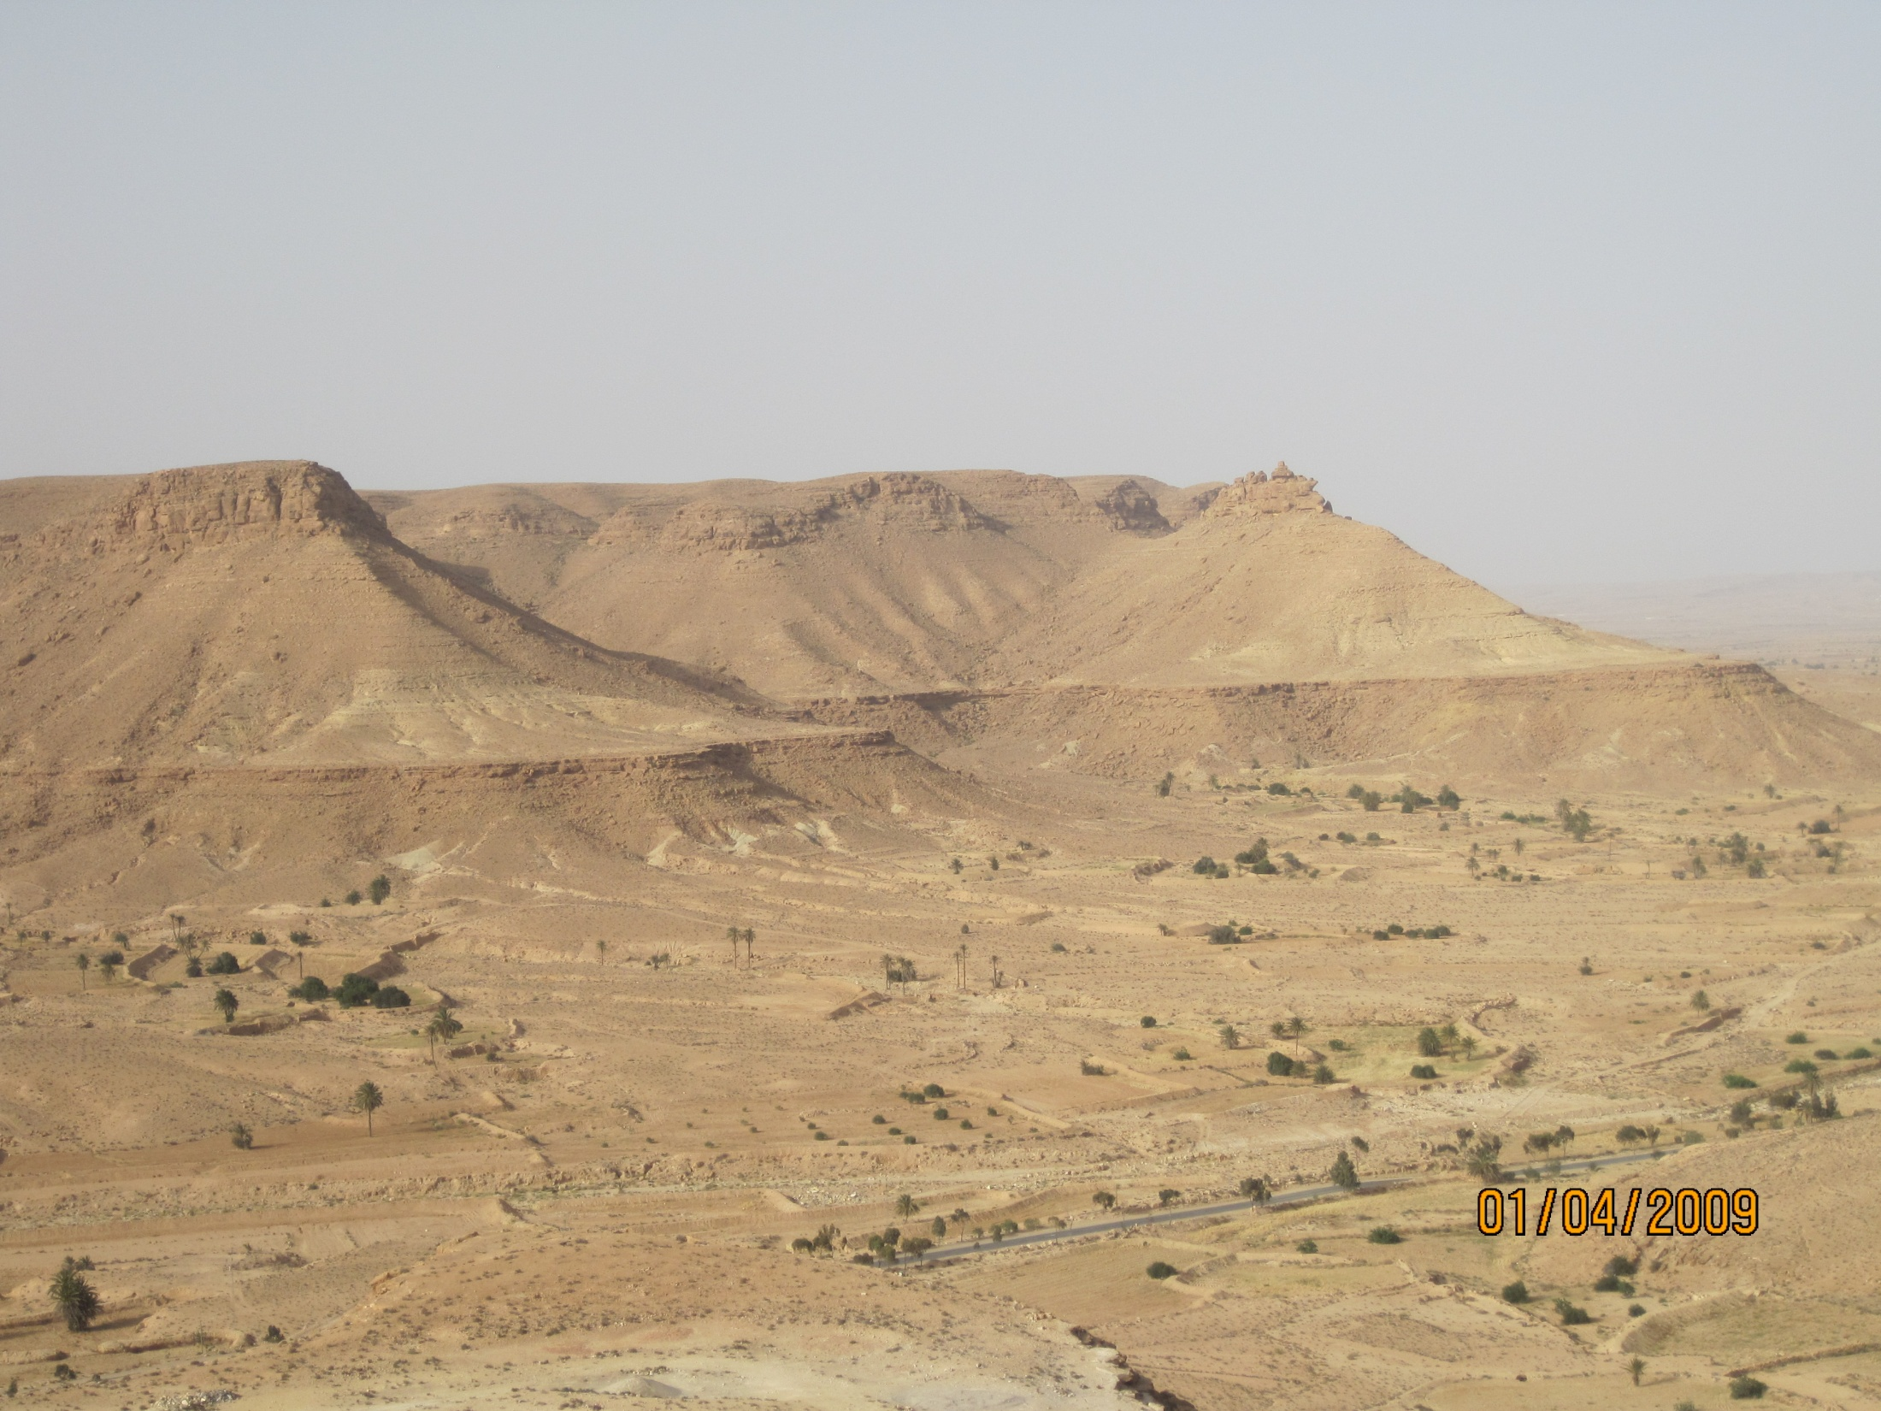

Slide 45
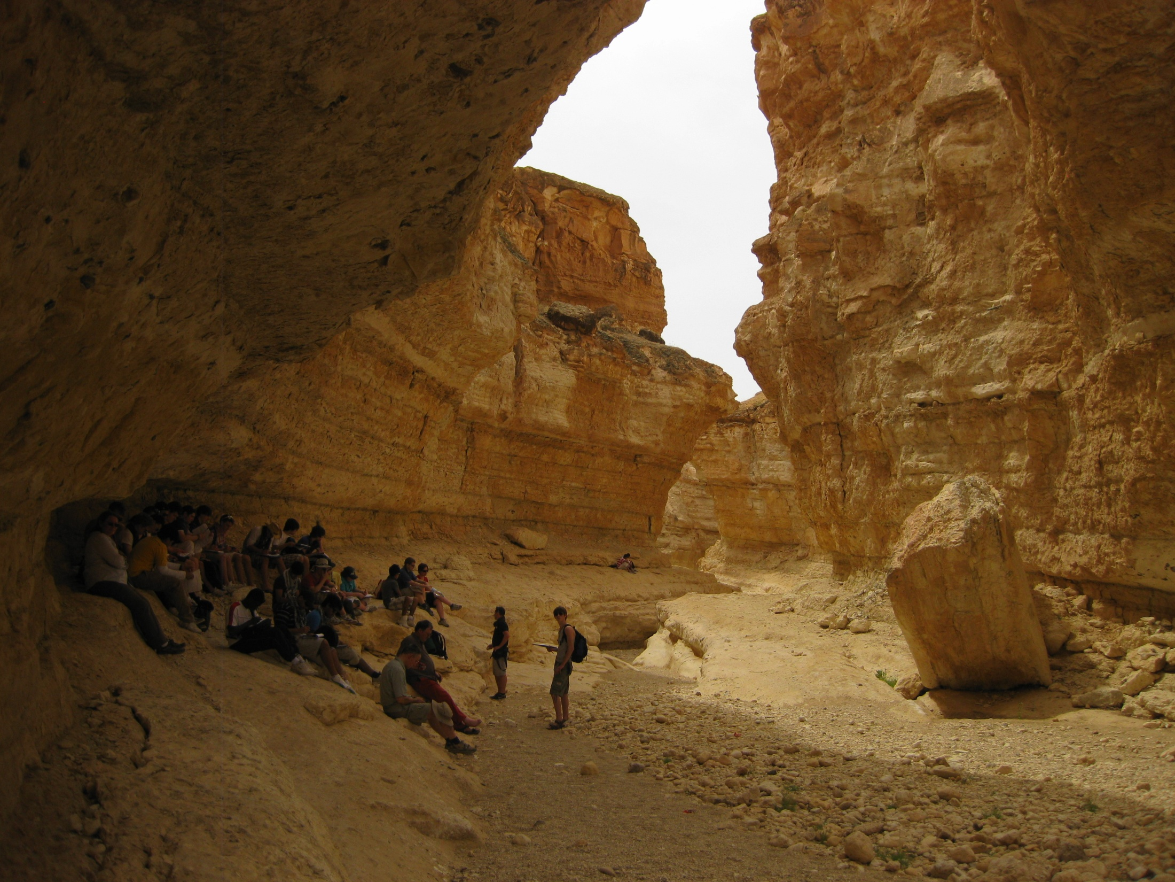

Slide 46
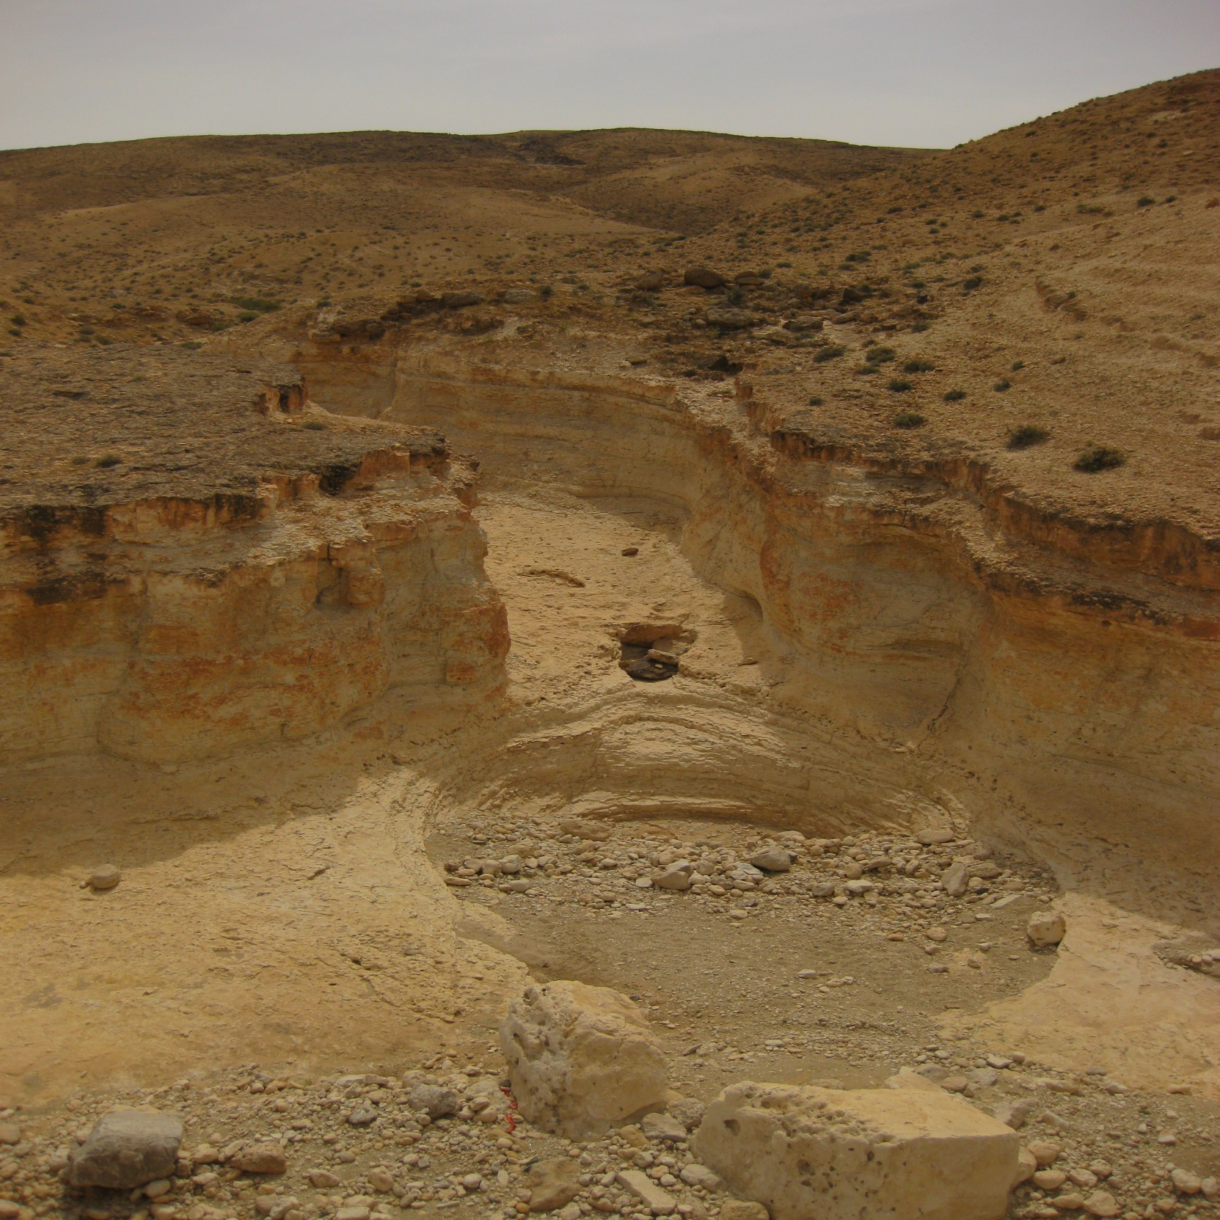

Slide 47
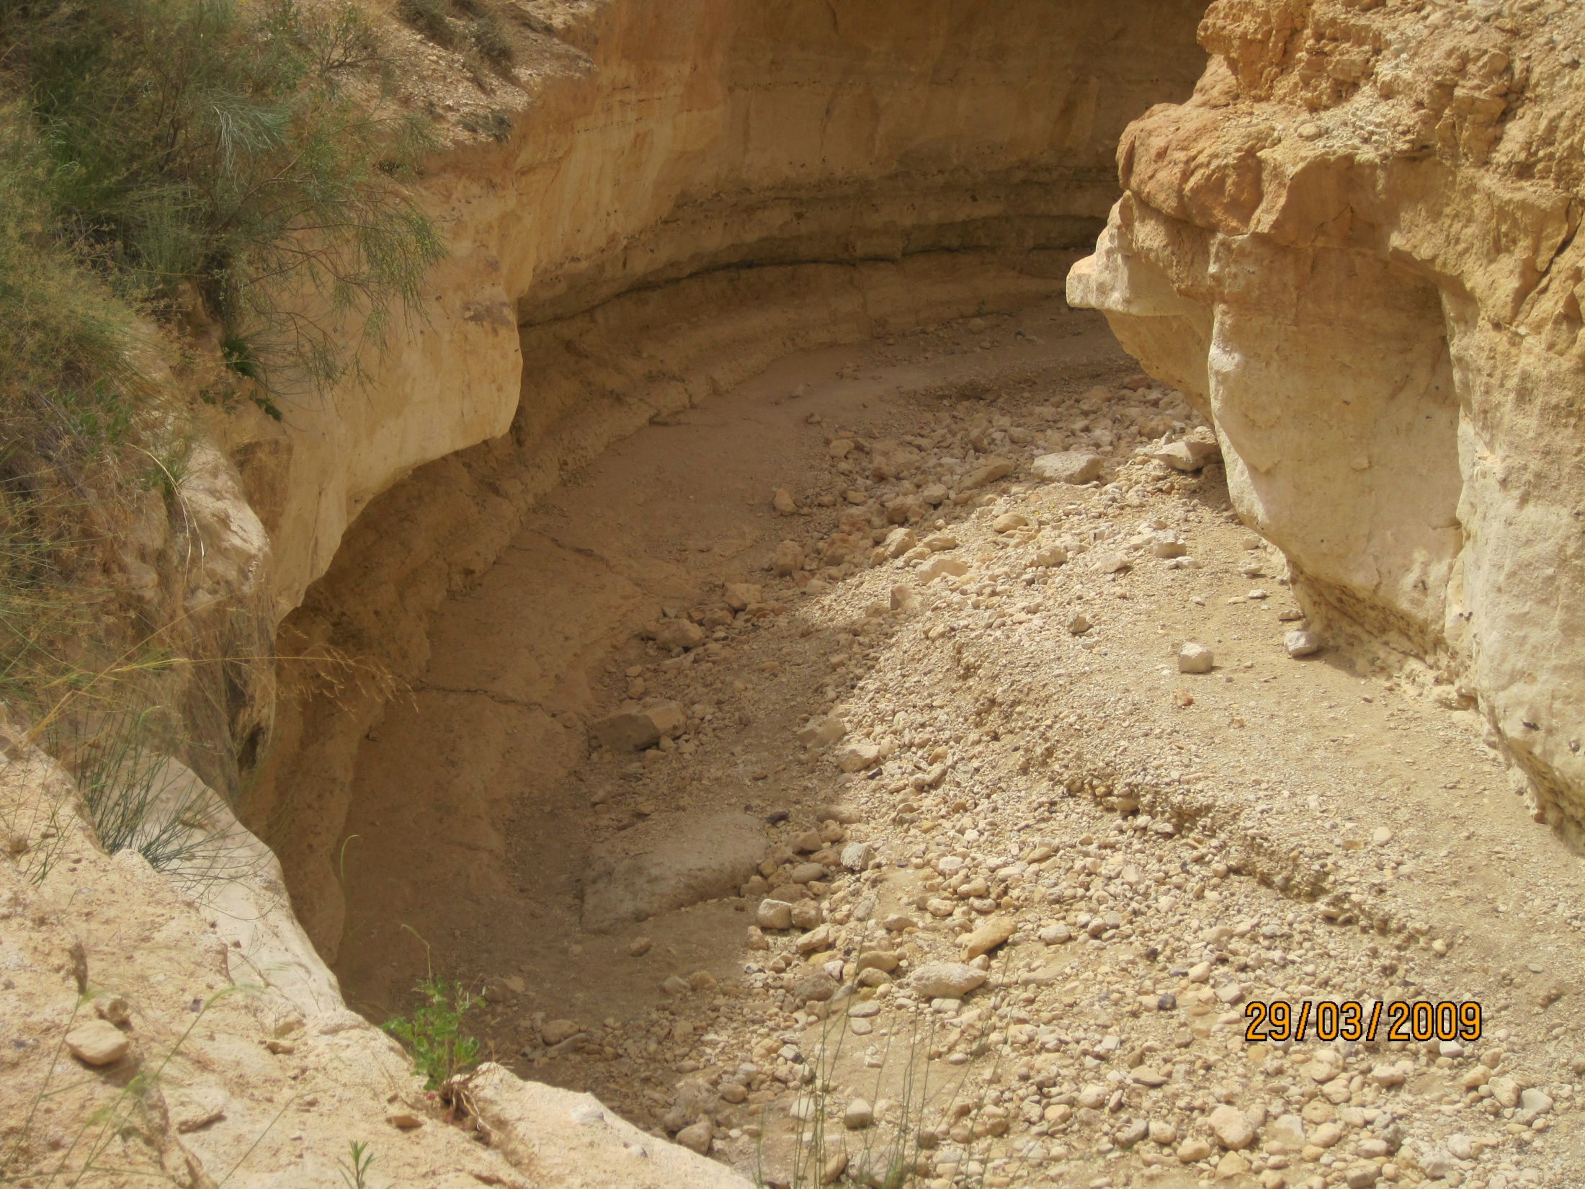

Slide 48
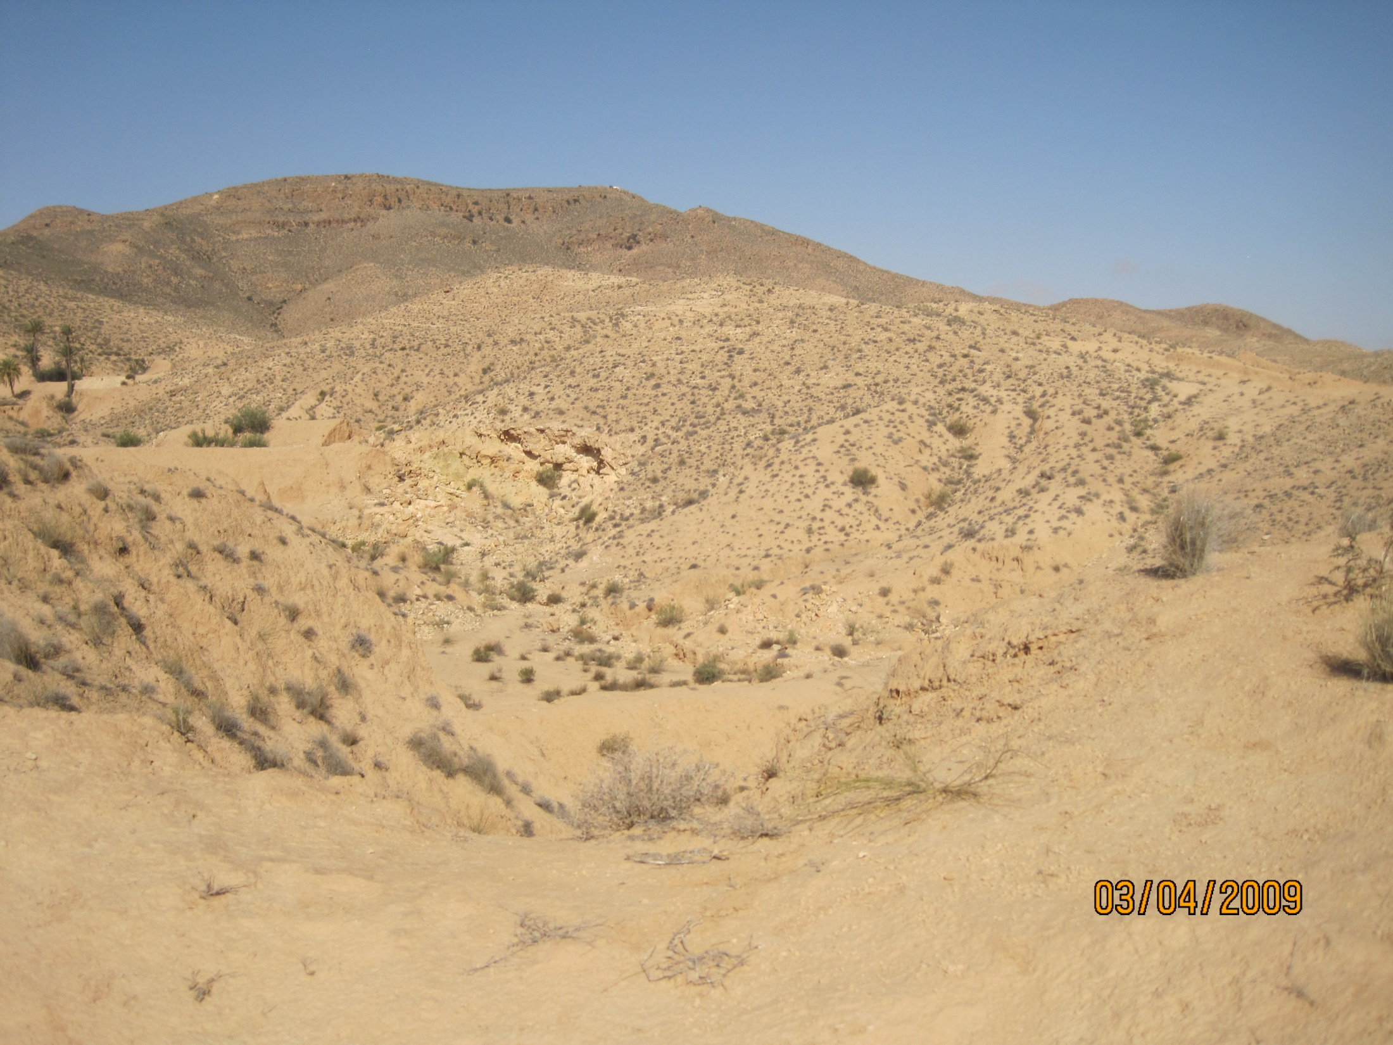

Slide 49
Why is the water powerful?
High-intensity rainfall and “storm”-like behaviour
Sparse vegetation – very little interception
High channel density – very little drainage basin dynamics existing – so it’s all surface run off
Dry, baked soil – limits infiltration
Rainsplash – fills soil pores very quickly, causing soils to lose permeability
Shallow soils allowing little water storage
Acting on relatively unconsolidated soil

Slide 50
Assess the role of water in the desert
Start thinking about comparison between wind and water as processes in desert
Dimensions of analysis:
  Temporal (past vs present; short vs long term)
  Spatial (little intensive versus large and weak)
  Conditions and forces (gentle but frequent, vs short and sharp)
Evaluation at each stage, not full conclusion

Slide 51
Aeolian: Deflation hollow

Slide 52
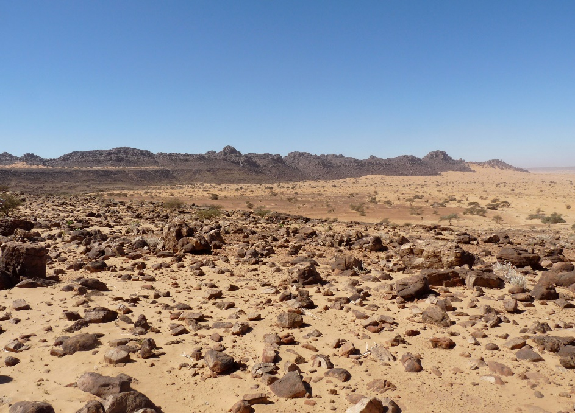

Slide 53
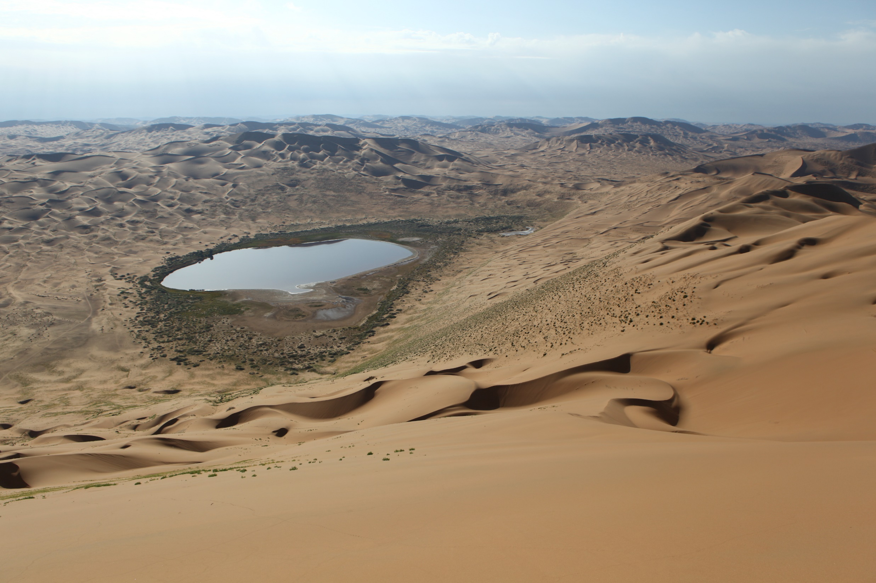

Slide 54
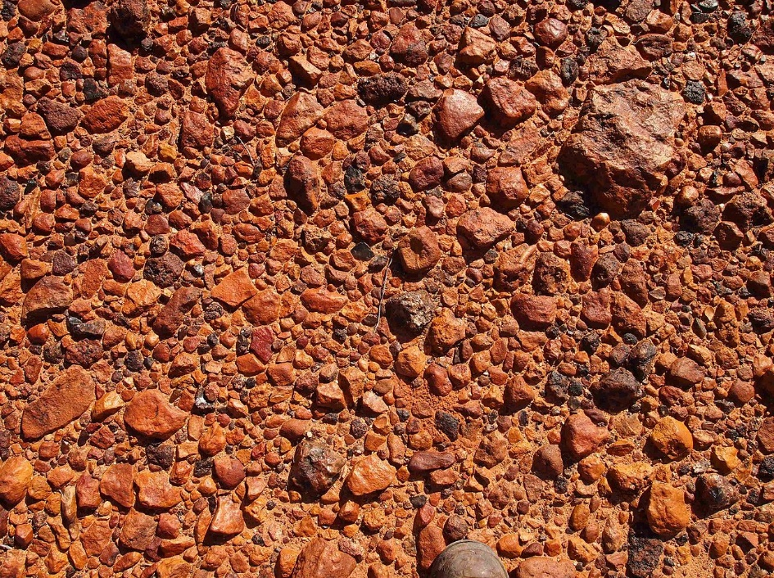

Slide 55
Aeolian: yardang

Slide 56
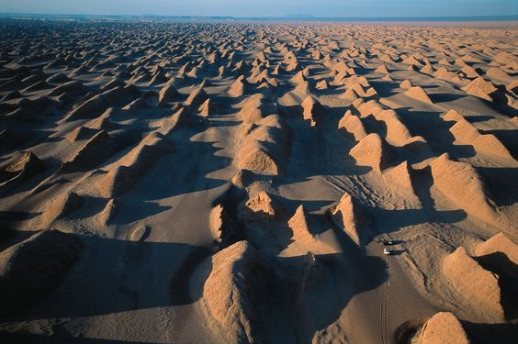

Slide 57
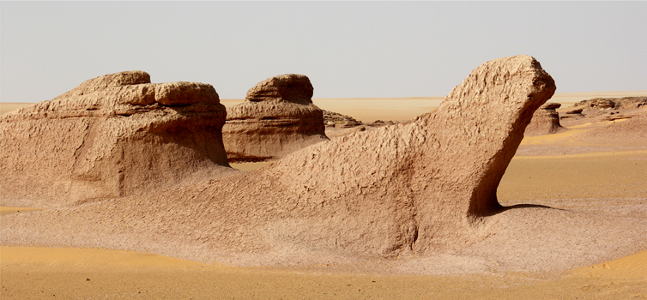

Slide 58
Aeolian: zeugen

Slide 59
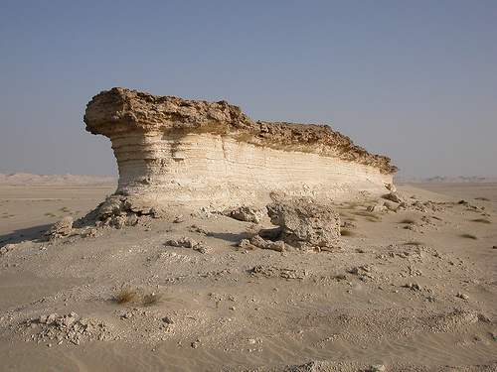

Slide 60
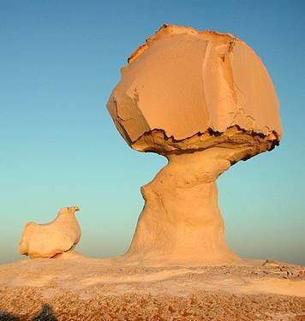

Slide 61
Aeolian: sand dune (types)

Slide 62
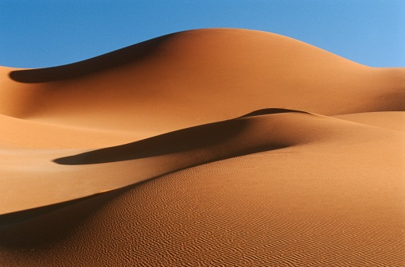

Slide 63
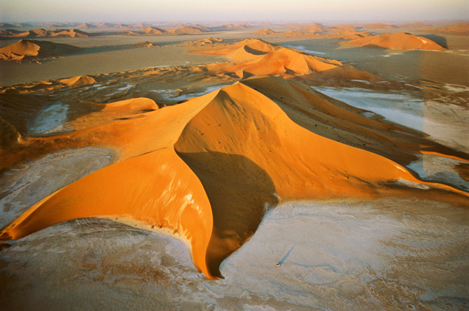

Slide 64
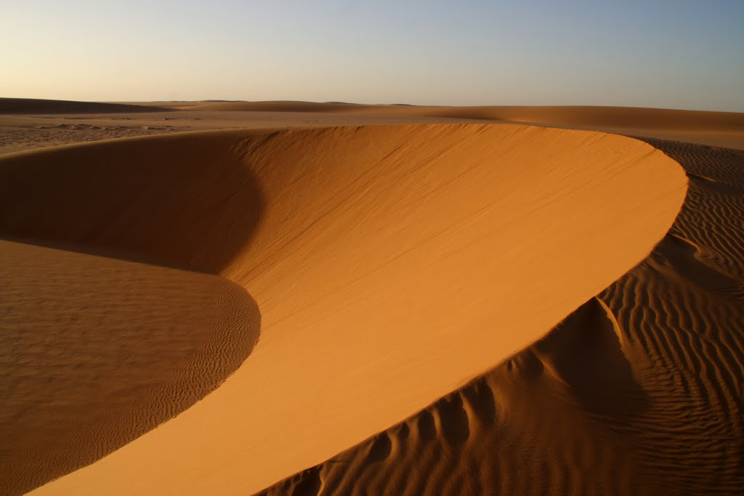

Slide 65
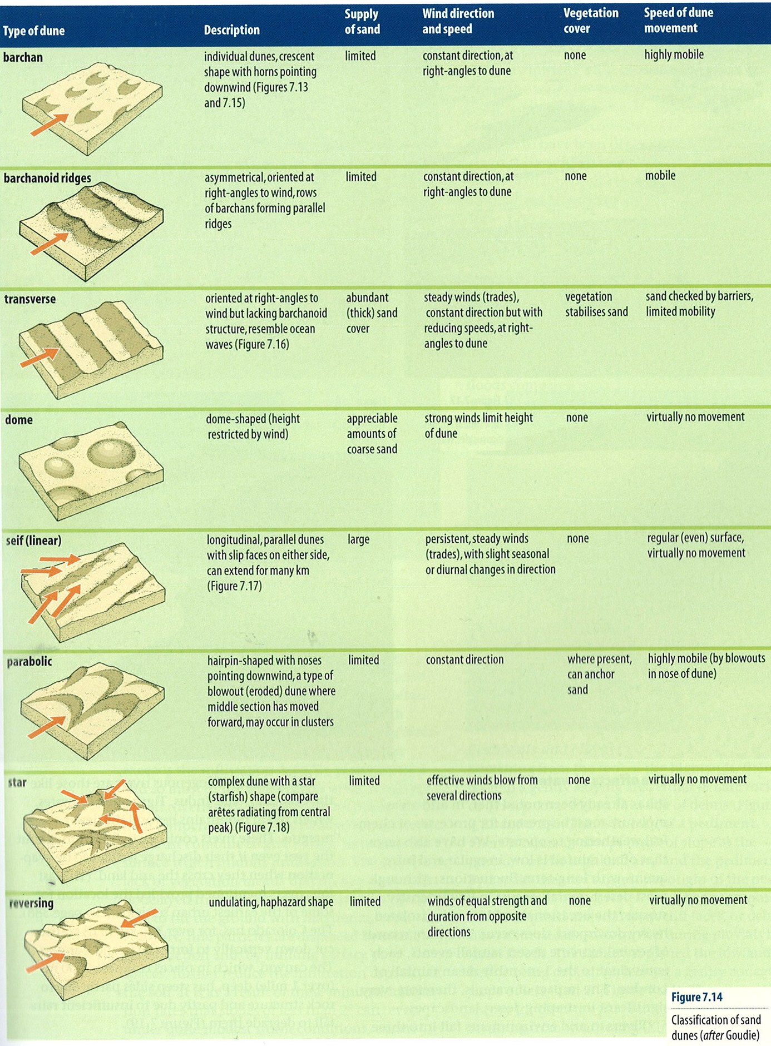

Slide 66
fluvial: connected sequence of landforms

Slide 67
Key Context
Upland/lowland
Intermontane basin
Nature of flow down the slope (landforms)
Pediment
Endoreic landforms
Large scale dissection (past water?)

Slide 68
fluvial: wadi & Arroyo (Canyon)

Slide 69
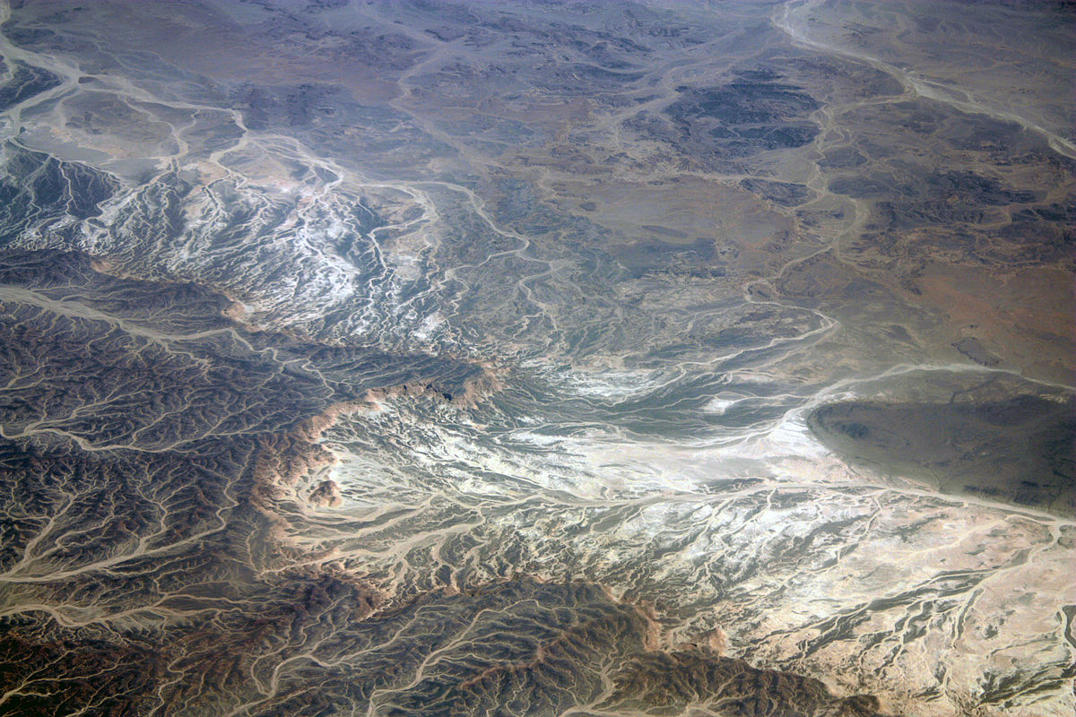

Slide 70
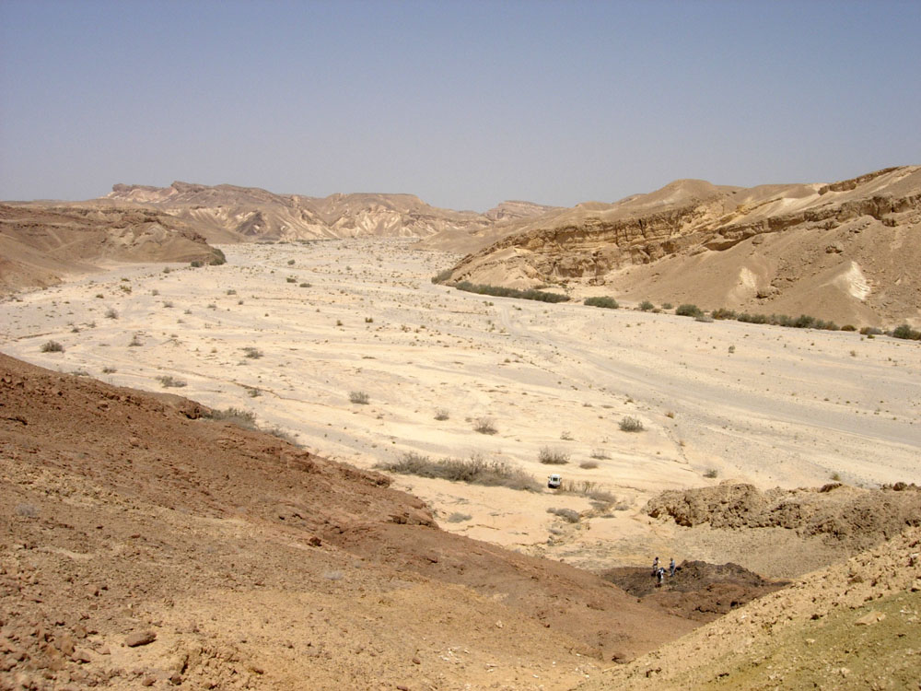

Slide 71
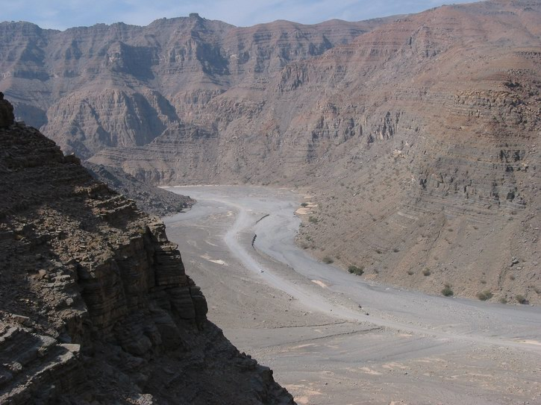

Slide 72
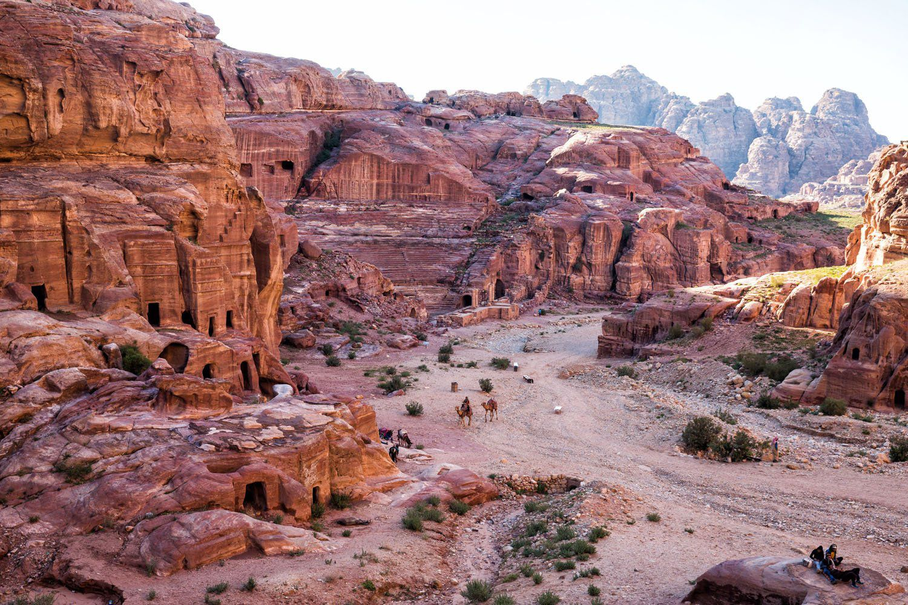

Slide 73
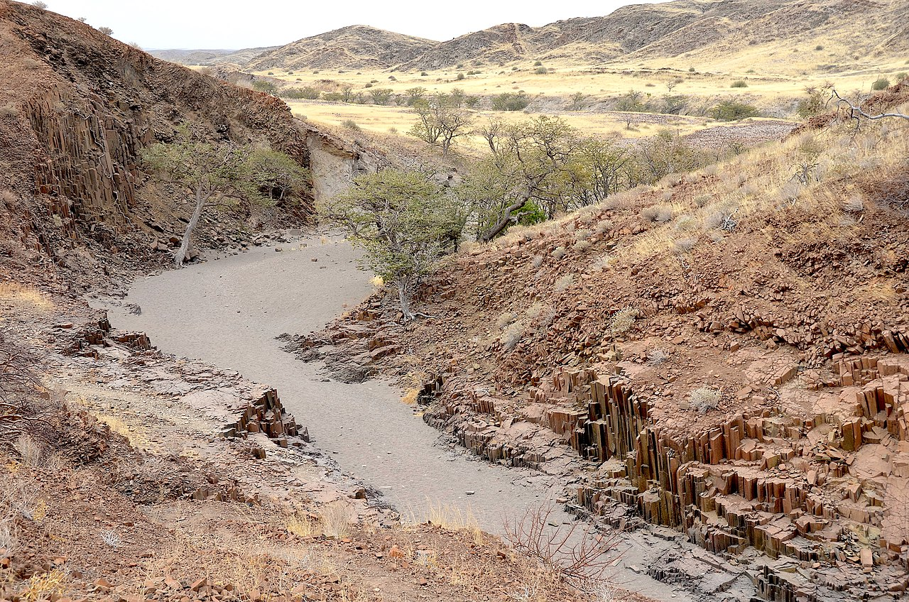

Slide 74
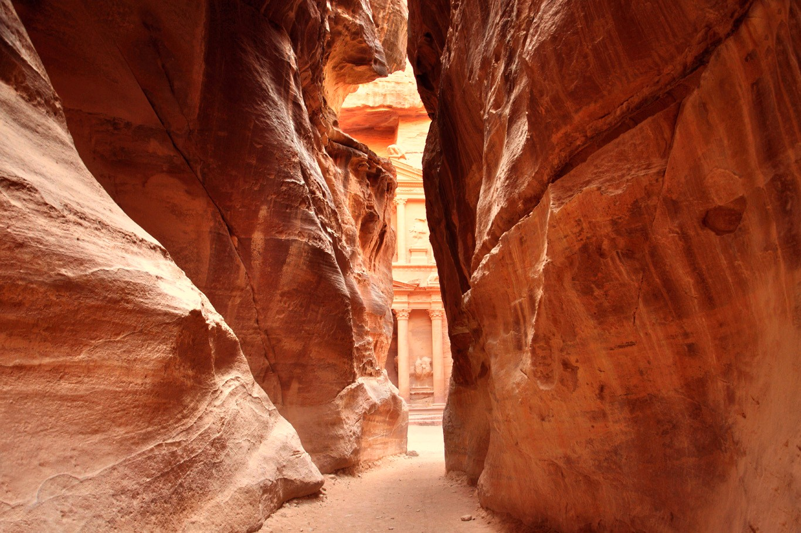

Slide 75
fluvial: alluvial fan (Bahada)

Slide 76
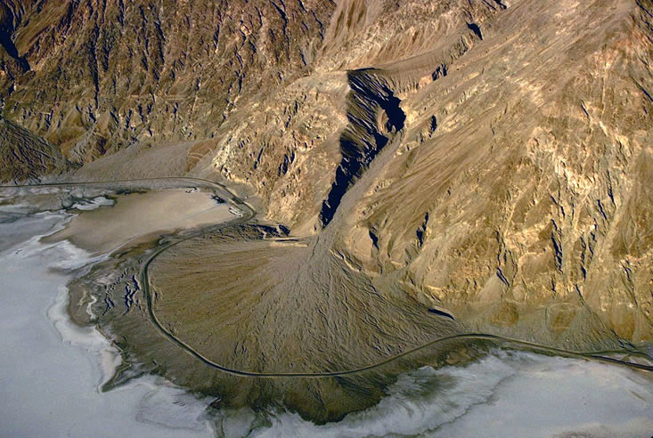

Slide 77
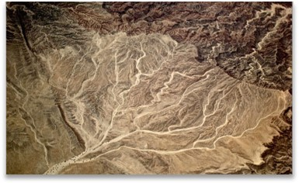

Slide 78
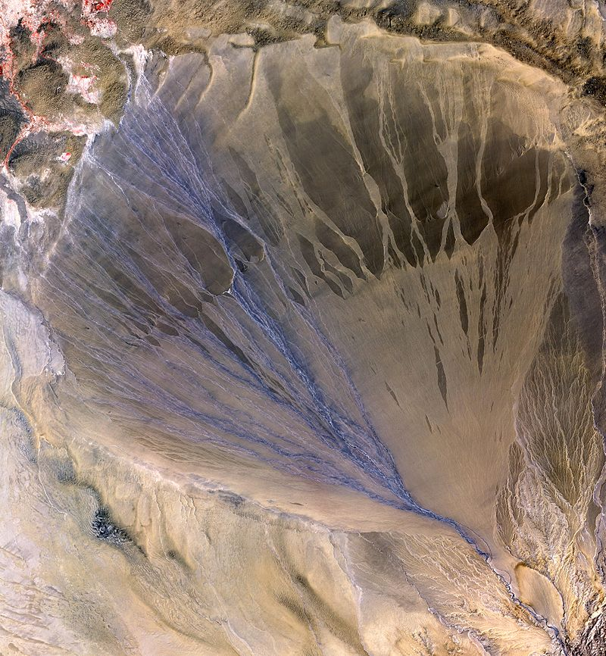

Slide 79
fluvial: playa, salt lake, chott

Slide 80
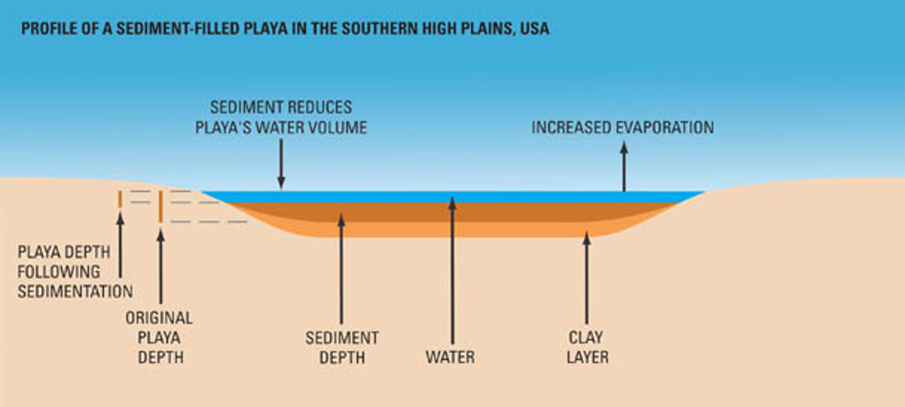

Slide 81
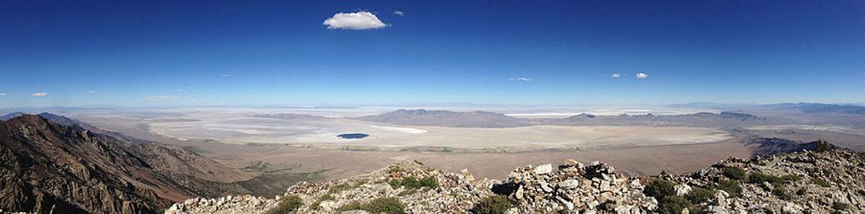

Slide 82
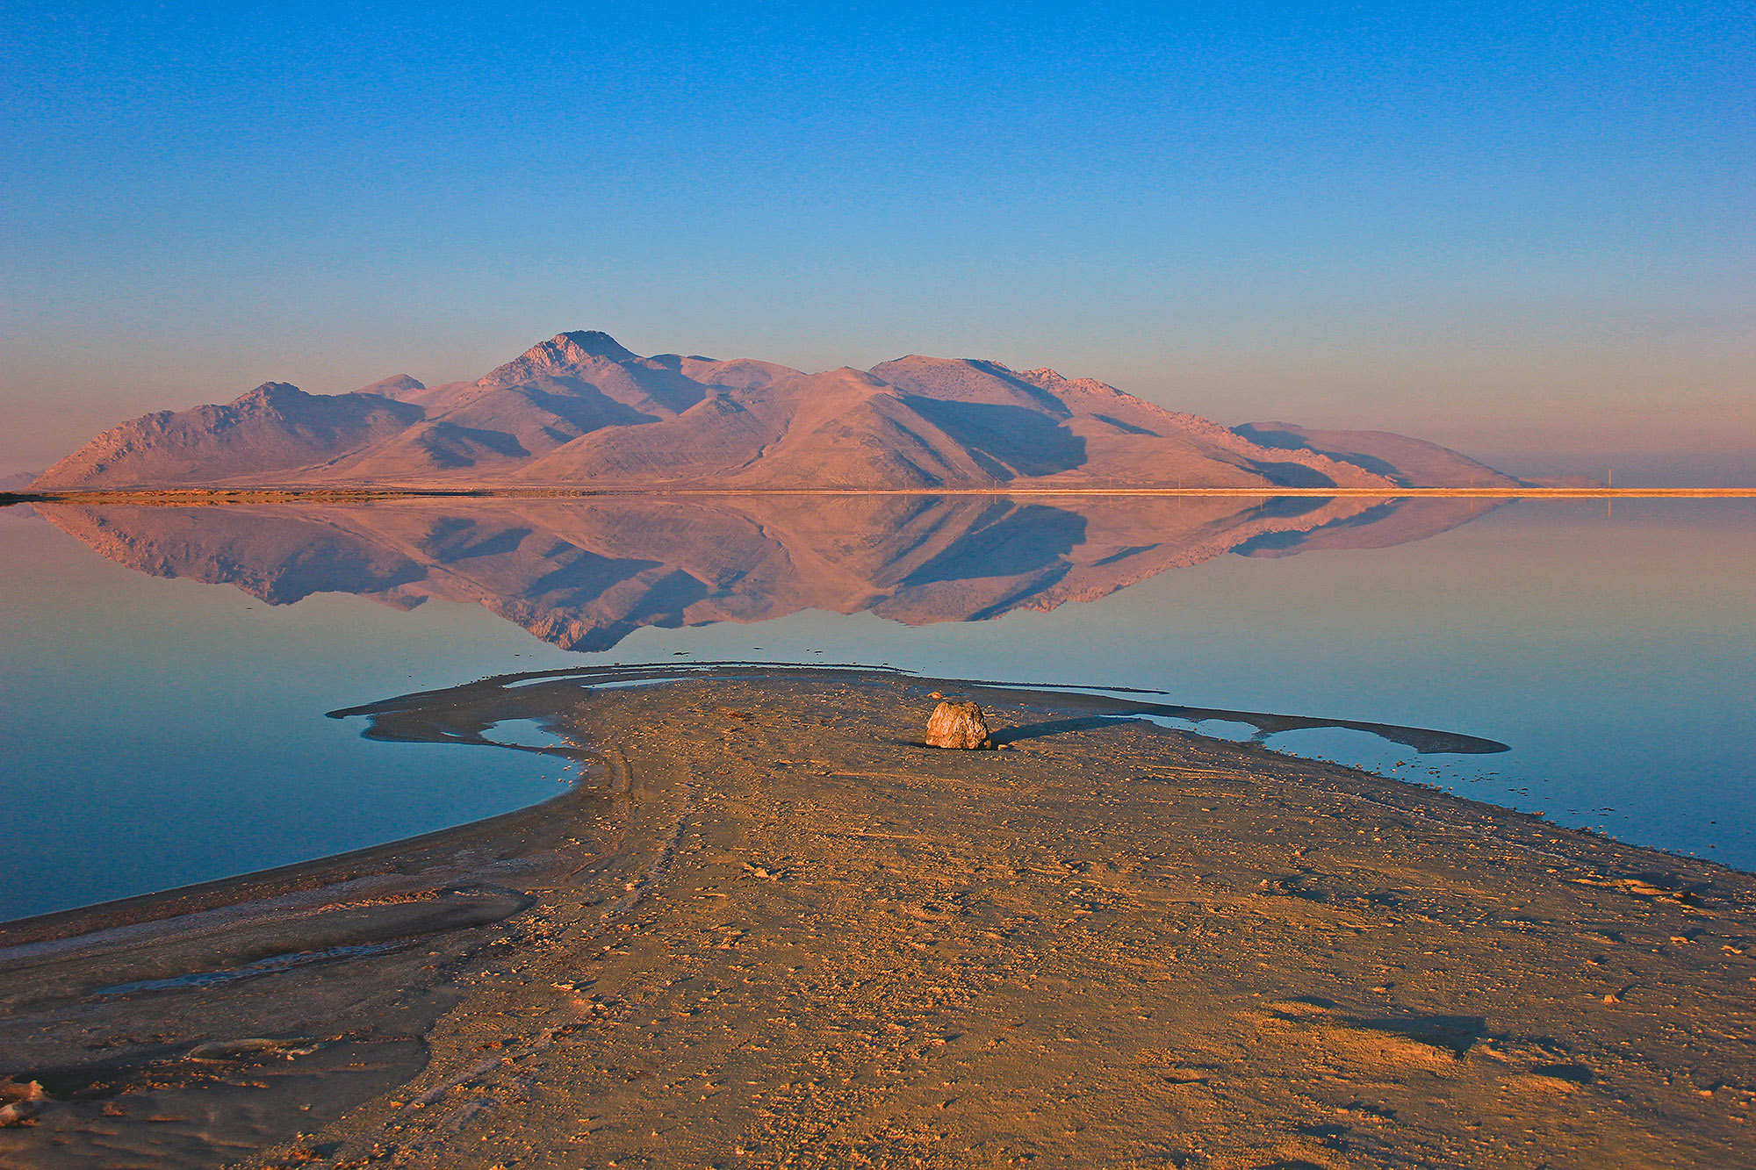

Slide 83


Slide 84


Slide 85


Slide 86


Slide 87


Slide 88
fluvial: inselberg (Mesa, butte, spire)

Slide 89


Slide 90


Slide 91


Slide 92
fluvial: inselberg (Bornhardt)

Slide 93


Slide 94


Slide 95


Slide 96


Slide 97
fluvial: inselberg (kopje)

Slide 98


Slide 99
LANDFORM AND PROCESS QUESTIONS

