Slide 1
Welcome back….!

Slide 2
What have we done?
Paper 1 and Paper 2 completed
Strong sense of the technical demands of the Cambridge course – precision, accurate, language and vocabulary are all critical
Developing sense of the importance of good essay technique and fluent writing – essays remain a feature of all papers.
Competence in source and data handling: we have to be able to respond to various materials.

Slide 3
2019 Results – A Level
30% of students scored A*
54% of students scored A*/A
70% of students scored A*/B
Key lessons:
Consistency is critical – have to do well at all four papers!
The process of Y12 Revision is hard – but vital.
Skills are skills – if you can write essays for human, you can do it for physical. If you can write at P1, you can do it at P3.

Slide 4
What are we doing?
Michaelmas Term:
  Only two units in Paper 3, Paper 4
  Hot arid & semi-arid environments (deserts)
  Some review and reminder of Year 12 material as homework and question setting
  November Benchmarks, focused on P1 and P2.
  End of term tests focused on P3 and P4
Lent Term:
  Hazardous environments. Course completed by Easter
Trinity Term:
  Very early exam series – always sooner than EPP.

Slide 5
Key Priorities for this Term:
Confidence that what you have is good enough to revise from for Year 12 material
Competence and understanding of your wider planning (UCAS, Predicted Grade etc.)
Preparation for benchmark – real test of Year 12 (full papers)
Finish this unit well

Slide 6
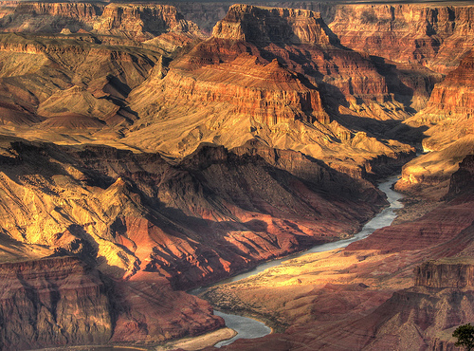
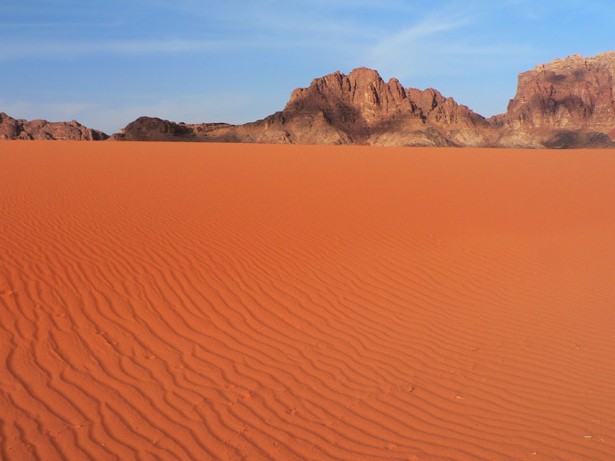
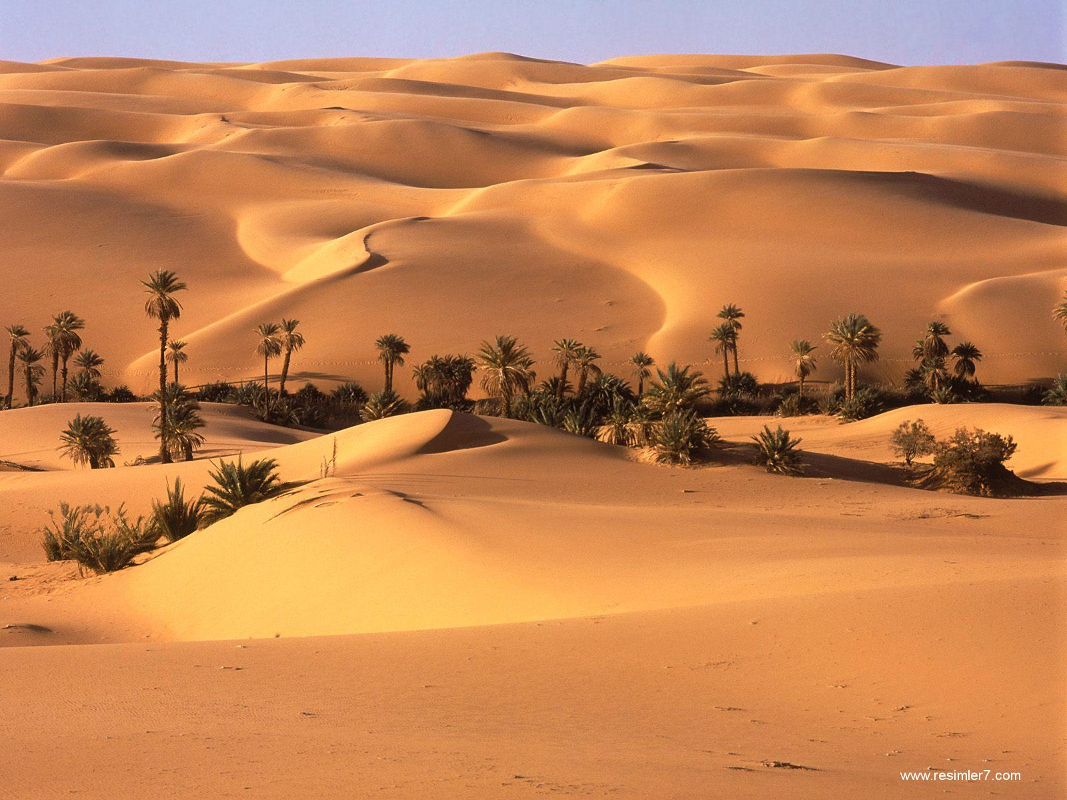
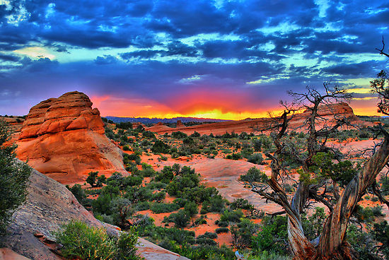
Advanced Physical, Paper 3
10. Hot arid and semi-arid environments

Slide 7
Unit 10 – Specification
10.1 Hot arid and semi-arid climates
Global distribution and climatic characteristics of hot arid and semi-arid environments.
Definitions and causes of aridity: pressure and wind systems, influence of ocean currents, rain shadow effect.
The key features of hot arid and semi-arid environments: high wind energy environments, diurnal and seasonal variations in precipitation and temperature.
10.2 Landforms of hot arid and semi-arid environments
Weathering processes: thermal fracture, exfoliation, salt weathering, chemical weathering, and their effects.
Processes of erosion, transport and deposition by wind: corrasion/abrasion, defl ation, traction, saltation, and suspension.
Erosion, transport and deposition by water action: hydrological regime, episodic rainfall, sheet and flash floods.
Characteristic landforms: sand dunes, wind sculptured rocks (yardang, zeugen), wadis, alluvial fans, arroyos, pediments, and piedmont zone (bahadas, playas, salt lakes, inselbergs).
Relative roles of aeolian and fluvial processes: evidence for past climate change (Pleistocene pluvials), and the role of past processes in the development of landforms.
10.3 Soils and vegetation
Vegetation: biomass productivity (biodiversity, limited nutrient cycling, fragility), adaptation of plants to extreme temperatures, physical and physiological drought.
Soils processes: upward capillary movement of water and minerals (salinisation).
The process of desertification (both natural and human factors) leading to the degradation of soils and vegetation in semi-arid environments.
10.4 Sustainable management of hot arid and semi-arid environments
Case study: candidates must study the problems of sustainable management in either a hot arid or a semi-arid environment and evaluate attempted or possible solutions.

Slide 8
What comes to mind when you think of “deserts”?

Slide 9
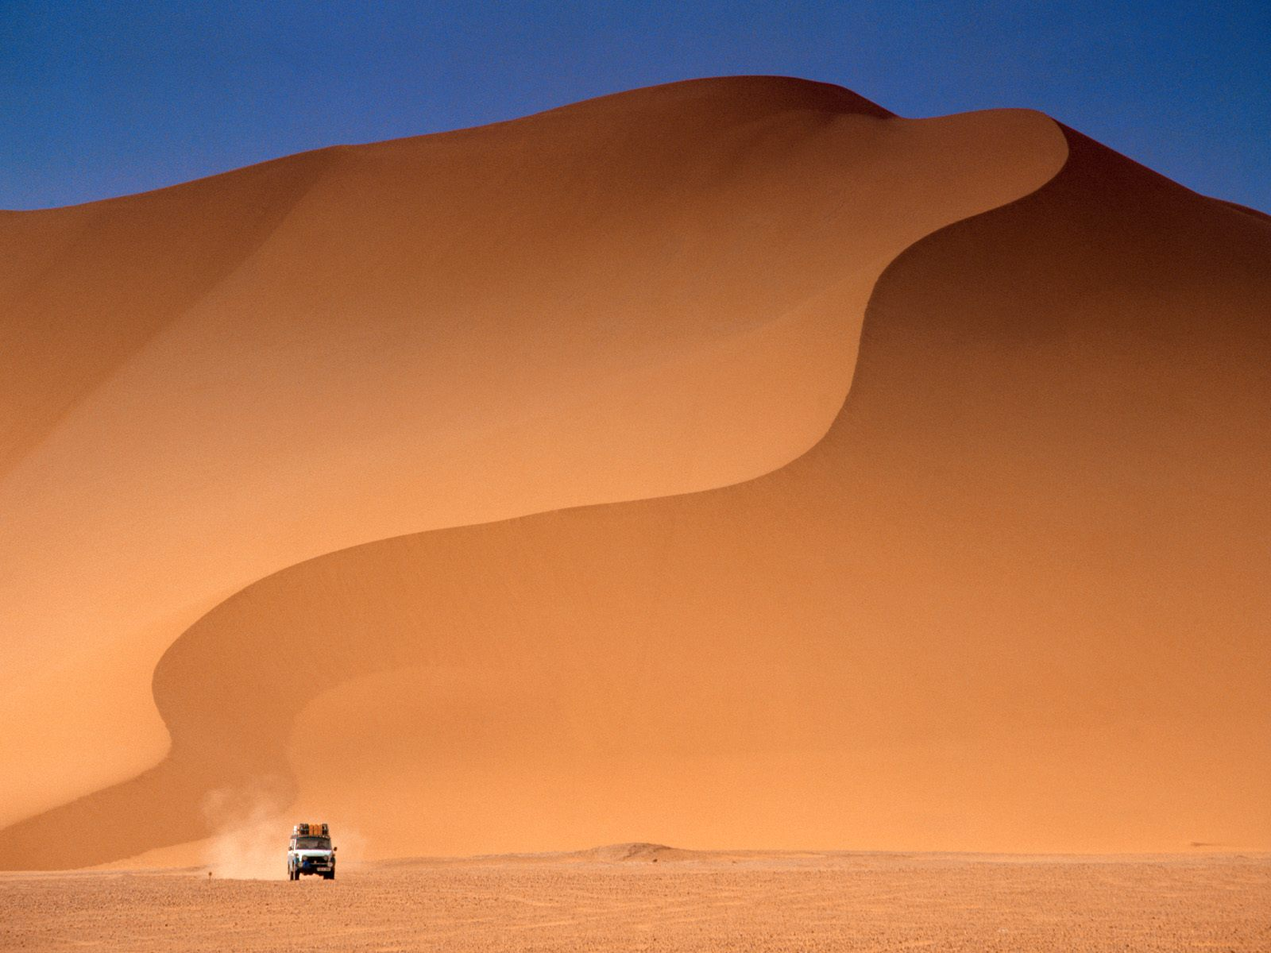
Advanced Physical, Paper 3
10.1. Hot arid and semi-arid climates

Slide 10
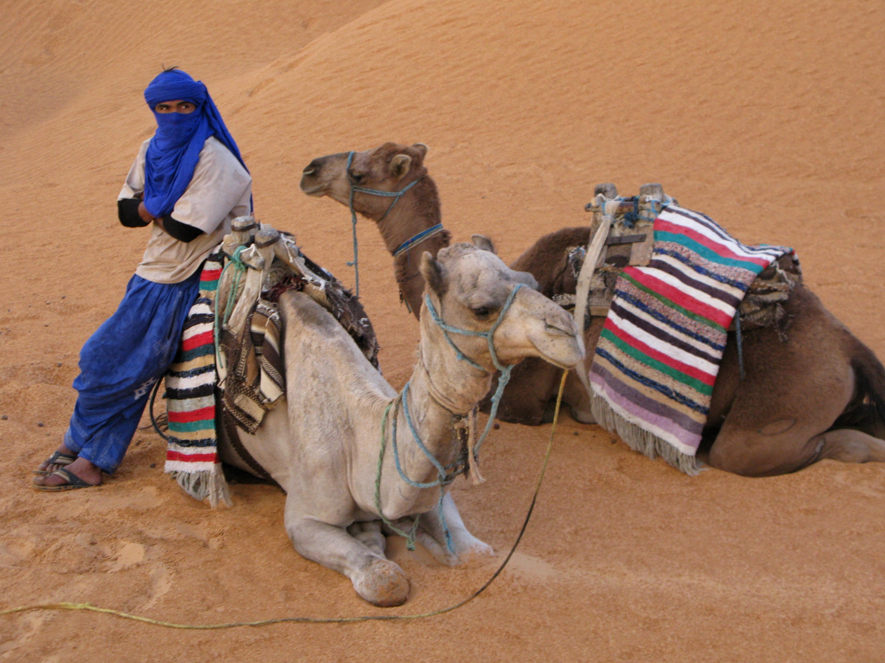

Slide 11
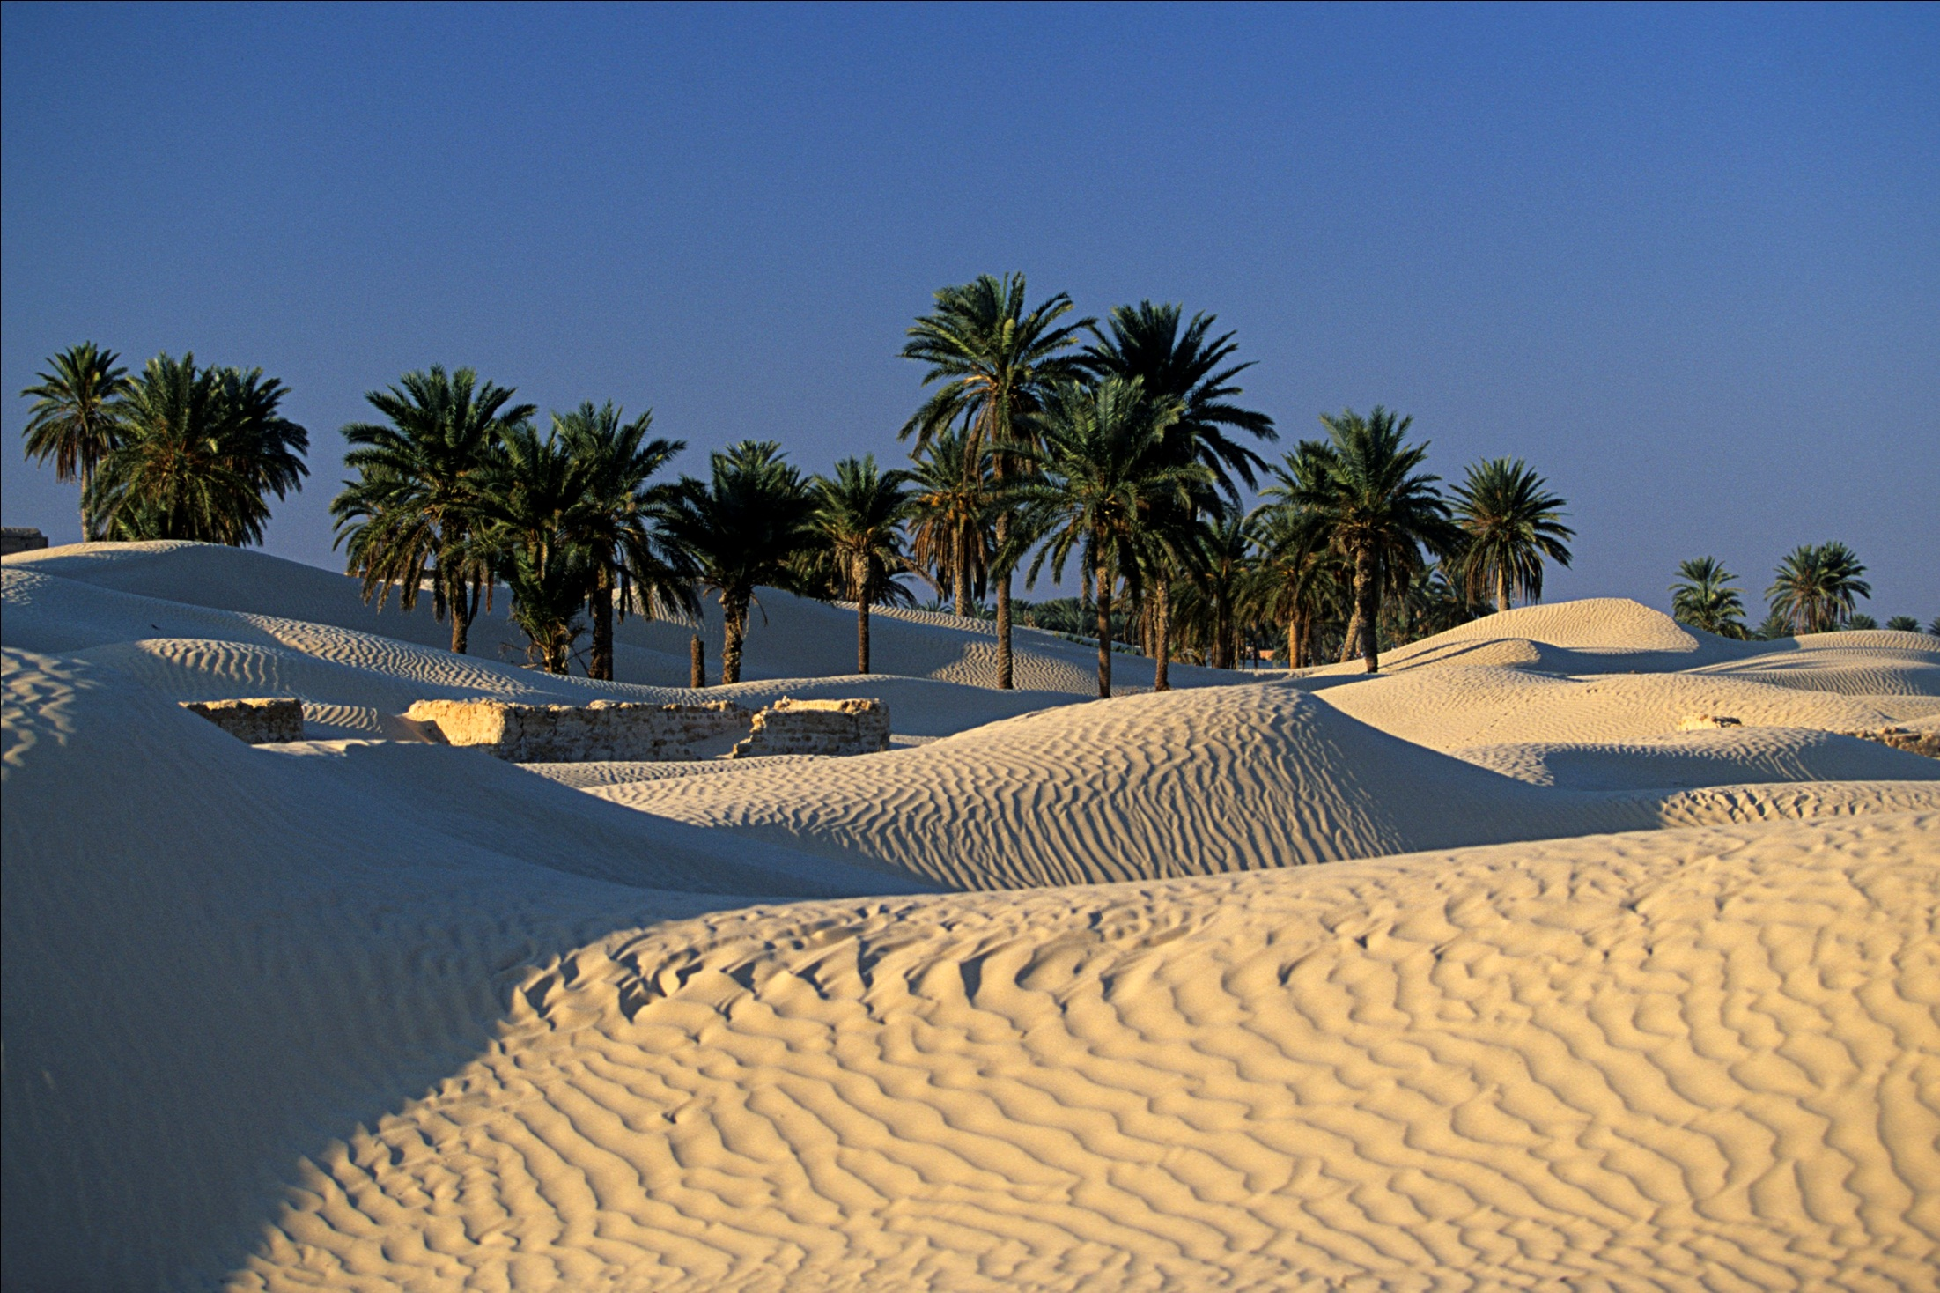

Slide 12
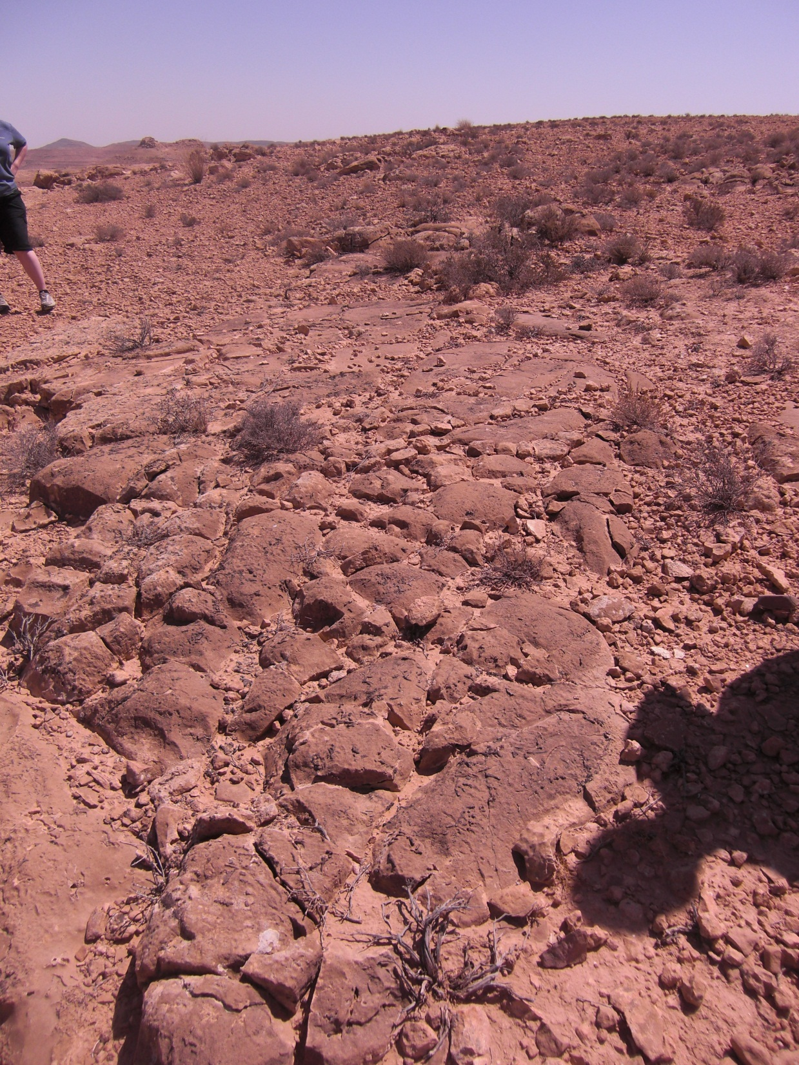

Slide 13
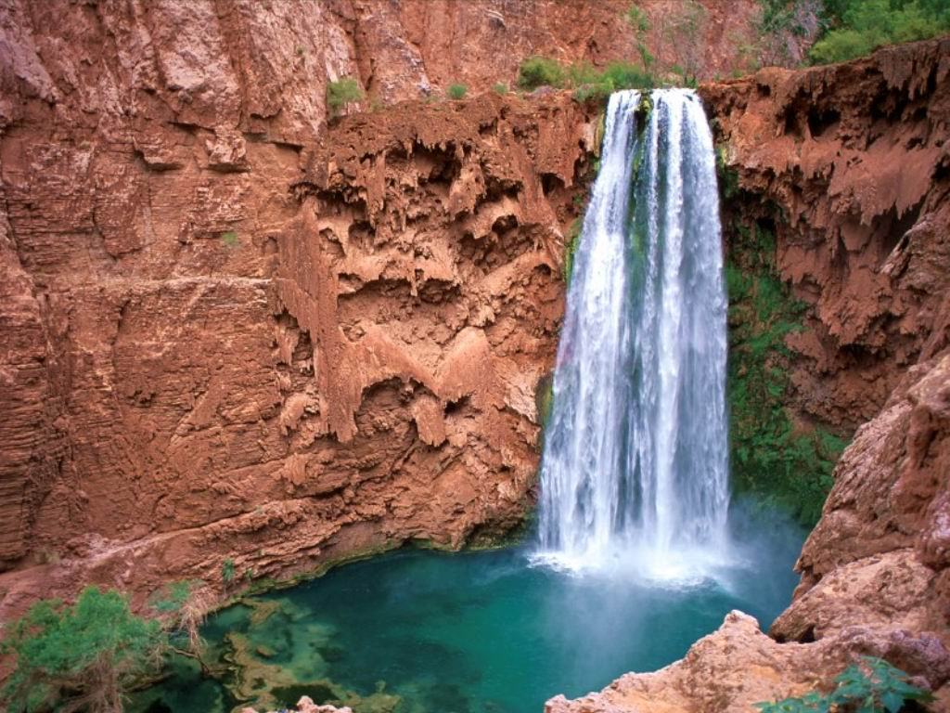

Slide 14
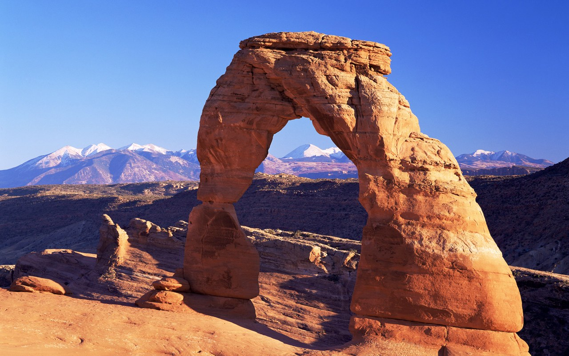

Slide 15
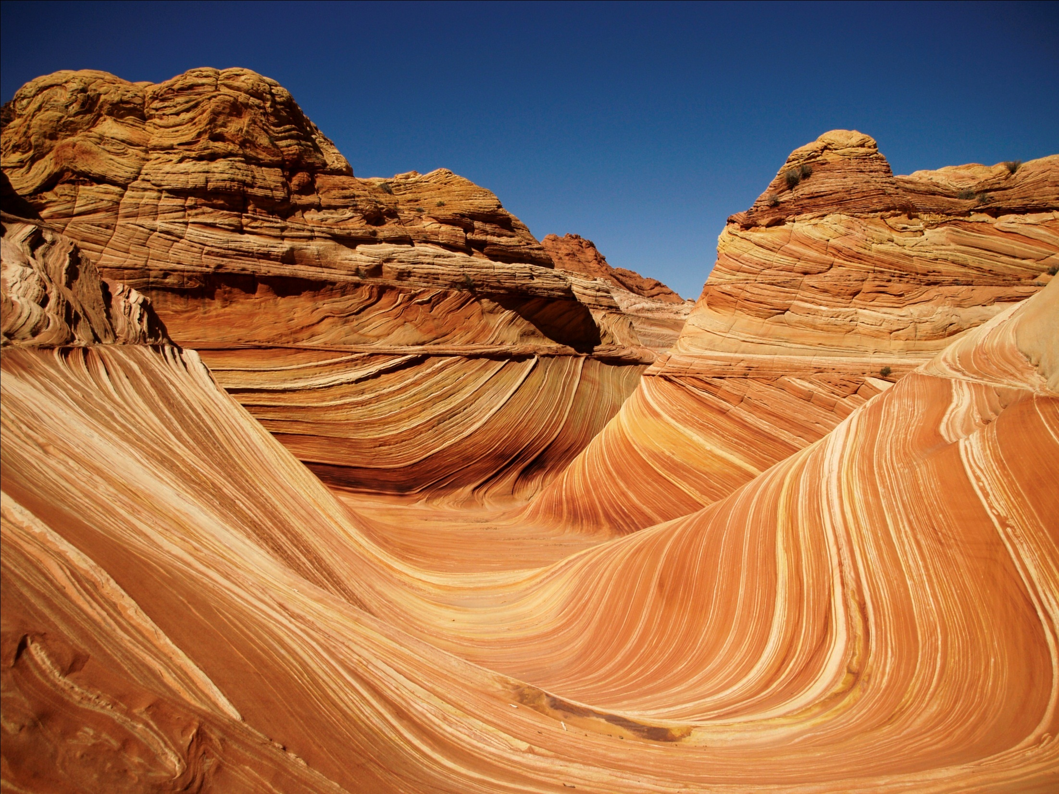

Slide 16
10.1 Hot arid and semi-arid climates
Global distribution and climatic characteristics of hot arid and semi-arid environments.
Definitions and causes of aridity: pressure and wind systems, influence of ocean currents, rain
shadow effect.
The key features of hot arid and semi-arid environments: high wind energy environments, diurnal and seasonal variations in precipitation and temperature.

Slide 17
Key Concepts
Deserts are defined by lack of moisture – either in total, or available at the surface
This unit focuses on hot arid and semi-arid environments, but they do cover a significant range of temperatures
Deserts are hugely varied – in land, in type, in aridity. You should recognise – and deliberately acknowledge this – in your work

Slide 18
What defines a desert?
Starting point – Koppen climate classification – part of the wider global climate patterns
Based on temperature, precipitation (both annual total, and seasonal totals) and vegetation
“B” are dry/arid climates –
  BW: desert
  BS: steppe climate
What do we notice about the locations?

Slide 19
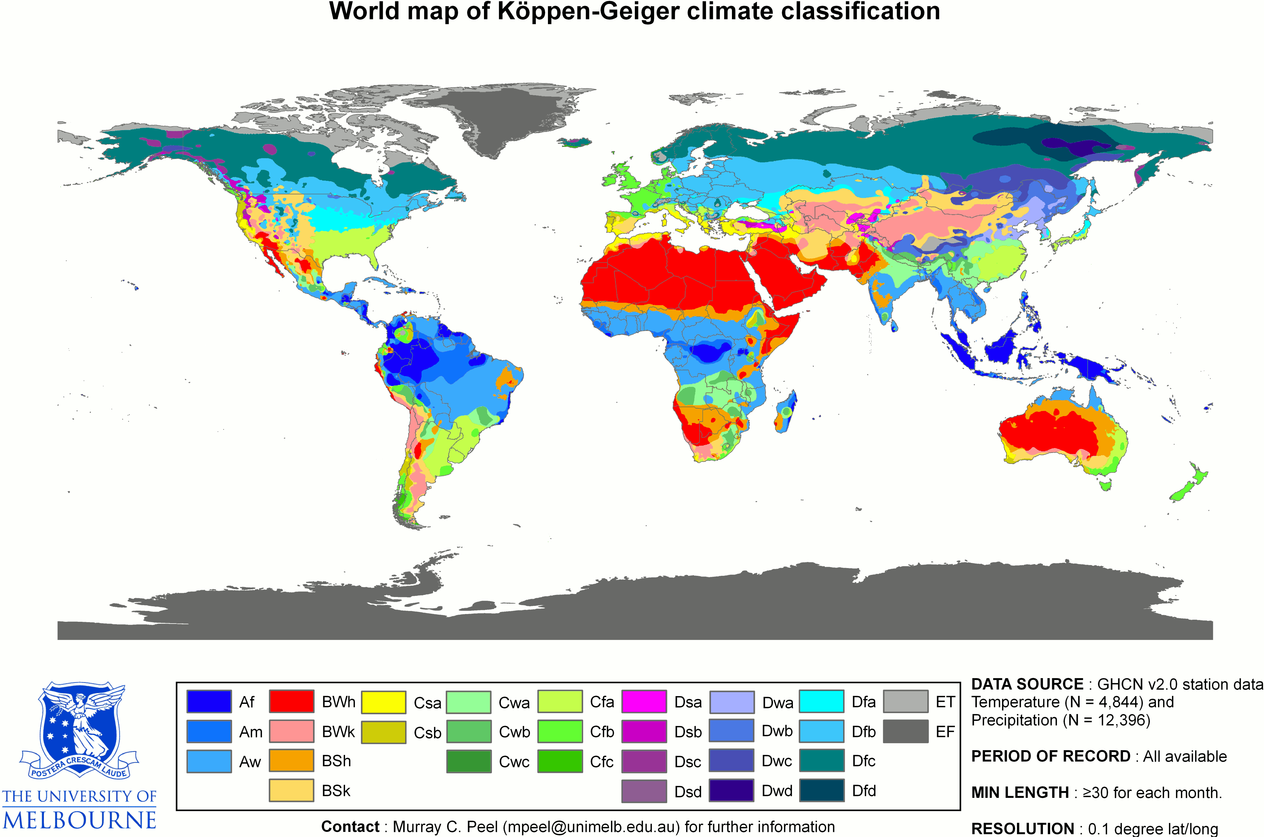
Desert:
BW/BS categories

Slide 20
Activity:
Label the world’s deserts
Desert:
BW/BS categories

Slide 21
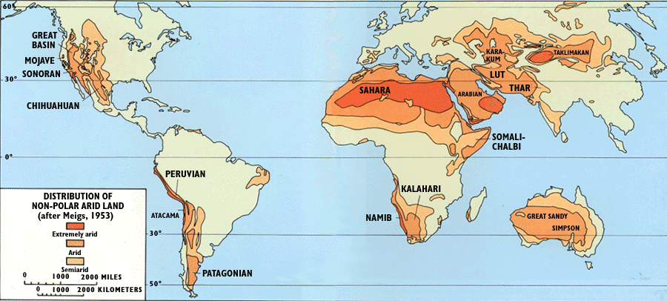

Slide 22
Categories of Desert: Rainfall
Meigs classification based on total annual rainfall (simplistic? seasonality?)
Creates three types of hot desert, based on total rainfall.
  Hyper arid < 100 mm
  Arid 100-250 mm
  Semi-arid 250-500 mm
Problems with this as a classification, but reasonably effective as a broad outline.
Good basic definition, if you can’t remember anything else!

Slide 23
Categories of Desert: Aridity Index
Relies on potential evapotranspiration – how much could be evaporated/transpired if there was sufficient water.
Measure of effective heat/dryness, rather than the input of rainfall.
Aridity Index = Precipitation / Potential ET
Tuscon, AZ. Precip: 300mm. Potential ET: 2500mm.
AI = 300/2500 = 0.12
Categories:
  Hyper arid: <0.05
  Arid: 0.05-0.20
  Semi-arid: 0.20-0.50

Slide 24
Activity: annotate to describe the distribution of deserts

Slide 25
Desert Climate
The key feature of a desert is aridity, but there are several other significant variations depending on the type of desert
Consider:
  Intensity/duration/seasonality of precipitation
  Diurnal temperature range
  Annual temperature range
  Local consequences and conditions (e.g. hot katabatic winds)

Slide 26
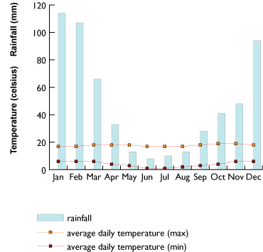
Semi-arid climate – La Paz, Bolivia

Slide 27
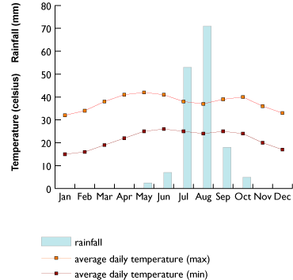
Arid Climate – Khartoum, Sudan

Slide 28
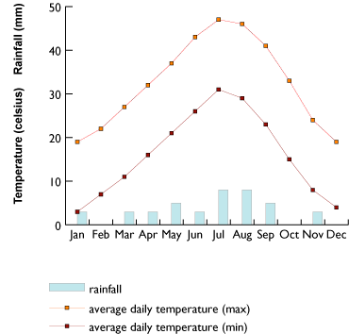
Hyper Arid Climate – Death Valley, USA

Slide 29
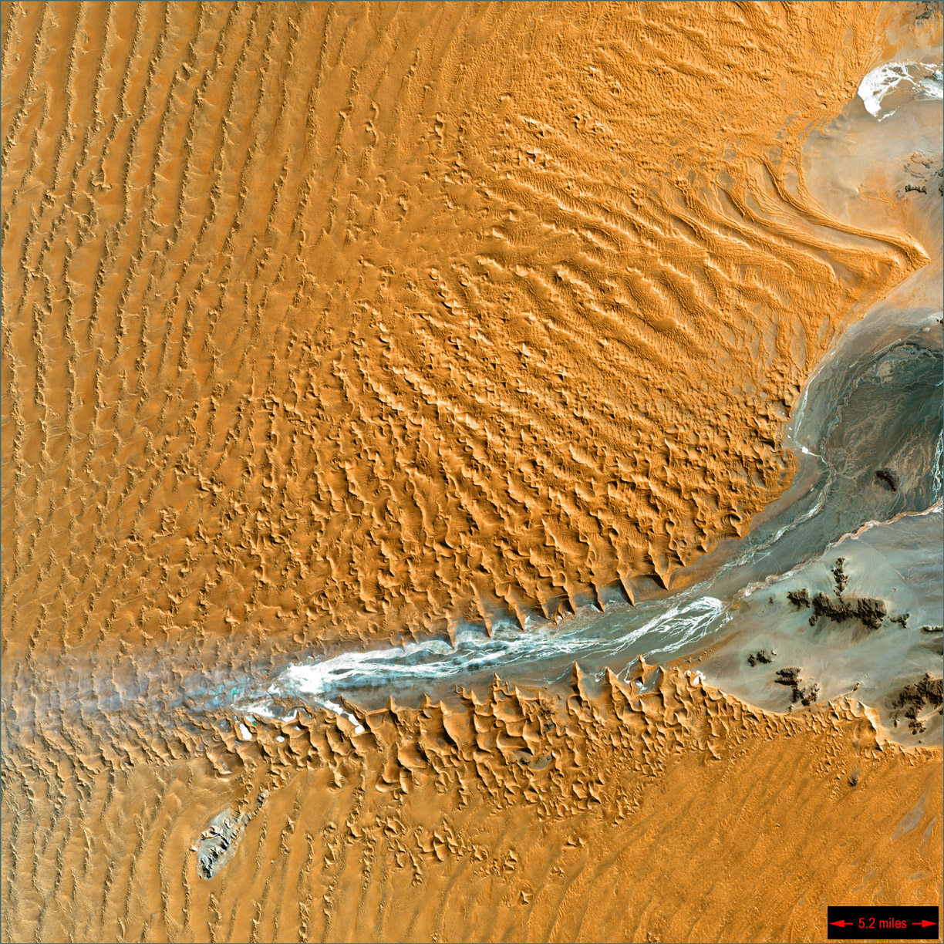
Formation of Deserts

Slide 30
Aridity – Definitions
Reminder that deserts can be defined by either aridity or rainfall totals.
Aridity measures effective dryness – not just what rain falls, but also the volume of potential evapotranspiration.
Categories of desert rely on precipitation or the aridity index (AI)

Slide 31
Aridity = Deserts
Establish the conditions for aridity, and you can almost guarantee to define areas of desert.
What is aridity – hot and dry. Where do we get hot and dry conditions?
Could start with global radiation distribution…

Slide 32
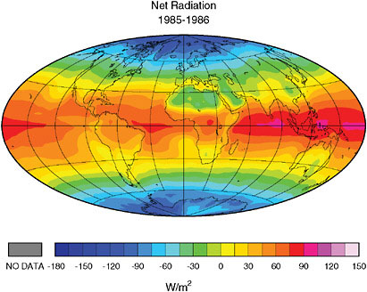

Slide 33
Dryness is key element
Radiation (temperature) alone does not explain distribution
Tropical rainforests are among hottest places on Earth, but still show considerable rainfall
Need to explore how the climate distributes heat and energy – and whether that can explain dry conditions.

Slide 34
Basic principles
Warm air rises – cooler air descends
Rising air (convection) creates clouds (condensation) and rainfall (precipitation)
Air is unstable and humid.
Descending (sinking) air is dry and does not rain.
Where do we get descending air where it’s still warm?

Slide 35
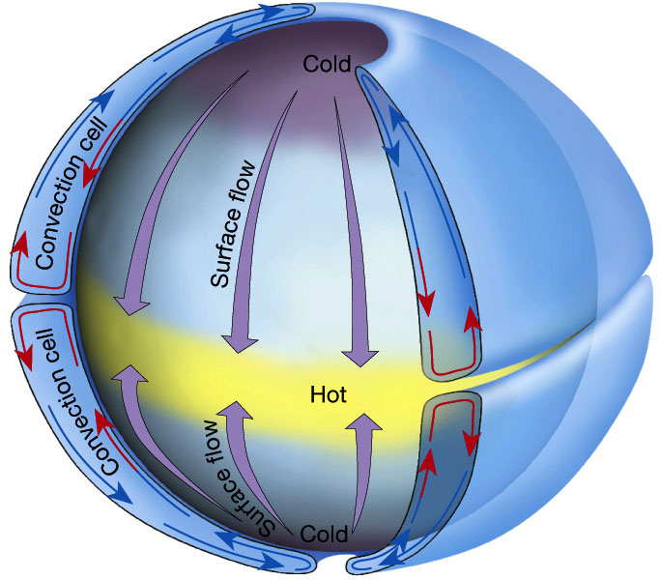

Slide 36
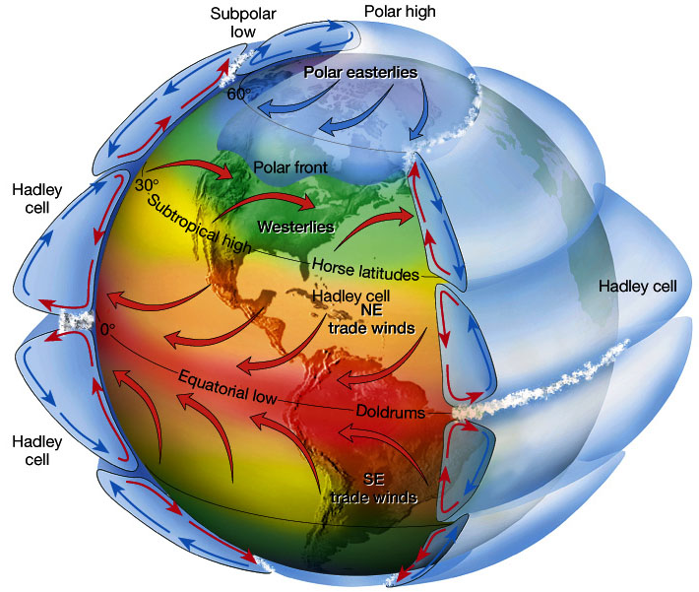

Slide 37
Hadley Cell circulation
Interested mainly in the first of the cells.
Warm air heated at the Equator, ascends (rains) and is driven towards the poles.
Cools and descends at the sub-tropical regions (about 20-30 N/S)
Returns as the trade wind circulation

Slide 38
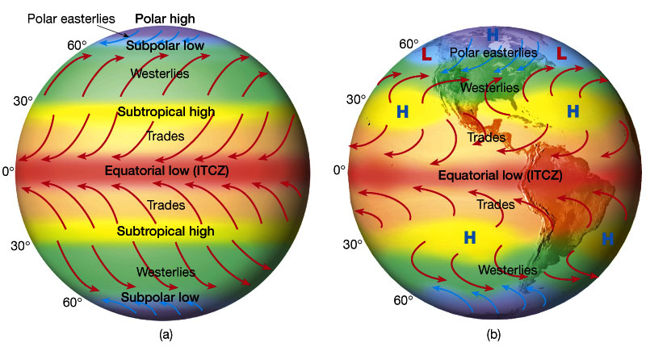

Slide 39
Observing the ITCZ
Best place to see the changes in ITCZ are in Africa: why?
  Large continental area with relatively even mass
  No major orographic features to bar the migration of convection
  No substantial oceanic changes
How do we see changes?
ITCZ Animation or another animation.

Slide 40
Distance from water source
Can be generated by large scale global climate (atmospheric circulation)
Can also be generated by other factors which create dry air.

Slide 41
Continentality
Atmospheric moisture comes from evaporated ocean water
If a location is far enough away from the oceans, the water content of the atmosphere will all have been deposited by the time it reaches.
This is ‘continentality’ – the dry inner areas of continents that the rain never reaches.
Example – hyper arid Sahara, Gobi (also RS)

Slide 42
Rainshadow
If you ‘rain out’ all of the moisture, it’s simply not possible to rain any more.
Major barriers (e.g. Mountains) create large amounts of rainfall – and then the area behind those mountains is dry.
This creates some of the major deserts – Atacama is a particularly useful example; Gobi also true.
Can combine factors.

Slide 43
Cold Ocean Currents
Water needs to be warm enough to evaporate
If areas of the ocean are cooled by currents, less moisture is taken up in to the atmosphere
This generates less moisture, and therefore, less rainfall
Example?

Slide 44
Summary
Aridity = lack of moisture in warm conditions
Creating aridity = getting rid of the moisture.
Four main ways:
  Warm atmospheric conditions, dry air, Hadley cell
  Continentality – too far from the water
  Cold ocean currents – not enough water in to the air
  Rain shadow effect – water is all rained out before it gets to the area.

Slide 45
Evaluation:
If you had to rank the factors in terms of which creates the
  Most deserts?
  Biggest deserts?
  Most arid deserts?
Remember, not all deserts are the same!

Slide 46
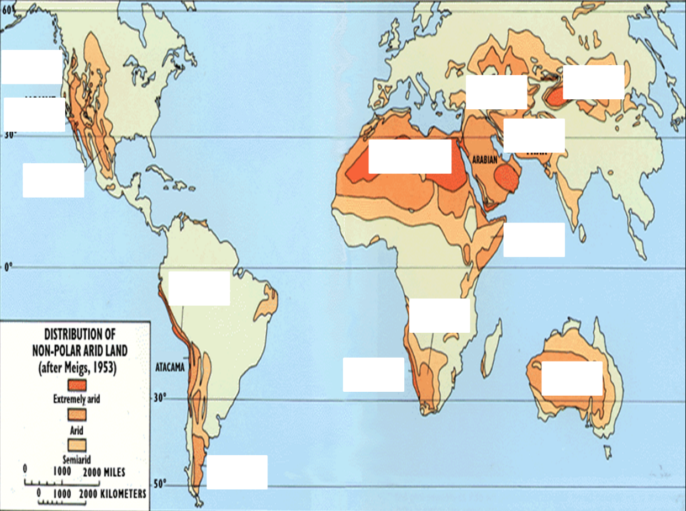
Connecting the Factors
Which factors specifically explain the key location characteristics we identified?

Slide 47
Is it only about aridity?
High diurnal range (which types?)
Range of temperature (which types?)
Seasonality of climate (which types?)
Some consequences:
  Dry hot winds (e.g. katabatic, fohn winds)
  High salt climates

Slide 48
Desert characteristics questions

